Slide 1
Condor 4.0
Finding and requesting NSHD variables
A practical guide to searching, building baskets and saving them
MRC National Survey of Health and Development • Imran Shah

Slide 2
OVERVIEW
What Condor does
Search
Add to basket
Review and save
Request data
Find variables
By name, keyword, category or library.
Collect them
Add one variable or many at a time. Linked variables come along too.
Check and save
Review your basket, then save it with a description.
Take it forward
Send your saved basket to LHA as part of a data request.
Condor gives you metadata: what each variable is, how it is coded and how it relates to others. The data itself is released later, through a data request to LHA.
Condor 4.0
2

Slide 3
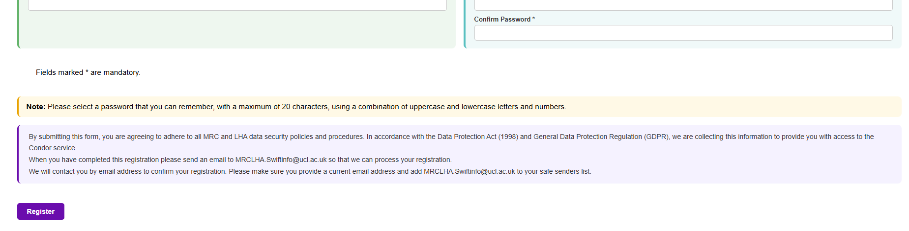
GETTING STARTED
Getting access
1 Register
Use Register in the menu and complete every field marked with an asterisk (*).
2 Email LHA
Send your username to MRCLHA.Swiftinfo@ucl.ac.uk so your account can be approved.
3 Wait for approval
LHA contacts you by email to confirm. Add their address to your safe senders list.
Condor 4.0
3

Slide 4
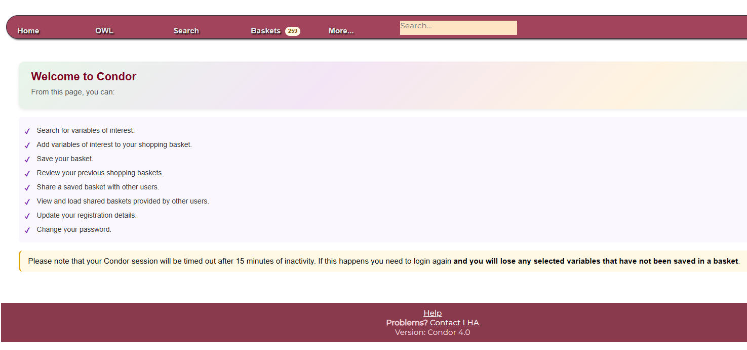
GETTING STARTED
Finding your way around
The menu bar
Home, OWL, Search, Baskets and More. Use Baskets to save, view, load or share.
The basket count
The badge beside Baskets shows how many variables you hold.
1-250
251-500
Over 500
Your session times out after 15 minutes of inactivity. Variables that have not been saved in a basket are lost, so save before you take a break.
Condor 4.0
4

Slide 5
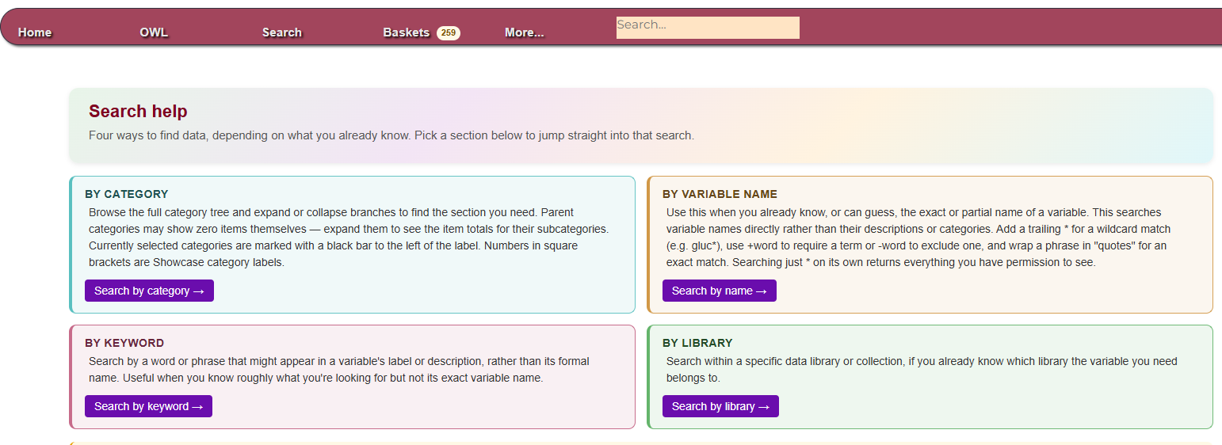
FINDING VARIABLES
Four ways to search
Name search tips: a trailing * is a wildcard (gluc*), +word requires a term, -word excludes one, "quotes" match an exact phrase, and * on its own returns everything you can see.
Condor 4.0
5

Slide 6
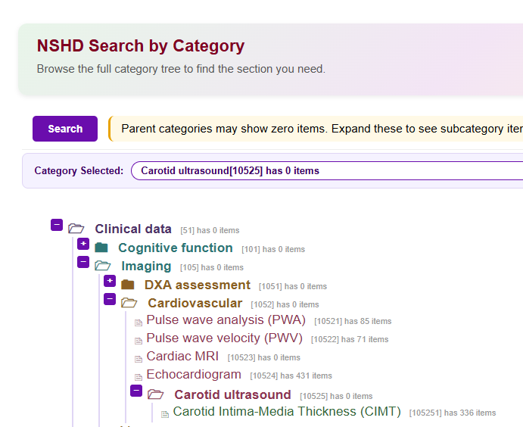
FINDING VARIABLES
Browsing by category
1 Expand or collapse
Click + or - beside a branch to open or close it.
2 Read the counts
Grey numbers show items per category. Parents may show 0: expand them to find the variables.
3 Select a category
Your choice appears in the Category Selected bar at the top.
4 Search
Click the Search button to list every variable in that category.
Condor 4.0
6

Slide 7
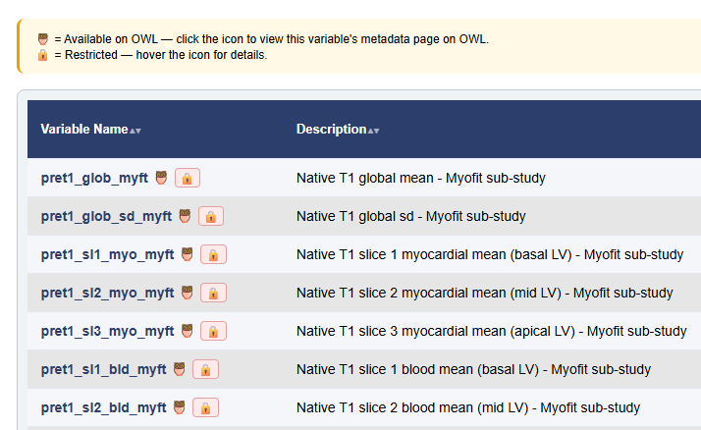


FINDING VARIABLES
Reading your results
Owl icon
This variable is also on OWL. Click the icon to open its OWL page in a new tab.
Padlock icon
Access to this variable is restricted. Hover over the icon to see the reason.
Sort any table
Click a column header to sort, and click again to reverse.
Condor 4.0
7

Slide 8
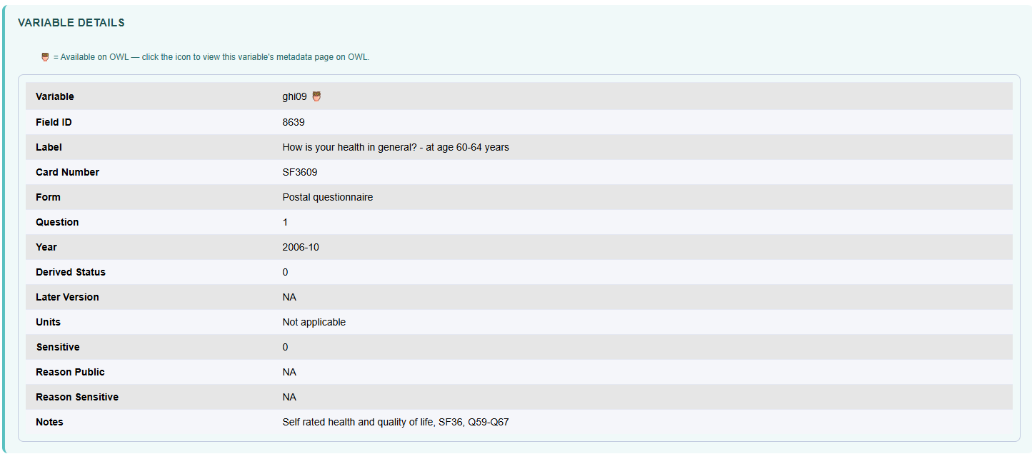
UNDERSTANDING A VARIABLE
The variable page
Variable details
Linked and longitudinal
Documents
Categories
Value labels
Distribution
Value labels list every code and what it means. The distribution shows how many participants gave each answer; missing values and very small groups are left out to protect privacy.
Condor 4.0
8

Slide 9
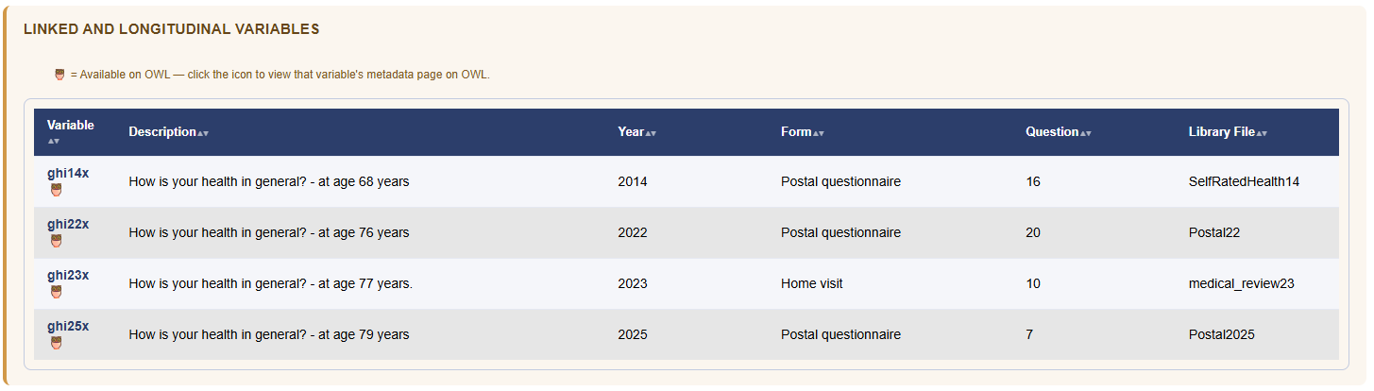
UNDERSTANDING A VARIABLE
Longitudinal and linked variables
Truly longitudinal
Same Showcase Field ID: identical wording and coding, so results are directly comparable across sweeps.
Linked
Connected by a shared measure, but wording or coding may differ. Check before treating them as comparable.
Condor 4.0
9

Slide 10
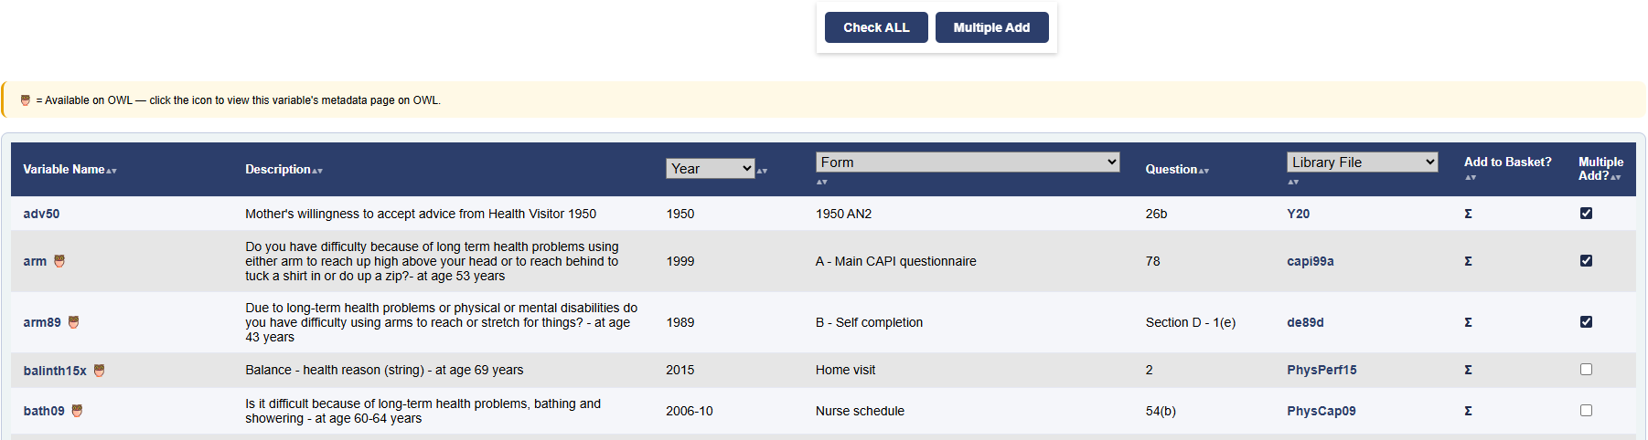
BUILDING YOUR BASKET
Adding variables to your basket
Add one variable
Click the Σ in the Add to Basket column.
Add several
Tick the Multiple Add boxes, then click Multiple Add. Check ALL ticks every box on the page.
Adding a large selection shows a "please wait" screen. That is normal.
Condor 4.0
10

Slide 11
BUILDING YOUR BASKET
Linked variables come too
You add
Added automatically (13 in this example)
htn23x
ht57u age 11
ht53u age 7
ht52u age 6
Standing height in cm, at age 77
ht99u age 53
+ 9 more
The same measure at other ages.
Why?
They measure the same thing at other ages, so you don't have to find each one yourself.
Restricted variables
Never added, even as linked. They are listed with the reason instead.
Don't want them?
Use the Keep linked variables toggle on the next slides.
Condor 4.0
11

Slide 12
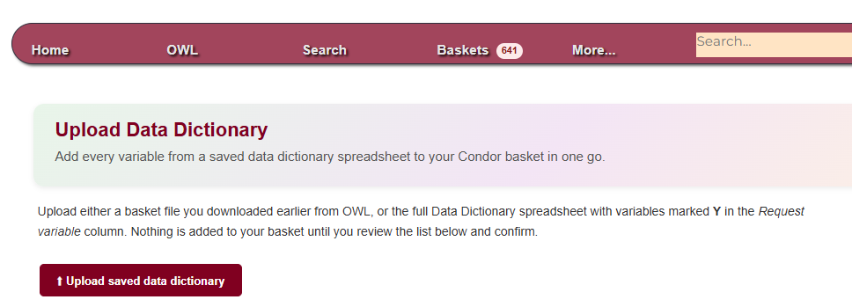
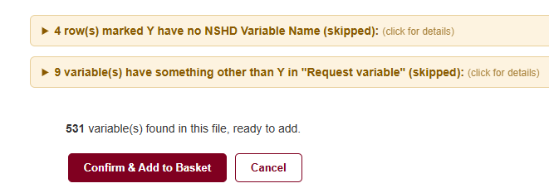
BUILDING YOUR BASKET
Uploading a data dictionary
After choosing a file
Two ways to build the list
Complete the Data Dictionary spreadsheet by hand, or download a basket you built on OWL.
Where to find it
Upload Data Dictionary, at the end of the OWL menu.
Checked before adding
Missing names, invalid values, and duplicates are all flagged first.
Condor 4.0
12

Slide 13
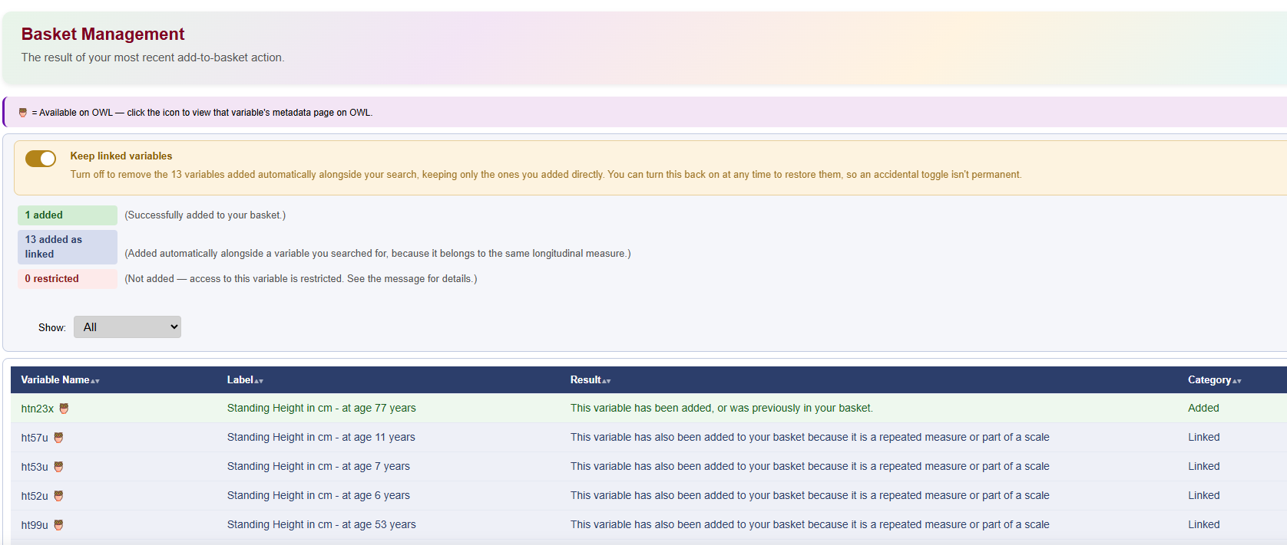
BUILDING YOUR BASKET
The Basket Management page
Added
The variables you chose.
Added as linked
Came along automatically.
Restricted
Could not be added.
The Show dropdown filters the table to restricted, added or linked rows. Each row shows the variable name, its label, the result and its category.
Condor 4.0
13

Slide 14
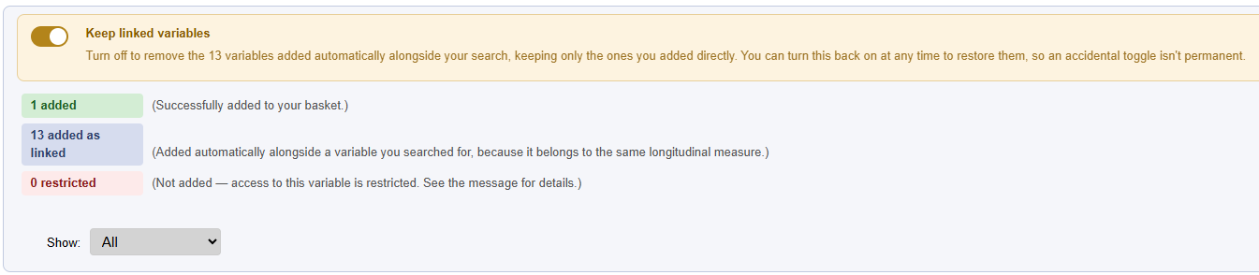
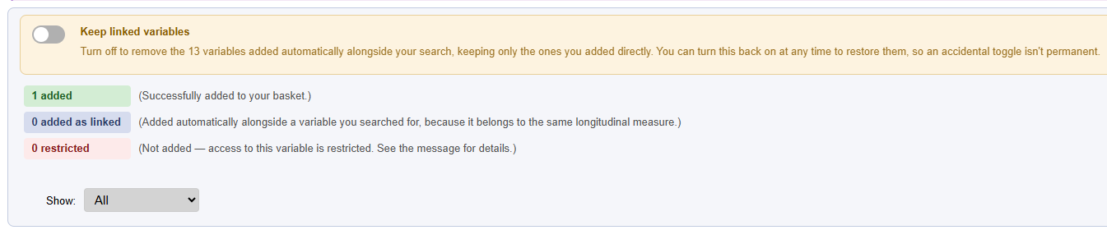
BUILDING YOUR BASKET
Keep or remove linked variables
Switch off
Removes the linked variables and keeps the one you chose.
Toggle ON: 1 added + 13 linked
Switch back on
Restores exactly the same linked variables.
Your latest add only
Earlier variables in your basket are not touched.
Toggle OFF: 1 added, 0 linked
Restricted variables
Never added, so the toggle does not affect them.
Condor 4.0
14

Slide 15
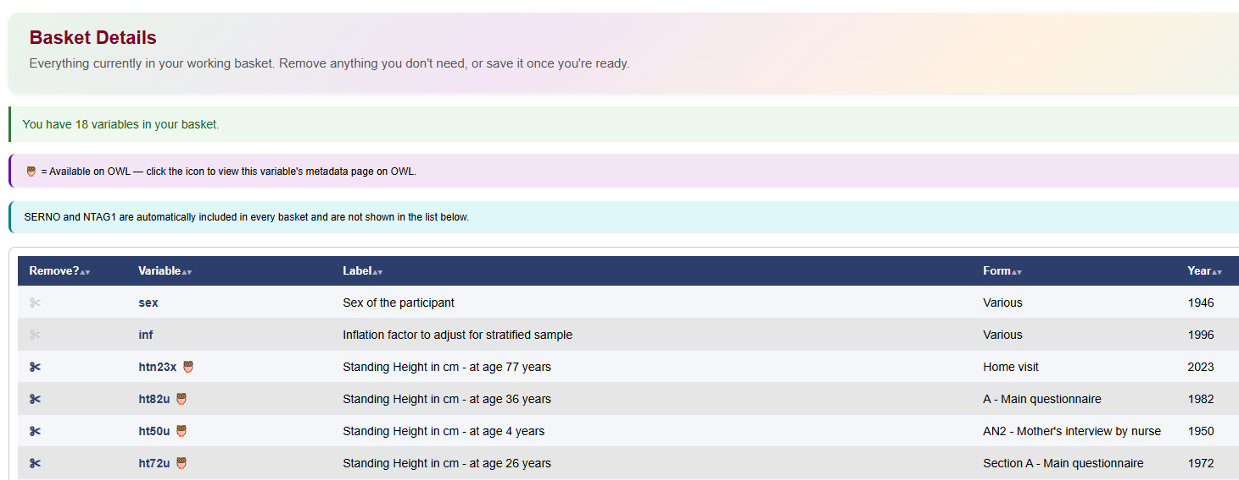
REVIEW AND SAVE
Viewing your current basket
Remove
Click the scissors, or use Remove All.
Protected
SEX and INF cannot be removed.
Hidden
SERNO and NTAG1 are always included.
The message above the table reflects the size of your basket:
Up to 250: a plain note
251 to 500: within the recommended range
Over 500: slower risk assessment
Condor 4.0
15

Slide 16
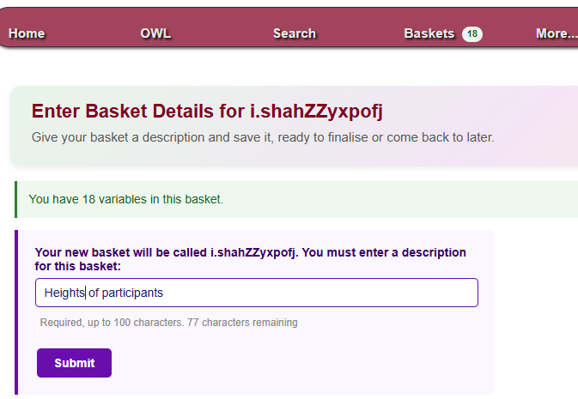
REVIEW AND SAVE
Saving a basket
1
Open Save from the Baskets menu.
2
Type a clear description. The counter shows how many of the 100 characters are left.
3
Click Submit. A "please wait" screen shows while it saves.
4
A read-only confirmation lists what was saved.
Use specific descriptions. Saved baskets are listed by creation date, so a vague name is hard to find later.
Condor 4.0
16

Slide 17
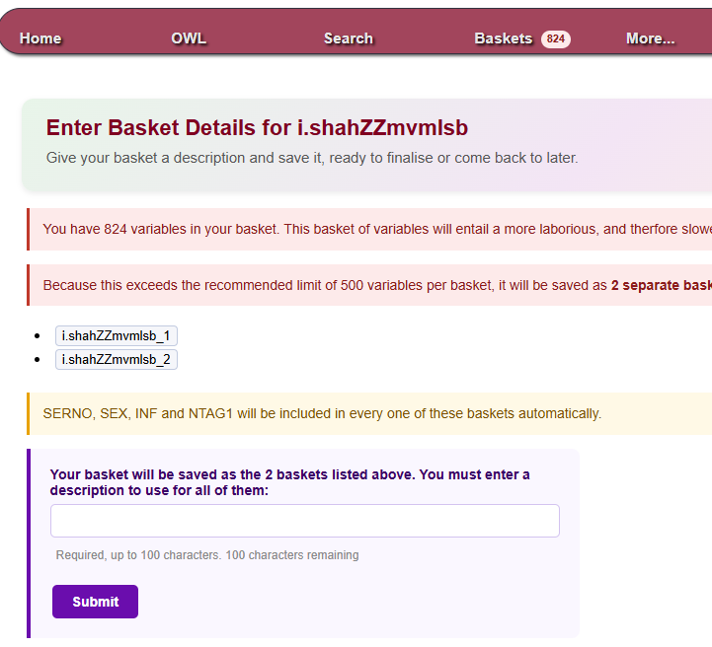
REVIEW AND SAVE
Saving a large basket
Over 500 variables
The basket is split automatically. SERNO, SEX, INF and NTAG1 are not counted.
Preview first
The form lists each new basket ID before you commit.
In every basket
SERNO, SEX, INF and NTAG1 are added to each split basket.
One description
It is reused, with (Basket 1 of 2) and so on added for you.
Condor 4.0
17

Slide 18
REVIEW AND SAVE
How large requests are reviewed
Reviewed together
Split baskets are assessed as one overall request, not as separate submissions.
500
Larger takes longer
More variables need a more thorough risk assessment before data can be released.
variables is the recommended maximum for one saved basket
You may be asked why
Over 500 variables in total? LHA may ask you to justify the request, even when it was split into several baskets.
Before saving: review your basket and remove anything you do not need, especially linked variables you did not ask for.
Condor 4.0
18

Slide 19
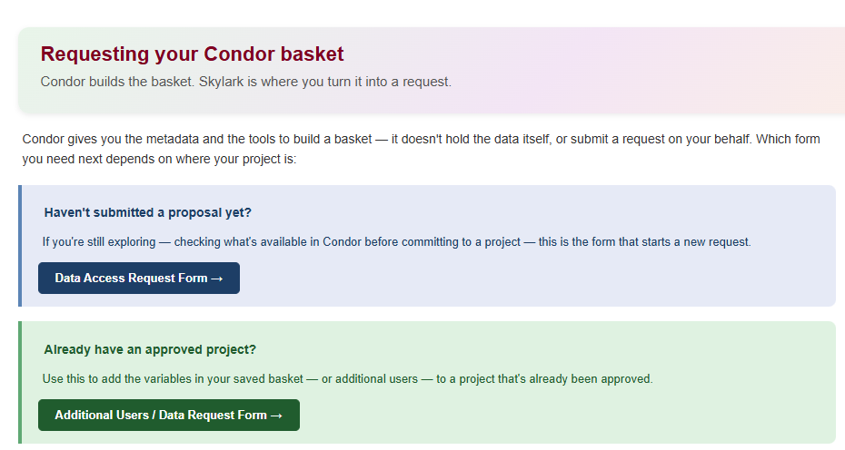
REVIEW AND SAVE
Requesting your Condor basket
New to this?
Still exploring? Use the Data Access Request Form to start a new proposal.
Already approved?
Use Additional Users / Data Request to add this basket to an existing project.
Found at the end of the OWL menu, and linked directly from the basket-saved confirmation page.
Condor 4.0
19

Slide 20
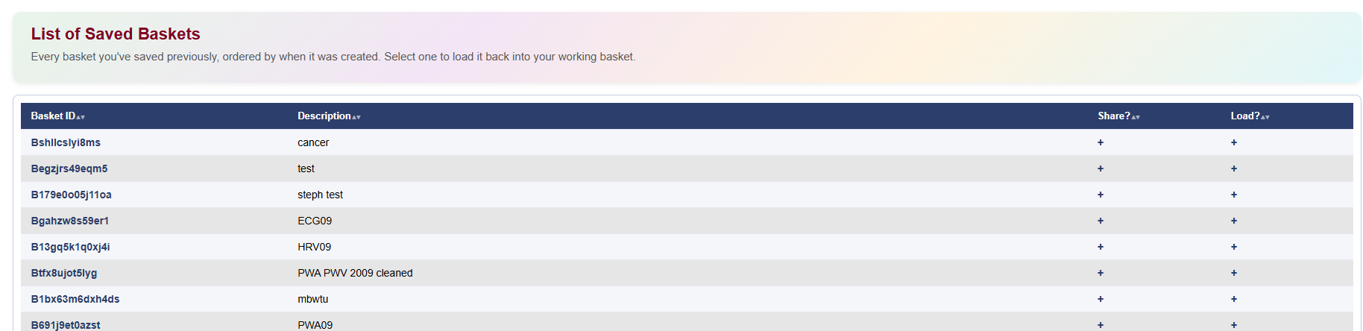
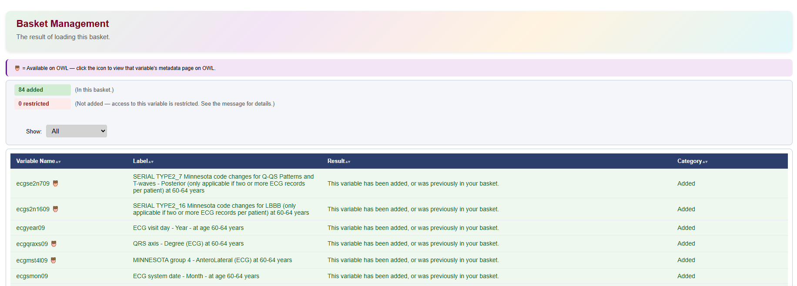
REUSE AND HELP
Loading, sharing and downloading
Load / Share My Basket
Your saved baskets, newest first. Select one to load it into your working basket, or share it with other users.
Load / Share My Basket
Load Shared Basket
Baskets other users have shared. Load one the same way.
After loading a basket
Download Basket
Export a saved basket for use outside Condor.
Condor 4.0
20

Slide 21
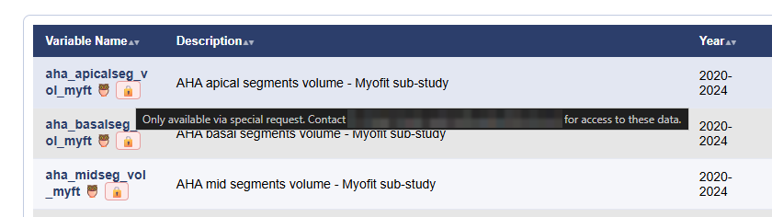
REUSE AND HELP
Restricted variables
What it means
You cannot add this variable to a basket.
Why?
Hover over the padlock to see the reason and who to ask.
Never added, even as linked
Restricted variables still appear on Basket Management with the reason, so you can see what was left out.
Need access?
Contact LHA using the link in the site footer.
Condor 4.0
21

Slide 22
REUSE AND HELP
Condor and OWL
Condor
OWL
✓ Search by name, keyword, category or library
✓ Build, save, load and share baskets
✓ Prepare a data request for LHA
✓ Needs an approved Condor account
✓ Public metadata platform
✓ No Condor account needed
✓ Guided walkthrough for first-time users
✓ The owl icon in Condor links straight to a variable's OWL page
Find the guided walkthrough under the OWL menu in Condor.
Condor 4.0
22

Slide 23
REUSE AND HELP
Recap and where to get help
Search
Add
Review
Save
Request
Get Started pages
In-app help from the menu, covering the same ground as this session.
OWL walkthrough
A short, hands-on introduction, from the OWL menu.
Contact LHA
For data access, restricted variables or sharing a basket, use the link in the site footer.
Remember: save before your session times out after 15 minutes of inactivity.
Condor 4.0
23

