Slide 1
R group meeting: generating interactive plots using ‘Glimma’
Mark Jones, Sherman Lab
2022-04-08

Slide 2
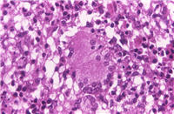
Background – M. abscessus
Mabs is a non-tuberculous mycobacterium that is of particular interest in the Cystic Fibrosis community (leads to worse lung outcomes in people with CF)
Hassan (postdoc in our lab) treated Mabs with commonly used first-line drugs (amikacin/AMI, clarithromycin/CLA) and combinations with hits from a drug screen (netupitant/NTP, niclosamide/NCA)
RNASeq done at NW Genomics, assembly and count data generated using DuffyTools package (Bob Morrison)

Slide 3
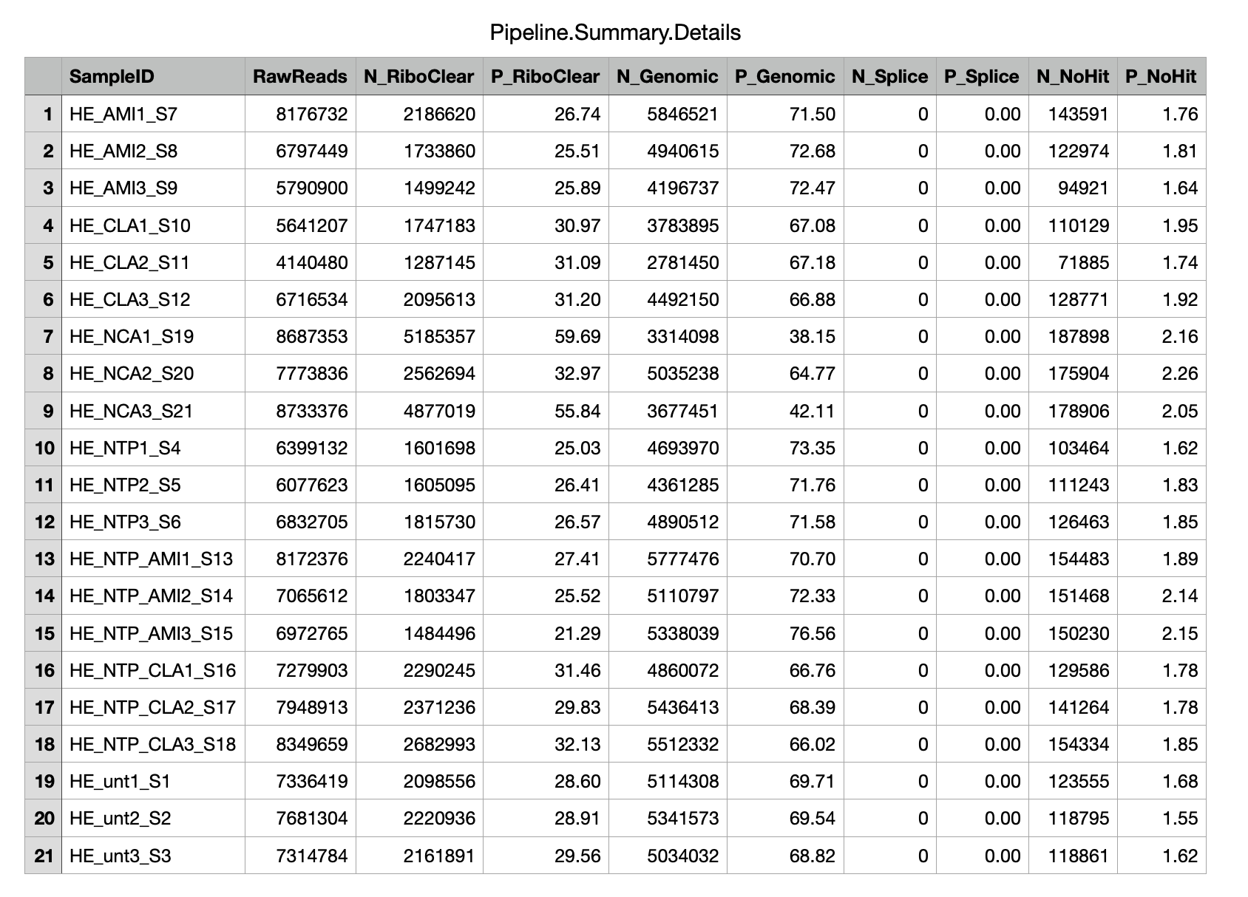
Sample
Total reads
rRNA database
H37Rv genome
Ignore
Other

Slide 4
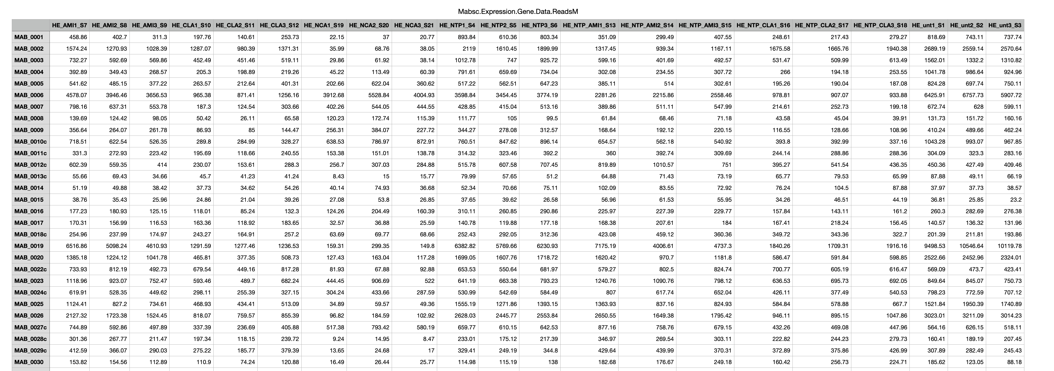
Genes
Samples

Slide 5
Analysis goals (for today)
import and format data properly
determine DEG using edgeR/limma
generate interavtive MDSplot and volcanoplot using Glimma

Slide 6
Additional reading:
http://combine-australia.github.io/RNAseq-R/06-rnaseq-day1.html
My code is based heavily on this
https://www.bioconductor.org/packages/devel/workflows/vignettes/RNAseq123/inst/doc/limmaWorkflow.html
https://ucdavis-bioinformatics-training.github.io/2018-June-RNA-Seq-Workshop/thursday/DE.html

