Slide 1
SEMRS: Secure Electronic Medical Records System
Ryan Kane and Ricky Orndorff
Department of Computer Science
Spring 2012

Slide 2
Context
Know the geographical area
Their HIPAA standards
General Income
HIV/AIDS population
[See notes]
Notes:
Dong:
You should just describe the problem here.
Mitchel's Plain Community Health Center
Largest community in Cape Town, SA
Majority of population has a middle school education
90% of population speaks Afrikaans
20% has HIV/AIDS
3,000 HIV/AIDS patients per month

Slide 3
Background on HIPAA Security Rules
Access Control
Audit Controls
Integrity Controls
Transmission Security
Notes:
Dong:
HIPAA standards. Be prepared to answer related HIPAA standards.
Check out HIPAA security rule. Focus on the technical safeguard
http://www.hhs.gov/ocr/privacy/hipaa/understanding/srsummary.html
Technical Safeguards
Access Control. A covered entity must implement technical policies and procedures that allow only authorized persons to access electronic protected health information (e-PHI).²⁴
Audit Controls. A covered entity must implement hardware, software, and/or procedural mechanisms to record and examine access and other activity in information systems that contain or use e-PHI.²⁵
Integrity Controls. A covered entity must implement policies and procedures to ensure that e-PHI is not improperly altered or destroyed. Electronic measures must be put in place to confirm that e-PHI has not been improperly altered or destroyed.²⁶
Transmission Security. A covered entity must implement technical security measures that guard against unauthorized access to e-PHI that is being transmitted over an electronic network.²⁷

Slide 4
Electronic Medical Records Management Systems Overview
Enforce patient confidentiality
Ensure data integrity
HIPAA
Notes:
Dong:
Put this here as background knowledge.
It is important to weigh patient confidentiality against a public responsibility to support national priorities.
HIPAA – Health Insurance Portability & Accountability Act
Pros:
- Hospitals/Clinics more efficient
- Reduce medical errors
- Lower healthcare costs

Slide 5
EMR Systems
 | ZEPRS | OpenEMR | THIRRA
Year Introduced | 2001 | 2001 | 2007
Pros | [] | [] | []
Cons | Perinatal Lacks Security | Too Broad | []
Notes:
Dong:
This should be here as part of background
****Need Pro’s and Con’s****
****table/chart****
Earliest dates back to 1995; VistA
Background info on
VistA- Veterans health info systems and technology Architecture
Used throughout the US Dept of Veteran Affairs
80 different clinical fxns, including: Mental Health, Blind Rehab, Ambulatory care, Radiology, Pharmaceutical, etc, etc etc
Software modules for clinical care and financial fxns
Currently the largest medical system in the US, provides care to 8 million veterans
Already had automated data processing previously, but added a GUI in 1997.
One of the first client-server architectures, that allowed health care providers to review and update a patient’s electronic medical record
THIRRA- project title Portable System forTeleHealth and Health Informatics for Rural and Remote Areas.
Started in 2007, Written in PHP, with a PostgreSQL database backend.
ZEPRS- The Zambia Electronic Perinatal Record System (ZEPRS)
- For an obesity clinic
-lacks security measures (i.e. encryption)
OpenEMR V 1.0 released in June 2001
-3700 downloads p/month

Slide 6
Problem Statement
Loss/Damage to patient files
Delay or hinder treatment progress
Confidentiality of patient files
Data integrity
Notes:
Why -
This project is for Mitchells Plain Community Healthcare Center in Cape Town, South Africa that treats patients for HIV/AIDS. All patients records are currently hard copy only, and patients’ records get displaced and damaged. Ultimately, a “hassle free treatment process”

Slide 7
Motivation
Improved medical records management system
Secure
Easy to use
Proposed Solution
Enforce patient confidentiality
Ensure data integrity
HIPAA
Notes:
-MCHC is one of the few public health clinics in South Africa,
-Only 2 physicians
What -
Solve the problem of displacement and damage to patients’ files
- Eliminate identity theft
- Ensure patient stays on the right regiment

Slide 8
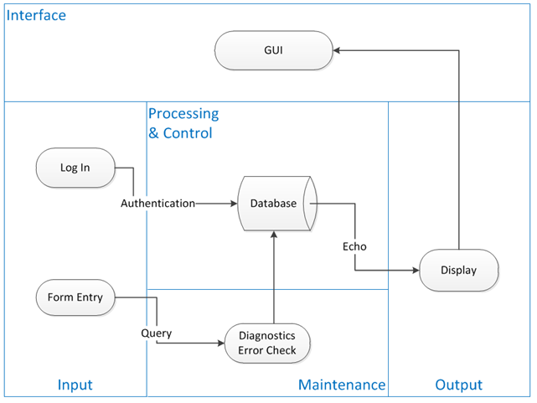
System Architecture Diagram
This system context diagram depicts the basic input, output, and processing of the SEMRS system.
Notes:
Dong:
This does not tell much.

Slide 9
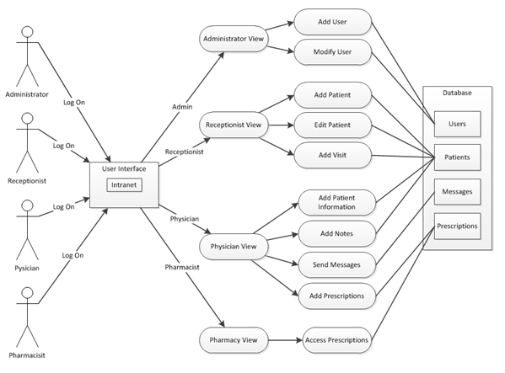
Use Case Diagram
This use case diagram depicts the different user types and what they have access to within the SEMRS system.
Notes:
***********May need a re-write on the caption

Slide 10
Proposed Implementation
Much simpler than OpenEMR, removed many unneeded features.
Onsite Access through intranet (LAN).
SSL Encryption

Slide 11

Solution Highlights
User group access control
Encryption and description algorithms
Secure transmission via openSSL
Audit log
Automatic log off
Notes:
Dong:
You should list and talk about the security features you implemented, including
User group access control (see here for explanations: http://www.tonymarston.net/php-mysql/role-based-access-control.html)
Encryption and description algorithms
Secure transmission via openSSL
Audit log
Automatic log off
Others that I am not aware of
This should be your presentation emphasis. Use one or two slide and present algorithm involved.
****
- Taken out financial data
Safeguard, (electronic paper trail)
SHA1 for message Authentication, DHE_RSA as the key exchange mechanism, allows for HTTPS Protocol, ( combination of hypertext transfer protocal and SSL/TLS protocal.) Provides encrypted communication to allow for secure identification of a network web server
How -
A software system that backs up patients’ files securely so that they can be readily available when needed
- Identity theft eliminated by integrating a photo into the system for each patient so that they can be identified through facial recognition and name, eliminating the need for a patient ID card, making the overall process smoother and easier for patients’

Slide 12
Summary
Lightweight
Secure EMR System
[Reiterate our main points]
[point 2]
[point 3]
Portability of a streamlined secure system
Notes:
Easily ported to other types of practices: pharmacies, cancer clinics, tuberculosis

Slide 13
Possible Future Work
Ability to upload existing hardcopy files
Prescriptions:
Add
Update
Control dispensing
Notes:
X-Rays, blood samples, other types of files…

