Slide 1
SEMRS: Secure Electronic Medical Records System
Ryan Kane and Ricky Orndorff
Department of Computer Science
Spring 2012

Slide 2
Problem Statement
Designed Specifically for MCHC
Loss/Damage to Patient’s files
Delay or hinder treatment progress
Confidentiality of patient files
Data integrity
Notes:
Why -
This project is for Mitchells Plain Community Healthcare Center in Cape Town, South Africa that treats patients for HIV/AIDS. All patients records are currently hard copy only, and patients’ records get displaced and damaged. Ultimately, a “hassle free treatment process”

Slide 3
Motivation
MCHC needs a better medical records management system
This system can improve the overall treatment process
Want to provide a system that is:
-Easy to use
-Secure
Notes:
-MCHC is one of the few public health clinics in South Africa,
-Only 2 physicians
What -
Solve the problem of displacement and damage to patients’ files
- Eliminate identity theft
- Ensure patient stays on the right regiment

Slide 4
History of Past EMR Systems
Earliest dates back to 1995; VistA
Few web enabled EMR systems:
ZEPRS - 2001
OpenEMR – 2001
THIRRA - 2007
Notes:
****Need Pro’s and Con’s****
****table/chart****
Background info on
VistA- Veterans health info systems and technology Architecture
Used throughout the US Dept of Veteran Affairs
80 different clinical fxns, including: Mental Health, Blind Rehab, Ambulatory care, Radiology, Pharmaceutical, etc, etc etc
Software modules for clinical care and financial fxns
Currently the largest medical system in the US, provides care to 8 million veterans
Already had automated data processing previously, but added a GUI in 1997.
One of the first client-server architectures, that allowed health care providers to review and update a patient’s electronic medical record
THIRRA- project title Portable System forTeleHealth and Health Informatics for Rural and Remote Areas.
Started in 2007, Written in PHP, with a PostgreSQL database backend.
ZEPRS- The Zambia Electronic Perinatal Record System (ZEPRS)
- For an obesity clinic
-lacks security measures (i.e. encryption)
OpenEMR V 1.0 released in June 2001
-3700 downloads p/month

Slide 5
Electronic Medical Records Management Systems Overview
Healthcare world moving away from paper records
Enforce patient confidentiality
Ensure data integrity
Patient confidentiality > National priorities
Notes:
It is important to weigh patient confidentiality against a public responsibility to support national priorities.
Pros:
- Hospitals/Clinics more efficient
- Reduce medical errors
- Lower healthcare costs

Slide 6

Solution
Much simpler than OpenEMR, removed many unneeded features.
Onsite Access through intranet (LAN).
SSL Encryption
Notes:
- Taken out financial data
Safeguard, (electronic paper trail)
SHA1 for message Authentication, DHE_RSA as the key exchange mechanism, allows for HTTPS Protocol, ( combination of hypertext transfer protocal and SSL/TLS protocal.) Provides encrypted communication to allow for secure identification of a network web server
How -
A software system that backs up patients’ files securely so that they can be readily available when needed
- Identity theft eliminated by integrating a photo into the system for each patient so that they can be identified through facial recognition and name, eliminating the need for a patient ID card, making the overall process smoother and easier for patients’

Slide 7
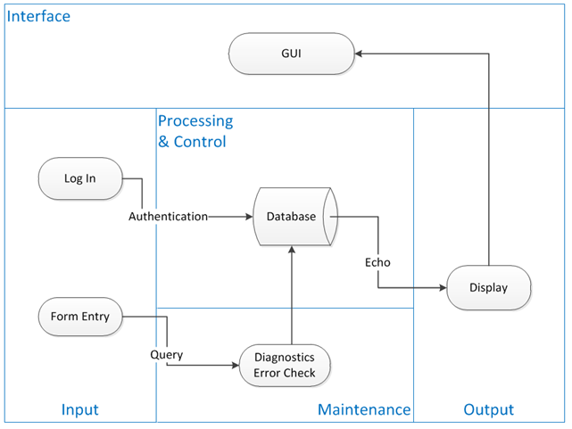
System Context Diagram
This system context diagram depicts the basic input, output, and processing of the SEMRS system.

Slide 8
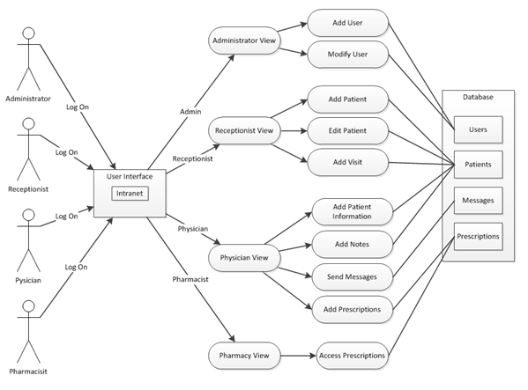
Use Case Diagram
This use case diagram depicts the different user account types and what they have access to within the SEMRS system.
Notes:
***********May need a re-write on the caption

Slide 9
Future Work
Ability to upload Patient files

Slide 10
Concepts Incorporated from OpenEMR
Patient records encrypted.
User access controls.
Remote access from a web browser.
Notes:
These are the 3 ‘big’ things the “state of the art” software uses
Closing Comment: “So if OpenEMR is so great, why is it not a good fit for our specific application?” (go to next slide)

Slide 11
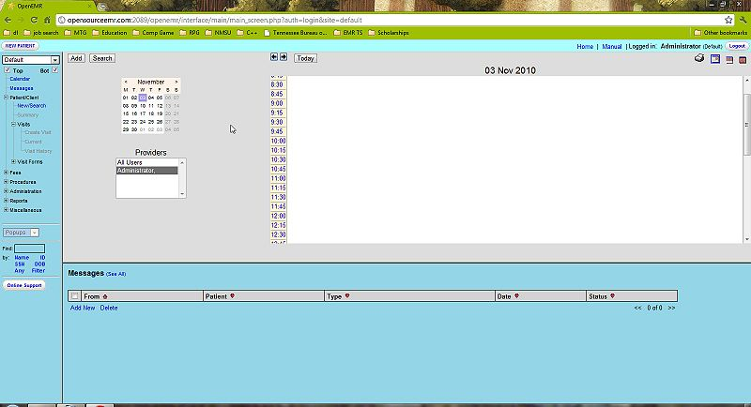
OpenEMR
A screenshot of OpenEMR’s mainscreen.
Notes:
-Too much going on, could be complicated.

Slide 12
The End
Notes:
References:
http://en.wikipedia.org/wiki/List_of_open-source_healthcare_software#Electronic_health_or_medical_record

