Slide 1
SEMRS: Secure Electronic Medical Records System
Ryan Kane and Ricky Orndorff
Department of Computer Science
Spring 2012

Slide 2
Project Background
Mitchell’s Plain Community Health Center
No general health insurance standard
Average annual income (2005) = 75,000 ZAR or 10,000 USD
Majority of population has 7th grade education
20% of the population diagnosed with HIV/AIDS
Notes:
Dong:
You should just describe the problem here.
South Africa does not have health insurance standards because:
“Hospitals and doctors will often require immediate payments for their health services.”
Mitchel's Plain Community Health Center
Largest community in Cape Town, SA
Majority of population has a middle school education
90% of population speaks Afrikaans
20% has HIV/AIDS
3,000 HIV/AIDS patients per month

Slide 3
Problem Statement
Loss/Damage to patient files
Delay or hinder treatment progress
Confidentiality of patient files
Data integrity
Notes:
Why -
This project is for Mitchells Plain Community Healthcare Center in Cape Town, South Africa that treats patients for HIV/AIDS. All patients records are currently hard copy only, and patients’ records get displaced and damaged. Ultimately, a “hassle free treatment process”

Slide 4
Motivation
Improved electronic medical records management system
Secure
Easy to use
Proposed Solution
Enforce patient confidentiality
Ensure data integrity
HIPAA
Notes:
-MCHC is one of the few public health clinics in South Africa,
-Only 2 physicians
7th grade education!!!
What -
Solve the problem of displacement and damage to patients’ files
- Eliminate identity theft
- Ensure patient stays on the right regiment

Slide 5
Background on HIPAA Security Rules
Access Control
Audit Controls
Integrity Controls
Transmission Security
Notes:
Dong:
HIPAA standards. Be prepared to answer related HIPAA standards.
Check out HIPAA security rule. Focus on the technical safeguard
http://www.hhs.gov/ocr/privacy/hipaa/understanding/srsummary.html
Technical Safeguards
Access Control. A covered entity must implement technical policies and procedures that allow only authorized persons to access electronic protected health information (e-PHI).²⁴
Audit Controls. A covered entity must implement hardware, software, and/or procedural mechanisms to record and examine access and other activity in information systems that contain or use e-PHI.²⁵
Integrity Controls. A covered entity must implement policies and procedures to ensure that e-PHI is not improperly altered or destroyed. Electronic measures must be put in place to confirm that e-PHI has not been improperly altered or destroyed.²⁶
Transmission Security. A covered entity must implement technical security measures that guard against unauthorized access to e-PHI that is being transmitted over an electronic network.²⁷
Access Control – User Groups
Audit Controls – Access Log
Integrity Controls – Database Backup
Transmission Security – SSL/HTTPS

Slide 6
EMR Frameworks, Protocols, & Systems
 | ZEPRS | OpenEMR | THIRRA
Year Introduced | 2001 | 2001 | 2007
Pros | Offline mode Role based access control | Most mature Insurance and Billing support | Mobile EHR Bio-surveillance mode Modularity
Cons | Lacks security | Complexity Lacks encryption | Lacks security
Notes:
There have been electronic medical records management systems that:
Enforce patient confidentiality
Ensure data integrity
HIPAA
Earliest dates back to 1995; VistA
Background info on
VistA- Veterans health info systems and technology Architecture
Used throughout the US Dept of Veteran Affairs
80 different clinical fxns, including: Mental Health, Blind Rehab, Ambulatory care, Radiology, Pharmaceutical, etc, etc etc
Software modules for clinical care and financial fxns
Currently the largest medical system in the US, provides care to 8 million veterans
Already had automated data processing previously, but added a GUI in 1997.
One of the first client-server architectures, that allowed health care providers to review and update a patient’s electronic medical record
THIRRA- project title Portable System forTeleHealth and Health Informatics for Rural and Remote Areas.
Started in 2007, Written in PHP, with a PostgreSQL database backend.
ZEPRS- The Zambia Electronic Perinatal Record System (ZEPRS)
- For an obesity clinic
-lacks security measures (i.e. encryption)
OpenEMR V 1.0 released in June 2001
-3700 downloads p/month

Slide 7
Proposed Implementation
Simpler than OpenEMR
Removed features
Onsite Access through intranet (LAN)
SSL Encryption

Slide 8
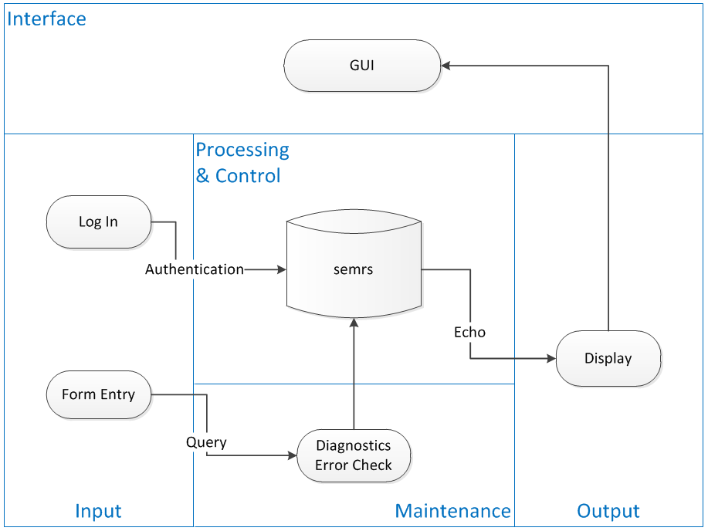
System Architecture Diagram
This system context diagram depicts the basic input, output, and processing of the SEMRS system.
Notes:
Our system is based on a 2 tier (client/server) architecture,
Explain…

Slide 9
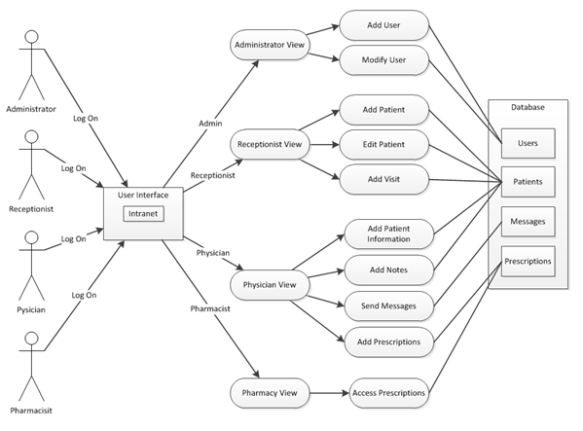
Use Case Diagram
This use case diagram depicts the different user types and what they have access to within the SEMRS system.
Notes:
***********May need a re-write on the caption

Slide 10
Summary
Portability of a streamlined secure system
SSL Encryption
Patients treatment will no longer be restarted
Uphold Confidentiality and data integrity
Automatic log off
Access controls
user groups
audit trail
Notes:
Easily ported to other types of practices: pharmacies, cancer clinics, tuberculosis
How we solved:
Loss/Damage to patient files
Delay or hinder treatment progress
Confidentiality of patient files
Data integrity
Dong:
You should list and talk about the security features you implemented, including
User group access control (see here for explanations: http://www.tonymarston.net/php-mysql/role-based-access-control.html)
Encryption and description algorithms
Secure transmission via openSSL
Audit log
Automatic log off
Others that I am not aware of
This should be your presentation emphasis. Use one or two slide and present algorithm involved.
****
- Taken out financial data
Safeguard, (electronic paper trail)
SHA1 for message Authentication, DHE_RSA as the key exchange mechanism, allows for HTTPS Protocol, ( combination of hypertext transfer protocal and SSL/TLS protocal.) Provides encrypted communication to allow for secure identification of a network web server
How -
A software system that backs up patients’ files securely so that they can be readily available when needed
- Identity theft eliminated by integrating a photo into the system for each patient so that they can be identified through facial recognition and name, eliminating the need for a patient ID card, making the overall process smoother and easier for patients’

Slide 11
Possible Future Work
Ability to upload existing multimodal hardcopy files
Prescriptions:
Add
Update
Control dispensing
Greater domain portability
Notes:
X-Rays, lab samples, other types of files…
In Summary,
We have developed a secure lightweight system that addresses the needs of MCHC

