Slide 1
SEMRS: Secure Electronic Medical Records System
Ryan Kane and Ricky Orndorff
Department of Computer Science
Spring 2012

Slide 2
Problem Statement
Designed Specifically for MCHC
Loss/Damage to Patient’s files
Delay or hinder treatment progress
Issue of identity theft

Slide 3
Motivation
MCHC needs a better medical records system
This system can improve the overall treatment process
Want to provide a system that is:
-Easy to use
-Secure
-Without unnecessary features
Notes:
-MCHC is one of the few public health clinics in South Africa,
-Only 2 physicians

Slide 4
Summary of SEMRS
Motivation - Why we chose this project?
Record backup
Problem - What we are solving?
Identity theft
Delay or hinder treatment progress
Solution - How we are fixing it?
Notes:
Why -
This project is for Mitchells Plain Community Healthcare Center in Cape Town, South Africa that treats patients for HIV/AIDS. All patients records are currently hard copy only, and patients’ records get displaced and damaged. Ultimately, a “hassle free treatment process”
What -
Solve the problem of displacement and damage to patients’ files
- Eliminate identity theft
- Ensure patient stays on the right regiment
How -
A software system that backs up patients’ files securely so that they can be readily available when needed
- Identity theft eliminated by integrating a photo into the system for each patient so that they can be identified through facial recognition and name, eliminating the need for a patient ID card, making the overall process smoother and easier for patients’

Slide 5

Medical Databases Overview
Healthcare world moving away from paper records.
Patient confidentiality > National priorities
How private are these records and who has access ?
Notes:
It is important to weigh patient confidentiality against a public responsibility to support national priorities.
Pros:
- Hospitals/Clinics more efficient
- Reduce medical errors
- Lower healthcare costs

Slide 6
History of Past EMR Systems
Earliest dates back to 1995; VistA
Few web enabled EMR systems:
ZEPRS - 2001
OpenEMR – 2001
THIRRA - 2007
Notes:
Background info on
VistA- Veterans health info systems and technology Architecture
Used throughout the US Dept of Veteran Affairs
80 different clinical fxns, including: Mental Health, Blind Rehab, Ambulatory care, Radiology, Pharmaceutical, etc, etc etc
Software modules for clinical care and financial fxns
Currently the largest medical system in the US, provides care to 8 million veterans
Already had automated data processing previously, but added a GUI in 1997.
One of the first client-server architectures, that allowed health care providers to review and update a patient’s electronic medical record
THIRRA- project title Portable System forTeleHealth and Health Informatics for Rural and Remote Areas.
Started in 2007, Written in PHP, with a PostgreSQL database backend.
ZEPRS- The Zambia Electronic Perinatal Record System (ZEPRS)
- For an obesity clinic
-lacks security measures (i.e. encryption)
OpenEMR V 1.0 released in June 2001
-3700 downloads p/month

Slide 7
Concepts Incorporated from OpenEMR
Patient records encrypted.
User access controls.
Remote access from a web browser.
Notes:
These are the 3 ‘big’ things the “state of the art” software uses
Closing Comment: “So if OpenEMR is so great, why is it not a good fit for our specific application?” (go to next slide)

Slide 8
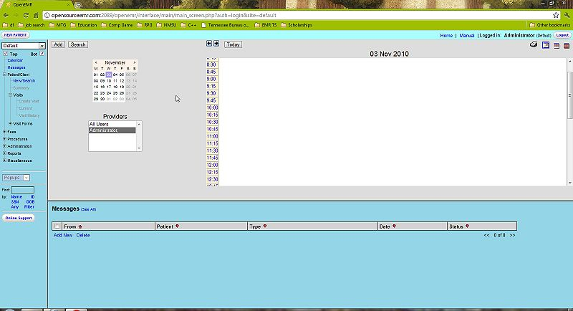
OpenEMR
A screenshot of OpenEMR’s mainscreen.
Notes:
-Too much going on, could be complicated.

Slide 9

Solution
Much simpler than OpenEMR, removed many unneeded features.
Onsite Access through intranet (LAN).
SSL Encryption
Notes:
- Taken out financial data
Safeguard, (electronic paper trail)
SHA1 for message Authentication, DHE_RSA as the key exchange mechanism, allows for HTTPS Protocol, ( combination of hypertext transfer protocal and SSL/TLS protocal.) Provides encrypted communication to allow for secure identification of a network web server

Slide 10
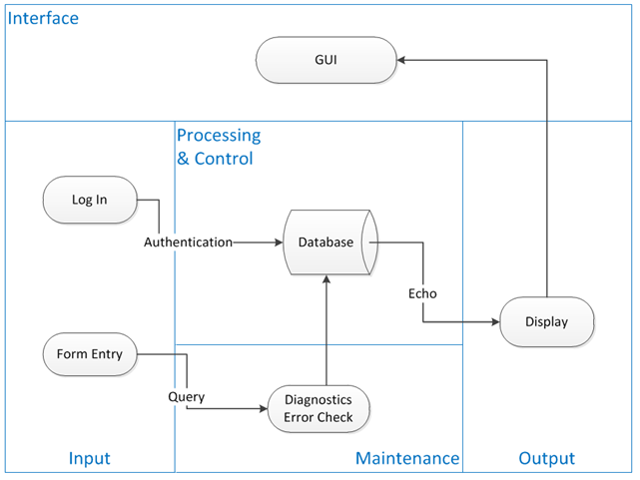
System Context Diagram
This system context diagram depicts the basic input, output, and processing of the SEMRS system.

Slide 11
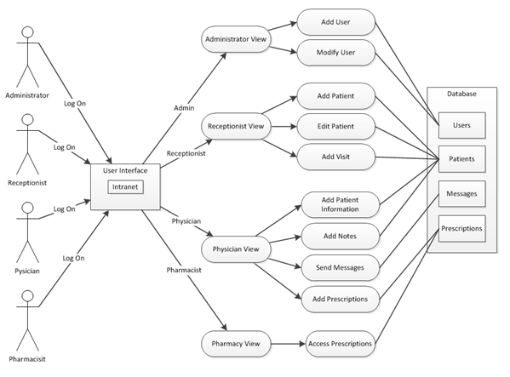
Use Case Diagram
This use case diagram depicts the different user account types and what they have access to within the SEMRS system.
Notes:
***********May need a re-write on the caption

Slide 12
Future Work
Ability to upload Patient files

Slide 13
fin
Notes:
References:
http://en.wikipedia.org/wiki/List_of_open-source_healthcare_software#Electronic_health_or_medical_record

