Slide 1
Java 2 Platform Update for Java User Group HK
Mickey Fan
Sun Microsystems of California Ltd

Slide 2

J2ME
CLDC 1.0
  monty, Lang, Util, io, ref
MIDP 2.0
  OTA, lcdui, game, media, midlet, pki, rms
MMAPI 1.0
  Media, control, protocol
WMA 1.0
  Messaging

Slide 3




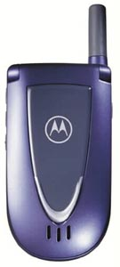




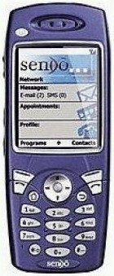
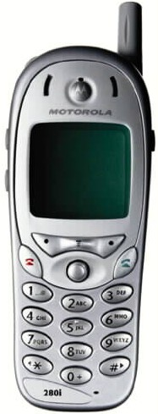

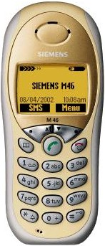







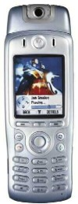
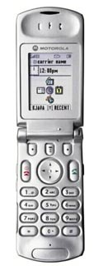

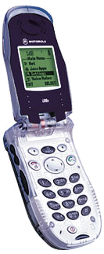
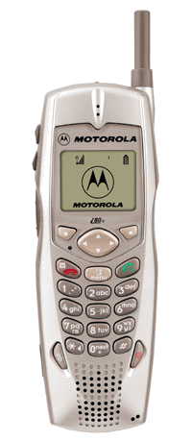

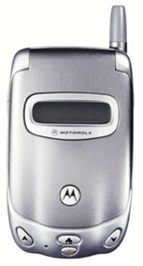
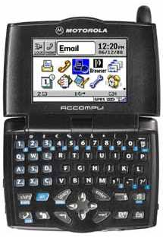

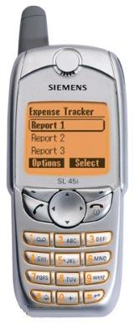
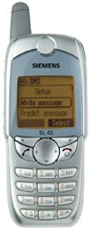





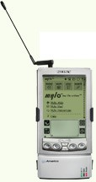


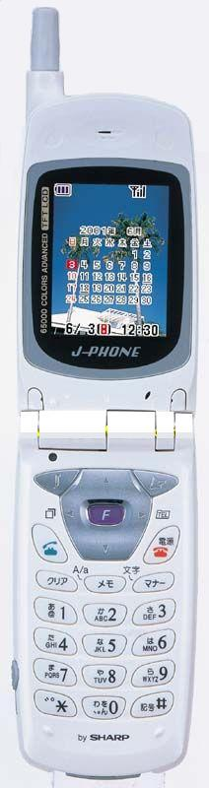



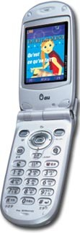


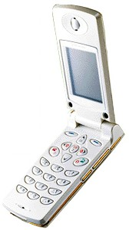
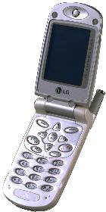


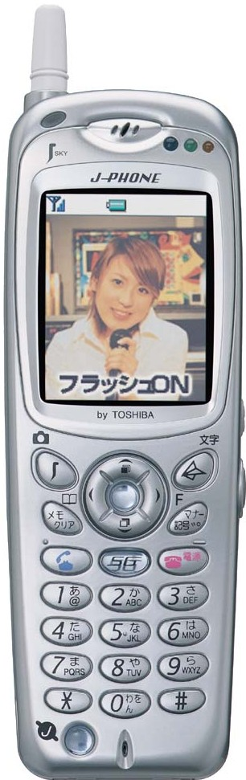









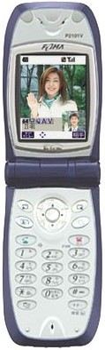




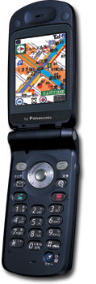





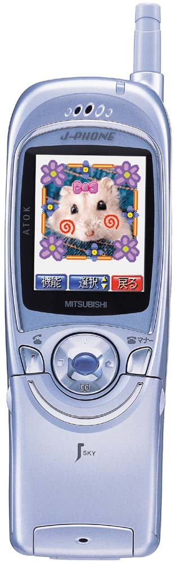
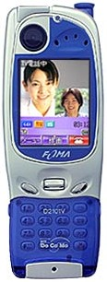
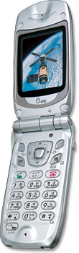
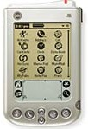

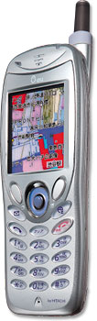

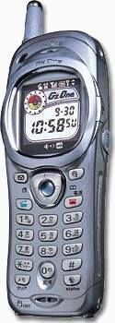
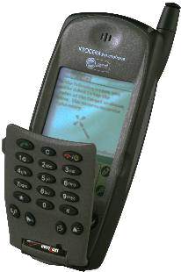
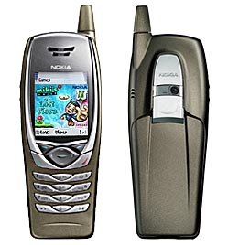


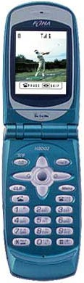








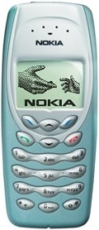
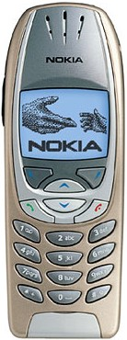


90+ J2ME Models from 19 OEMs
iPaq
T280i
V60i
V66i
i55rx
i85s
Z100
M50
M46
A 008
SCH
X250
i300
SCH
X350
Rainbow
SCH
460
HipTop
A388
V70
A820
T720
i90c
i95cl
i80s
A009
i50sx
SL45i
SL42
N400
Blackberry
5810
Cnain
2000
iBook
CX-300L
Ez-X1
Zaurus
SH51
SH08
SH07
SH52
SH09
T06
A3013T
T07
C3011SA
J-SA51
P800
Clie
SO503i
C5001T
i705
Treo 280
C3001H
C451H
C3003P
P503i
FOMA
P2101v
J-P51
F503i
C452CA
Cassiopeia
A3012CA
D503i
D05
FOMA
D2101v
D06
C3002K
QCP 6035
P503is
F503is
9290
6100
5100
6800
3510
3650
7250
8910i
N503i
N503is
FOMA N2002
N05
7210
6310i
3410
7650
6650

Slide 4

JSR-118 (MIDP 2.0)
Nov 20, 2002 , Final Released
MIDP 2.0 is a complete specification that includes all of the functionality and is backward compatible with MIDP 1.0
Expert group consists of nearly 60 companies including network operators, manufacturers, content developers, technology providers and individuals

Slide 5

Application Delivery
MIDP 2.0 formally includes the Over The Air (OTA) Recommended Practice document associated with MIDP 1.0
Enhancements were made to this specification to enable reliable delivery of server notifications
Notifications are enabled for successful application installation as well as deletion

Slide 6

Enhanced UI
Builds upon the features of LCDUI
  Custom Item support
  Layout control
  Graphics enhancements
  Miscellaneous improvements
Backward compatible with MIDP 1.0

Slide 7

Game API
Provides a rich set of features for developing 2D gaming content
  Enables native implementation
  Simplifies game development
Compatible with LCDUI Graphics classes
Flexible design

Slide 8

Sound
Provides rich audio capabilities to MIDlets:
  Tone Generation (required)
  Sampled sounds (e.g. wav) (optional)
  MIDI (optional)
Structured as a subset of JSR-135 (Multimedia), to gives full upward compatibility

Slide 9

Security
MIDP 1.0 used the “sandbox” security model,
similar to Applets, where MIDlets are only exposed to “safe” APIs
MIDP 2.0 specifies how MIDlet Suites can be cryptographically signed so that their authenticity and origin can be validated
A new security framework is also specified such that some “trusted” or “privileged” MIDlets, based on their signature, can get access to APIs outside the sandbox, which are not safe to expose to all MIDlets
  For example, originating a phone call, using
  the Push networking features, as well as
  privileged features from future JSRs

Slide 10

Game API—Overview
Provides a rich set of features for developing 2D gaming content
  Enables native implementation
  Simplifies game development
Flexible design
Compatible with LCDUI Graphics classes

Slide 11
Game API—Class Hierarchy
Canvas
GameCanvas
Object
LayerManager
Graphics
Layer
Image
Sprite
TiledLayer

Slide 12

Game API—Layer
Abstract superclass of all visual elements
  Size
  Location
  Visibility
May be added to a LayerManager

Slide 13
Game API—TiledLayer
Visual element composed of a grid that can be filled using a set of cells
Cells are provided in a single Image
Animated cells can be defined
Each element of the grid can contain a specific cell, or can be left empty
Allows large visual elements to be created

Slide 14
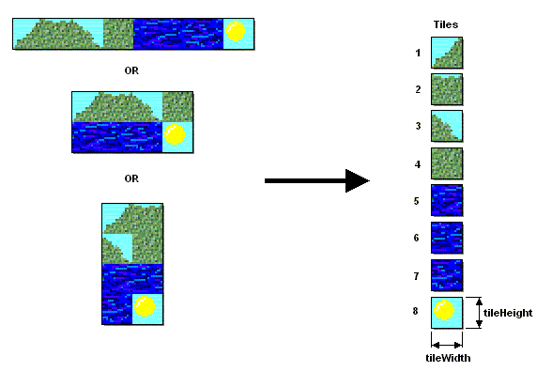
Game API—TiledLayer
Cells are provided in a single Image

Slide 15
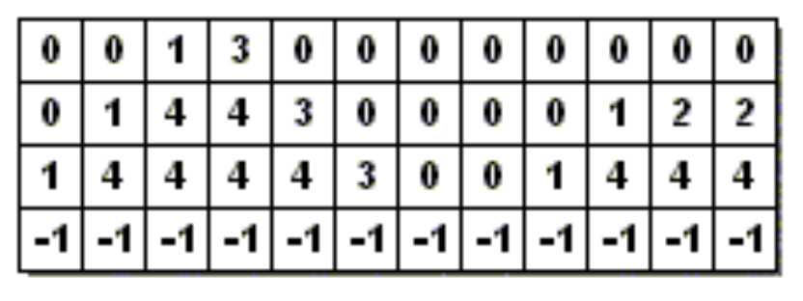
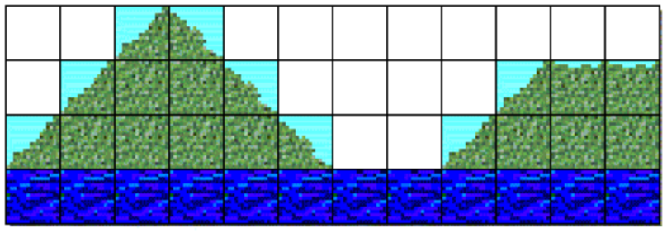
Game API—TiledLayer
Each element of the grid may contain a specific cell

Slide 16
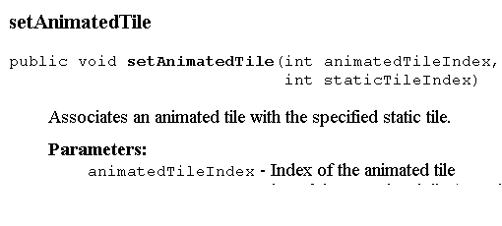
Example
Demo!!!

Slide 17

Game API—Sprite
Visual element that can display one of several frames
  Frames are provided in a single Image
  Specific frame or animated sequence
Transforms
Collision detection
  With a TiledLayer
  With another Sprite

Slide 18
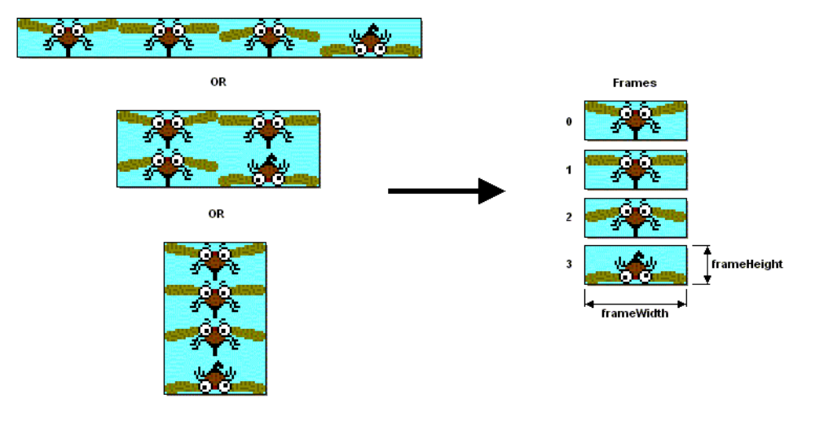
Game API—Sprite
Frames are provided in a single Image

Slide 19








Game API—Sprite
Various transforms can be applied
TRANS_NONE
TRANS_MIRROR_ROT_180
TRANS_MIRROR
TRANS_ROT_180
TRANS_ROT_90
TRANS_MIRROR_ROT_90
TRANS_MIRROR_ROT_270
TRANS_ROT_270

Slide 20
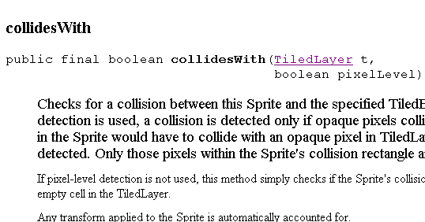
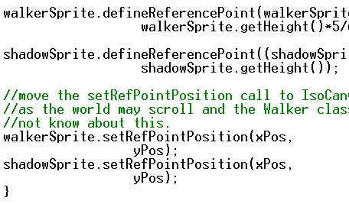
Example

Slide 21
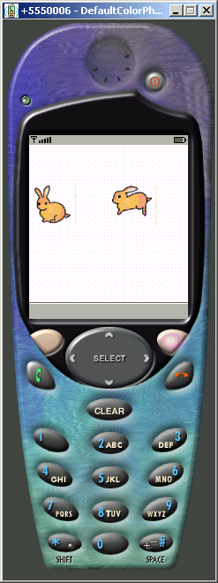
Collide Demo
if (walkerSprite.collidesWith(blackSprite, false))
{System.out.println("Collide dectected");}
if (walkerSprite.collidesWith(blackSprite, true))
{ System.out.println("Collide Pixel Level");}

Slide 22
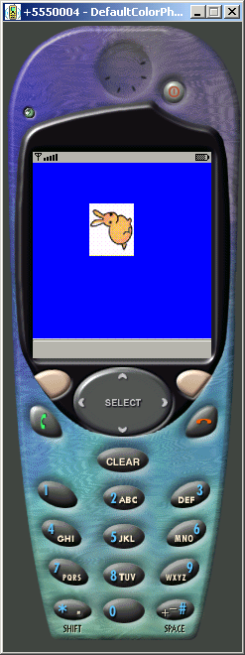

Transformation Demo
Graphics g = getGraphics();
while (true){
walkerSprite.nextFrame();
walkerSprite.setTransform( walkerSprite.TRANS_MIRROR);
walkerSprite.setTransform( walkerSprite.TRANS_MIRROR_ROT270);
...
....
...
Transformation can change x,y, width, Height

Slide 23
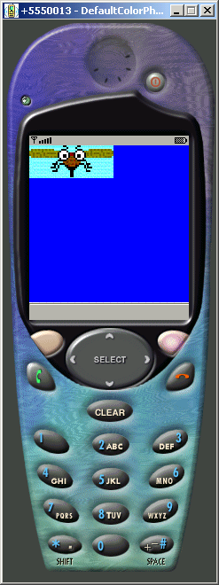
Sprite Demo
walkerSprite.setVisible(true);
walkerSprite.setFrameSequence(imageSequence);
layerManager.append(walkerSprite);
....
public void run() {
Graphics g = getGraphics();
while (true) {
walkerSprite.nextFrame();
....
private static final int[] imageSequence = {0,1,2};

Slide 24
Game API—LayerManager
Manages an ordered list of Layer objects
  Layers may be added and removed as needed
  List order implies Z-order
Automates the rendering process
  Definable view window
  Scrolling support

Slide 25
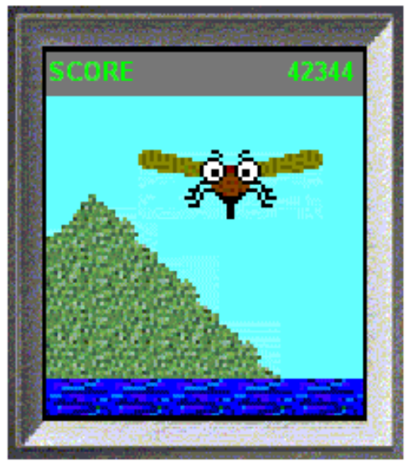
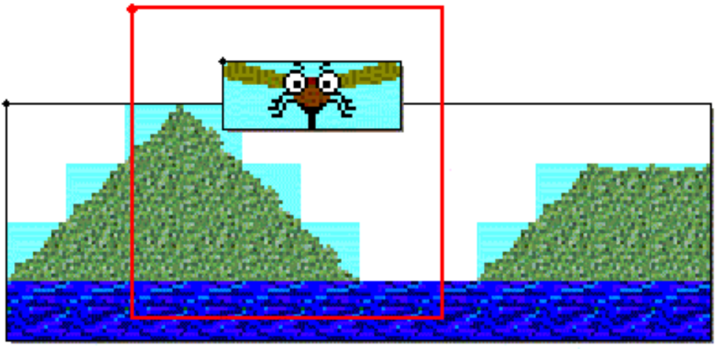
Game API—LayerManager
Definable view window

Slide 26
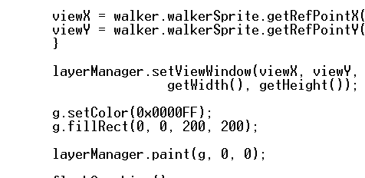
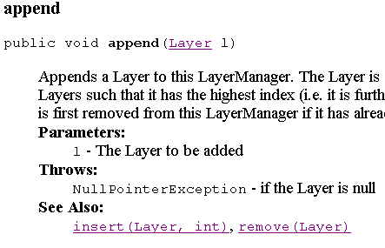
Example

Slide 27

Tiled Layer Demo
tiledLayer1.setPosition(-(tileWidth/2),-(tileHeight/2));
tiledLayer2.setPosition(0,0);
tiledLayer1.setCell(0, 0, 1);
tiledLayer1.setCell(1, 0, 1);
.....
tiledLayer1.setVisible(true);
tiledLayer2.setVisible(true);
layerManager.append(tiledLayer2);
layerManager.append(tiledLayer1);

Slide 28
Game API—GameCanvas
Enhances Canvas with game-centric features
Key input support
  Query game key states directly
  Simultaneous key presses
Off-screen buffer
  May be painted directly
  Synchronous flushing

Slide 29
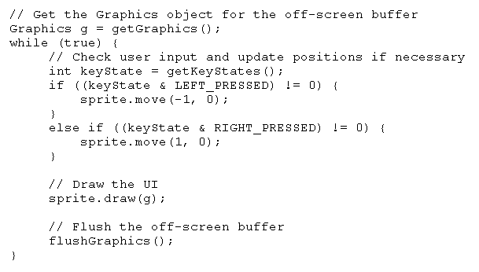
Example

Slide 30
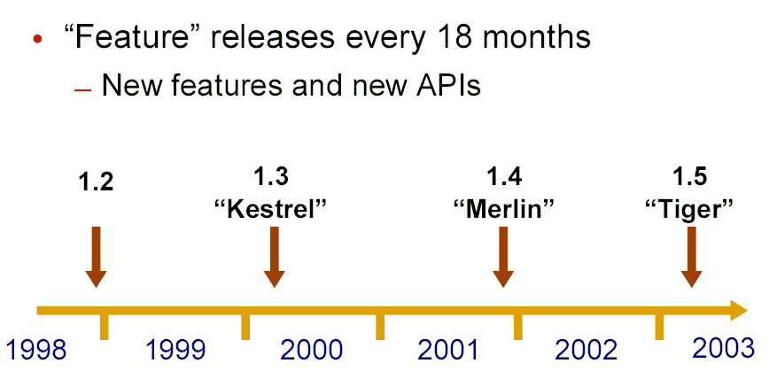

J2SE

Slide 31
J2SE
J2SE 1.4.1
  First Merlin maintenance release.
  Supports Itanium compiler.
  Improved GC
  Java WebStart...
J2SE 1.4.2
  May 03
  Performance
  Full Java Webstart...
J2SE 1.5
  Improvement on the Core
  Autoboxing, Enumeration, Generic...

Slide 32
Autoboxing
Automatic conversion of data of primitive type to the corresponding wrapper type.
  boxing
  r.value() == i equiv r=i
  unboxing
  i == r.value() equiv i = r

Slide 33

Enumeration
public class Card implements Comparable, java.io.Serializable {
  public enum Rank { deuce, three, four, five, six, seven, eight, nine, ten, jack, queen, king, ace }
  public enum Suit { clubs, diamonds, hearts, spades }
  private final Rank rank; private final Suit suit;
  private Card(Rank rank, Suit suit) {
    if (rank == null || suit == null) throw new NullPointerException(rank + ", " + suit);
    this.rank = rank; this.suit = suit; }
  public Rank rank() { return rank; }
  public Suit suit() { return suit; }
  public String toString() { return rank + " of " + suit; }
  public int compareTo(Object o) {
  Card c = (Card)o; int rankCompare = rank.compareTo(c.rank); return rankCompare != 0 ? rankCompare : suit.compareTo(c.suit); } private static List<Card> sortedDeck = new ArrayList<Card>(52); static { for (Iterator<Rank> i = Rank.VALUES.iterator(); i.hasNext(); ) { Rank rank = i.next(); for (Iterator<Suit> j = Suit.VALUES.iterator(); j.hasNext(); ) sortedDeck.add(new Card(rank, j.next())); } } // Returns a shuffled deck public static List<Card> newDeck() { List<Card> result = new ArrayList<Card>(sortedDeck); Collections.shuffle(result); return result; } }

Slide 34


News in J2EE 1.4
JAX-RPC 1.0
SAAJ 1.1
JAXR 1.0
J2EE Management 1.0
JMX 1.2
J2EE Deployment 1.1
J2EE Auth Contract for Containers 1.0
Web Services for J2EE 1.1

Slide 35

Update in J2EE 1.4
J2SETM 1.4
JAXP 1.2
Servlet 2.4
JSPTM 2.0
EJBTM 2.1
Connector 1.5
JMS 1.1
JavaMailTM 1.3

Slide 36
Portable Logout
Function call can invalidate all active session

Slide 37
Serlvet Request Listener
Provide more control and flexible especially called from the container
  Servlet Context Listner
  Http Session Event ( New! )
  Servlet Request Event ( New! )

Slide 38

Servlet – Filter and Dispatcher
By using the new <dispatcher> element in the deployment descriptor, the developer can indicate for a filter-mapping whether he would like the Filter to be applied to requests:

Slide 39
Filter in Servlet 2.3
Client
Container
Filter1
Filter2
Servlet
FilterChain

Slide 40
Filter in Servlet 2.3
X
Container
Filter1
Filter2
Servlet
FilterChain
X = Client, forward, Include, Error

Slide 41
<Dispatcher> Tag in Serlvet 2.4
Only client request
  <filter-mapping>
  <filter-name>Logging Filter</filter-name>
  <url-pattern>/products/*</url-pattern>
  </filter-mapping>
All Request
  <filter-mapping>
  <filter-name>Logging Filter</filter-name>
  <url-pattern>/products/*</url-pattern>
  <dispatcher>FORWARD</dispatcher>
  <dispatcher>INCLUDE</dispatcher>
  <dispatcher>ERROR</dispatcher>
  <dispatcher>REQUEST</dispatcher>
  </filter-mapping>

Slide 42
Thank You
Mickey Fan
mickey.fan@sun.com

