Slide 1

Model Driven Architecture

Slide 2

Agenda
Traditional software development
What’s MDA?
MDA Benefits
Example
Development processes
The future & promise?

Slide 3

Traditional Software Development

Slide 4

“The sooner you start, the longer it takes.”
Fred Brooks
The Mythical Man Month, 1975

Slide 5
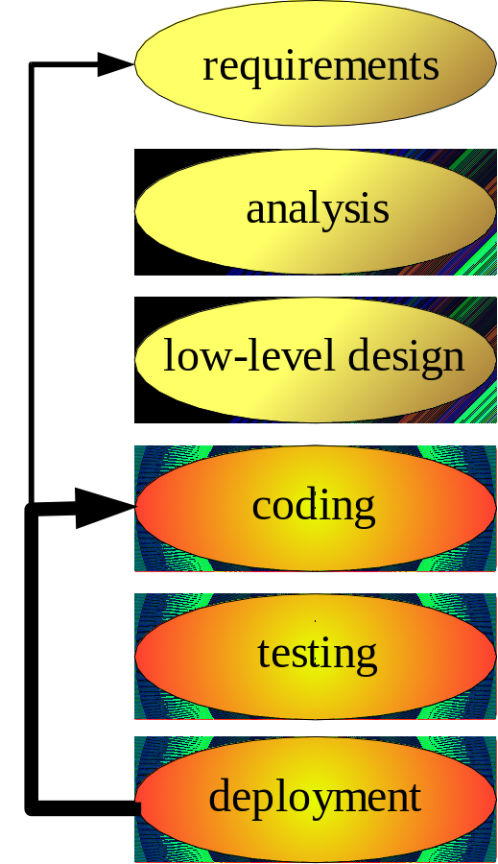
Traditional Development
The Productivity Problem
Writing software is Labor Intensive
Rely on numerous technologies
Driven by low-level design & coding
  Changes are done at code level
  Enlarging distance from design docs
Only the same people understand the system
  Limited value but essential docs
Spend time either in
  Building high-level doc
  Understand the software at maintenance phase
Iterative Development
Developer shortcut

Slide 6
Traditional Development
The Portability Problem
Software industry release new stuffs each year
  Java, Linux, XML, HTML, SOAP, UML, J2EE, .Net, Web Service, etc…
We need to follow because:
  Demanded by customers (Web UI)
  Solves some real problem (Web Service for integration)
  Become legacy (stop supported)
Investment lose value or even worthless
Technology changes no guarantee backwards compatible
Result →Port existing system to new platform(s)

Slide 7
Traditional Development
The Interoperability Problem
Software is not isolated → communicates with other
  e.g. Web-base system talks to existing backend system
Span multiple technologies (both old & new):
  e.g. Entity EJB use RBMS for storage
  e.g. Session EJB use CORBA, Web Services
Avoid huge monolithic system → n-tiers application
  More realistic to built
  Easier to maintenance
Using different technologies but talk to each other
  Interoperability!

Slide 8


Traditional Development
The Maintenance & Documentation Problem
Documentation is often done afterthought
Developers feel coding as main task
  Writing documentation is unproductive
  Only useful for the maintenance team, not them
No incentive other than the Manager ;-)
Result →Low quality documentation, out-of-date
Change in code → change in doc BY HAND!
Generate doc from code → solves only low-level documentation

Slide 9
What is MDA?

Slide 10
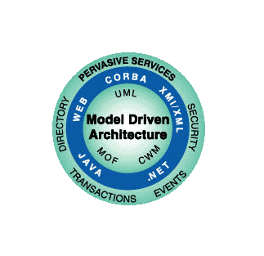
Model-Driven Architecture
Object Management Group
A new way to specify and build systems
  Based on modeling with UML
  Modeling instead of programming
  Merging model and coding
  Based on standards
    UML, MOF, CWM, XMI…..
“MDA is about moving to the NEXT level – instead of offering another set of APIs, it offers an opportunity to model those APIs generically – and then generate code for accessing the APIs you choose (or get stuck with). More importantly from the view of the app developer, you model *your application* generically, ignoring the plethora of APIs”
Richard Soley
Finance
Manufacturing
E-Commerce
Space
Telecommunication
Transportation
Health Care
More...
Notes:
The foundation of the solution that enables you to tackle these business challenges is an emerging standard from the Object Management Group (OMG) called Model-Driven Architecture (MDA).
MDA’s vision is to define a new way of specifying and building systems which is based on modeling with UML. MDA captures the use of UML for more than just pretty pictures. For example, in the past and even still today designers model a system and these pretty pictures are collected and bound into a document and sent to the developers as a documentation set. Developers pick out what they think is valuable and leave the rest. In addition, you see that over time the paper model is not maintained when the application changes, so model and code are no longer in sync. The model becomes useless as a documentation set because it no longer reflects the application accurately. MDA’s vision is to merge the modeling and coding worlds.
OMG MDA changes the way organizations design and develop software by separating an application’s business logic from the infrastructure on which it runs.
Based on modeling with UML: Traditional software design and development focuses on creating applications that are deployed on a specific platform. MDA enables organizations to model (in UML) at a higher level of abstraction. In essence the models are the application “blue-prints”, independent of any particular hardware, operating system or middleware.
Modeling instead of programming: This approach ensures that business models drive application development, instead of the other way around. The ultimate goal: To truly bridge modeling and development.
Merging modeling and coding: Modeling, however, is still a paper-based exercise for a lot of organizations. The result is that, although the model is intended to be the application blueprint, as the application evolves the model and code are no longer synchronized because the application is updated and the model isn’t. Therefore, from a documentation perspective the model becomes useless. This is what MDA tries to address: Merging the modeling and coding worlds.
Based on standards: MDA makes use of a strong set of universal standards for modeling that makes it a very useful and interesting concept. MDA is built on UML, the Meta Object Facility (MOF), XML Metadata Interchange (XMI), and the Common Warehouse Metamodel (CWM)
MDA is not the next big thing. Let me explain.
The problem is that every year we see a new infrastructure being introduced. If we look at the last 10 years; C/C++, Java, J2EE, Web Services, .NET, and who knows what’s coming out next year. The nice thing about MDA is that it clearly separates the business model from the architecture model and it separates the architecture model from the implementation language. This makes it very clear to determine where to apply changes in the application:
Business changes on the business model
Architecture changes on the architecture model
Code changes on code model
Addition information for the speaker:
Dr Richard Soley is Chairman and CEO of the Object Management Group (OMG)

Slide 11
Model-Driven Architecture
Clear distinction between the models and the implementation
  Platform Independent Model (PIM)
  Platform Specific Model (PSM)
  Code Model
Business and technology changes
  Constantly changing environment of today’s market
  Business model (PIM) remains stable
Platform
Independent
Model
Platform
Specific
Model
Code
Model
Notes:
MDA addresses the challenges of today's highly networked, constantly changing systems environment, providing an architecture that assures:
Portability, increasing application re-use and reducing the cost and complexity of application development and management, now and into the future.
Cross-platform Interoperability, using rigorous methods to guarantee that standards based on multiple implementation technologies all implement identical business functions.
Platform Independence, greatly reducing the time, cost and complexity associated with re-targeting applications for different platforms-including those yet to be introduced.
Domain Specificity, through Domain-specific models that enable rapid implementation of new, industry-specific applications over diverse platforms.
Productivity, by allowing developers, designers and system administrators to use languages and concepts they are comfortable with, while allowing seamless communication and integration across the teams.
The benefits of MDA are significant-to business leaders and developers alike:
Reduced cost throughout the application life-cycle
Reduced development time for new applications
Improved application quality
Increased return on technology investments
Rapid inclusion of emerging technology benefits into their existing systems
MDA provides a solid framework that frees system infrastructures to evolve in response to a never-ending parade of platforms, while preserving and leveraging existing technology investments. It enables system integration strategies that are better, faster and cheaper.
Crucial return on investment: applications and domain models can be reused and adopted to ongoing business and technology changes. It allows a software environment to evolve and change while the business model (PIM) remains stable. This stable base is necessary to cope with the constantly changing environment of today’s market.

Slide 12
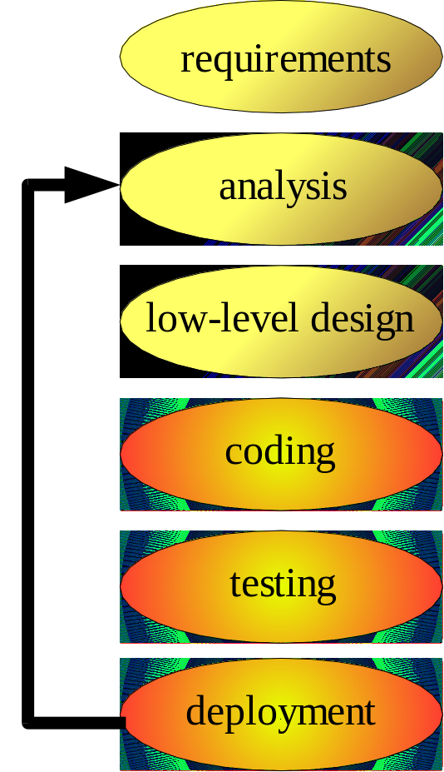
MDA Benefits
Increase Productivity
Raising the Level of Abstraction
  Artifacts of different steps in lifecycle
  Abstraction of system
  Shifts developer to analysis & design
  More resources to solve business issues
Automation of transformation
PIM developers need not concern the platform specific details
PSM developers write less code
Doc are no longer just paper!
Model-driven iteration
Notes:
MDA addresses the challenges of today's highly networked, constantly changing systems environment, providing an architecture that assures:
Portability, increasing application re-use and reducing the cost and complexity of application development and management, now and into the future.
Cross-platform Interoperability, using rigorous methods to guarantee that standards based on multiple implementation technologies all implement identical business functions.
Platform Independence, greatly reducing the time, cost and complexity associated with re-targeting applications for different platforms-including those yet to be introduced.
Domain Specificity, through Domain-specific models that enable rapid implementation of new, industry-specific applications over diverse platforms.
Productivity, by allowing developers, designers and system administrators to use languages and concepts they are comfortable with, while allowing seamless communication and integration across the teams.
The benefits of MDA are significant-to business leaders and developers alike:
Reduced cost throughout the application life-cycle
Reduced development time for new applications
Improved application quality
Increased return on technology investments
Rapid inclusion of emerging technology benefits into their existing systems
MDA provides a solid framework that frees system infrastructures to evolve in response to a never-ending parade of platforms, while preserving and leveraging existing technology investments. It enables system integration strategies that are better, faster and cheaper.
Crucial return on investment: applications and domain models can be reused and adopted to ongoing business and technology changes. It allows a software environment to evolve and change while the business model (PIM) remains stable. This stable base is necessary to cope with the constantly changing environment of today’s market.

Slide 13
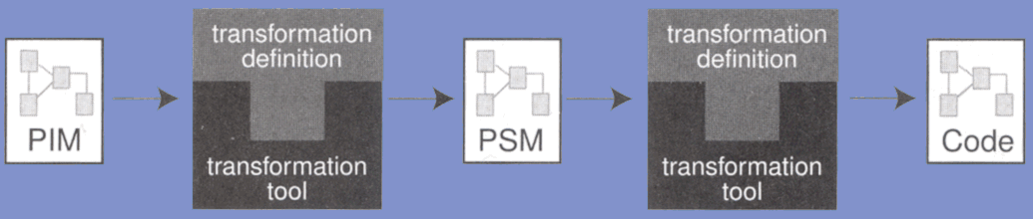
MDA Benefits
Enhance Portability
PIM is independent of technologies
Automatic transformed into multiple platforms (PSM) → Portable
Portability depends on availability of transformation tools
Provide concrete languages to support custom transformation definitions
Notes:
MDA addresses the challenges of today's highly networked, constantly changing systems environment, providing an architecture that assures:
Portability, increasing application re-use and reducing the cost and complexity of application development and management, now and into the future.
Cross-platform Interoperability, using rigorous methods to guarantee that standards based on multiple implementation technologies all implement identical business functions.
Platform Independence, greatly reducing the time, cost and complexity associated with re-targeting applications for different platforms-including those yet to be introduced.
Domain Specificity, through Domain-specific models that enable rapid implementation of new, industry-specific applications over diverse platforms.
Productivity, by allowing developers, designers and system administrators to use languages and concepts they are comfortable with, while allowing seamless communication and integration across the teams.
The benefits of MDA are significant-to business leaders and developers alike:
Reduced cost throughout the application life-cycle
Reduced development time for new applications
Improved application quality
Increased return on technology investments
Rapid inclusion of emerging technology benefits into their existing systems
MDA provides a solid framework that frees system infrastructures to evolve in response to a never-ending parade of platforms, while preserving and leveraging existing technology investments. It enables system integration strategies that are better, faster and cheaper.
Crucial return on investment: applications and domain models can be reused and adopted to ongoing business and technology changes. It allows a software environment to evolve and change while the business model (PIM) remains stable. This stable base is necessary to cope with the constantly changing environment of today’s market.

Slide 14
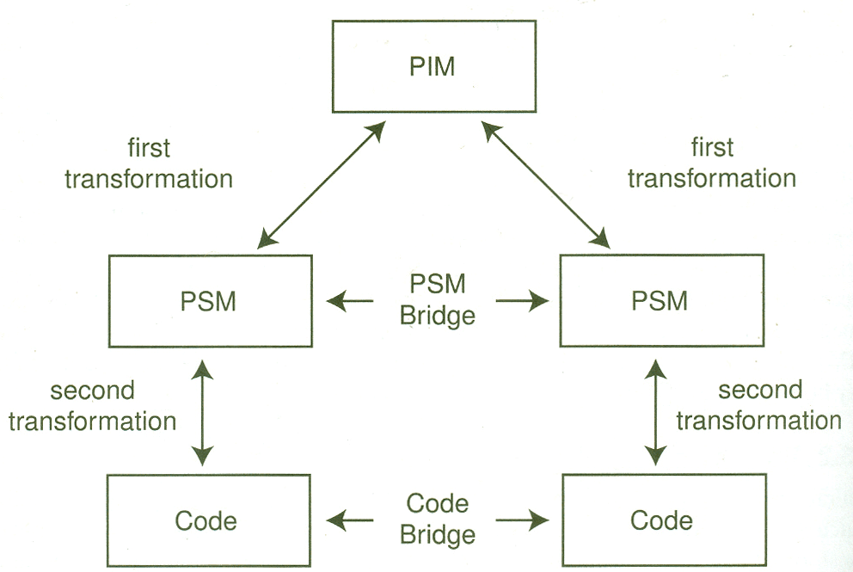
MDA Benefits
Higher Interoperability
PIM transformed into multiple PSMs, each targeting a particular platform
The tool knows the relationships between each PSM
Deduces how to bridge them together
  e.g. EJB → DBMS Table
Notes:
MDA addresses the challenges of today's highly networked, constantly changing systems environment, providing an architecture that assures:
Portability, increasing application re-use and reducing the cost and complexity of application development and management, now and into the future.
Cross-platform Interoperability, using rigorous methods to guarantee that standards based on multiple implementation technologies all implement identical business functions.
Platform Independence, greatly reducing the time, cost and complexity associated with re-targeting applications for different platforms-including those yet to be introduced.
Domain Specificity, through Domain-specific models that enable rapid implementation of new, industry-specific applications over diverse platforms.
Productivity, by allowing developers, designers and system administrators to use languages and concepts they are comfortable with, while allowing seamless communication and integration across the teams.
The benefits of MDA are significant-to business leaders and developers alike:
Reduced cost throughout the application life-cycle
Reduced development time for new applications
Improved application quality
Increased return on technology investments
Rapid inclusion of emerging technology benefits into their existing systems
MDA provides a solid framework that frees system infrastructures to evolve in response to a never-ending parade of platforms, while preserving and leveraging existing technology investments. It enables system integration strategies that are better, faster and cheaper.
Crucial return on investment: applications and domain models can be reused and adopted to ongoing business and technology changes. It allows a software environment to evolve and change while the business model (PIM) remains stable. This stable base is necessary to cope with the constantly changing environment of today’s market.

Slide 15
MDA Benefits
Easier to Maintenance and Documentation
Developers focus on PIM
  A higher abstraction than code
  Models →high-level documentation
Change made to PIM → propagates to PSM & Code
  Keep developers maintain the “doc”
  Work in a more declarative way
  Remains consistent with the code
Documentation becomes useful !
PIM
PSM
Notes:
MDA addresses the challenges of today's highly networked, constantly changing systems environment, providing an architecture that assures:
Portability, increasing application re-use and reducing the cost and complexity of application development and management, now and into the future.
Cross-platform Interoperability, using rigorous methods to guarantee that standards based on multiple implementation technologies all implement identical business functions.
Platform Independence, greatly reducing the time, cost and complexity associated with re-targeting applications for different platforms-including those yet to be introduced.
Domain Specificity, through Domain-specific models that enable rapid implementation of new, industry-specific applications over diverse platforms.
Productivity, by allowing developers, designers and system administrators to use languages and concepts they are comfortable with, while allowing seamless communication and integration across the teams.
The benefits of MDA are significant-to business leaders and developers alike:
Reduced cost throughout the application life-cycle
Reduced development time for new applications
Improved application quality
Increased return on technology investments
Rapid inclusion of emerging technology benefits into their existing systems
MDA provides a solid framework that frees system infrastructures to evolve in response to a never-ending parade of platforms, while preserving and leveraging existing technology investments. It enables system integration strategies that are better, faster and cheaper.
Crucial return on investment: applications and domain models can be reused and adopted to ongoing business and technology changes. It allows a software environment to evolve and change while the business model (PIM) remains stable. This stable base is necessary to cope with the constantly changing environment of today’s market.

Slide 16
Example

Slide 17
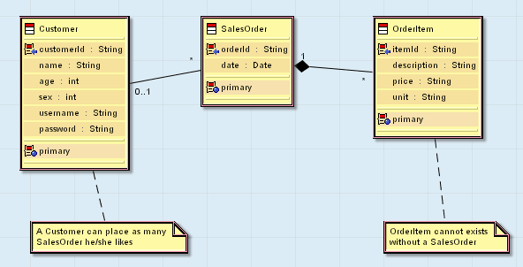
Example
A simple online shop
A simple e-commerce shop with 3 classes
PIM which to capture the business requirement only:

Slide 18
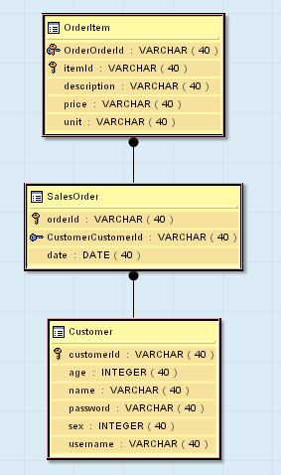
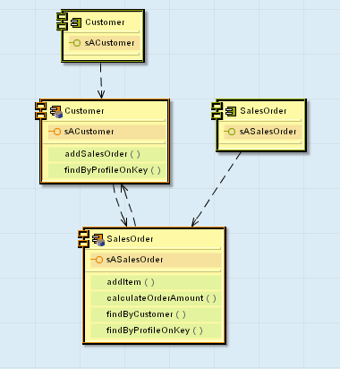
Example
Transformed into Multiple PSMs
Three PSM is generated: Web, EJB & DBMS:

Slide 19
Example
Each PSM transformed into Code
Code generated for the DBMS PSM
  SQL scripts to create and drop database tables
  SQL scripts to load initial data
Code generated for the EJB PSM
  Home interfaces, Remote/Local Interface
  Entity beans and Session beans, Message driven beans
  Primary key classes and Finder classes
  Helper classes for update objects and data objects
  Deployment descriptors for the selected EJB server
Code generated for the WEB PSM
  Action classes - perform various functions such as browse, create, and so on
  Form bean - set and get methods for the attributes submitted via the JSP
  JSP - generate the HTML output sent to the client
  Resource bundles - for internationalization of the Web application

Slide 20
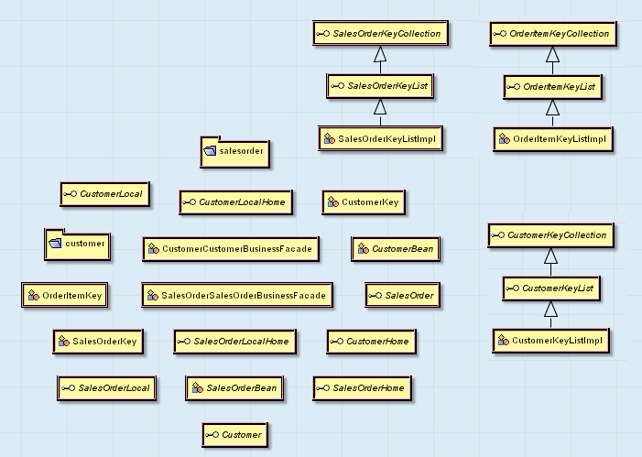
Example
Each PSM transformed into Code
Example of the EJB Components in Code Model:

Slide 21
Development Processes

Slide 22
Development Processes
Agile Software Development & Extreme Programming
MDA doesn’t require a specific development process
  You are free to use whatever methodology
Agile Software Development
  Minimize the amount/effort spent on “paper” model
  A model only worth when helps to achieve the final goal
  MDA to rescue!
Extreme Programming
  Writing code in small increments with test case
  Focus on code is too limited
  Using MDA → “doc” is no longer overheard
  “Extreme Modeling” ;-)

Slide 23
Development Processes
Rational Unified Process (RUP)
RUP is a more elaborate process than AS/XP.
UML model plays important role within RUP
  Too large & unwieldy
  Favoring bureaucratic development (large stacks of paper instead of coding)
Transforms these model to PSM & Code
  Modeling in RUP is no longer bureaucratic overhead
  Better control over the code

Slide 24
The MDA Promise

Slide 25
The MDA Promise
The MDA Paradigm Shift
MDA development lifecycle is similar to traditional’s
A Historic Perspective:
Shift of Focus
  Higher level language → machine code
  MDA → Higher level languages (PSMs)
  No more coding?
Year | Programming was done by…
Before 1950 | Raw machine code
1950 – 1965 | Assembly languages
1965 – 1985 | Procedural(Structural) languages
1985 – Today | Object-oriented languages
Today – … | AOP? Component Programming?
Notes:
People afraid the introduction of Procedural Language will badly affect the program’s performance. At early phase the compiler doesn’t do a good transformation from high-level language into assembly language. However, as technology evolved, we know that the compiler can do as good as we did before and the systems nowadays are too complex to do it manually.
The same paradigm can be applied to MDA. When the transformation definition & the tool evolved, we no longer need to afraid the quality of code generated.

Slide 26
The MDA Promise
Too Good to Be True?
Skeptical response from developers
  No way to generate a complete working program from a model
  Adjustment required
MDA is still in it’s infancy
  Still need to customize PSMs
  Already enhanced the productivity, portability, interoperability & maintenance effort
  Shows the potential of changing the way you write software, radically!
  Just like we shifted from writing assembly code!
Notes:
MDA addresses the challenges of today's highly networked, constantly changing systems environment, providing an architecture that assures:
Portability, increasing application re-use and reducing the cost and complexity of application development and management, now and into the future.
Cross-platform Interoperability, using rigorous methods to guarantee that standards based on multiple implementation technologies all implement identical business functions.
Platform Independence, greatly reducing the time, cost and complexity associated with re-targeting applications for different platforms-including those yet to be introduced.
Domain Specificity, through Domain-specific models that enable rapid implementation of new, industry-specific applications over diverse platforms.
Productivity, by allowing developers, designers and system administrators to use languages and concepts they are comfortable with, while allowing seamless communication and integration across the teams.
The benefits of MDA are significant-to business leaders and developers alike:
Reduced cost throughout the application life-cycle
Reduced development time for new applications
Improved application quality
Increased return on technology investments
Rapid inclusion of emerging technology benefits into their existing systems
MDA provides a solid framework that frees system infrastructures to evolve in response to a never-ending parade of platforms, while preserving and leveraging existing technology investments. It enables system integration strategies that are better, faster and cheaper.
Crucial return on investment: applications and domain models can be reused and adopted to ongoing business and technology changes. It allows a software environment to evolve and change while the business model (PIM) remains stable. This stable base is necessary to cope with the constantly changing environment of today’s market.

Slide 27
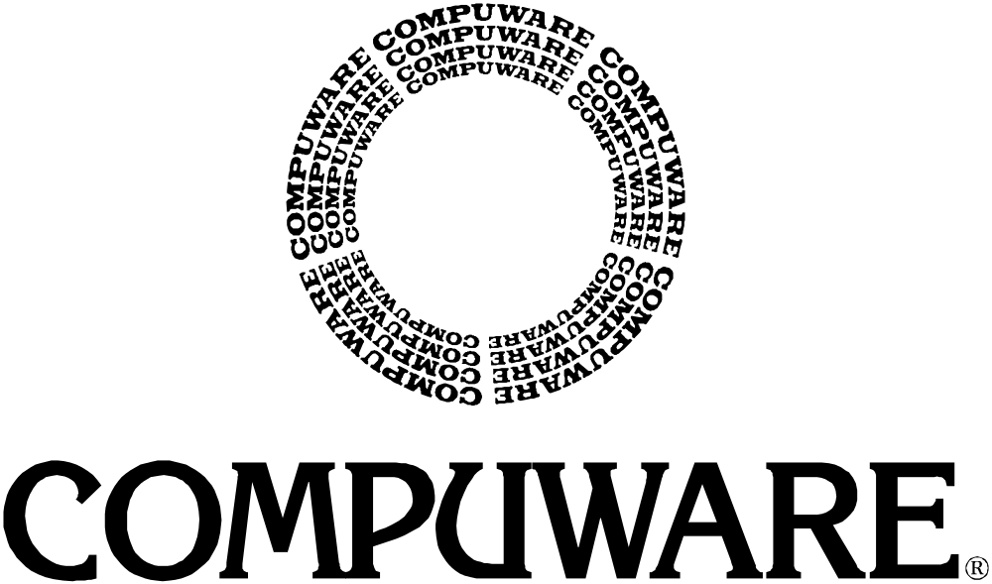
People and software for business applications
sm

