Slide 1
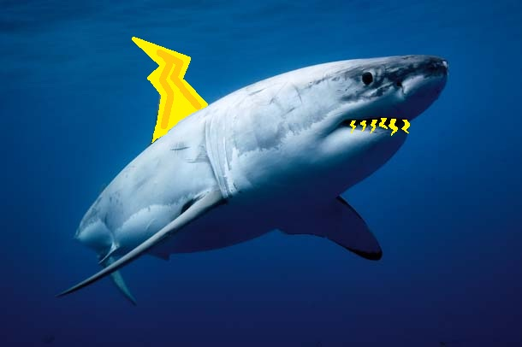
Thunder Sharks
Project 3
Ryan McNulty
Adam Park
Greg Seaman

Slide 2
Strategy Overview
Decide on which cells to move to using depth-first search with iterative deepening
Move to each cell using North Star and wheel encoders
Once within center threshold, use camera to center
Camera centering takes into account current location in maze

Slide 3
MazeStrategy
Search map for highest value paths starting at length 2
If no paths of value, increase path length up to 35 (depth-first iterative deepening)
Value determined by points on path
  Bonus given for straight paths
  Penalty given for going in the top row where North Star data is bad and bottom row where lighting is poor
Call moveToCell() on next path location
If path blocked, calculate a new path

Slide 4
moveToCell()
Used to navigate to next cell based on path produced by MazeStrategy
Takes the index of the next cell to move to
Turns to cell location
Set goal (x,y) to current Kalman plus cell distance in new direction
Call moveTo() as in project 1 to get within 10cm of cell center
Once within threshold call centerInCell() to center bot

Slide 5
centerInCell()
Gets list of squares like in project 2
If the robot sees no pairs, turn to look for squares
  Array holds direction for each cell where the bot can see a pair of squares
  Turn to direction plus a small random theta in [-15°, 15°]
If the robot sees pairs, use visual error to center
  Strafe based on the center of the largest pair of squares
  Move forward or back based on height largest pair
Center until error threshold reached or too many iterations

Slide 6
Improvements
Added state machine to centering algorithm for robot to correct in all four directions
Reset Kalman with each cell to avoid error accumulation
Changed Kalman uncertainty appropriately
Additionally used height of squares for centering

