Slide 1
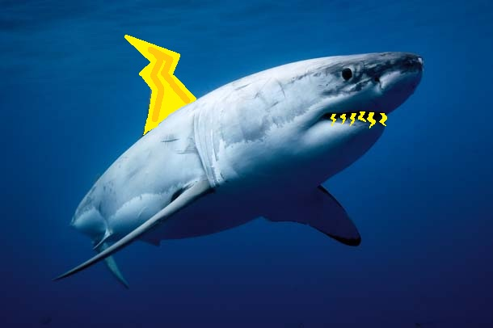
Thunder Sharks
Project 2
Ryan McNulty
Adam Park
Greg Seaman

Slide 2
Navigation Overview
CameraPose handles processing of squares
Movement structured through calls to moveTo()
TurnTo() handles turning
StrafeTo() centers robot in hallway

Slide 3
CameraPose
Camera images are filtered by cvInRangeS
  Two calls used for separate pink values, or-ed together
findSquares called on both filtered images
Squares on top of each other removed with removeOverlap()
matchSquares() creates pairs of squares
getCenterError() numerically represents error from the camera image

Slide 4
MatchSquares
Test each square with each subsequent square in the list
  If y values are close, x values are far, and centers in top 3/5 of screen
  Add both squares to squarePair structure
After all squares matched, sort list
  Largest squares most useful for calculating error
getCenterError() called on these pairs
  If no pairs, return 0, tell robot to use other sensors
  Else return midpoint of largest pair minus center of image

Slide 5
MoveTo
Updates and filters WE and NS as in project 1
Camera image data processed every three updates
  Strafe to center of hallway with strafeTo()
turnTo() called on goal theta, same as project 1
Error distance x and y calculated with respect to the robot
  If y-error large move forward according to PID
  If x-error large call strafeTo()
  Else at cell center

Slide 6
StrafeTo
Error calculated using getCenterError()
If error greater than threshold, strafe left or right according to error sign
Call turnTo() to ensure robot theta still correct
StrafeTo() called on every camera update and when the error in the robots x direction is large enough

