Slide 1
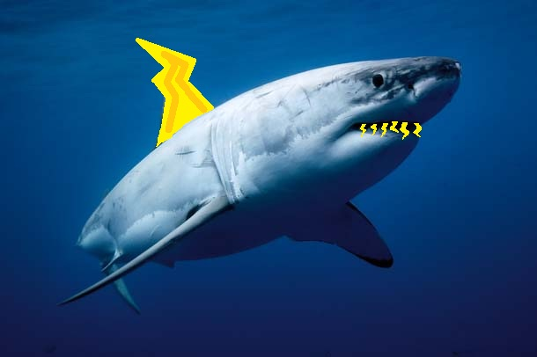
Project 1
Thunder Sharks
Ryan McNulty
Adam Park
Greg Seaman

Slide 2
Code Structure Outline
RobotPose Class
- Update Position: Making use of Kalman Filter and change uncertainty depending on the North Star signal strength
- Wheel Encoders: Using FIR Filter to remove noise and basic trigonometry to create a pose according to the WE in global system
- North Star: Using measured constants to rotate, transform, and scale a NS reading and create a pose according to the NS in global system
- Room Change: When we detect a room change we use a different set of constants for updating our NS pose
PIDController Class: Used control the speed at which the robot will travel

Slide 3
Update Position
//Get current coordinates
robot->update(); updateNS(); updateWE(turning);
//If there is a weaker NS signal change the uncertainty
if(robot->NavStrengthRaw()<30000){
rovioKalmanFilterSetUncertainty(&kf,uncertainty_weak_ns);
}else{
rovioKalmanFilterSetUncertainty(&kf,uncertainty_default);
}
rovioKalmanFilter(&kf,NSdata, WEdata, track);
pose_kalman.x = track[0];
pose_kalman.y = track[1];
pose_kalman.theta = track[2];

Slide 4
North Star
//Init
x = robot->X(); y = robot->Y(); theta = robot->Theta();
//Rotate
x_2 = x * cos(-pose_start.theta) - y * sin(-pose_start.theta);
y_2 = x * sin(-pose_start.theta) + y * cos(-pose_start.theta);
//Translate
x = x_2 - pose_start.x; y = y_2 - pose_start.y;
//Scale
x = x * ns_x_to_cm[room_cur];
y = y * ns_y_to_cm[room_cur];
//Transform theta
theta = (theta - pose_start.theta);
//Apply FIR filter
pose_ns.x = firFilter(fir_x_ns,x);
pose_ns.y = firFilter(fir_y_ns,y);

Slide 5
Room Change
//Change room coordinates
if(new_room != room_cur){
pose_start.theta = ns_theta[new_room];
//Set the new pose_start to current reading
pose_start.x = pose_kalman.x / ns_x_to_cm[room_cur];
pose_start.y = pose_kalman.y / ns_y_to_cm[room_cur];
//Rotate
x_2 = x * cos(-pose_start.theta) - y * sin(-pose_start.theta);
y_2 = x * sin(-pose_start.theta) + y * cos(-pose_start.theta);
//Translate
pose_start.x = x_2 - pose_start.x;
pose_start.y = y_2 - pose_start.y;
room_cur = new_room;

Slide 6
Wheel Encoders
//Filter
if(!turning){
left = firFilter(fir_left_we, left);
right = firFilter(fir_right_we, right);
}
rear = firFilter(fir_rear_we, rear);
//Transform
float dy = ((left * sin(150.0 * M_PI/180.0)) +
(right * sin(30.0 * M_PI/180.0)) + (rear * sin(90.0 * M_PI/180.0)))/3.0;
float dx = ((left * cos(150.0 * M_PI/180.0)) +
(right * cos(30.0 * M_PI/180.0)))/2.0;
float dtheta = (rear*we_to_rad);
//Rotate
if(!turning){
dx_2 = dx * cos(pose_we.theta - M_PI_2) - dy * sin(pose_we.theta - M_PI_2);
dy_2 = dx * sin(pose_we.theta - M_PI_2) + dy * cos(pose_we.theta - M_PI_2);
//Scale
pose_we.x += dx_2*we_to_cm;
pose_we.y += dy_2*we_to_cm;
}

Slide 7
PID Controller
//Get PID
float PID_xres = PID_x->UpdatePID(error_distance_x, pose_kalman.x);
//Calculate speed based on PID
float total_PID = abs(sqrt(PID_xres * PID_xres + PID_yres * PID_yres));
//Set robot's current speed and set new kalman velocity
if(total_PID > 50.0){
robot_speed = 1;
velocity[0] = vel_1 * cos(pose_kalman.theta);
velocity[1] = vel_1 * sin(pose_kalman.theta);
velocity[2] = 0.0;
rovioKalmanFilterSetVelocity(&kf,velocity);
}
//Move unless within range of base
if (! robot->IR_Detected() && error_distance > 10.0) {
robot->Move(RI_MOVE_FORWARD, robot_speed);
moveTo(x, y);
}

