Slide 1

Concurrent Union-Find in OCaml 5
Research Mini-Project Implementation using CAS Atomics
Yaswanth Srinivas | Prince | Mukhesh RM
April 30, 2026

Slide 2

Project Objectives
Parallel Connectivity: Implement lock-free Disjoint Set Union (DSU) leveraging OCaml 5 Multicore features.
Performance Comparison: Evaluate CAS-based (Compare-and-Set) vs. Lock-based (Mutex) synchronization.
Workload Analysis: Investigate speedup across different graph densities and interleaved operation mixes.
Correctness Validation: Use randomized stress tests and linearizability checks to ensure data integrity.

Slide 3
The Concurrency Challenge in DSU
Sequential Baseline: Fast, relies on mutating parent pointers (path compression) and union-by-rank.
The Race Condition: In a concurrent setting, if multiple domains mutate parent arrays simultaneously during find or union, components can become disconnected or form cycles.
Our Approach: Implement and evaluate 4 variants: Sequential, Global Mutex, Node-Lock, and Lock-Free CAS (Compare-and-Set).

Slide 4
DSU Implementation Variants
Variant | Synchronisation | Blocking | Path Compression
Sequential | None | N/A | Full Two-Pass
Mutex (Global) | 1 Global Lock | Yes | Path Splitting
Node-Lock | Lock-per-Node | Yes | Path Splitting
CAS (Atomic) | Atomic CAS | No | Path Splitting

Slide 5
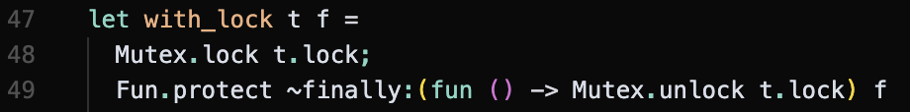
Variant 1: Global Mutex
Single Lock Mechanism
The simplest concurrent approach: wrap every operation in a global mutex. This serializes all work.
Ensures atomicity for the entire traversal.
with_lock uses Fun.protect to ensure the mutex
is unlocked even on failure
High contention: No parallelism.

Slide 6
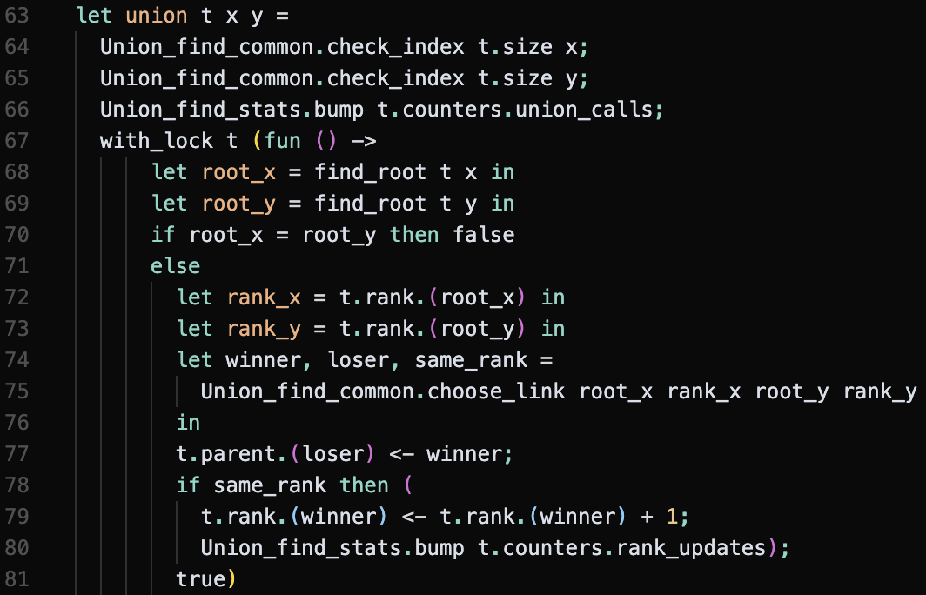
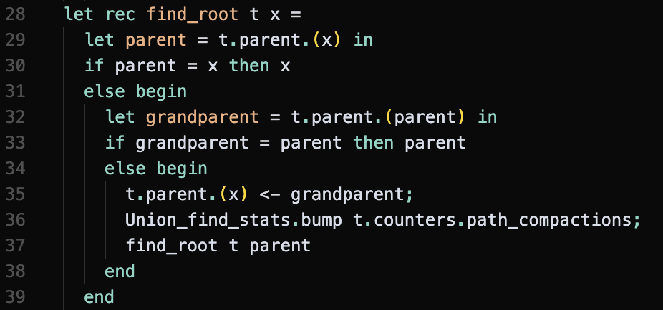
Variant 1: Global Mutex (Find & Union)

Slide 7
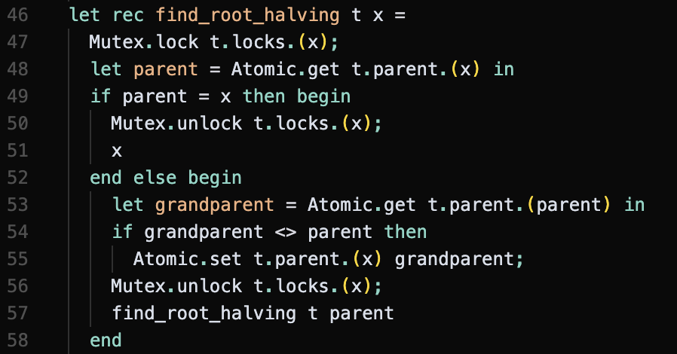
Variant 2: Node-Lock (Find)
Fine-Grained Strategy
Instead of one lock, we have an array of locks, one for each node.
Permits parallelism for disjoint components.
High overhead: Multiple lock acquisitions per operation.

Slide 8
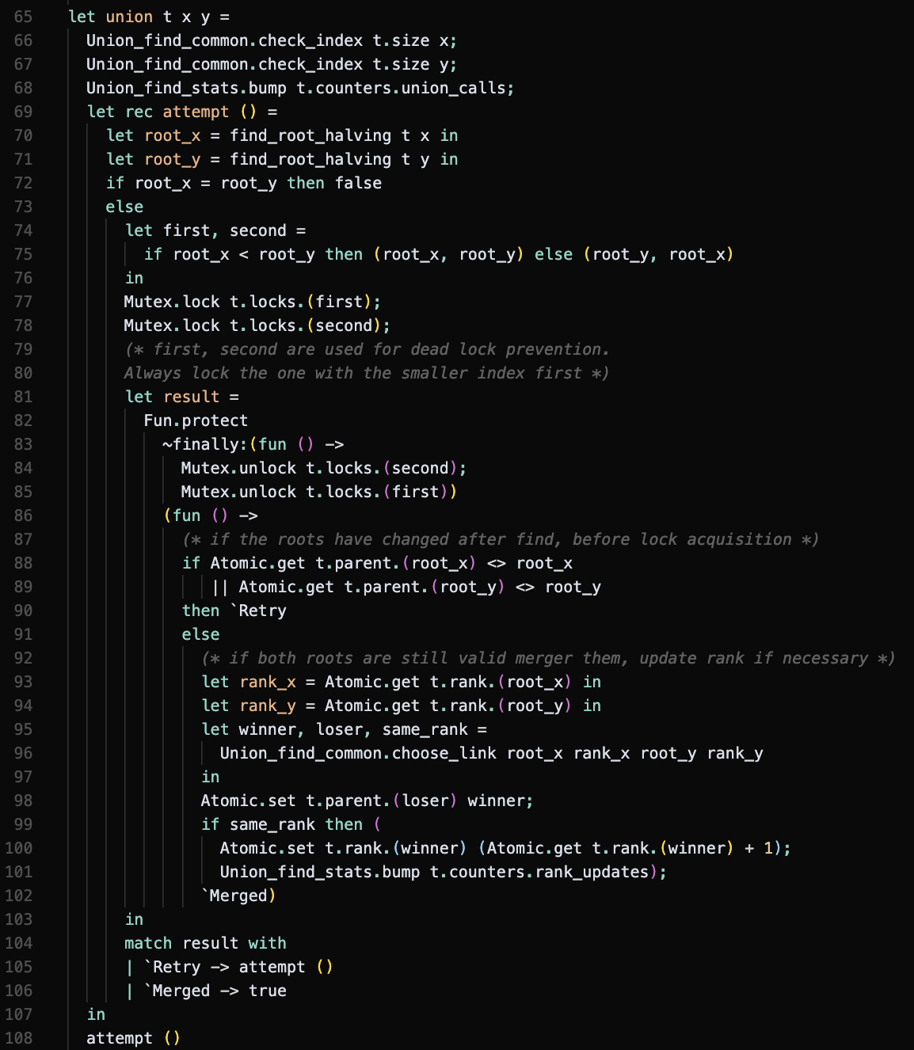
Variant 2: Node-Lock (Union)
Lock ordering
Problem: Cyclic dependencies between roots can cause deadlocks.
Solution: To prevent it, we sort the roots and lock the smaller index first.

Slide 9
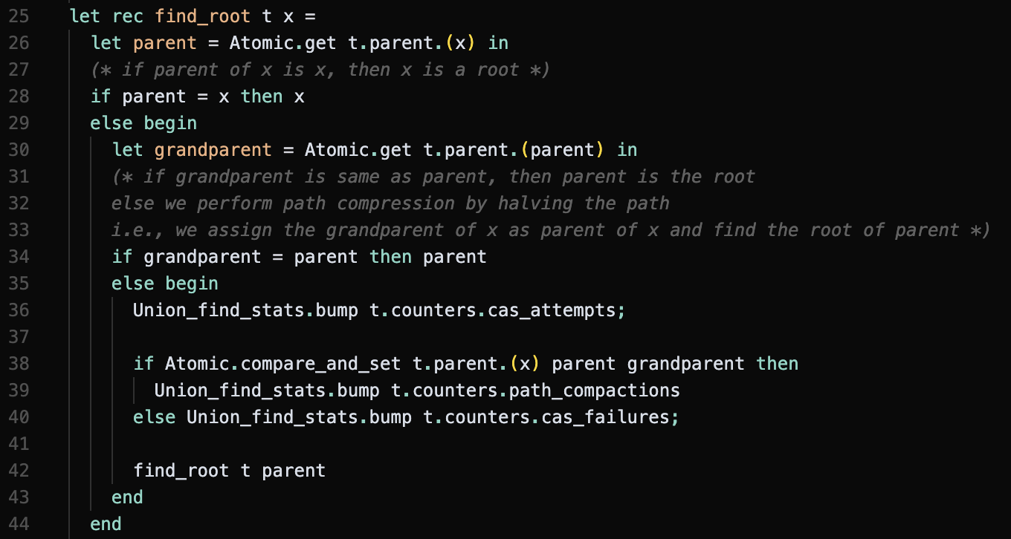
Variant 3: CAS (Find)
Lock-free implementation
Uses Atomic.compare_and_set to perform single-pass path compression without blocking.
Failed CAS means another thread updated the parent; we continue traversal regardless.

Slide 10
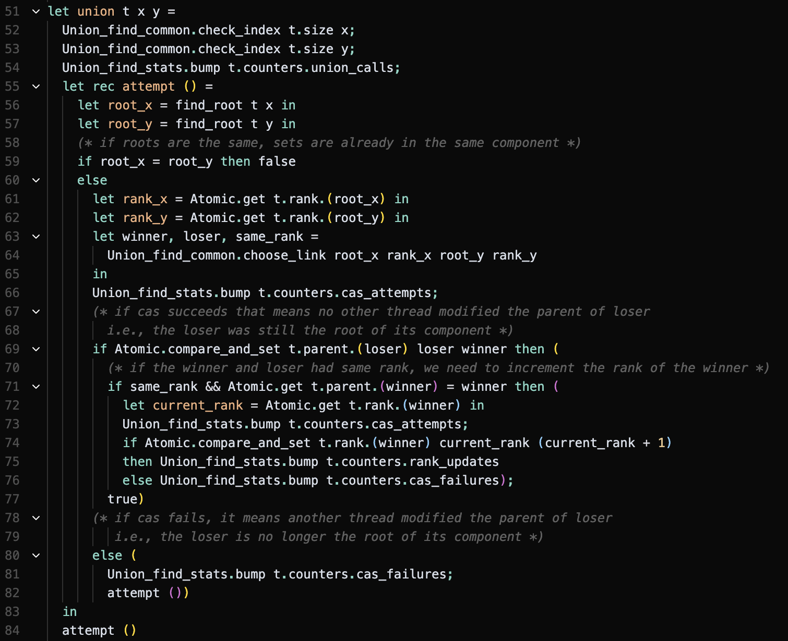
Variant 3: CAS (Union)
Optimistic Retry
No blocking; failed CAS triggers a recursive attempt ().
The successful linkage CAS is the linearization point.

Slide 11

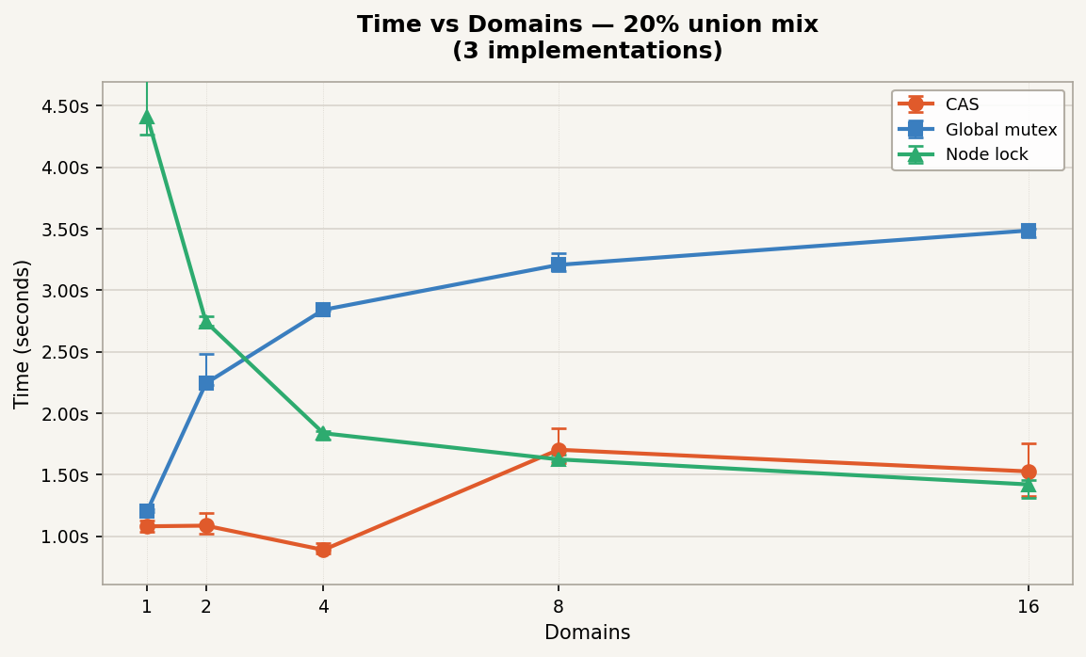
Results: 20% Union Mix Workload
Performance at low contention
Benchmarking over 200k nodes and 1M interleaved operations.
CAS achieves a 1.22x speedup over sequential execution.
Peaks precisely at 4 OCaml domains.
Coarse mutex performs progressively worse as domains increase.

Slide 12

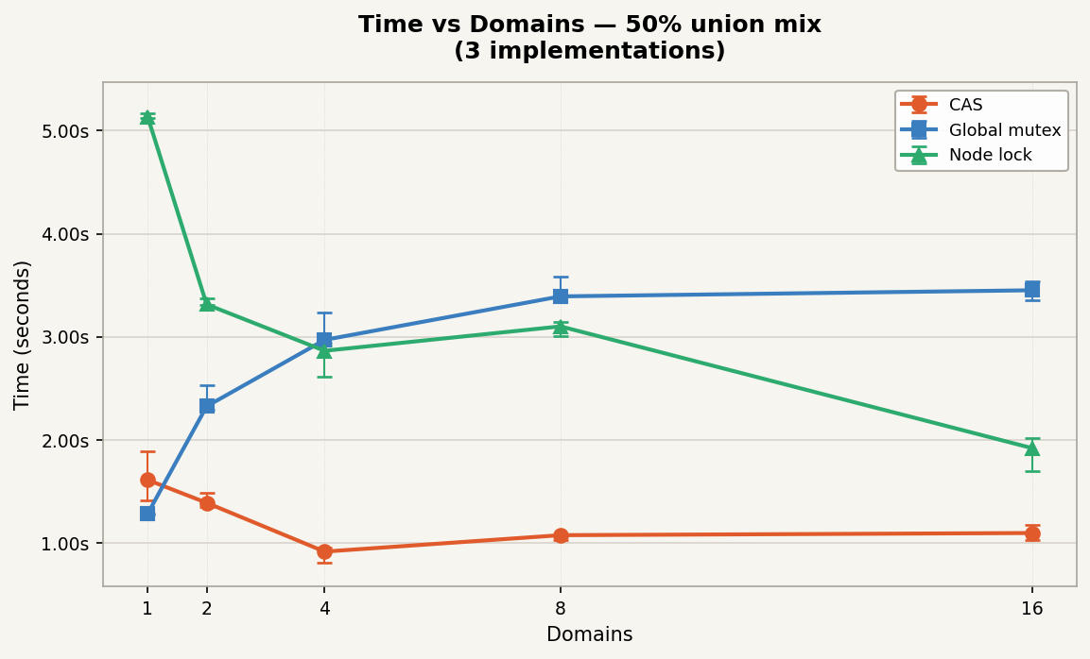
Results: 50% Union Mix Workload
Strong Scaling for Balanced Workloads
Higher proportion of unions emphasizes the benefits of lock-free parallelism.
CAS achieves a 1.76x speedup.
Node-lock shows scaling but suffers from high constant overhead.

Slide 13
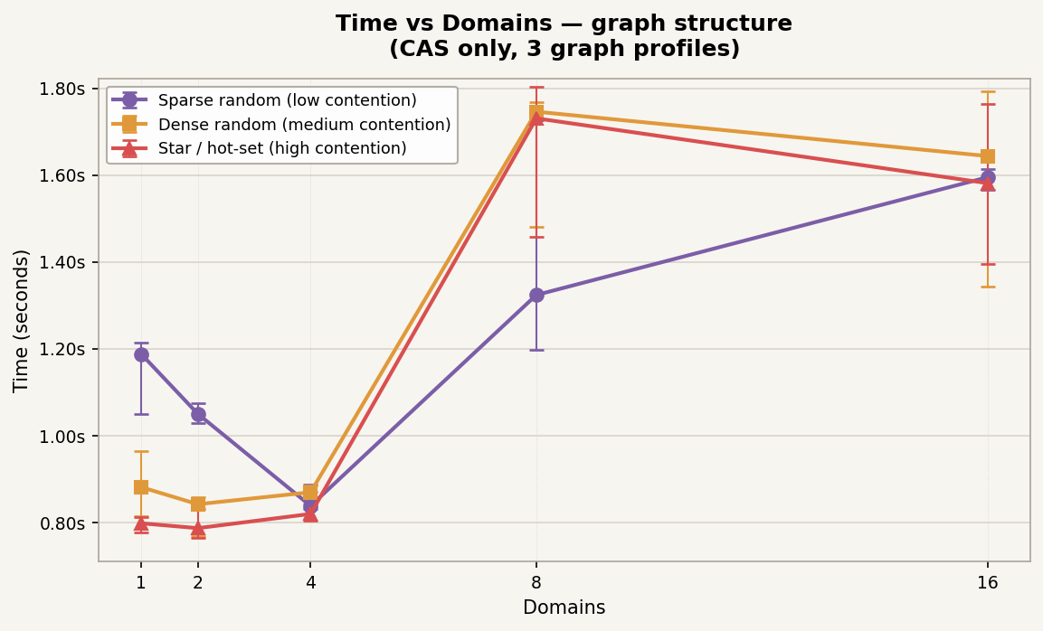
Analysis: Graph Structure Sensitivity
Time vs Domains (CAS Only)
We tested CAS against 3 distinct graph structure profiles to identify structural bottlenecks.
Different topologies create varying levels of contention on root nodes.
CAS failure rates remained below 0.1% across all profiles, indicating atomic memory traffic is the actual limiting factor.

Slide 14
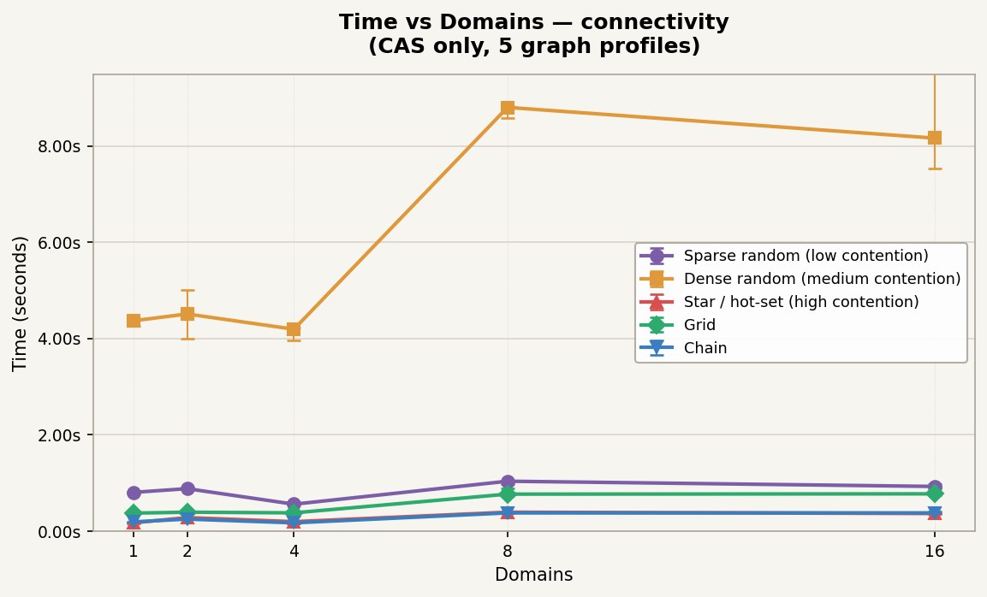
Analysis: Connectivity Profiles
Impact of Edge Density
Testing 5 different connectivity profiles mapping dense vs sparse connections.
Highly connected graphs require deeper path traversals.
Path halving ensures traversal times stay amortized even as graph density grows.

Slide 15

Conclusions
Lock-free CAS outperforms lock-based alternatives on OCaml 5 for DSU.
Performance bottleneck beyond 4 domains is atomic memory traffic and OS scheduling, not CAS retry storms.
The coarse global mutex completely eliminates scaling. The fine-grained per-node lock scales better relatively but suffers from heavy constant overhead, resulting in worse absolute times.
Questions?

