Slide 1
arb_open
Arbitros Kernel
WIFI
Device Driver
HAL
External
Device
(WIFI module)
drv_wifiOpen
External
Device
(wifi module)
Extern
arb_close
drv_wifiClose
UART
arb_read
drv_wifiRead
arb_write
drv_wifiWrite
GPIO
arb_ioctl
drv_wifiIoctl
User-Space Application

Slide 2
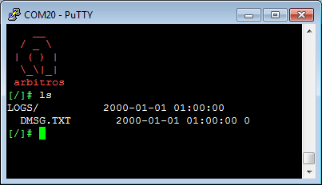
usr_console
Valid?
buffer
yes
Process User
CMD
drv_console
Tokenized Msg
Valid?
Process Kernel CMD
yes
arb_console

Slide 3
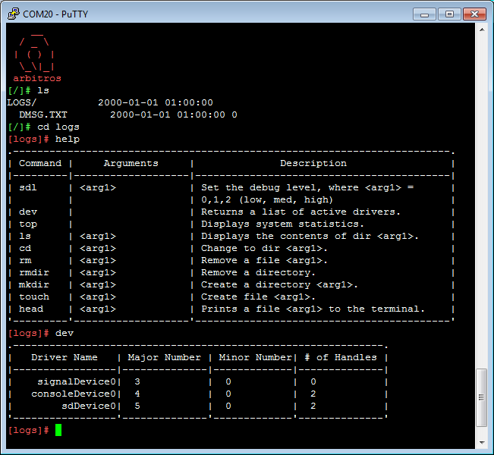

Slide 4
