Slide 1
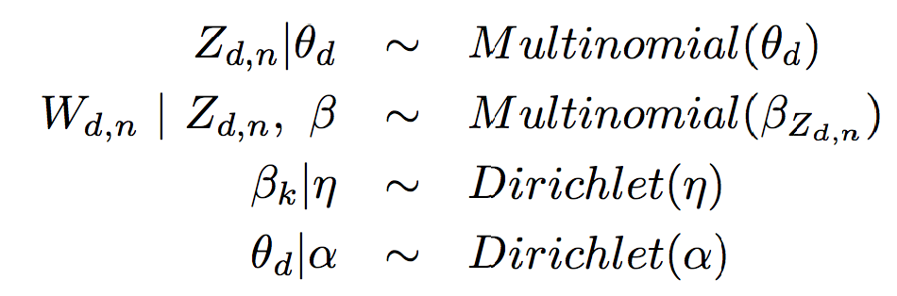




Latent Dirichlet Allocation (LDA)
A Bayesian Unsupervised Learning Model
Z_{d,n}
W_{d,n}
n=1,…,N_{d}
k=1…K

Slide 2
Agenda Items
LDA – introduction & some notations (graphical models)
LDA – theory and intuition
LDA – application
LDA – extensions
References

Slide 3
LDA – Introduction & some notations (graphical models)

Slide 4
What is Latent Dirichlet Allocation (LDA)?
Latent Dirichlet Allocation (LDA) is a topic model, which was first proposed by Blei et al. in 2003.
Topic models are “[probabilistic] latent variable models of documents that exploit the correlations among the words and latent semantic themes” (Blei and Lafferty, 2007)
The name “topics” signifies the hidden, to be estimated, variable relations (=distributions) that link words in a vocabulary and their occurrence in documents.
Simple intuition: A document is seen as a mixture of topics.
So, what is LDA?
It’s a way of automatically discovering topics that documents contain.
LDA represents documents as mixtures of topics that spit out words with certain probabilities.

Slide 5
LDA – First example
Suppose you have the following set of sentences (or documents):
I like to drink coffee.
Colombian coffee beans are better than Ethiopian.
Machine learning algorithms and reporting are data scientist’s common tasks.
A member of DS team created a report for the daily consumption of coffee in Profusion.
For example, given these sentences and asked for 2 topics, LDA might produce something like:
Topic A: 50% coffee, 15% bean, 10% Colombian, 10% Ethiopian, … (at which point, you could interpret topic A to be about coffee lovers)
Topic B: 20% machine, 20% learning, 20% reporting, 15% data, … (at which point, you could interpret topic B to be about data science )
Sentences 1 and 2: 100% Topic A
Sentences 3: 100% Topic B
Sentence 4: 60% Topic A, 40% Topic B

Slide 6
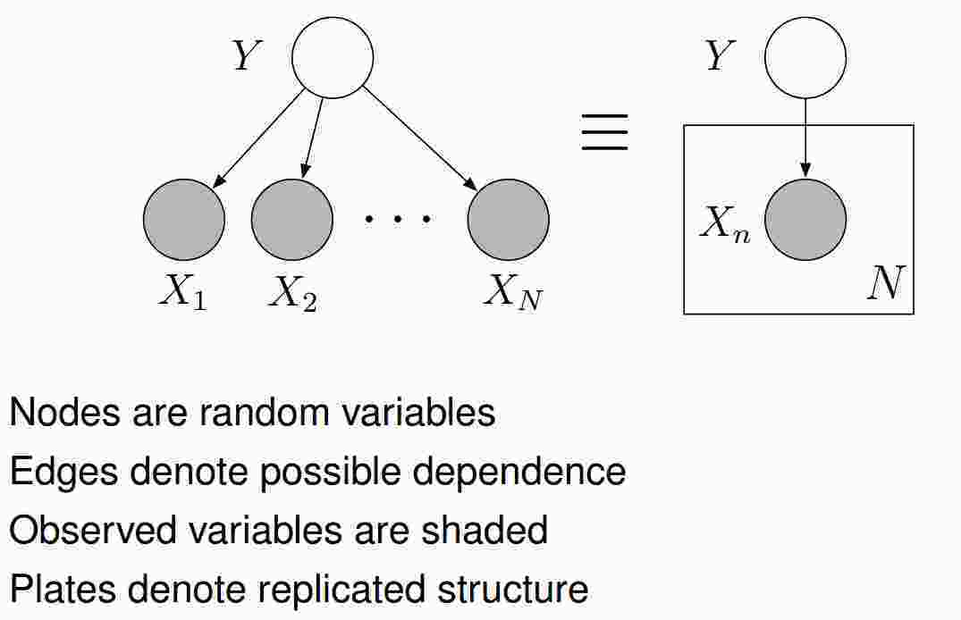
Graphical Model
Introduction

Slide 7
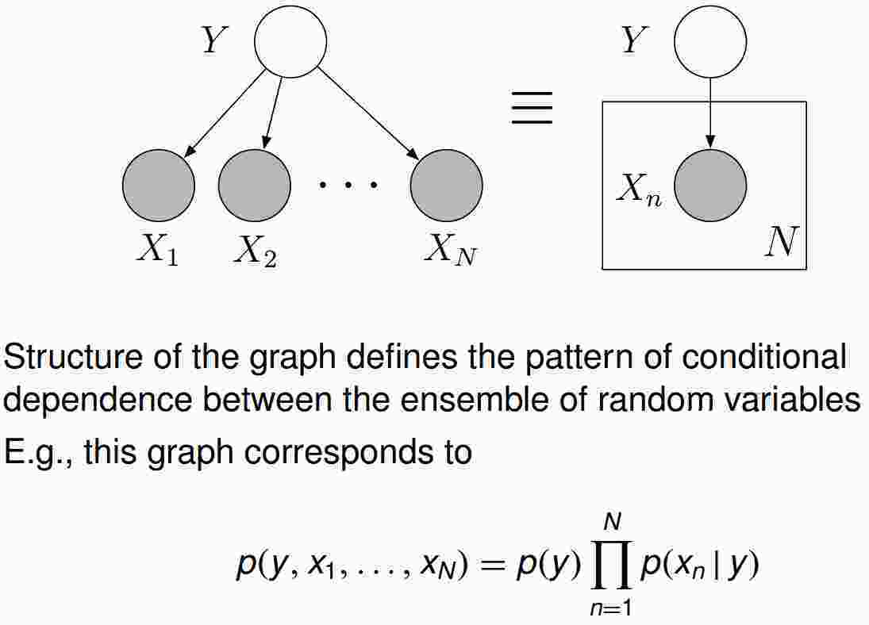
Graphical models

Slide 8
LDA – theory and intuition

Slide 9
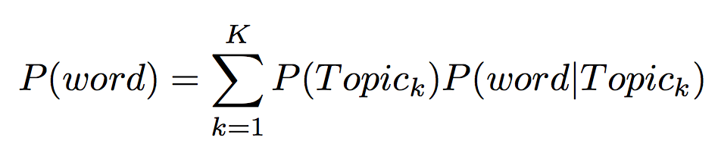
LDA – From scratch
How are words in a document generated?
One possibility:
Each word comes from different topics (bag of words: ignore order)
Mixture Weight
for Topic k
Multinomial Distribution
over ALL words based
on topic k

Slide 10
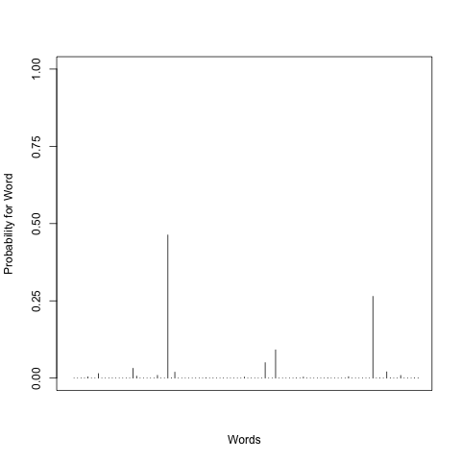
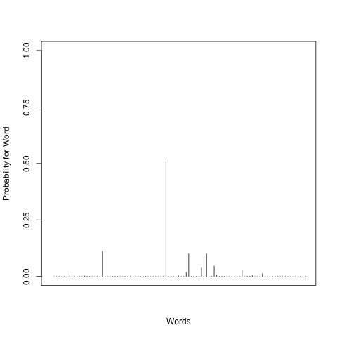
LDA - Just a mixture model
2) Pick a word
Big Data
1) Pick a topic
Machine Learning
Topic 1
Word
Leadership
Topic K

Slide 11




LDA - Just a mixture model
So we really want to know
Z (cluster for the word for each topic)
(document composition)
(key words)
Big Data
Machine Learning
Topic 1
Word
Leadership
Topic K

Slide 12
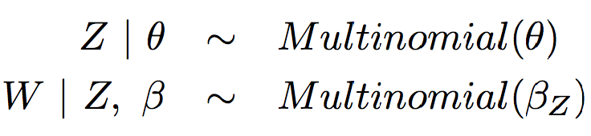
Graphical representation
1 word from 1 document generative process
Z
W

Slide 13
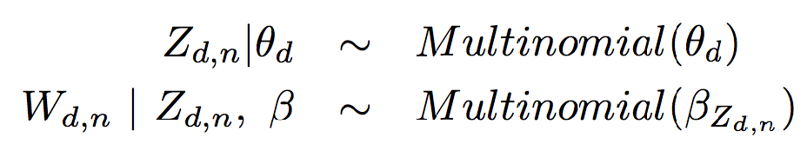
More general
K: number of topics
N_{d}: number of words
D: number of documents
Z_{d,n}
W_{d,n}
n=1,…,N_{d}
k=1…K
d=1,…,D

Slide 14
Thinking Bayesian
Bayesian: But what about the distribution for and ??
K: number of topics
N_{d}: number of words
D: number of documents
Z_{d,n}
W_{d,n}
n=1,…,N_{d}
k=1…K
d=1,…,D

Slide 15
LDA as hierarchical Bayesian model
and control the “sparsity” of the weights for the multinomial.
Implications: a priori we assume
Topics have few key words
Documents only have a small subset of topics

Slide 16
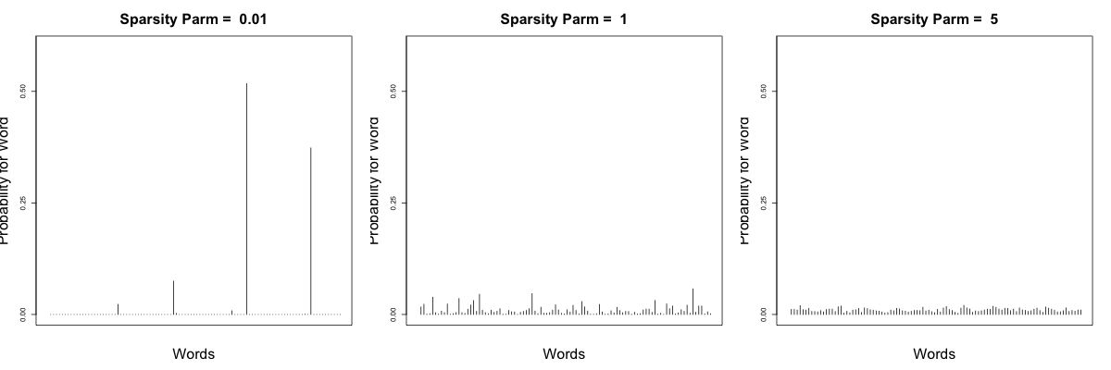
Dirichlet Distribution with Different Sparsity Parameters

Slide 17
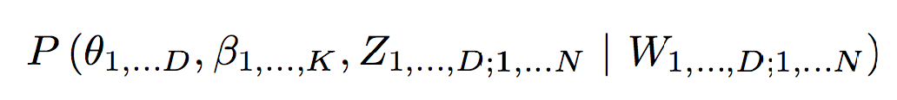
Calculate the posterior
How do we fit this model?
Want the posterior:
Worst part of Bayesian Analysis…..personally speaking

Slide 18
Computing the posterior
Mean field variational methods (Blei et al., 2001,2003)
Expectation propagation (Minka and Lafferty, 2002)
Collapsed Gibbs sampling (Griffiths and Steyvers, 2002)
Collapsed variational inference (The et al., 2006)

Slide 19
Application

Slide 20
LDA in the R Environment
1. Introductions and examples to topicmodels are available from:
the package reference documentation which can be viewed via the R help system, or as a single PDF file (topicmodels.pdf at http://cran.r-project.org/package=topicmodels), or
the authors’ paper in the Journal of Statistical Software (Grun and Hornik, 2011).
For data input the topicmodels package depends on the package tm (text mining)
2. The current functionality of tm is documented in detail in the package’s online help and in its reference manual (tm.pdf at http://cran.r-project.org/package=tm ). tm is handling text mining tasks. It enables the user to import data from various formats and offers standard tools for pre-processing and further transformation and filtering of texts and text collections. (removal of punctuation, numbers, whitespace and stop words, conversion to lower case, stemming and so on.)
3. lda package implements latent Dirichlet allocation (Lda) and related models. This includes (but is not limited to) sLda [(supervised Lda, see Blei and McAuliffe (2007))], [related topic models (Rtm, see Chang and Blei (2009))], and the mixed-membership stochastic blockmodel [(Mmsb, see Airoldi et al. (2008))].
R packages for LDA
1. tm
2. topicmodels
3. lda

Slide 21
Application - Profusion blogs
59 blogs (15 June 2014 – 31 March 2016)

Slide 22
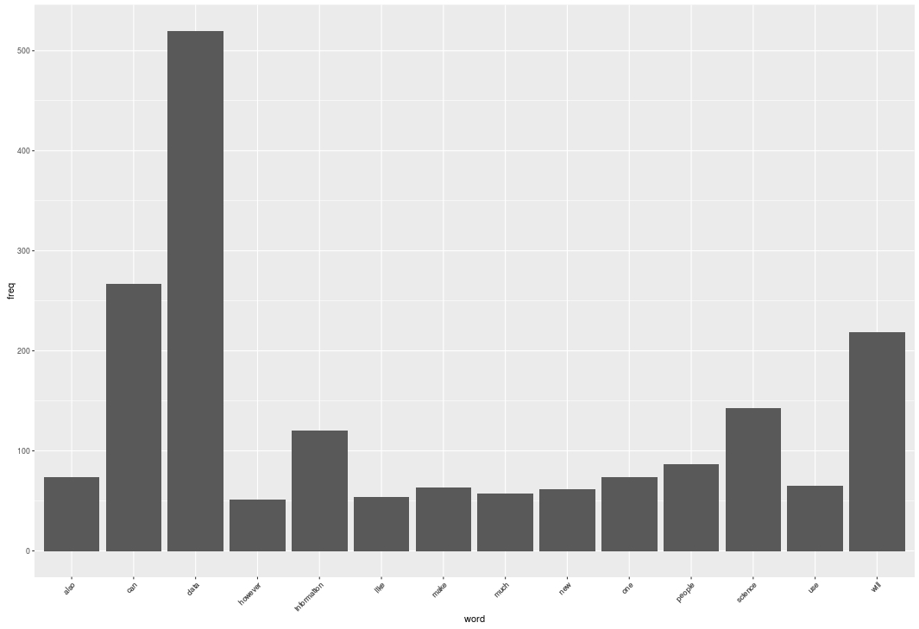
What words do they commonly use?

Slide 23
Relationships Between Terms
Data
science: 0.68
consequently: 0.64
team: 0.64
business:0.61
scientists:0.61
Science
data: 0.68
business:0.64
capability: 0.64
encouraging: 0.64
promises: 0.64
will
benefits: 0.61
technology: 0.61
people
perform: 0.72
highest: 0.71
technique: 0.69
rarely: 0.68
sale:0.66
engaged: 0.65
encourage: 0.64
purchasing: 0.62

Slide 24
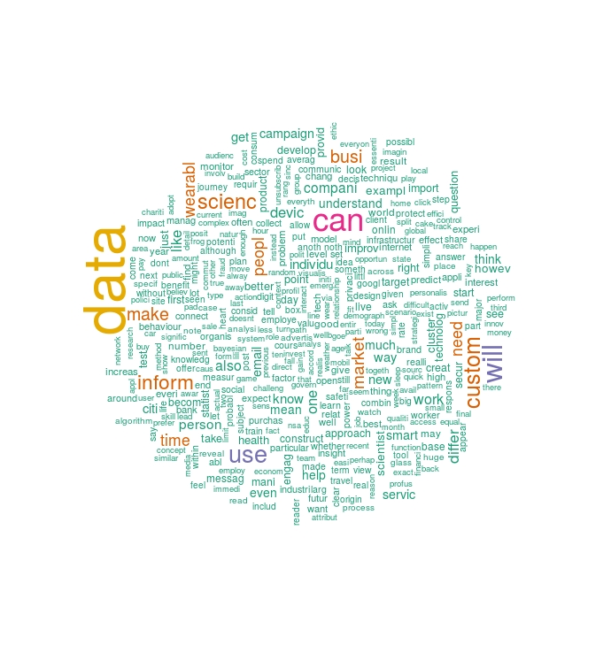
Word Cloud

Slide 25
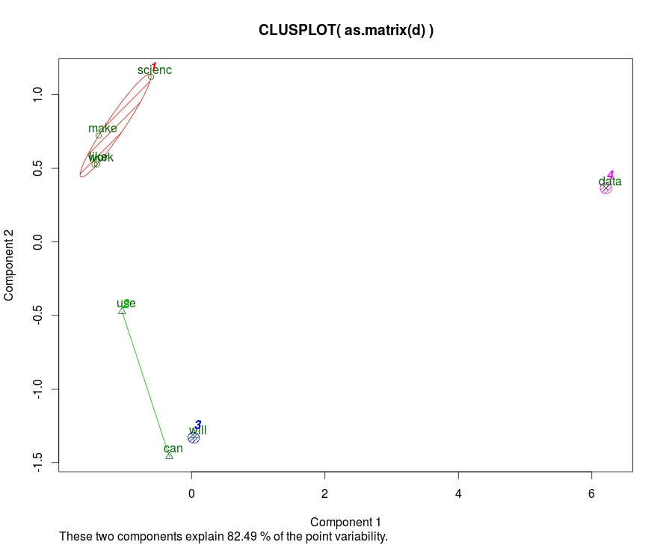
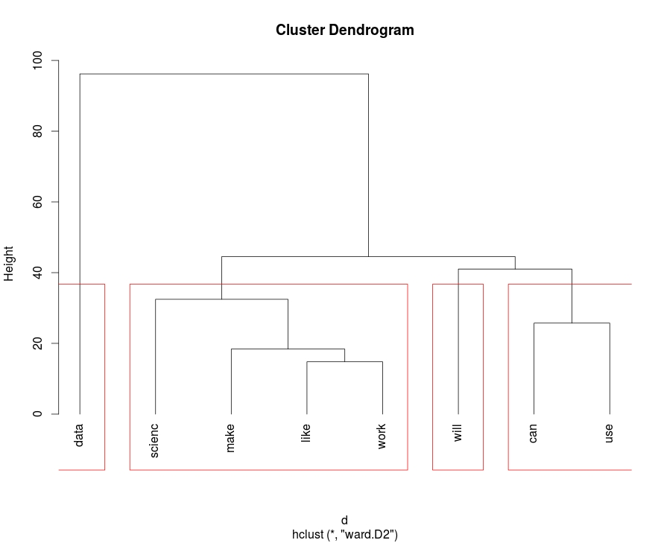
Clustering
K-means clustering
Hierarchal Clustering

Slide 26
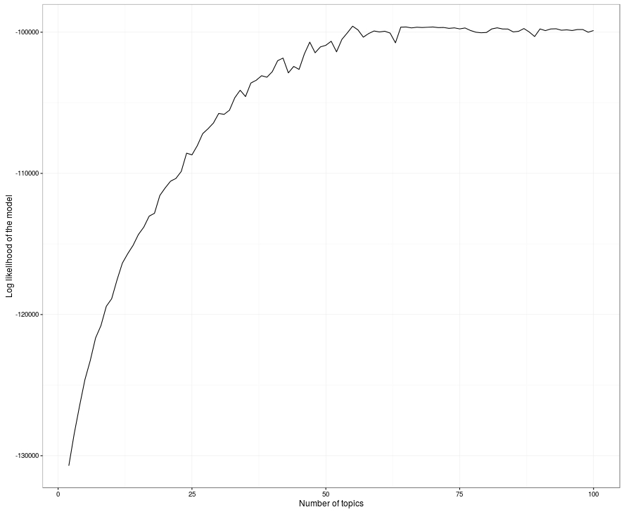
Topic modelling
Optimal number of topics
Rule of thumb:
The correct number is the number you want, just like with k-means.
Try out different values of k, select the one has largest likelihood.

Slide 27
LDA
Custom: 0.0193
Data: 0.0160
Can: 0.0137
Email: 0.0106
Use: 0.0096
DS & email
Data: 0.0263
Wearable: 0.0146
Can: 0.0128
Inform: 0.0122
Will: 0.0102
DS & wearables
Data: 0.0358
Can: 0.0182
Science: 0.0164
Business: 0.0147
Use: 0.0108
DS & business
Data: 0.0336
Will: 0.0177
Can: 0.0111
Smart: 0.0093
Construct: 0.0085
DS & smart cities

Slide 28
LDA extensions
There are numerous extensions to the standard LDA model:
hierarchical Dirichlet processes (Hdp, Teh et al., 2006b)
dynamic topic models (Dtm, Blei and Lafferty, 2006)
correlated topic models (Ctm, Blei and Lafferty, 2007)
etc.

Slide 29
References
D. M. Blei, A. Ng, and M. I. Jordan. Latent Dirichlet allocation. Journal of Machine Learning Research, 3:993–1022, 2003.
D. M. Blei. Topic models. Video lecture, 2009. URL http://videolectures.net/mlss09uk_blei_tm/.
D. M. Blei. Introduction to probabilistic topic models, 2011. URL http://www.cs.princeton.edu/~blei/papers/Blei2011.pdf.
D. M. Blei and J. D. Lafferty. A correlated topic model of Science. Annals of Applied Statistics, 1(1): 17–35, 2007.
H.-A. Chang and C.-H. Yu. Latent Dirichlet allocation. Seminar paper, 2007. URL http://cassava.fudan.edu.cn/seminars/ppt/lecture-lda.pdf.
Y. W. Teh, M. I. Jordan, M. J. Beal, and D. M. Blei. Hierarchical Dirichlet processes. Journal of the American Statistical Association, 101:1566–1581, 2006b
Y. Wang, P. Sabzmeydani, and G. Mori. Semi-latent Dirichlet allocation: A hierarchical model for human action recognition. Lecture Notes in Computer Science, 4814:240–254, 2007

Slide 30
Questions?
Thanks !!!!

