Slide 1
Market Position Analysis
Strategic Reach vs Value
Ryan Nesbitt

Slide 2
How Does Our Company Compare?
What defines a top-performer?
What are we missing?
Ryan Nesbitt

Slide 3
Mapping Dimensions Across 27 Companies
Engineered and Normalized features
Two Dimensions:
Quantity = Breadth = Reach
Quality = Depth = Value
Ryan Nesbitt

Slide 4
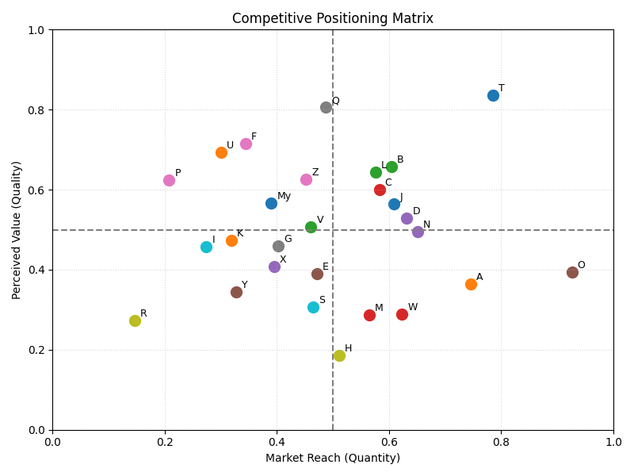
Market Position Analysis
Midfield positioning
Room to shift upward
Ryan Nesbitt

Slide 5
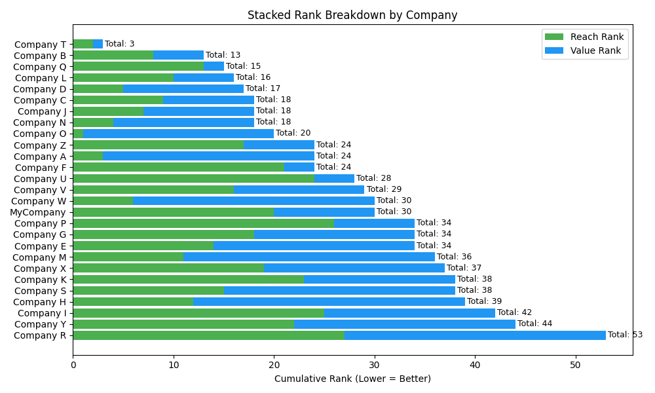
Market Position Analysis
Reach > Value
Clear path forward
Ryan Nesbitt

Slide 6
What Does This Tell Us?
Strong operational scale (high Reach)
Underperforming perception (low Value)
Ryan Nesbitt

Slide 7
Recommendation
Resource distribution:
30% Reach
70% Value
Focus areas:
Satisfaction (CX)
Loyalty (NPS)
Elevate Value to match Reach = Top 3
Ryan Nesbitt

