Slide 1
Song Mood Classification
Classifying songs into happy or sad using Spotify’s audio features
By Ryan Moerer

Slide 2
Motivation
Try my hand at song classification.
Gain insight into what characteristics of a song contribute to making it happy or sad.
Fit, tune, and compare several popular machine learning models.
Be able to make accurate predictions about whether a song is happy or sad.

Slide 3
Data Collection

Slide 4
Spotify API
Spotify's API provides a variety of audio features and information for each track in its collection:
Acousticness
Danceability
Instrumentalness
Energy
Speechiness
Valence (Musical positivity)
Liveness (Likelihood that a track is live)
Loudness
Key (Pitch Class notation. E.g. 0 = C, 1 = C♯/D♭, 2 = D, and so on)
Mode (1 = Major, 0 = Minor)
Tempo
Time Signature (ranges from 3 to 7 indicating time signatures of "3/4", to "7/4")
Explicit
Duration

Slide 5
Challenges
Finding a sample of songs accurately labelled happy and sad.
Creating a representative sample of happy and sad songs.
Combining various Spotify API calls into a single dataframe.

Slide 6
Data Collection Method
Get a subset of 50 playlists entitled “happy songs” and “sad songs” respectively.
Get all track id’s for all playlists.
Get track meta-information (name, artist, album, etc.).
Get audio features for each track.
Combine all information into single dataframe.
Create balanced dataset.

Slide 7
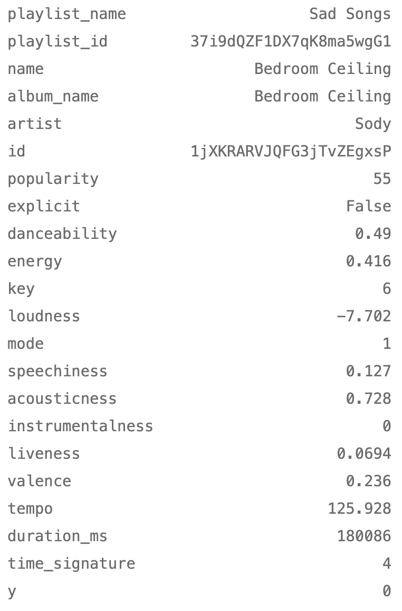
Dataset
4555 Happy songs
4555 Sad Songs
y = {1: happy, 0: sad}

Slide 8
Data Cleaning & Pre-Processing
Only include information relevant to the musical characteristics of the track.
Remove unnecessary/noisy features.
One-hot encoding categorical data?
Mode and explicit already encoded as binary features.
Key already ordinally ranked.
Split dataset into testing and training set (70% training, 30% testing, stratify=True).
Further preprocessing/variable transformation done on model by model basis.

Slide 9
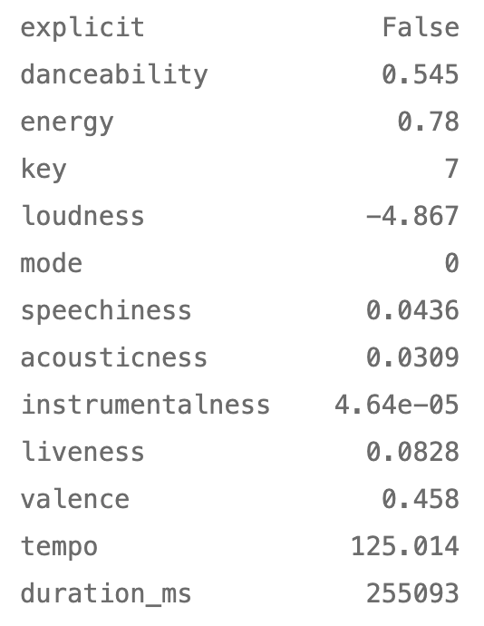

Slide 10
Data Exploration

Slide 11
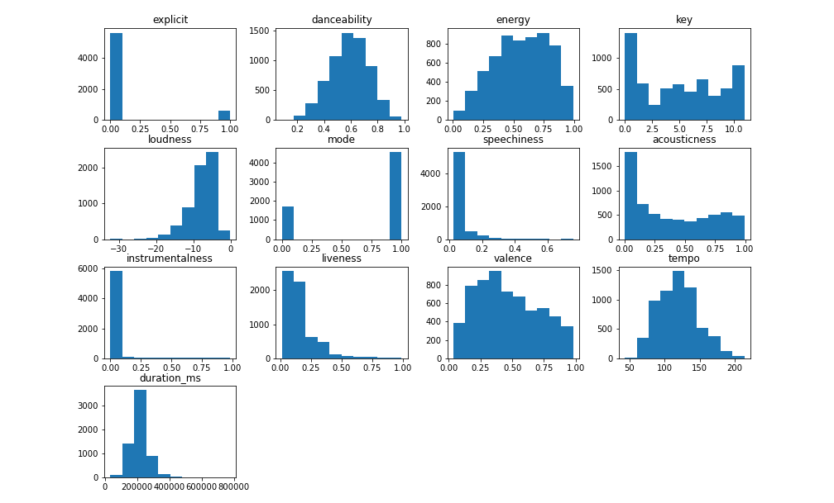

Slide 12
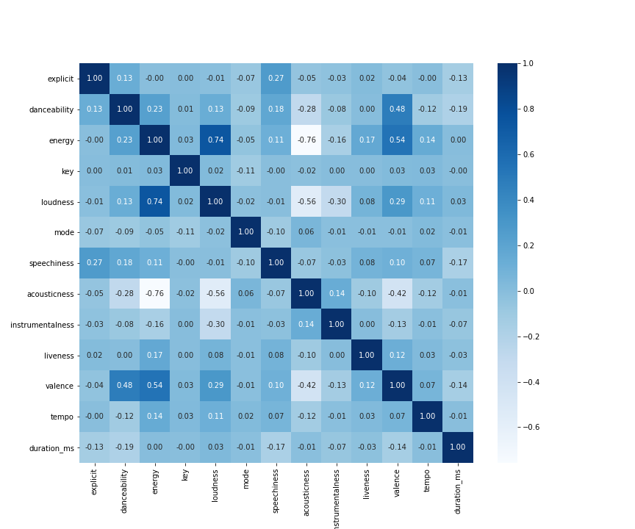
Correlation Matrix of Features

Slide 13
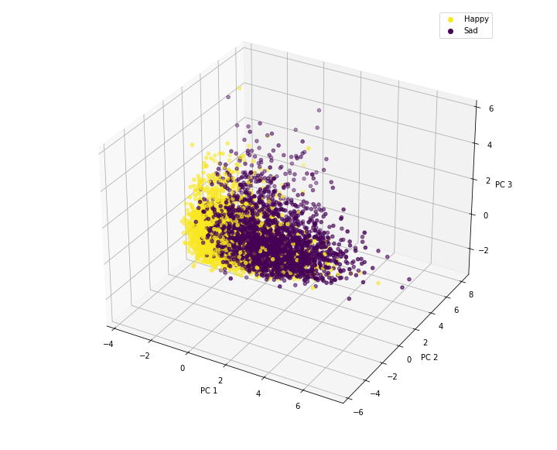
3D PCA Plot of Features

Slide 14
Modeling

Slide 15
Methodology
Model choices:
K Nearest Neighbors
Logistic Regression
Random Forest
An ensemble approach to modelling that fits a multitude of decision trees and outputs the class selected by the most trees.
Use cross-validation and grid search to tune hyperparameters.
Metric of interest: Accuracy

Slide 16
K Nearest Neighbors
# standardize the training features
scaler = StandardScaler()
X_train_scaled = scaler.fit_transform(X_train)
# create param grid
params = {'n_neighbors': list(range(1,51))}
# KNN classifier with weights computed as inverse of distance
knn = KNeighborsClassifier(weights='distance')
# grid search to tune k
grid_search_knn = GridSearchCV(knn, param_grid=params, scoring='accuracy', cv=10)
grid_search_knn.fit(X_train_scaled, y_train)
# best training accuracy and params
knn_gridsearch.best_params_, knn_gridsearch.best_score_
({'n_neighbors': 21}, 0.832453080627238)

Slide 17
Logistic Regression
# create param grid
params = {'C':10**np.linspace(-4,5,20)}
# Logistic Regression with l1 regularization
log_reg = LogisticRegression(penalty='l1', solver='liblinear', random_state=42)
# grid search to tune penalty parameter
log_gridsearch = GridSearchCV(log_reg, params, scoring='accuracy', cv=10)
log_gridsearch.fit(X_train_scaled, y_train)
# best params/best cross-validated accuracy
log_gridsearch.best_params_, log_gridsearch.best_score_
({'C': 0.023357214690901212}, 0.8350192410585671)

Slide 18
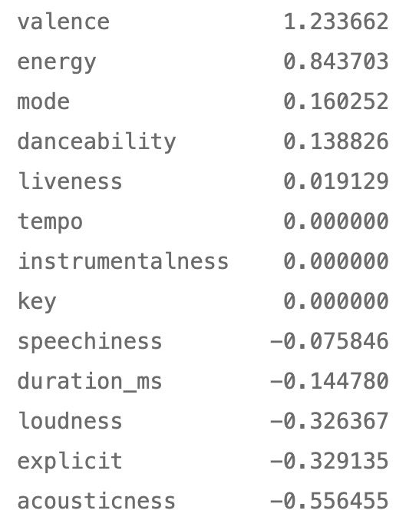
Logistic Regression Coefficients

Slide 19
Random Forest
# param grid
params = {'max_features': [1,2,3,4,5,6]}
# RF model with 1000 trees
rf_clf = RandomForestClassifier(n_estimators=1000,random_state=42)
# gridsearch to find best number of features to sample at each split
rf_gridsearch = GridSearchCV(rf_clf, param_grid=params, cv=5)
rf_gridsearch.fit(X_train, y_train)
# best params/cross-validate accuracy
rf_gridsearch.best_params_, rf_gridsearch.best_score_
({'max_features': 2}, 0.8435143061295829)

Slide 20
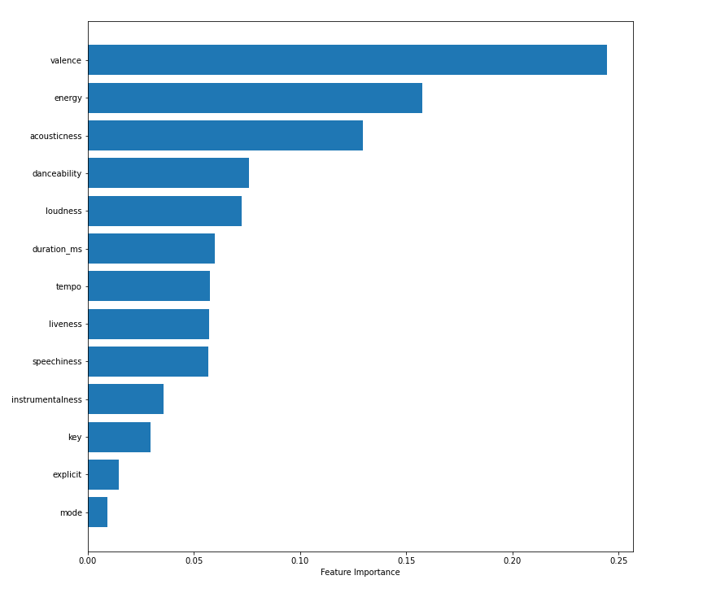
Feature Importance

Slide 21
Test Set Results
Model | Precision | Recall | F1 Score | Accuracy
Random Forest | 0.836 | 0.826 | 0.831 | 0.832
Logistic Regression | 0.834 | 0.803 | 0.817 | 0.821
KNN | 0.820 | 0.803 | 0.812 | 0.814

Slide 22
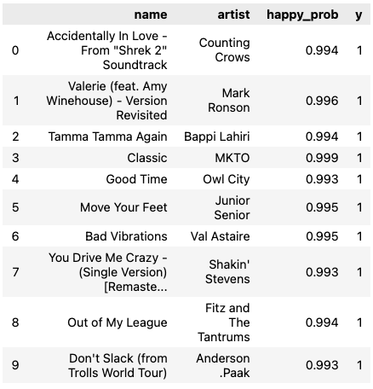
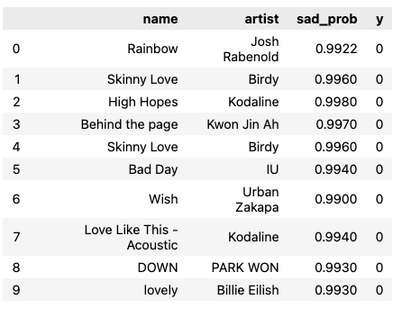
Happy
Sad

Slide 23
Areas For Improvement
Include other moods.
Larger, more representative sample of data.
Include other characteristics of songs (Song title, lyrics, artist, etc.).
Spend more time on tuning hyperparameters.
Try smarter/different models

