Slide 1
QA Chatbot on financial reports
Proudly prepared by
Reza Mohajerpoor

Slide 2
Executive Summary
70% completeness
95% Accuracy
Build an agentic AI Chatbot app that
User uploads a financial report
User asks any question (arithmetic) from the report
App executes math operations and accurately answer the questions

Slide 3
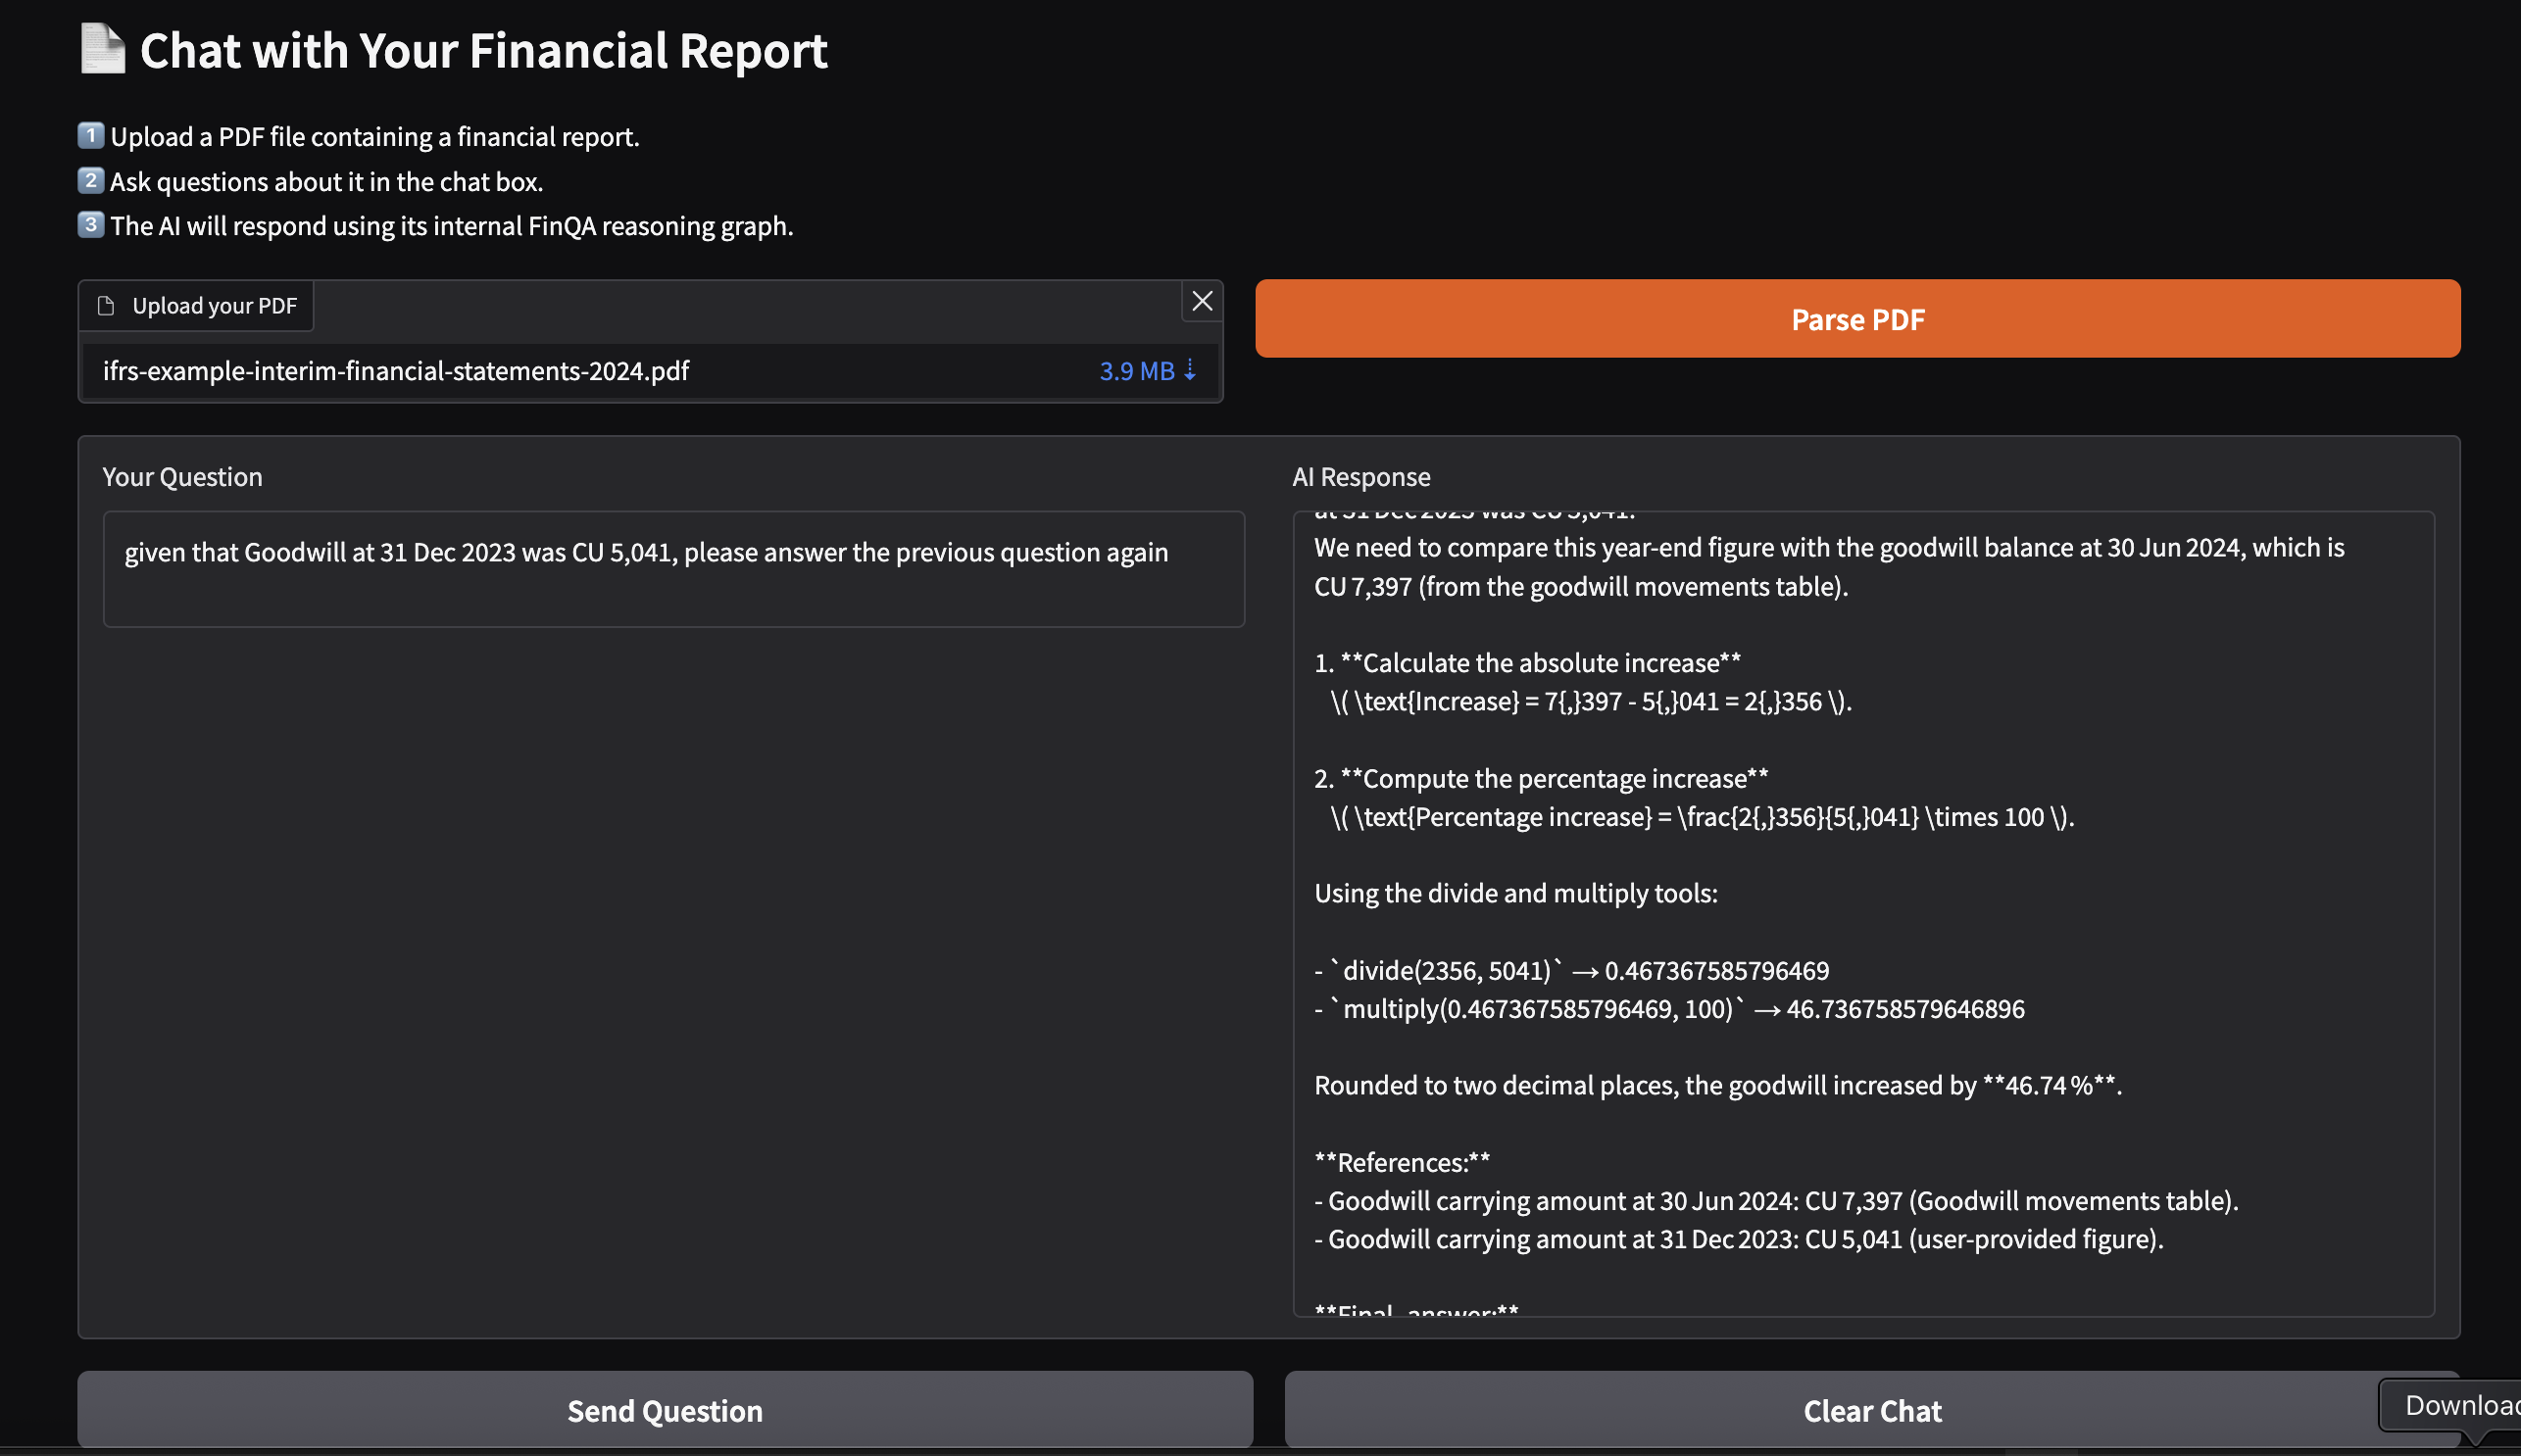
Demo
https://87f5844fa2f1758fa8.gradio.live/

Slide 4
Methodology
Parse the uploaded document (used docling)
Chunk and embed the document (recursive chunking)
Retrieve relevant chunks to the user’s questions
Retrieve relevant Type-2 QA examples (few shot learning) from the Convfinqa dataset
Use CoT reasoning and arithmetic tools in a ReAct agent to answer the user’s questions
Develop a ResponseAgent wrapper class for the developed graph agentic system
Deploy the ResponseAgent class to an app (I used Gradio)

Slide 5
ConvFinqa Data Processing
Created a title + summary for each document
Embedded the created title-summary column
Created columns from the dialogue field and a QA docstring column
Created columns from the metadata field
Similarity search on the user’s query is on the title-summary column and QA docstring of dialogues with type-2 questions are provided as few-shot example for the LLM to think and plan properly

Slide 6
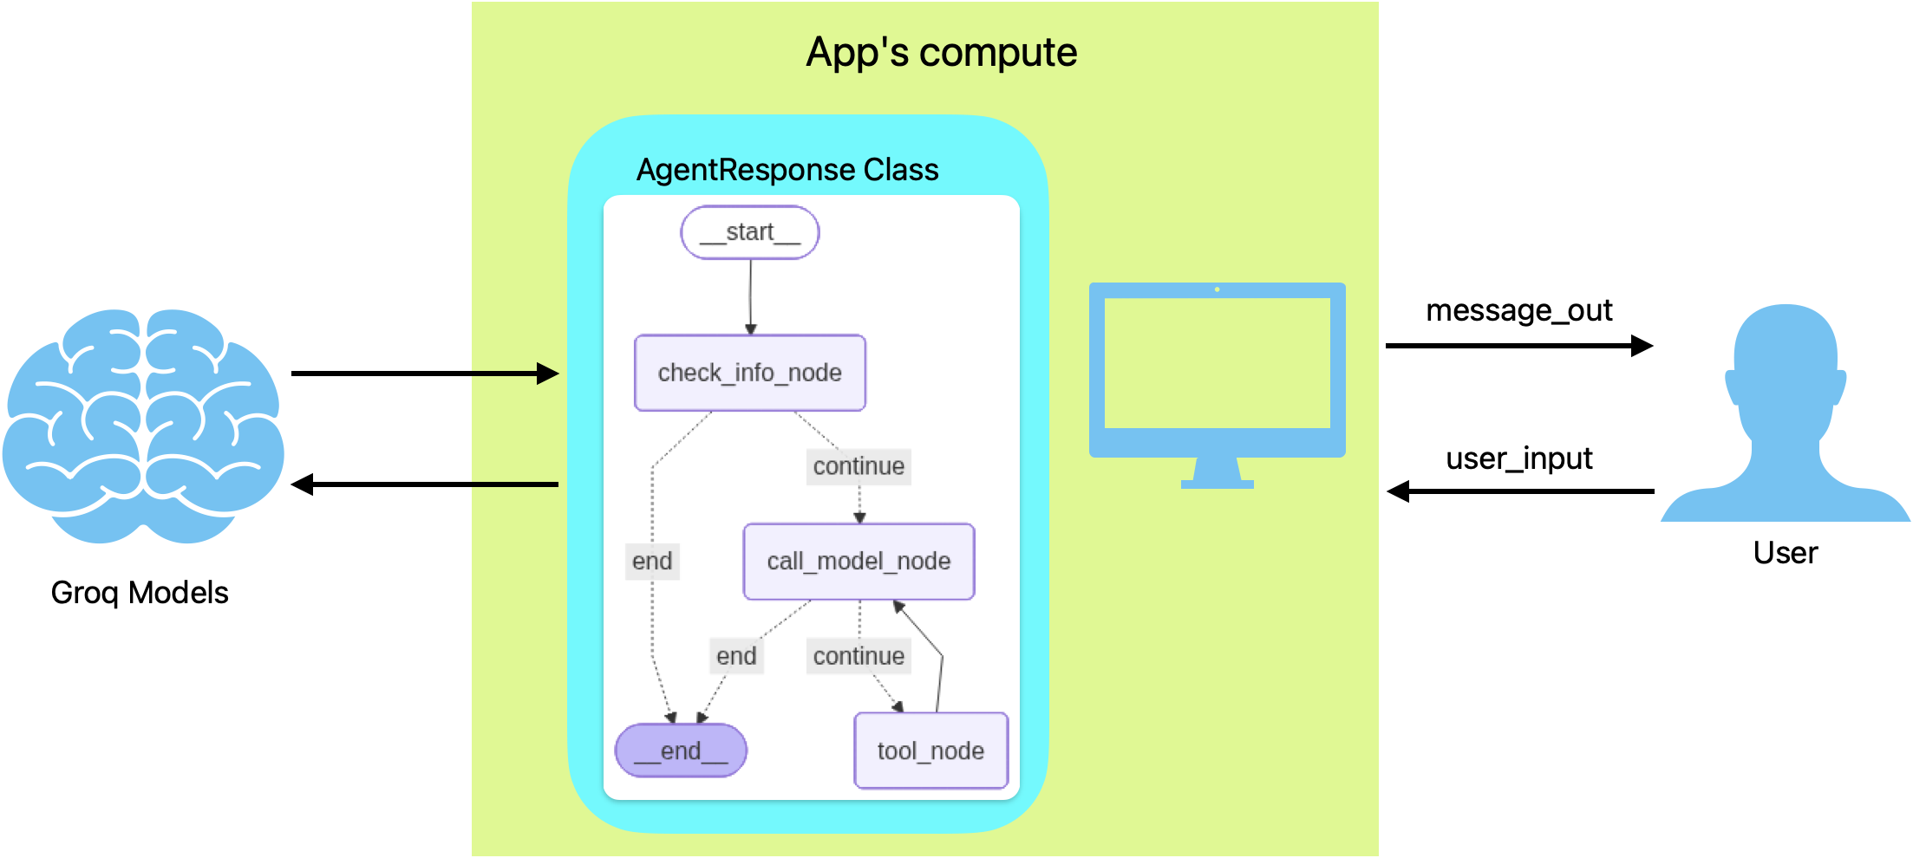
Agentic architecture

Slide 7
Future Work
Further develop parsing, chunking, and retrieval techniques for better context engineering
Test and learn with users for improving prompts and testing retrieval techniques
Develop JLLM pipelines
Deploy the model to a model serving endpoint for availability and scalability
Develop monitoring pipeline (streaming/batch job)
Develop alerting pipeline (streaming/batch job)

Slide 8
Vibe Coding Practice
I used vibe coding for:
Writing function components of the design (a great assistant)
Generating great prompts
Designing sample QAs from sample financial documents for testing the agentic workflow
Philosophically it works similar to Stack Overflow in older days but stronger and gets better at it

