Slide 1
Instant Insanity on 12 qubits
A compact encoding and constrained QAOA, checked against brute force at every step
Team: Zain Irfan, Mark Gebuza, Rithwik Mohanty
Qiskit Fall Fest CT 2026 · qBraid challenge · warm-up, core and bonus (N = 4 to 8)
Notes:
Speaker 1: introduce the team and the one-line story: 3 qubits per cube, a mixer that only allows legal moves, and classical checks everywhere.

Slide 2
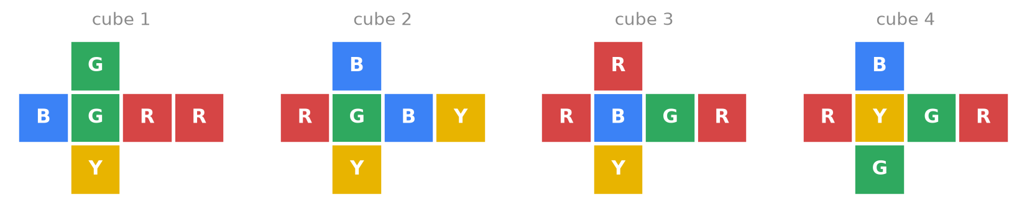
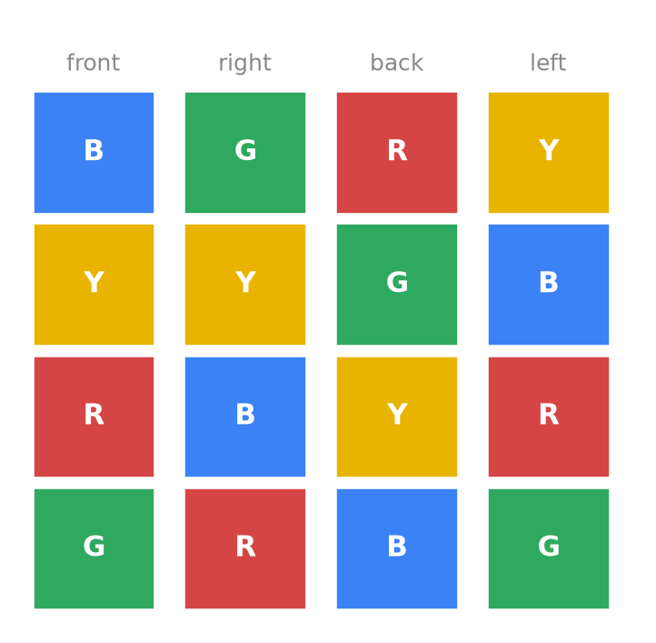
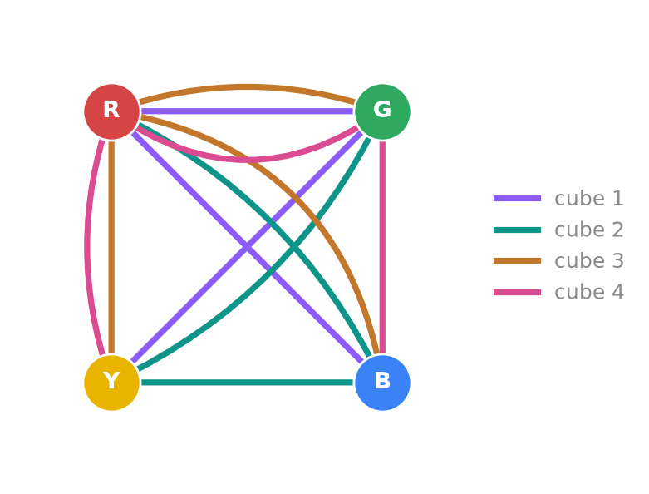
The puzzle: 8 good towers out of 331,776
Stack 4 cubes so every side shows red, green, blue and yellow exactly once
The four cubes, unfolded
The one solved tower
331,776
8
0.14 s
Graph view: colours are dots, opposite pairs are lines
ways to stack 4 cubes
solved: one tower, 8 views
classical brute force
The general N-cube problem is NP-complete. We do not claim a speedup.
Notes:
Speaker 1: why it's hard by hand, why it's easy for a computer at N=4, and how the graph view shrinks it to 6 choices per cube.

Slide 3
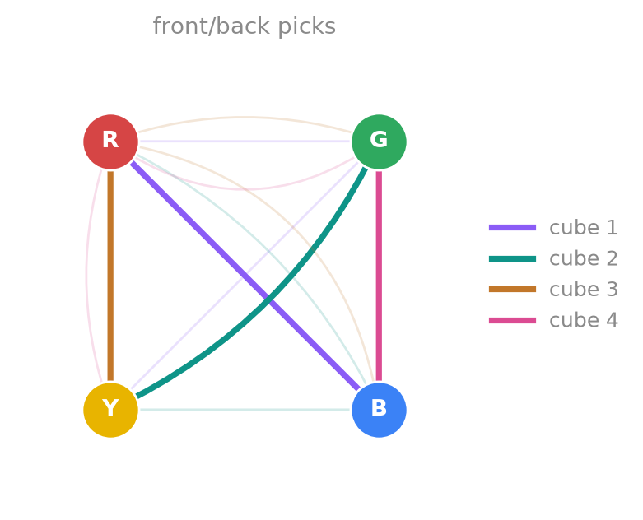
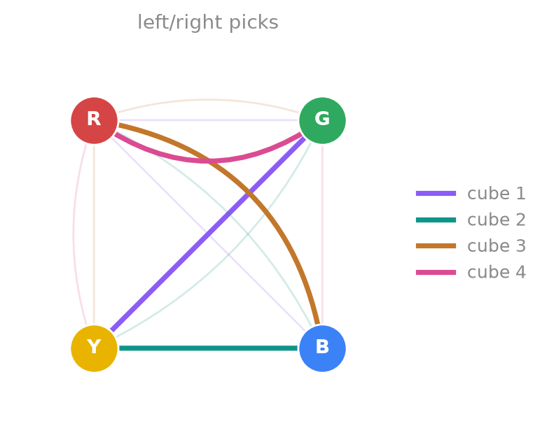
The trick: 6 choices per cube fit in 3 qubits
Colours are dots, opposite-face pairs are lines. The answer's picks touch every colour exactly twice
code | bits | front/back | left/right
0 | 000 | 0 | 1
1 | 001 | 0 | 2
2 | 010 | 1 | 0
3 | 011 | 1 | 2
4 | 100 | 2 | 0
5 | 101 | 2 | 1
6, 7 | 11x | unused | never
Front + back together show every colour twice, so pick one line per cube that touches each dot exactly twice (top left). Same for left + right (bottom left).
Which way round each pair faces can be fixed afterwards.
So a cube only picks 2 different pairs: 3 × 2 = 6 choices, stored as a code 0 to 5 in 3 qubits.
Cost C = Σ (d − 2)²
d = how many picked lines touch a colour. C = 0 exactly for a solved tower. 164 Z terms at N = 4.
Codes 6 and 7 need no penalty: the circuit never creates them.
Notes:
Speaker 1: bit order — qubit 0 is the rightmost character in a Qiskit key; cube 1 is the last 3 characters. We tested the decoder on the known answer.

Slide 4
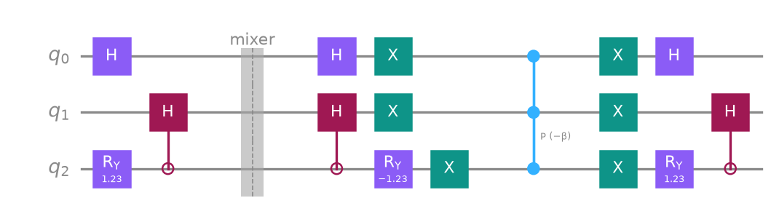
Algorithm: QAOA that only makes legal moves
Start in all legal choices, then alternate a cost layer and a per-cube mixer, p times
1 Start
each cube in an equal mix of its 6 codes (RY, controlled-H, H)
2 Cost layer
exp(−iγH): each Z string is a CNOT ladder + one RZ
3 Mixer
exp(−iβ|u⟩⟨u|) per cube: any legal choice can become any other, never an illegal one
4 Tune
pick γ, β by minimising the average cost on a simulator, never using the answer
Above: one cube's start state, then one mixer step (undo the start, phase on |000⟩, redo). One full layer at N = 4 is about 550 CNOTs after transpiling to rz, sx, x, cx.
5 Measure
decode every shot and check it with solves()
Notes:
Speaker 2: the mixer is the 'complete graph' mixer over 6 codes. Tuning: layer by layer, each depth starts from the previous angles stretched (INTERP).

Slide 5
Classical checks before any claim
Every check is an assert in the notebook; all pass
H = classical cost
N = 4 to 6: every valid state; N = 7, 8: 3,000 random ones. Largest gap 0.
Lowest energy = the answer
exactly 2 zero-cost states = count_answers = graph method; no ties (next cost is 2).
✓
✓
Independent cost agrees
the starter's 24-qubit QUBO is zero on the same 2 states.
Circuit stays legal
start state is 1/6 on each valid code; leakage to codes 6, 7 is 2e-15; 0 invalid shots.
✓
✓
Fast simulator = Qiskit
our 6^N simulator matches Statevector of the real circuit to 3e-17.
Every tower checked
each measured shot is decoded (qubit 0 = rightmost bit) and passed to solves().
✓
✓
Notes:
Speaker 2: this is the slide for the tie-break criterion. Say how each check would catch a bug.

Slide 6
Four cubes: 73% of shots are the solved tower
Constrained QAOA, 12 qubits, 1000 shots per circuit; random legal guess = 0.15%
p | CX | depth | SV1 | exact
1 | 550 | 522 | 1.7% | 1.1%
4 | 2,188 | 2,040 | 8.7% | 8.8%
8 | 4,372 | 4,064 | 42% | 42%
12 | 6,556 | 6,088 | 73% | 73%
Device: aws:aws:sim:sv1
Measured at p = 12: about 475× a random legal guess. Measured shots match the exact value within shot noise.
Warm-up (front/back only, starter): 31% good picks at p = 2.
Notes:
Speaker 2: the line is the exact simulation; the table is shots. Point out the baseline and that no shot was an illegal code.

Slide 7
Bonus: same method for N cubes and N colours
make_puzzle seeds {5: 16, 6: 86, 7: 68, 8: 4}, each with exactly one tower; depth fixed at p = 10
N | qubits | CX | exact | SV1 shots | × random
4 | 12 | 5,464 | 58% | 59% | 375
5 | 15 | 9,285 | 9.1% | 9.5% | 354
6 | 18 | 13,446 | 9.5% | 9.4% | 2,206
7 | 21 | 16,627 | 3.5% | 3.3% | 4,877
8 | 24 | 21,128 | 4.3% | 3.3% | 36,057
Qubits grow as 3N; CNOTs per layer grow about linearly here (550 → 2,100).
At fixed depth success falls with N, but more slowly than random guessing: the advantage over guessing grows. Keeping success high would need more layers.
Notes:
Speaker 3: angles for N=5-8 were tuned offline with the same function and reloaded; the notebook recomputes their success. N=7,8 local shots come from the exact distribution unless run on SV1.

Slide 8
What we learned, and what we'd try next
Layers needed to reach 50% success
Learned
Rules built into the encoding: half the qubits, no penalties, 0 wasted shots.
QAOA concentrates probability on the answer (73% vs 0.15% guessing), checked shot by shot.
Layers needed grow with N, and vary a lot between puzzles of the same size.
Fair comparison: no quantum advantage
A smart classical solver finds the 8-cube tower in 13 ms. QAOA would need about 65,000 CNOTs per shot at 50%, plus thousands of runs to tune: far beyond today's hardware.
Next step
Track how layers grow at larger N, with CVaR (tune for the best shots, not the average).
AI use: Claude Code wrote code and docs; every model was checked against brute force.
9 puzzles, exact simulation, angles tuned on the average cost only. Puzzles of the same size differ a lot, so one puzzle per size is not enough.
Notes:
Speaker 3: the chart answers 'how many layers to keep success at 50%?'. Then the fair comparison: classical wins clearly at these sizes. Close with the next step.

