Slide 1

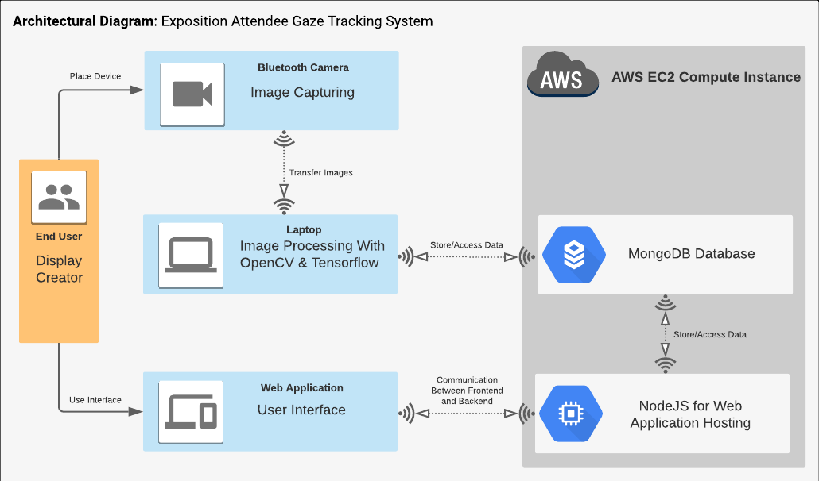
Exposition Attendee Gaze Tracking System
Summary
Results
What makes a successful exposition display? This is a question businesses must ask themselves when looking to use an expo as a means to promote their brand and showcase their product. My proposal is of a computer vision system that tracks the gaze of attendees at an expo, so that detailed data may be provided to a user of what component of their display most effectively caught peoples’ eye. The result of this would be a more detailed understanding of how a display performs, so that its design may be altered to grab attention more effectively.
The proposed system involves placing a camera at a position near the display. This camera will record where about on the display attendees’ gaze fell and for how long. The recorded gaze data is then displayed as a heat map overlayed onto a picture of the display in question, giving the user a good idea of what was most effective (or ineffective) about their design. Users data is stored on a database and accessible via a web application, thereby opening the possibility for collaboration between different users. For example, a new user may not yet have gathered sufficient data to be of help to themselves, instead they could view past effective display designs and pick elements from these for use in their own display.
Placeholder
test
Technologies
Conclusion
TensorFlow
OpenCV
Convolutional Neural Networks
Python
[placeholder]
Info
GitHub: https://github.com/rmon-gmit/fyp

