Slide 1
Modeling the Effects of Introducing Toxorhynchites to areas infected with Dengue Fever
Cameron, MinXiong, & Riley
Dixie State University
Advisor: Dr. Vinodh Chellamuthu
Notes:
ALL

Slide 2
Outline
Brief Background on Dengue Fever
Mathematical Model
Effects of New Predator
Results
Conclusion
Notes:
Cameron

Slide 3
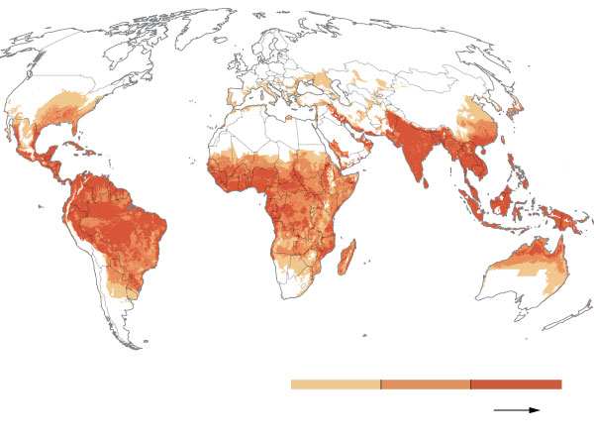
Dengue Fever
An infection that is spread through mosquitoes
Up to 400 million people per year get infected with dengue fever, per the CDC
Over half of the world's population live in areas with a risk of dengue fever
Notes:
Cameron

Slide 4
Ways to Control Dengue Fever
Finding a way to control the amount of vectors carrying the infection
A species of Wolbachia mosquitoes can suppress the ability to spread the disease
Introducing Toxorhynchites to decrease the aquatic mosquito population
Notes:
Cameron

Slide 5
Parameters
M | Vector Carrying Capacity | 50
r | Intrinsic Birth Rate of Vectors | 0.2
w | Natural Death Rate of Vectors | 0.12
b | Natural Birth Rate of Vectors | 0.32
h | Prey Searching Rate | 0.1 - 0.65
a_{T} | Predator’s Satiety Rate | 0.01 - 0.03
𝛄_{T} | Predator’s Conversation Factor | 0.15
e | Predator’s Mortality Rate | 0.1
Notes:
Cameron

Slide 6
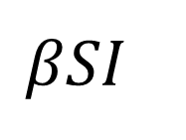
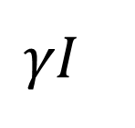

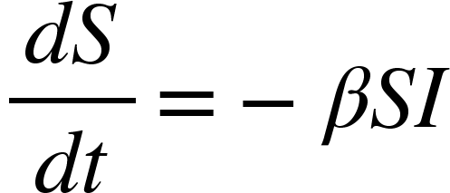
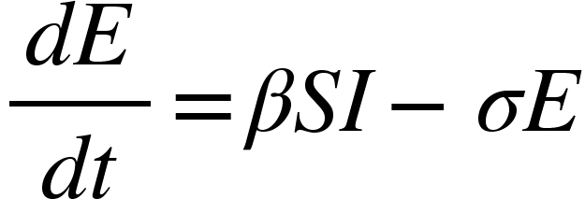
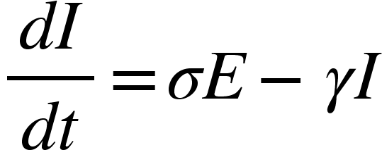
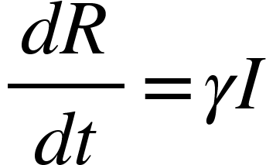
Modeling Disease with ODE’s
SEIR Model
S
E
I
R
Notes:
Minxiong

Slide 7
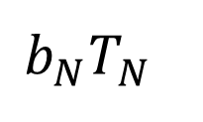
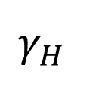
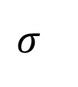

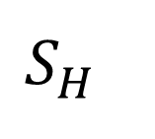
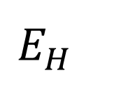
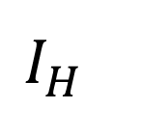
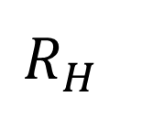
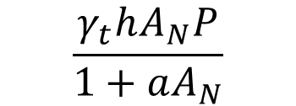
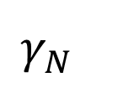
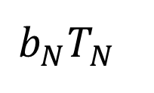
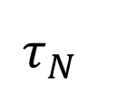
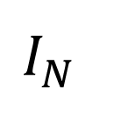
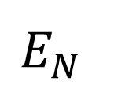
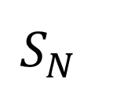
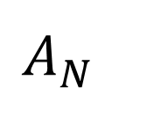
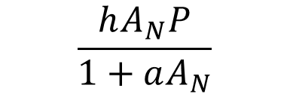
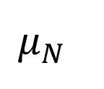
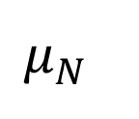
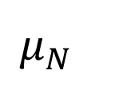
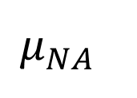
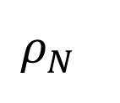
Model without Wolbachia
P
Notes:
Minxiong

Slide 8
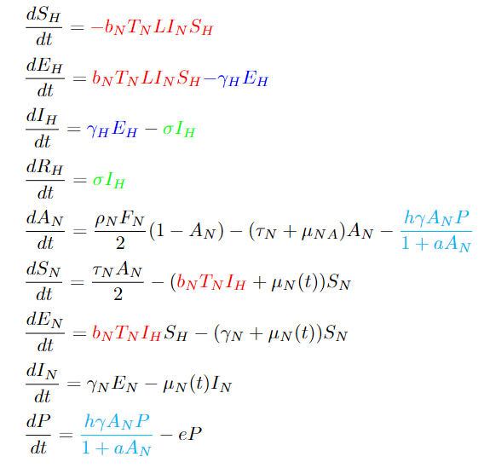
Differential Equations without Wolbachia
Notes:
Minxiong

Slide 9
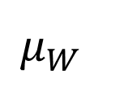
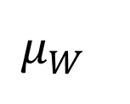
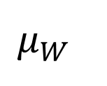
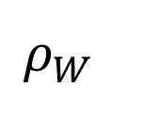
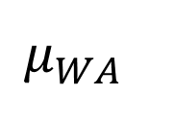
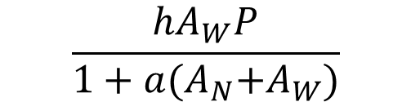
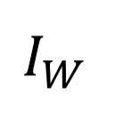
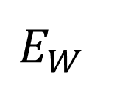
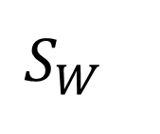
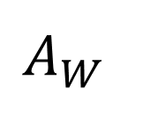
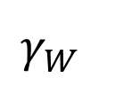
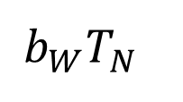
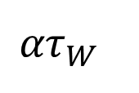
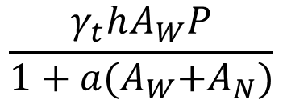
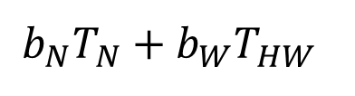
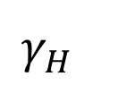
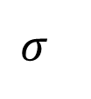
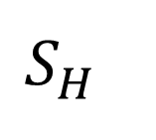
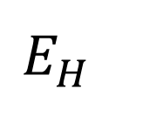
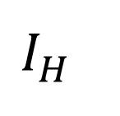
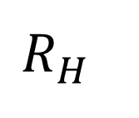















Model with Wolbachia
P
‹#›
Notes:
Minxiong

Slide 10

Key Equations
Notes:
Minxiong

Slide 11

Key Equations
Notes:
Minxiong

Slide 12
Results
Notes:
Riley

Slide 13

Original Parameters
Notes:
Riley

Slide 14
Satiety Rate = 0.01 & Searching Rate = 0.1
Notes:
Riley

Slide 15

Satiety Rate = 0.03 & Searching Rate = 0.65
Notes:
Riley

Slide 16

Conversation Rate = 0.6
Notes:
Riley

Slide 17
What did we learn?

Slide 18
Results When Releasing Multiple Times
Notes:
Riley

Slide 19

Releasing every 14 days
Notes:
Riley

Slide 20
Release when average temperature over the previous 7 days is greater than 30 °C and it's been a minimum of 7 days since the last release.
OR
Release when it’s been over 10 days since the last release.
OR
Release when the overall proportion of Toxorhynchites gets below 0.1 and it’s been at least 7 days since the last release.
Conditions
Notes:
Riley

Slide 21

Notes:
Riley

Slide 22
Release when average temperature over the previous 7 days is below than 24 °C and it's been a minimum of 7 days since the last release.
OR
Release when it’s been over 10 days since the last release.
OR
Release when the overall proportion of Toxorhynchites gets below 0.1 and it’s been at least 7 days since the last release.
Conditions
Notes:
Riley

Slide 23

Notes:
Riley

Slide 24
Conclusion
The more we release the Toxorhynchites, the fewer number of cases are expected to occur.
The predator only delays the rate of infection.
Releasing when the average temperature of the previous seven days was cooler than 24 °C led to a lower proportion of infected humans.
Notes:
Riley

Slide 25
Future Work
Continue finding an optimal release temperature and frequency to limit the disease.
Explore other sources to confirm our variables, and search for other values for conversation rate, birth rate, and maturation rate.
Explore how precipitation can affect the populations of each variety of mosquito.
Notes:
Riley

Slide 26
Works Cited
Donald, Claire L, et al. “Toxorhynchites Species: A Review of Current Knowledge.”
Insects, MDPI, 30 Oct. 2020, https://www.ncbi.nlm.nih.gov/pmc/articles /PMC7693308/.
GN;, Ndii MZ;Hickson RI;Allingham D;Mercer. “Modelling the Transmission Dynamics of
Dengue in the Presence of Wolbachia.” Mathematical Biosciences, U.S. National Library of Medicine, https://pubmed.ncbi.nlm.nih.gov/25645184/.
Pierre-louis, Kendra, and Nadja Popovich. “How Dengue, a Deadly Mosquito-Borne Disease, Could Spread in a
Warming World.” The New York Times, The New York Times, 10 June 2019, https://www.nytimes.com/interactive/2019/06/10/climate/dengue-mosquito-spread-map.html.
Zhou, Fengyan, and Hongxing Yao. “Dynamics and Biocontrol: The Indirect Effects of a
Predator Population on a Host-Vector Disease Model.” Abstract and Applied Analysis, Hindawi, 27 Jan. 2014, https://www.hindawi.com/journals/aaa /2014/252718/.
Notes:
Riley

Slide 27
Thank You
Notes:
All

