Slide 1
Erlang
Jon Bowen
CS 3210

Slide 2
Agenda
History
Language Overview and Samples
Language Evaluation

Slide 3
History
Begin at the end
Programs are structured as concurrent processes
Processes share no memory and communicate with asynchronous message passing
Processes are lightweight
Processes belong to the language and not to the operating system

Slide 4
History
Motivation
A better way of programming telephony applications
Requirements:
Highly concurrent and distributed
Fault-tolerant
Real time
Highly available
Hot swapping
NOT required: Intensive computation

Slide 5
History
Moments
1985: Joe Armstrong hired at Ericsson into exploratory group
1985: Work in Smalltalk results in notation close to Prolog. Switch to Prolog
1985: Robert Virding incorporates work on parallel logic programming
1987: Ericsson groups agrees to use Erlang (implemented in Prolog) in a real problem
1988: Rapid change from user feedback results in stabilization by year end
Notes:
Project to program basic telephony in every language that will run on our Unix system and compare the result
Conclusion:
Small languages desirable
Functional programming liked but “the absence of variables which are updated means that the exchange database has to be passed around as function arguments which is a bit awkward”
Logic programming was best in terms of elegance
Concurrency was essential to problem set
-

Slide 6
History
Choices
Design choices by end of 1988:
Buffered message reception with pattern matching and out of order handling
Error handling abstracted to process level (no difference between hardware and software messages)
Explicit links between processes propagate errors.
Errors cause all linked processes to die (all alive / all dead)
Messages in mailboxes instead of pipes
Notes:
In-order message handling added too much complexity
Fault-tolerant systems need at least two computers; involves more than merely protecting from program exceptions
All detail in message passing extracted to “process”
Message model does not depend on knowing if sending process is really another machine or just another software process; uniform handling
Linking idea based on mechanical telecomm switches. If an input goes to ground, all resources released
Mounting dependencies made using pipes for message passing too complicated

Slide 7
History
Moments
End of 1989: initial user group conclusions
Programmer-hours to implement new feature in Erlang compared to PLEX reduced by factor of 3 – 25
Erlang runtime memory requirements small
Erlang compiled code size acceptable
Erlang runtime needed to be at least 40 times faster for product development
End of 1989: initial user group conclusions
=> Make Erlang faster

Slide 8
History
Moments
1990: JAM (Joe’s Abstract Machine) designed by Armstrong. Emulator implemented in C by Mike Williams
JAM C emulator ~70 faster than Prolog emulator
Frequent small garbage collection used
Encouraged copying all data involved in message passing
Unforeseen, but increased process isolation, concurrency, and construction of distributed systems
Notes:
JAM work began with study of abstract machines for implementing parallel logic machines
Early implementation of Erlang were implemented in Prolog.
JAM was first written in Erlang and run through Erlang Prolog emulator.
Final JAM emulator written in C
Garbage collection concerns:
What if programmers structure programs as one big process
What if large number of processes decide to GC at same time
In practice, not a problem

Slide 9
History
Moments
1993: Erlang book allowed to be published
1993: BEAM Compiler
1995: Distributed Erlang
Notes:
Ericsson decided to commercialize Erlang
BEAM instructions
macro-expanded to C then compiled
large code size
~10x faster than JAM interpreted programs
transformed to instructions for 32-bit threaded interpreter
Smaller code size
~3x faster than JAM interpreted programs
Erlang is reliable if TCP/IP is

Slide 10
History
December 1995: AXE-N Collapse
Erlang selected as language in reboot of major Ericsson project
From lab experiment to complete platform: Open Telecom Platform (OTP)
Extensive and well-tested libraries
Design patterns for common applications
Documentation
Philosophy and learning support
Mnesia DBMS and query language
Binaries in reference-counted storage area
HiPE compiler

Slide 11
History
Pushed Into the World
Projects with Erlang produce excellent results
1998…Ericsson bans use of Erlang internally
Development group convinces Ericsson to release Erlang and OTP as open source
Development group promptly quits, forms new company, and delivers first product 6 months later

Slide 12
The Language
Functional language?
Additional practical needs from being used in massive production systems
“Erlang is not a strict side-effect-free functional language but a concurrent language where what happens inside a process is described by a simple functional language”
Example:
If two different processes receive a Pid representing a file, both are free to send messages to the file process in any way they like. It is up to the logic of the application to prevent this from happening
Notes:
“Sequential Erlang has a pure functional subset, but nobody can force the programmer to use this subset; indeed, there are often good reasons for not using it”

Slide 13
The Language
27 Total Keywords
after | bxor | not
and | case | of
andalso | catch | or
band | cond | orelse
begin | div | receive
bnot | end | rem
bor | fun | try
bsl | if | when
bsr | let | xor
http://erlang.org/doc/reference_manual/introduction.html

Slide 14
The Language
Common Data Types
Number 1, 3.14, -41
Atom inch, monday, bob
Tuple {inch, 1, “abc”}
List [1, 1, 2, 3, 5, 7]
Map #{name => “Bob”}
Functions
Notes:
- Note the absence of strings

Slide 15
The Language
Of Note
Variables begin with a capital letter or _
Variables can only be bound once per scope
Assignment operator, =, is better though of as a matching assertion
Lists can be split with the | operator
Pattern matching is used in parameter passing and “assignment”

Slide 16
The Language
Samples
>> io:fwrite("Hello World!~n").
Hello World!
ok
>>
>> L = [1, 2, 3, "go"].
>> [S | T] = L. % S = 1, T = [2,3,”go”]
>>
>> [A, B | R] = L. % A = 1, B = 2, R = [3, “go”]

Slide 17
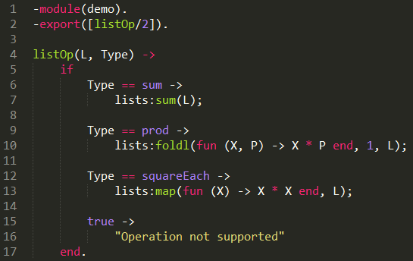
The Language
Samples

Slide 18
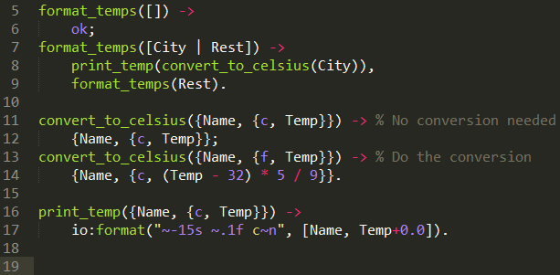
The Language
Samples
Parameter: [{"Denver",{f,70}},{"Seattle",{f,65}},{"London",{c,20}}]

Slide 19
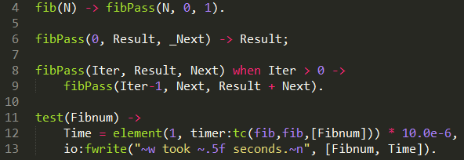
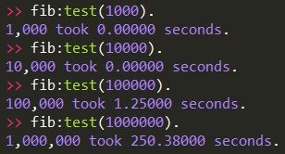
The Language
Samples

Slide 20
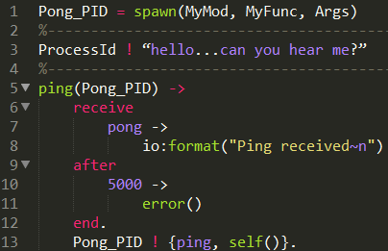
The Language
Samples

Slide 21
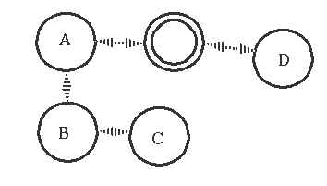
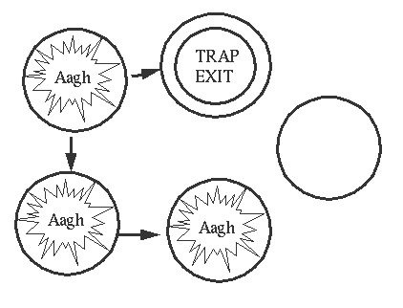
The Language
Error Handling

Slide 22
Language Evaluation
Readability / Writability
Strengths
Small size of language
Typically one best way to accomplish something
Language encourages standard structure
Weaknesses
No or limited type checking
Data structures can look very complex
Piecewise function definition can be abused

Slide 23
Language Evaluation
Reliability
Strengths
Immutable data and no references
Processes to do work and processes to supervise
Message passing uses mailboxes
Error handling approach
Weaknesses
Lack of type checking can cause runtime errors
All or nothing security

Slide 24
Language Evaluation
Cost
Strengths
Small language reduces learning curve
Reliability directly reduces maintenance cost
Code changes can be applied “on the fly”
Concurrency + distributed = massively scalable
Weaknesses
Smaller language community
Slower than alternatives for serial operations with high CPU use

Slide 25
Standard References
Armstrong, Joe. Programming Erlang: Software for a Concurrent World. Pragmatic Programmers LLC, 2013.
St. Laurent, Simon. Introducing Erlang: Getting Started in Functional Programming 2nd Ed. O’Reilly Media, Inc., 2017
Herbert, Fred. Learn You Some Erlang for Great Good!: A Beginner's Guide. No Starch Press, Inc., 2013.
Armstrong, Joe. “A History of Erlang.” 19 Mar. 2018, http://webcem01.cem.itesm.mx:8005/erlang/cd/downloads/hopl_erlang.pdf.
“An Erlang Course.” Erlang/OTP unit at Ericsson, 2 Apr. 2018, https://www.erlang.org/course.
Erlang Homepage. Erlang/OTP unit at Ericsson, 2 Apr. 2018, https://www.erlang.org.
“Documentation.” Erlang/OTP unit at Ericsson, 2 Apr. 2018, https://www.erlang.org/docs

