Slide 1
Preprocessing: NYPD Data
Initially we used NYC OpenData’s filter functionality to filter out examples outside of the borough of Williamsburg.
RapidMiner for Preprocessing
Replaced missing values for some features. Replacement based on context.
Filtered out rows will missing data.
Converting categorical data to numerical data with separate columns
Aggregated data in to months
From the prepared data, we hand selected columns that are of interest to us.

Slide 2
Forecasting Median Rent: Multiple Linear Regression
Input: Current Median Rent Price, +50ish other Columns
Target: Future Median Rent Price
Additional Processing/Modeling Steps:
Normalization of values to [0, 1]
Forward Sequential Feature Selection to find the most predictive features.
Split Validation: Data was split to a training and validation sets (70:30).
Training Set: 74 rows (months of data)
Test Set: 31 rows (months of data)

Slide 3
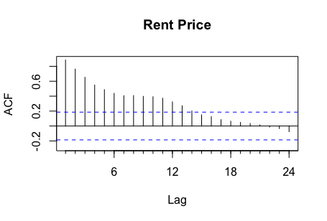
Forecasting Median Rent: Multiple Linear Regression
To evaluate the performance of our models, we will be comparing loss of the model with multiple variables against a linear regression model using only previous rent prices.
To evaluate which time lag would be best to use for the function, we first generated an autocorrelation plot with RStudio.
The most correlated lag is the most recent month, and will be used in a single variable linear regression model for obtaining a ”baseline” performance.

Slide 4
Forward Sequential Feature Selection: How many Features?
We observed that with higher numbers of features, we have decreased the training loss, but increase the test loss.
This suggests that we have overfitting with more features.
Optimal number of features is ~5. This number will be used for all multiple linear regression models.

Slide 5
Multiple Linear Regression: Predict 1 Month Ahead
 | Most Recent Rent Only | Top 5 Attributes
Training RMSE | 83.7 | 75.0
Test RMSE | 44.7 | 33.2
Forecasting Loss is reduced in model with 5 attributes.

Slide 6
Multiple Linear Regression: Predict 2 Month Ahead
 | Most Recent Rent Only | Top 5 Attributes
Training RMSE | 118.5 | 98.8
Test RMSE | 72.4 | 50.7
Forecasting Loss is reduced in model with 5 attributes.

Slide 7
Multiple Linear Regression: Predict 3 Month Ahead
 | Most Recent Rent Only | Top 5 Attributes
Training RMSE | 139.6 | 108.2
Test RMSE | 95.4 | 73.5
Forecasting Loss is reduced in model with 5 attributes.

Slide 8
Multiple Linear Regression (Weights)
Linear regression is Interpretable.
1 Month Forecast
Feature Name | Weights (Normalized)
Rent Price | 0.79
ELECTRIC | 0.11
Derelict Vehicles | 0.10
General Construction/Plumbing | -0.13
Street Condition | -0.15
2 Month Forecast
Feature Name | Weights (Normalized)
Rent Price | 0.58
General Construction/Plumbing | -0.23
DANGEROUS WEAPONS | -0.14
Street Condition | -0.22
Noise | 0.15
3 Month Forecast
Feature Name | Weights (Normalized)
Rent Price | 0.65
Street Sign - Damaged | 0.23
General Construction/Plumbing | -0.17
DANGEROUS WEAPONS | -0.25
CRIMINAL MISCHIEF & RELATED OF | -0.29
Notes:
NOTE: crimes are neg correlated

