Slide 1

Harnessing Big Data to Forecast NYC Rent Prices
Abstract Presentation - 2019/03/06
Ryan Moriarty, rpm295@nyu.edu
Anthony Tse, at4091@nyu.edu
William Jiang, wj419@nyu.edu
Anasse Bari, PHD , abari@nyu.edu

Slide 2
Data Understanding: Data Sources
NYC Crime Data
Includes felony, misdemeanor, and violation crimes reported to the New York City Police Department (NYPD).
311 Data
311 Service Requests. Includes requests for various public departments:
Department of Transportation: Potholes, etc.
NYPD : Noise Complaints, Illegal Parking, etc.
Department of Sanitation: Waste Disposal, etc.
NYC Taxi Data
Quantity of arrivals and destinations from various Neighborhoods.

Slide 3

Data Acquisition
Rent price index sourced from StreetEasy
NYC Open Data
NYPD Crime Data
felony, misdemeanor, and violation crimes
311 Complaints
DoT: Potholes, etc.
NYPD : Noise Complaints, Illegal Parking, etc.

Slide 4
Data Selection
Data contains daily records from 2010 until end of 2018.
Williamsburg neighborhood chosen as our initial data set

Slide 5
Preprocessing
Used NYC Open Data’s filtering option to select data belonging only to Williamsburg
Used R on NYPD and 311 Complaints to:
Replaced missing values for some features. Replacement based on context.
Convert categorical data into numerical data
Aggregate daily records into monthly records
Filtered out rows will missing data.

Slide 6
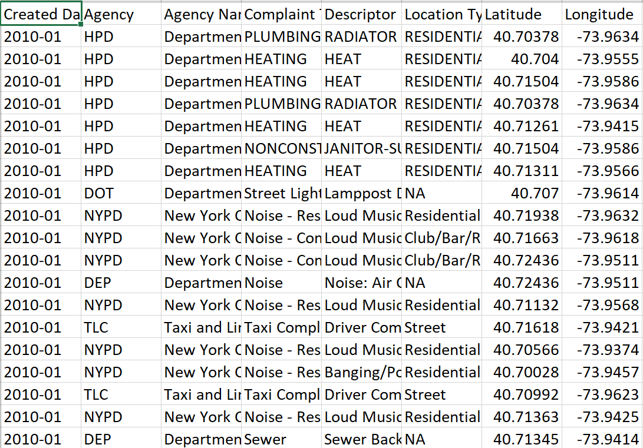
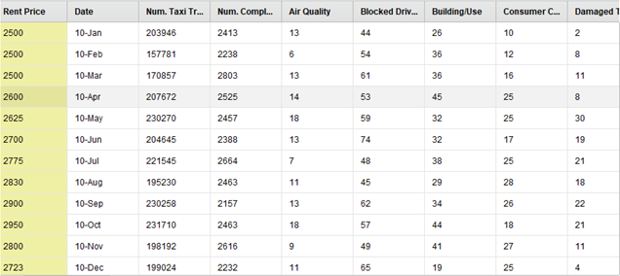

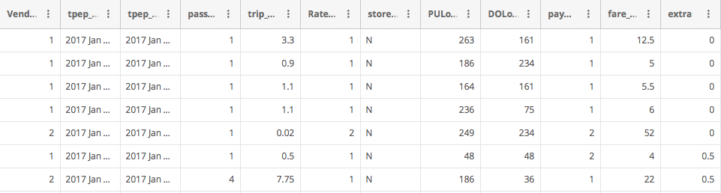
Data Aggregation
311 Complaints:
~300,000 rows
Aggregated Data:
105 Rows,
NYPD Complaints:
~20,000 rows
NYC Taxi Data

Slide 7
Preprocessing: NYPD Data
Initially we used NYC OpenData’s filter functionality to filter out examples outside of the borough of Williamsburg.
RapidMiner for Preprocessing
Replaced missing values for some features. Replacement based on context.
Filtered out rows will missing data.
Converting categorical data to numerical data with separate columns
Aggregated data in to months
From the prepared data, we hand selected columns that are of interest to us.

Slide 8
Forecasting Median Rent: Multiple Linear Regression
Input: Current Median Rent Price, +50ish other Columns
Target: Future Median Rent Price
Additional Processing/Modeling Steps:
Normalization of values to [0, 1]
Forward Sequential Feature Selection to find the most predictive features.
Split Validation: Data was split to a training and validation sets (70:30).
Training Set: 74 rows (months of data)
Test Set: 31 rows (months of data)

Slide 9
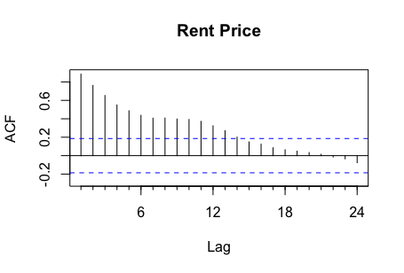
Forecasting Median Rent: Multiple Linear Regression
To evaluate the performance of our models, we will be comparing loss of the model with multiple variables against a linear regression model using only previous rent prices.
To evaluate which time lag would be best to use for the function, we first generated an autocorrelation plot with RStudio.
The most correlated lag is the most recent month, and will be used in a single variable linear regression model for obtaining a ”baseline” performance.

Slide 10
Forward Sequential Feature Selection: How many Features?
We observed that with higher numbers of features, we have decreased the training loss, but increase the test loss.
This suggests that we have overfitting with more features.
Optimal number of features is ~5. This number will be used for all multiple linear regression models.

Slide 11
Multiple Linear Regression: Predict 1 Month Ahead
 | Most Recent Rent Only | Top 5 Attributes
Training RMSE | 83.7 | 75.0
Test RMSE | 44.7 | 33.2
Forecasting Loss is reduced in model with 5 attributes.

Slide 12
Multiple Linear Regression: Predict 2 Month Ahead
 | Most Recent Rent Only | Top 5 Attributes
Training RMSE | 118.5 | 98.8
Test RMSE | 72.4 | 50.7
Forecasting Loss is reduced in model with 5 attributes.

Slide 13
Multiple Linear Regression: Predict 3 Month Ahead
 | Most Recent Rent Only | Top 5 Attributes
Training RMSE | 139.6 | 108.2
Test RMSE | 95.4 | 73.5
Forecasting Loss is reduced in model with 5 attributes.

Slide 14
Multiple Linear Regression (Weights)
Linear regression is Interpretable.
1 Month Forecast
Feature Name | Weights (Normalized)
Rent Price | 0.79
ELECTRIC | 0.11
Derelict Vehicles | 0.10
General Construction/Plumbing | -0.13
Street Condition | -0.15
2 Month Forecast
Feature Name | Weights (Normalized)
Rent Price | 0.58
General Construction/Plumbing | -0.23
DANGEROUS WEAPONS | -0.14
Street Condition | -0.22
Noise | 0.15
3 Month Forecast
Feature Name | Weights (Normalized)
Rent Price | 0.65
Street Sign - Damaged | 0.23
General Construction/Plumbing | -0.17
DANGEROUS WEAPONS | -0.25
CRIMINAL MISCHIEF & RELATED OF | -0.29
Notes:
NOTE: crimes are neg correlated

Slide 15
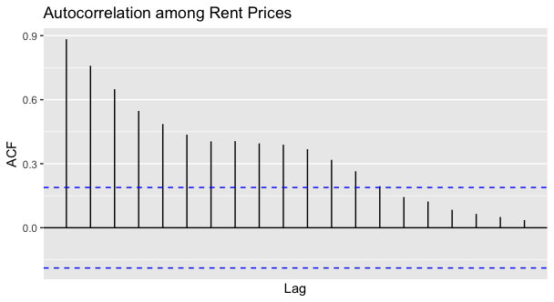
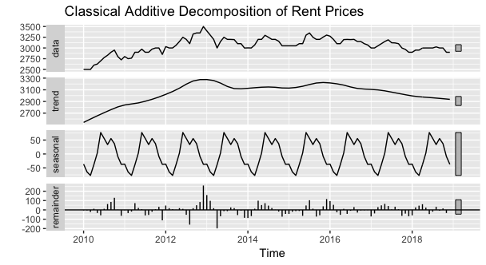
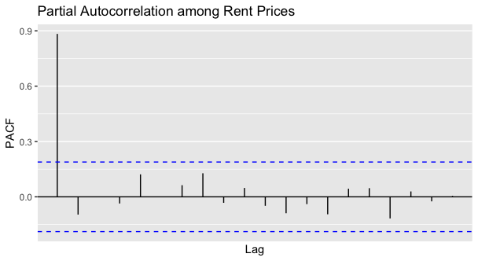
Time Series Modeling

Slide 16
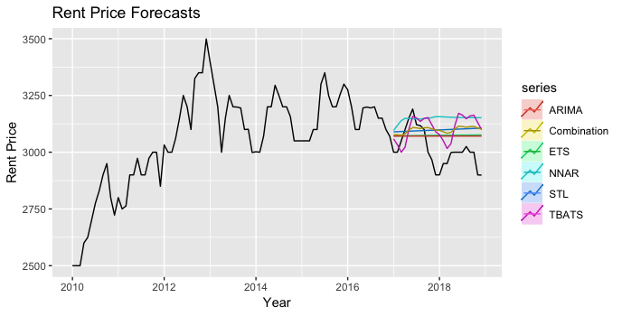
Time Series cont.
We then broke the data into training (2010-2016) and test (2017-2018) sets and ran a series of models on it
RMSE:
ARIMA: 98.38
Combination: 117.05
ETS: 100.90
NNAR: 157.61
STL: 118.20
TBATS: 126.00

Slide 17
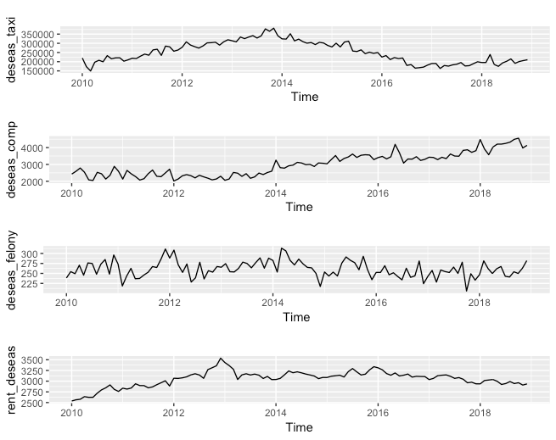
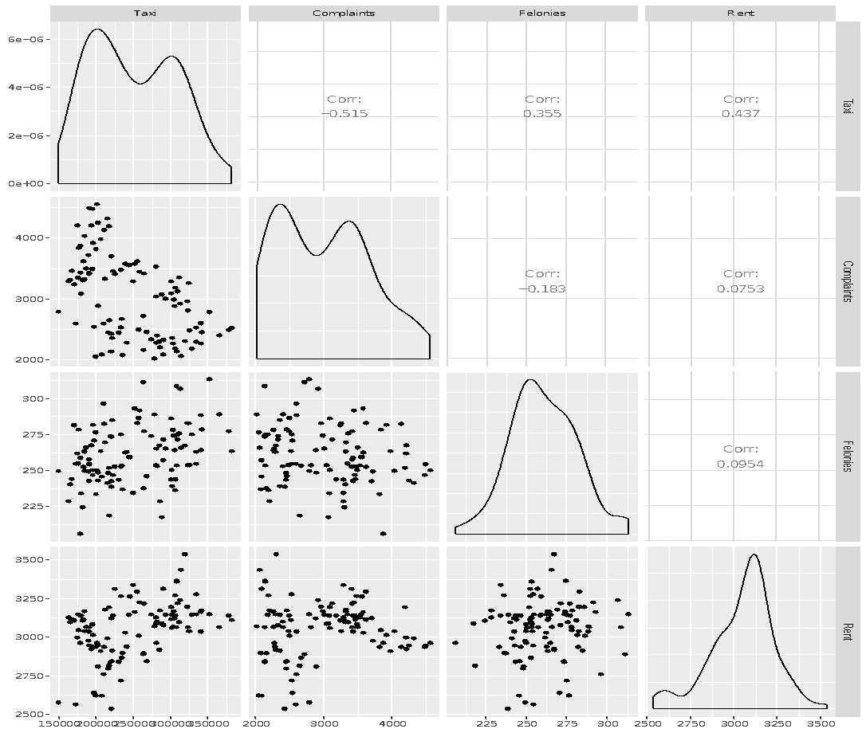
ARIMAX Modeling
Only the felonies time series had a statistically significant p-value for granger causality at a lag of 3.

Slide 18
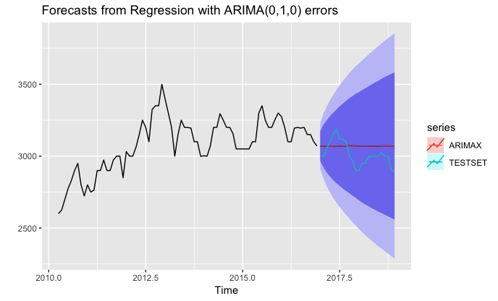
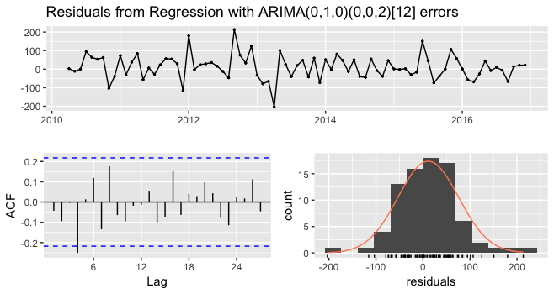
ARIMAX cont.
RMSE:
ARIMA: 98.38
ARIMAX: 98.02
NAÏVE w/ Drift: 182.12
ARIMAX using the lagged felony time series as an external regressor slightly improved accuracy.

Slide 19
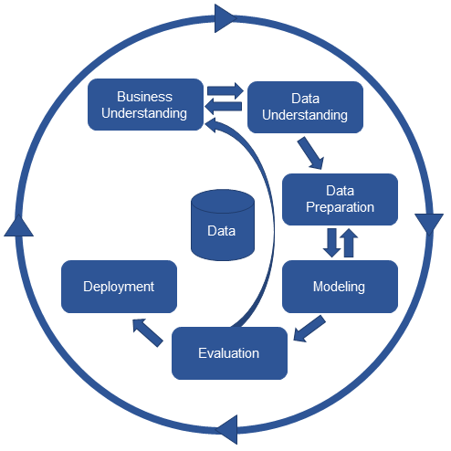

Evaluation/Next Steps
We were able to forecast Williamsburg rent prices up to two years out with a RMSE of ~$100
Adding alternative datasets didn’t significantly improve accuracy
Next steps would be to try different neighborhoods or different external variables and compare results

