Slide 1
RESTful Services in Python on Google App Engine
Ryan Morlok
Docalytics

Slide 2
Overview
REST vs RPC
Why JSON?
Simple Example
Google Cloud Endpoints
Protopy

Slide 3
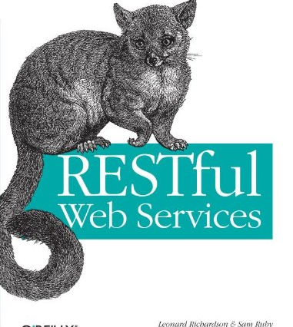
REST vs RPC
REST is noun oriented while RPC is verb oriented
REST leverages HTTP verbs, RPC overrides POST
A pragmatic spectrum exists

Slide 4
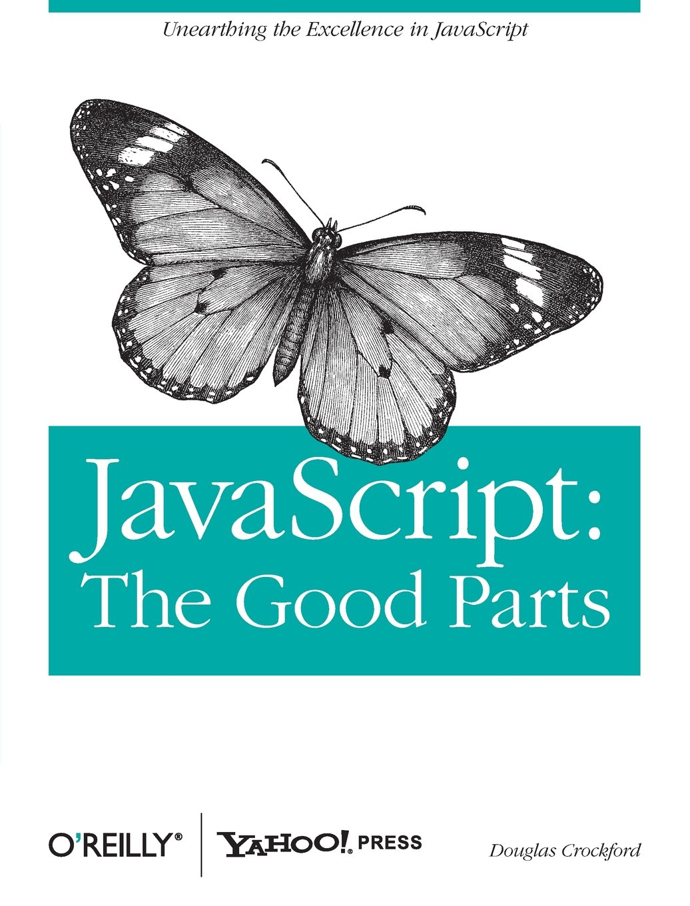
JSON
JavaScript Object Notation
Invented by Douglas Crockford in in the early-2000’s
Based on the object literal format in JavaScript

Slide 5
JSON versus XML
Data interchange format
Simple
Maps naturally to native data types
Human Readable/Writable
Limited data types
Document format
Formal (schema definitions, namespaces, etc)
Transforms
XPath/Xquery
Extensible

Slide 6
Tools
Postman REST Client
Fiddler
cUrl
Python requests library

Slide 7
Entities
Team:
Name
Mascot
Colors
Player:
Team
Name
Position

Slide 8
NDB Entities
from google.appengine.ext import ndb
class Team(ndb.Model): name = ndb.StringProperty() colors = ndb.StringProperty(repeated=True) mascot = ndb.StringProperty() class Player(ndb.Model): team = ndb.KeyProperty() name = ndb.StringProperty() position = ndb.StringProperty()

Slide 9
Team: Entity ➔Dict ➔JSON
def team_to_dict(team): d = team.to_dict() d['id'] = team.key.id() if team.key else None return d
# json.dumps(team_to_dict(Team(name="Minnesota", mascot="Gopher", colors=["maroon", "gold"])))
# => {"id": null, "colors": ["maroon", "gold"], "name": "Minnesota", "mascot": "Gopher"}

Slide 10
Player: Entity ➔Dict ➔JSON
def player_to_dict(player): return { 'id': player.key.id() if player.key else None, 'name': player.name, 'position': player.position, 'team_id': player.team.id() if player.team else None }
# json.dumps(main.player_to_dict(main.Player(name="Kyle Rau", position="Forward", team=t.key)))
# => {"position": "Forward", "team_id": 1, "id": null, "name": "Kyle Rau"}

Slide 11
Google Cloud Endpoints

Slide 12
