Slide 1
RESTful Services in Python on Google App Engine
Ryan Morlok
Docalytics

Slide 2
Overview
What is REST?
Why JSON?
HTTP Considerations
One example, three ways
Raw Webapp2
Google Cloud Endpoints
Protopy

Slide 3
http://documents.morlok.net/devfest-2015

Slide 4

What Make REST Different?
REpresentational State Transfer
An approach, not a standard
REST is noun oriented while RPC is verb oriented
URIs
HTTP Verbs
A pragmatic spectrum exists

Slide 5

JSON
JavaScript Object Notation
Invented by Douglas Crockford in in the early-2000’s
Based on the object literal format in JavaScript

Slide 6
JSON versus XML
Data interchange format
Simple
Maps naturally to native data types
Human Readable/Writable
Limited data types
Document format
Formal (schema definitions, namespaces, etc)
Transforms
XPath/Xquery
Extensible

Slide 7
CRUD via HTTP
Create | ➔ | POST
Read | ➔ | GET
Update | ➔ | PUT, PATCH
Delete | ➔ | DELETE

Slide 8
PUT versus PATCH
Idempotent
Set the resource as desired
Can also be used for create
Idempotent
Set sub-properties of the resource
Only used for update
Absent Property != null

Slide 9
HTTP Status Codes
Code | Meaining | Used in
200 | OK | Successful GETs, PUTs, PATCHes
201 | Created | Successful POSTs
204 | No Content | Successful DELETEs
301 | Moved Permanently
302 | Found
400 | Bad Request | Invalid query parameters or request body
403 | Forbidden | Access denied to resource
404 | Not Found | Cannot find resource
410 | Gone
418 | I’m a teapot | This is the real meaning of this code
500 | Internal Server Error | You screwed up
501 | Not implemented | Valid resource, method not supported

Slide 10
Tools
Fiddler
Postman REST Client
cUrl
Python requests library

Slide 11
Entities
Team:
Name
Mascot
Colors
Player:
Team
Name
Position
Team
1
*
Player

Slide 12
URL Structure
GET | /v1/teams
POST | /v1/teams
GET | /v1/teams/<team_id>
PUT | /v1/teams/<team_id>
PATCH | /v1/teams/<team_id>
DELETE | /v1/teams/<team_id>
GET | /v1/teams/<team_id>/players
POST | /v1/teams/<team_id>/players
GET | /v1/teams/<team_id>/players/<player_id>
PUT | /v1/teams/<team_id>/players/<player_id>
PATCH | /v1/teams/<team_id>/players/<player_id>
DELETE | /v1/teams/<team_id>/players/<player_id>

Slide 13
NDB Entities
from google.appengine.ext import ndb
class Team(ndb.Model): name = ndb.StringProperty() colors = ndb.StringProperty(repeated=True) mascot = ndb.StringProperty() class Player(ndb.Model): team = ndb.KeyProperty() name = ndb.StringProperty() position = ndb.StringProperty()

Slide 14
JSON Structure
Team
{
"id": "...",
"name": "Minnesota",
"mascot": "Gopher",
"colors": [
"maroon",
"gold"
]
}
Player
{
"id": "...",
"name": "Kyle Rau",
"position": "Defense",
"team_id": ”...",
}

Slide 15
Json + Webapp2

Slide 16
Monkey Patch Webapp2 for PATCH
import webapp2 allowed_methods = webapp2.WSGIApplication.allowed_methods new_allowed_methods = allowed_methods.union(('PATCH',)) webapp2.WSGIApplication.allowed_methods = new_allowed_methods

Slide 17
Define Endpoints
class TeamHandler(webapp2.RequestHandler): … def get_team(self, team_id): self.response.content_type = 'application/json' self.response.write(json.dumps(team_to_dict(
get_team_or_404(team_id))))
app = webapp2.WSGIApplication([ … webapp2.Route(r'/v1/teams/<team_id>',
methods=['GET’],
handler='main.TeamHandler:get_team',
name='get_team’)
…
])

Slide 18
Raise Exceptions For Error Statuses
def get_team_or_404(team_id): t = ndb.Key(urlsafe=team_id).get() if not t: raise webapp2.exc.HTTPNotFound() if not isinstance(t, Team): raise webapp2.exc.HTTPNotFound() return t

Slide 19
Team: Entity ➔ Dict ➔ JSON
def team_to_dict(team): d = team.to_dict() d['id'] = team.key.id() if team.key else None return d
# json.dumps(team_to_dict(Team(name="Minnesota",
mascot="Gopher", colors=["maroon", "gold"])))
# => {
"id": null,
"colors": ["maroon", "gold"],
"name": "Minnesota",
"mascot": "Gopher”
}

Slide 20
Player: Entity ➔ Dict ➔ JSON
def player_to_dict(player): return { 'id': player.key.id() if player.key else None, 'name': player.name, 'position': player.position, 'team_id': player.team.id() if player.team
else None }
# json.dumps(main.player_to_dict(
main.Player(name="Kyle Rau", position="Forward",
team=t.key)))
# => {"position": "Forward", "team_id": 1,
"id": null, "name": "Kyle Rau"}

Slide 21
Set Headers, Status, Write Response
class TeamHandler(webapp2.RequestHandler): …
def create_team(self): team = None try: team_dict = json.loads(self.request.body) team = dict_to_team_set(team_dict) team.put() except: raise webapp2.exc.HTTPBadRequest() self.response.headers['Location'] = webapp2.uri_for(
'get_team', team_id=team.key.urlsafe()) self.response.status_int = 201 self.response.content_type = 'application/json' self.response.write(json.dumps(team_to_dict(team)))

Slide 22
Google Cloud Endpoints

Slide 23
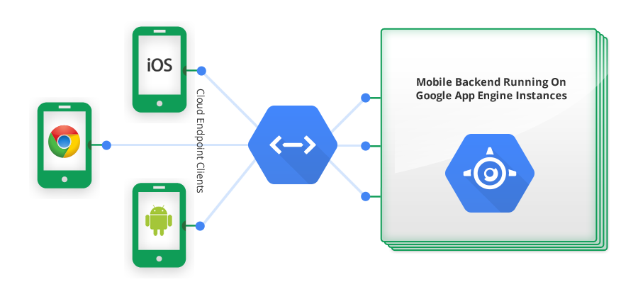

Slide 24
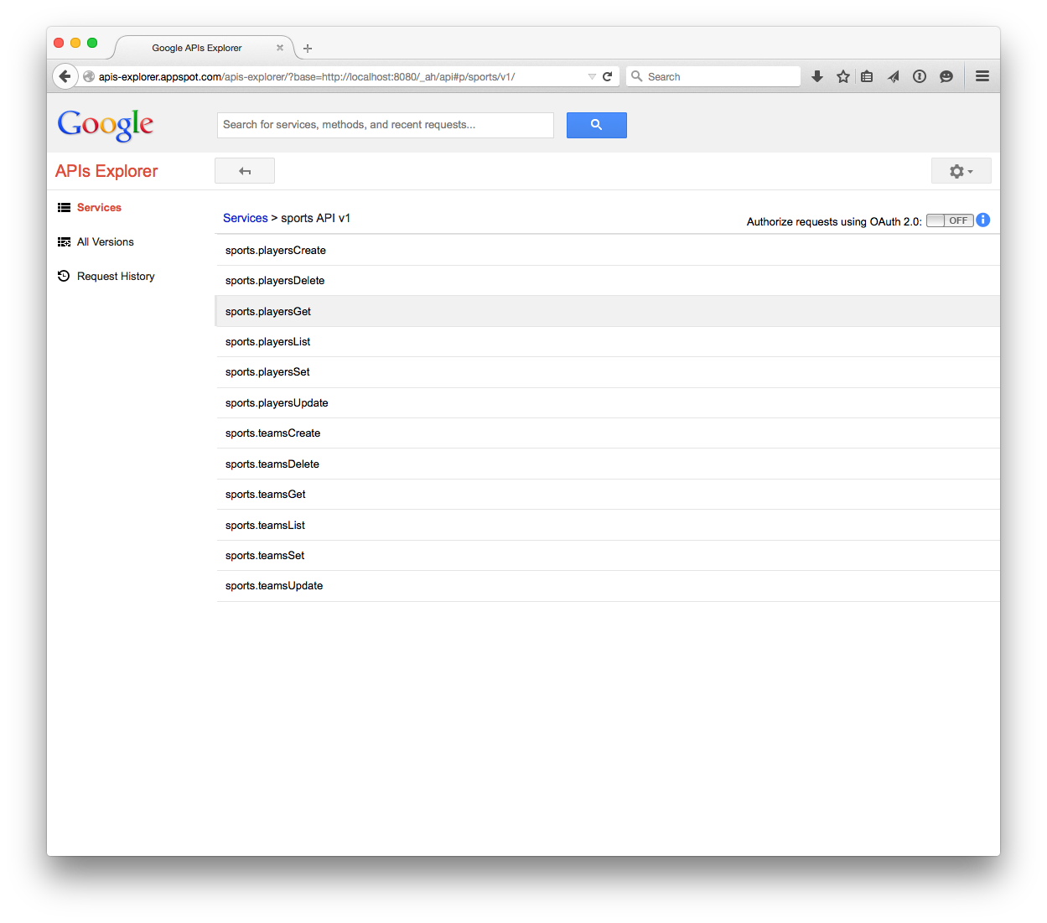
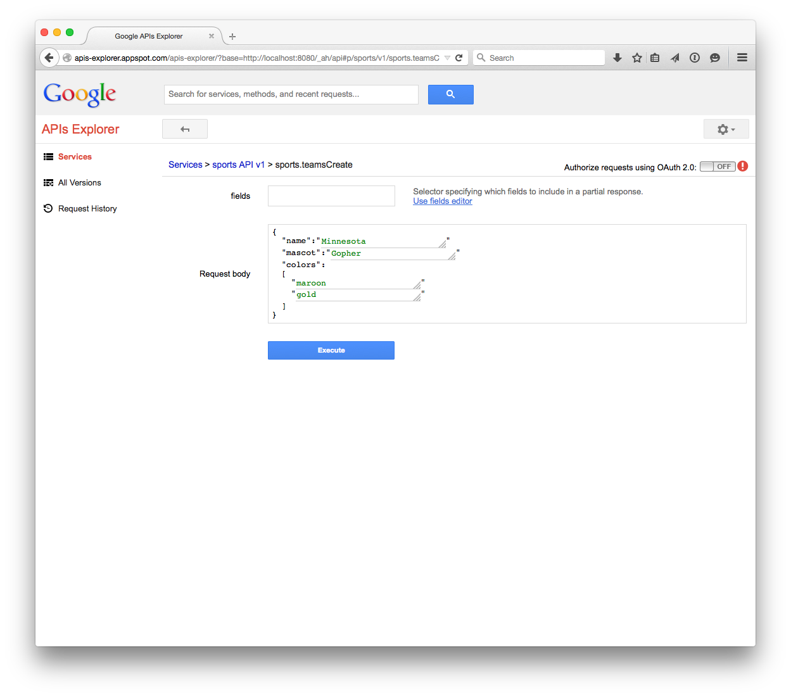
API Explorer

Slide 25
Define Messages
from protorpc import messages, message_types, remote
class TeamMessage(messages.Message): id = messages.StringField(1) name = messages.StringField(2) colors = messages.StringField(3, repeated=True) mascot = messages.StringField(4) class PlayerMessage(messages.Message): id = messages.StringField(1) name = messages.StringField(2) position = messages.StringField(3) team_id = messages.StringField(4)

Slide 26
Annotate Endpoints
@endpoints.api(name='sports', version='v1', description='Sports API') class SportsAPI(remote.Service):
@endpoints.method(message_types.VoidMessage, TeamsResponseMessage, name='teamsList', path='teams', http_method='GET') def get_teams(self, request): response = TeamsResponseMessage() response.teams = [] for team in Team.query().iter(): response.teams.append(team_to_msg(team)) return response

Slide 27
All Data Needs a Wrapper
TEAM_UPDATE = endpoints.ResourceContainer( TeamMessage, team_id=messages.StringField(2, required=True))
class SportsAPI(remote.Service): @endpoints.method(TEAM_UPDATE, TeamMessage, name='teamsSet', path='teams/{team_id}', http_method='PUT') def set_team(self, request): team = get_team_or_404(request.team_id) team = msg_to_team_set(request, team=team) team.put() return team_to_msg(team)

Slide 28
PATCH Not Possible
def msg_to_player_update(msg, player=None): player = player or Player() if msg.name is not None: player.name = msg.name if msg.position is not None: player.position = msg.position if msg.team_id is not None: team_id = msg.team_id player.team = ndb.Key(urlsafe=team_id) return player

Slide 29
protopy

Slide 30
Why ProtoPy
Messages are good, but need to be simplified
Fully support PATCH
Maintain control of HTTP
Control URL structure
Support for unstructured data

Slide 31
Messages
class TeamMessage(messages.Message): id = messages.StringField() name = messages.StringField() colors = messages.StringField(repeated=True) mascot = messages.StringField() class PlayerMessage(messages.Message): id = messages.StringField() name = messages.StringField() position = messages.StringField() team_id = messages.StringField()

Slide 32
Annotate Endpoints
class PlayerHandler(webapp2.RequestHandler): @protopy.endpoint @protopy.query.string('position') def get_players(self, team_id, position): _ = get_team_or_404(team_id) response = PlayersResponseMessage() response.players = [] q = Player.query(Player.team ==
ndb.Key(urlsafe=team_id)) if position: q = q.filter(Player.position == position) for player in q.iter(): response.players.append(player_to_msg(player)) return response

Slide 33
Control HTTP
class PlayerHandler(webapp2.RequestHandler): @protopy.endpoint(player_details=PlayerMessage) def create_player(self, team_id, player_details): _ = get_team_or_404(team_id) player_details.team_id = team_id player = msg_to_player_set(player_details) player.put() return 201, player_to_msg(player),
{'Location': webapp2.uri_for('get_player',
team_id=team_id, player_id=player.key.urlsafe())}

Slide 34
Closing Thoughts

Slide 35
Code Structure
Handlers
HTTP Concerns
Messages
Models, Messages
Services
Business Logic
Models
Models
Persistence

Slide 36
Tips & Tricks
Special IDs
RPC methods off of resources when it makes more sense
Think hard before using nested resources
Prefer PATCH to PUT

Slide 37


Thank You
@rmorlok
ryan.morlok@morlok.com
https://github.com/rmorlok

