Slide 1
The Zeeman Effect
Measuring the Bohr Magneton
Ryan Morshead & Nathan Milgram

Slide 2
Introduction
Pieter Zeeman is credited explaining what we call the Zeeman effect.
Substances which emit photons exhibit this effect when subjected to magnetic fields.
There are two types of effects, the normal and anomalous Zeeman effects.
The normal Zeeman effect occurs when there is no spin magnetic moment.
In the more common anomalous Zeeman effect, several lines appear.
Our Goal in this experiment is to measure
the value of the Bohr magneton (μ_{B}) using this effect
Notes:
Pieter Zeeman is credited with the quantum explanation of spin and its relation to a particle’s magnetic field. This relationship produces the phenomena we call the Zeeman effect.
This effect is responsible for line splitting in the emission spectra of substances subjected to uniform magnetic fields.
Normal Zeeman effect, which is the one we will be reporting on, occurs when the spin quantum number S is zero. In other words the net spin of the electrons is zero. In this case the change in energy for displaced lines is
The more common anomalous Zeeman effect concerns the case where the total spin is not zero. As a result the number of lines which appear is far greater an more complex.

Slide 3
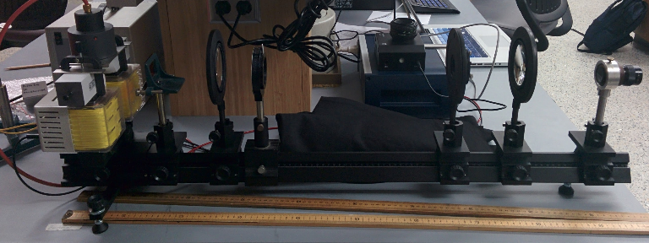
Experimental Arrangement
Sample Housing and Magnets
Lenses
Ocular
Red Filter
Polarization Filter
Fabry-Perot etalon
*Ocular is replaced with VideoCom for the experiment
Notes:
We have the experimental arrangement, there’s a series of lenses which focus the photons from the housing at various points, along with a polarizer, filter, fabry erot etalon, and in this case an ocular. Though during the experiment with is switched with the VideoCom spectrometer.
The polarizer lets us isolate the different polarized components which the Zeeman effect separates. The components, in this particular arrangement are either perpendicular, for the displaced lines, and parallel for non displaced lines

Slide 4
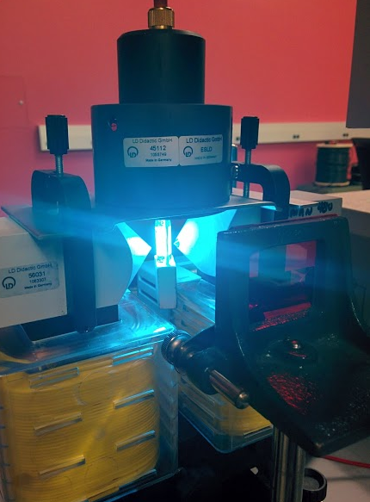
Sample Housing and Magnets
We apply a current to a Cadmium lamp to cause the Cd to release photons.
The red filter limits observations to Cd’s 643.8 nm emission line.
The magnets one either side make B-fields which alter this emission line.
Notes:
In order to create photons we apply a current to a cadmium lamp at which point the added energy causes excited electrons to emit photons as the descend to lower energy levels.
The red filter which you can see in this image will limit out observations to Cadmiums 643.8 nm emission line
The two magnets which cause the polarization and line splitting are on either side of the glowing lamp in the image.

Slide 5
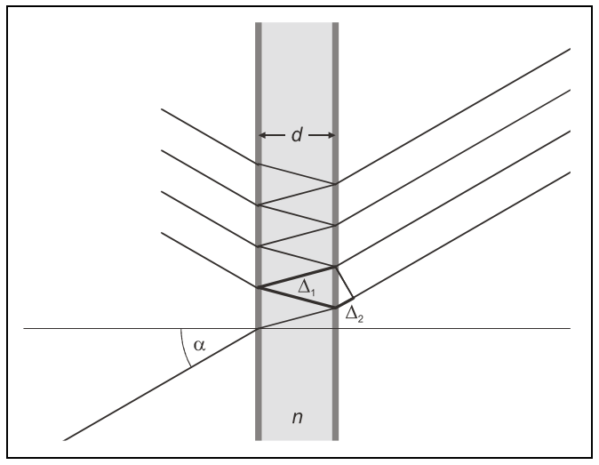
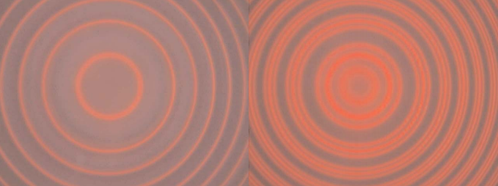
Fabry-Perot etalon
Made of transparent plate with reflective coating on either side.
An interference patter is created by reflection inside the etalon.
Phase shift through etalon:
Constructive Interference:
Pattern is circular about the α=0 line
No field
With field
Notes:
The fabry perot etalon is essentially a glass plate with a aluminized sides to create internal reflection.
Through this internal reflection we are able to observe an interference pattern.
Phase shift arises from path difference via reflection inside the etalon minus the difference from delta 2. where in the equation n is the refraction index of the glass
The pattern of the interference is circular as seen through the ocular and is centered about the α=0 line.
Because the light passes through the glass, different wavelength will observe different levels of refraction and thus different distances between the rings in the pattern shown below.

Slide 6
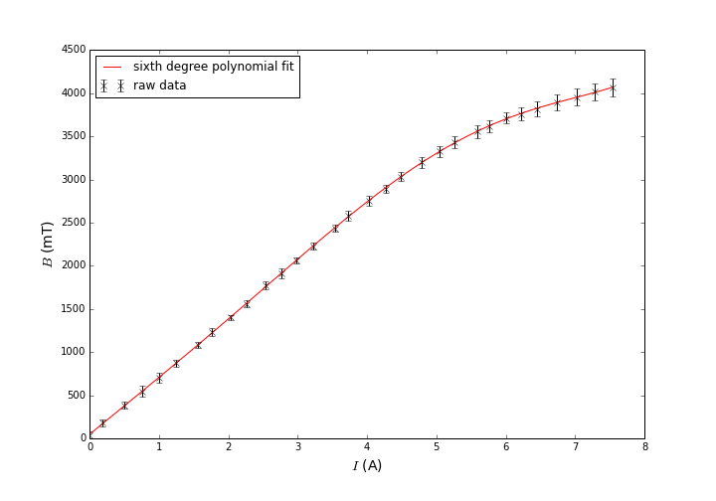
Calibration
We measure the magnetic field (B-field) strength and the current (I) required to generate it.
This data is then fit to a curve to predict the B-field at an arbitrary I.
Notes:
We begin by measuring magnetic field (B-field) strength along with the current (I) required to generate that particular field.
This data is then fit to a curve in order to predict the B-field at an arbitrary current.
Here we use a sixth degree polynomial fit there is no particular theory surrounding this data set. If there was we might use a more appropriate fit equation. However this seems to perform admirably

Slide 7
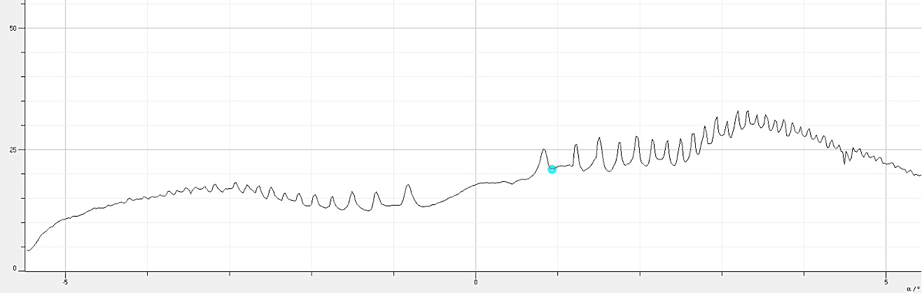
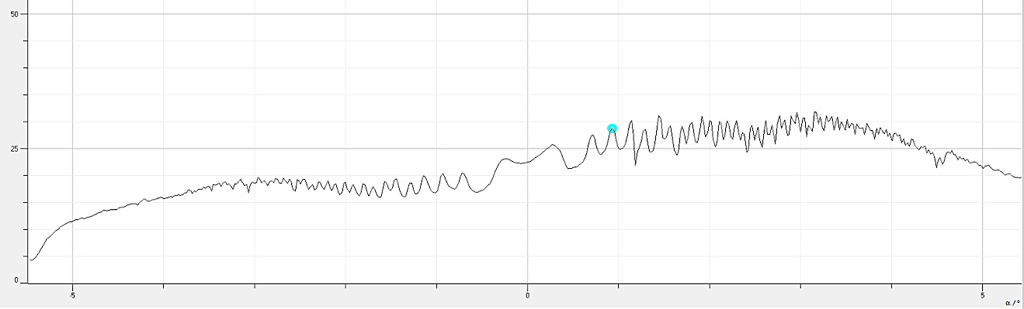
Procedure
We incrementally increase the B-field in order to take advantage of the relation:
The degrees of divergence from the non-displaced line (L=0) for different B’s gives a linear fit, with slope μ_{B}.
We use a spectrometer to analyze the Fabry Perot interference pattern.
Spectrometer output is shown below:
No field
With field
*note the increased number of lines when the field is present
Notes:
We incrementally increase the B-field in order to take advantage of the energy shift equation for substances in magnetic fields.
By knowing how much the emission lines diverge from the non-displaced line (L=0) at each value of B, we can determine, via a linear fit, the value of μ_{B}.
In order to get that information we use the videocom spectrometer.
The output we get is shown below.

Slide 8


The program gives us the peak location in degrees from the non-displaced line.
With this information we use the following equation to find λ.
It’s then an easy task to convert wavelength to energy using
where it can be applied to
in the case where L=-1
Notes:
The program gives us an output that allows us to determine the peak location in degrees from the non-displaced line.
With this information we determine Δλ, where λ is the wavelength of the non-displaced line, and α is the divergence from the non-displaced line in degrees.
It’s then an easy task to convert wavelength to energy using
where it can be applied to
in the case where L=1

Slide 9
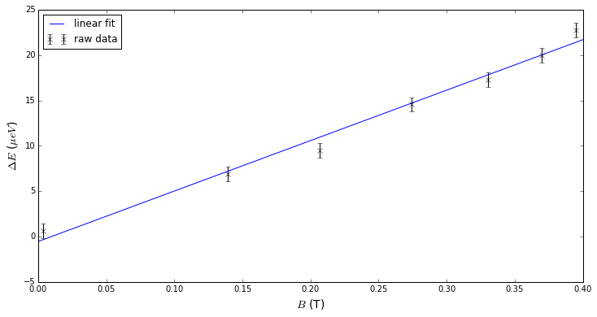
Linear Fit of ΔE vs. B-field

Slide 10
Results
The slope of the linear fit for ΔE vs. B-field provides us with one value for μ_{B}.
Using an alternate method where we simply apply values for ΔΕ and B to
and simply average the resulting μ_{B} values.
The results are as follows:
 | μ_{B} ± δμ_{B} (μeV/T) | Y-intercept (μeV)
Linear Fit | 56±3 | -0.5±0.8
Averaged | 61±2 | NA
Expected | 57.88 | 0
Notes:
Note small y-intercept also suggests small error. For even with a reasonable value for the bohr magneton from the slope we

Slide 11
Conclusion
We observed the Zeeman effect and took advantage of it to accurately measure to Bohr magneton.
The linear fit measures it to within one standard deviation of the accepted value
The simple average measures it to within two standard deviations of the accepted value

