Slide 1
Group 4
By: Mohamed Bakr, Dylan LoPresti, Cole Hausman, Ryan Mosenkis

Slide 2
Roles
Mohamed: Product Owner
Cole: Scrum Master
Dylan: Ethics and Justice Leader
Ryan: Developer

Slide 3
About Our Project
A common problem occurs when a person loses their internet connection while browsing the internet. To solve this, allow these people to play a simple game to entertain them until their internet connection becomes stable once again.
Our main two key user stories were first, implementing obstacles and objectives for the player to avoid and collect. Second, implementing a bot to play the game, which allows for the user to learn the gameplay.

Slide 4
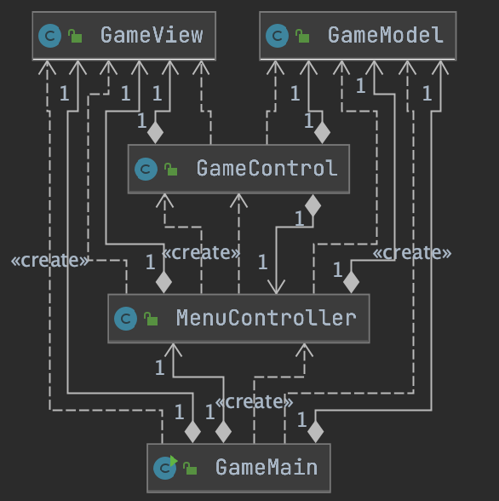
Design and Implementation
Classes:
GameMain
GameView
GameModel
GameControl
MenuController
Notes:
What were the major classes implemented? Present a very basic UML class diagram that includes only the class names and important relationships! Make sure its readable by the listener! And more importantly, make sure you can clearly explain it! Keep unnecessary details out, such as fields and methods. Make a diagram that has only the class names, relationships between the classes. Include only those fields and methods that are an integral part of your design and are relevant for your presentation.
o Any interesting data structures out of the ordinary? Discuss it!
o The team is encouraged to use UML state and sequence diagrams to help discuss challenging parts of their design.
o Did you use any advanced data structures of your own, or from the Java API? What were the major algorithms used? (e.g. if you implemented a computer player, how did you govern how the computer plays? Did you apply any AI algorithms? Or brute force? What rules did you use?)

Slide 5
Demonstration

Slide 6
Reflection
Our scrum process went fairly well over the course of the project. We were able to effectively plan out sprints utilizing our product backlog time estimates to create a well planned out burndown chart. As well as this, our time tracking went very well and the result is that our burndown chart looked very close the estimated time. However, we were not without setbacks, we fell behind in terms of keeping all of our scrum artifacts up to date especially near the end of the project.
If we had to do it again, we would be sure to take time to keep everything up to date so that we would not be scrambling and everyone would have a very clear vision of what is currently being worked on and what is still to come.
o For successes, we created a fully functioning game even including sounds and an automated bot to play the game as well
o For our challenges, git merges proved to be brutal as the various branches slowly had to come together, and while it worked out in the end, it was tough to work through the issues that arose in git along the way

Slide 7
Conclusion
Through our work on this project, we learned how important teamwork and communication are for completing a project in a timely, organized manner.
If we could release version 2.0, we would implement new features such as true machine learning AI, crouching mechanics, varying obstacle sizes, etc.

