Slide 1


Attrition and Salary Prediction
Richard M. Palmer
Case Study 2
DS6306 – Section 408 - Fall 208 - Bivin Sadler

Slide 2
Introduction
Goal is to find a way to predict both of the following:
Attrition of employees (Yes or No)
Monthly Income
Using data on 870 Employees
19 numeric variables
7 categorical variables
6unusable variables

Slide 3
Unusable Variables
Constant values:
EmployeeCount
StandardHours
Over18
No Correlation with MonthlyIncome
HourlyRate
DailyRate
MonthlyRate

Slide 4
Data Summary
Categorical Data
Department
EducationField
Gender
Job Role
Marital Status
Business Travel
Overtime
Numeric Data
Age
Distance From Home
EnvironmentSatisfaction
JobInvolvement
JobLevel
JobSatisfacton
NumCompaniesWorked
PercentSalaryHike
PerformanceRating
StandardHours
Numeric Data
RelationshipSatisfaction
StockOptionLevel
TotalWorkingYears
TrainingTimesLastYear
WorkLifeBalance
YearsAtCompany
YearsInCurrentRole
YearsSinceLastPromotion
YearsWithCurrManager

Slide 5
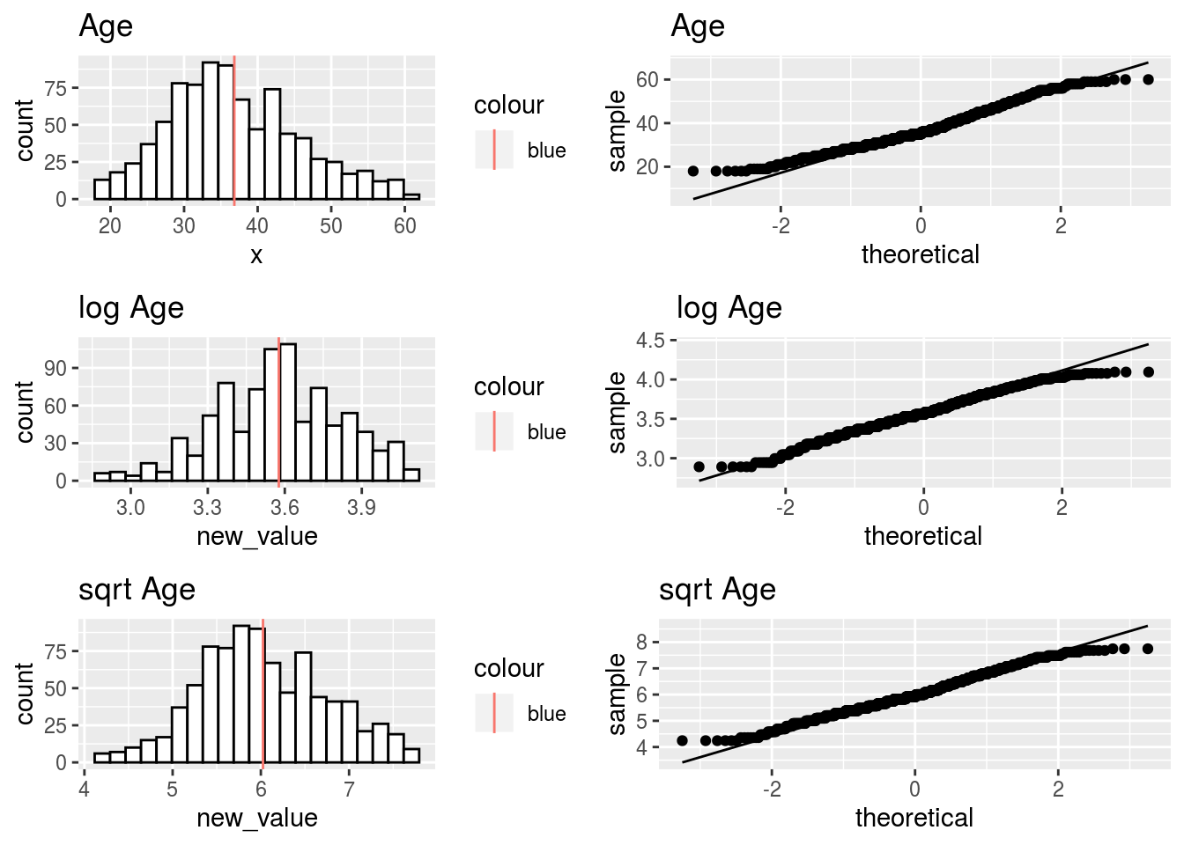
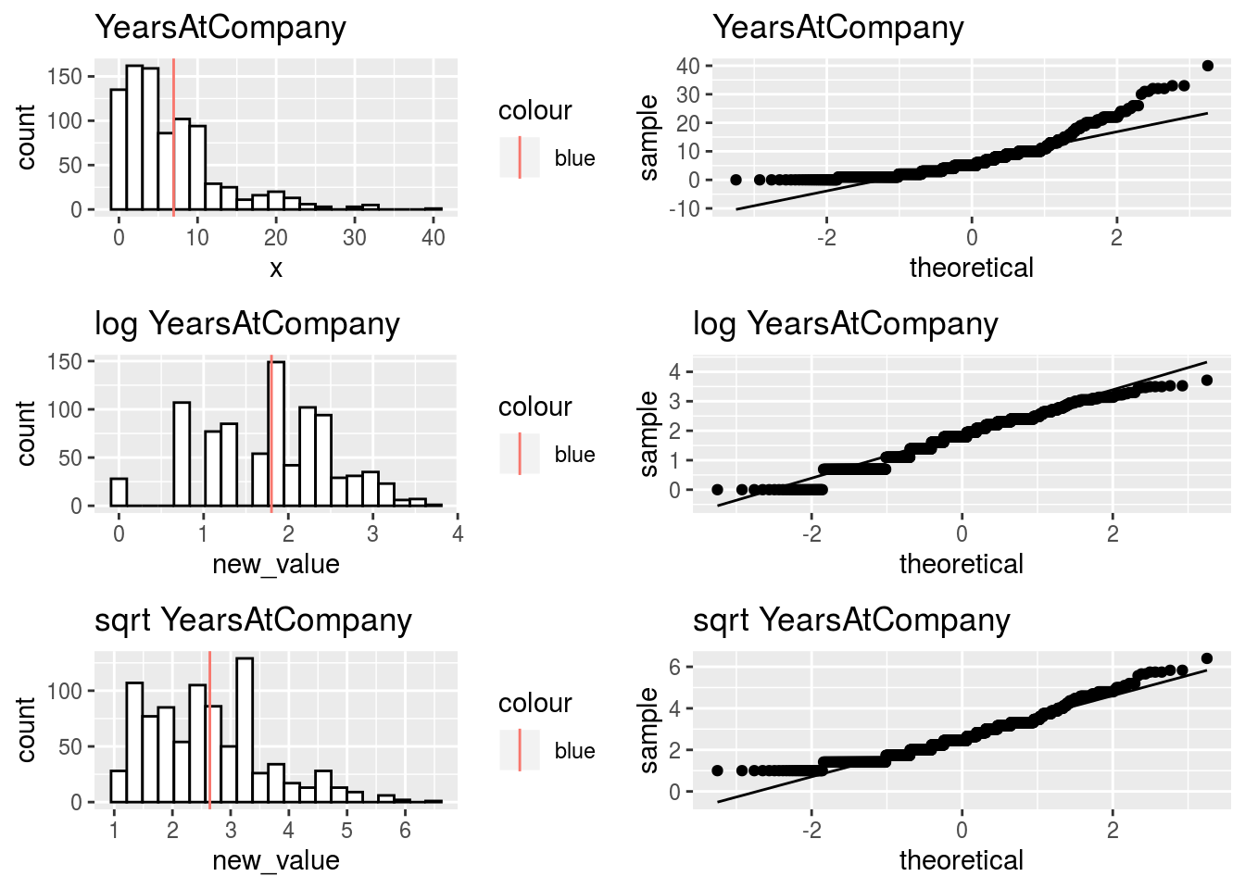
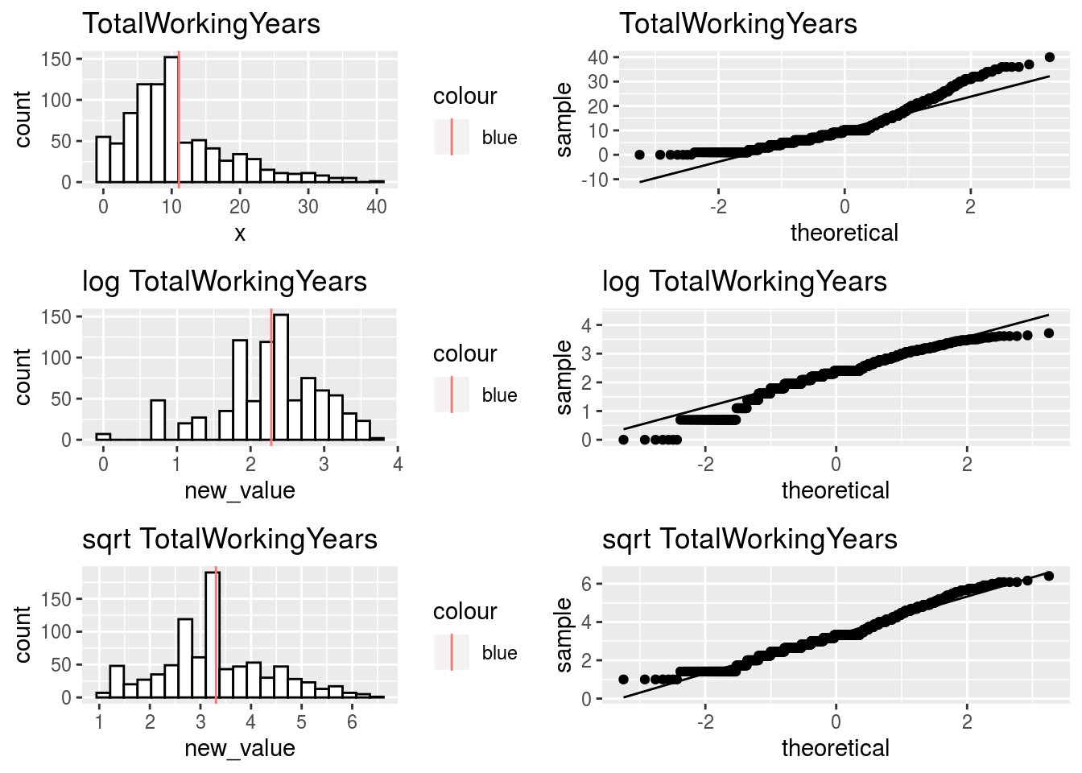
Data Transformation
We want numeric predictors to have distributions that are close to normal.
Look at histograms and consider whether log() or sqrt() transforms help.
No transform required
Log helps
Square Root helps

Slide 6
Data Transformation
Categorical Data
Department
EducationField
Gender
Job Role
BusinessTravel
Marital Status
OverTime
Over18
Numeric Data
Age
EnvironmentSatisfaction
JobInvolvement
JobLevel
JobSatisfacton
NumCompaniesWorked
PercentSalaryHike
PerformanceRating
HourlyRate
DailyRate
MonthlyRate
Numeric Data
RelationshipSatisfaction
StockOptionLevel
TrainingTimesLastYear
WorkLifeBalance
TotalWorkingYears
Distance From Home
YearsAtCompany
YearsInCurrentRole
YearsSinceLastPromotion
YearsWithCurrManager
StandardHours
EmployeeCount
Made Numeric
Discarded
Square Root
Log

Slide 7
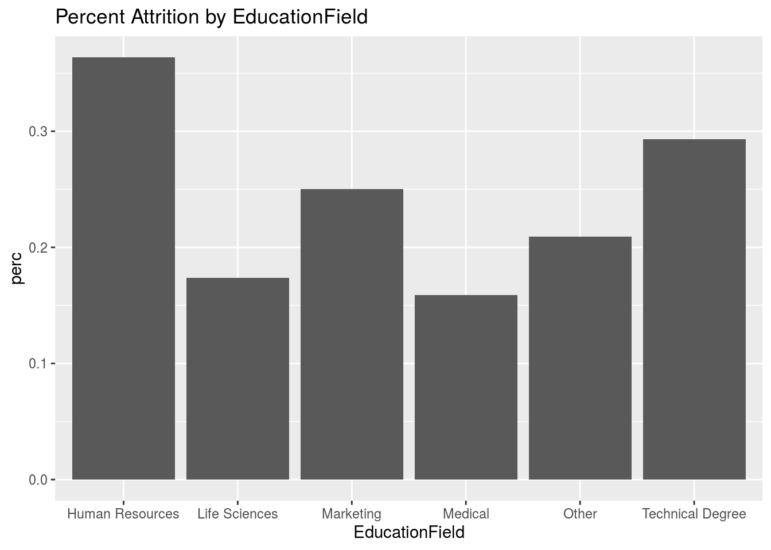
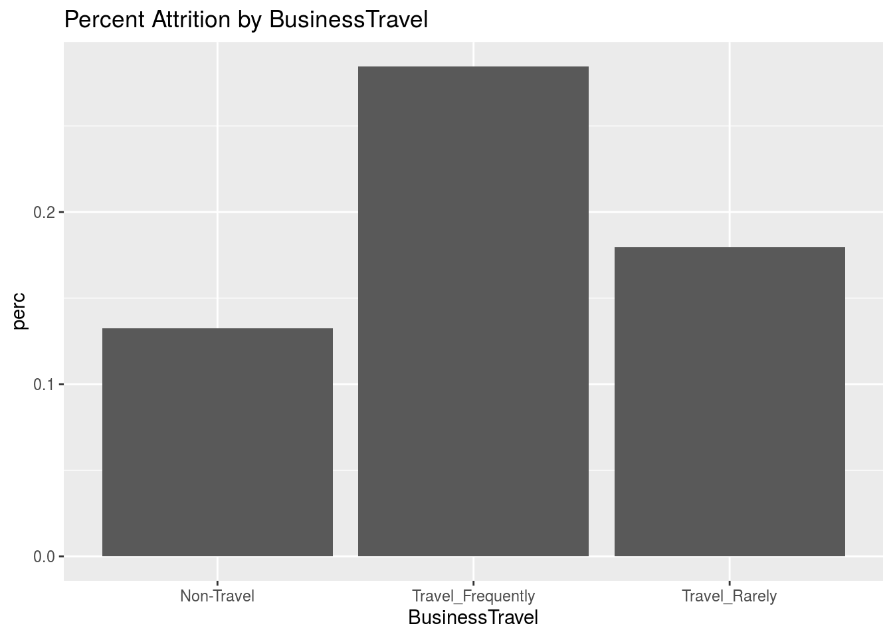
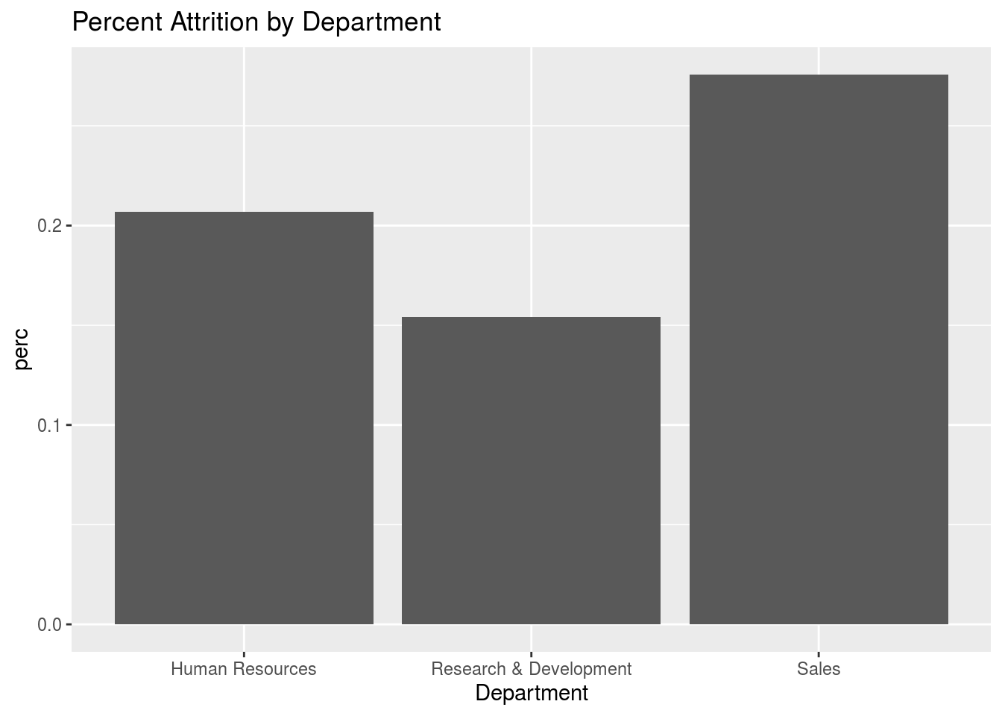
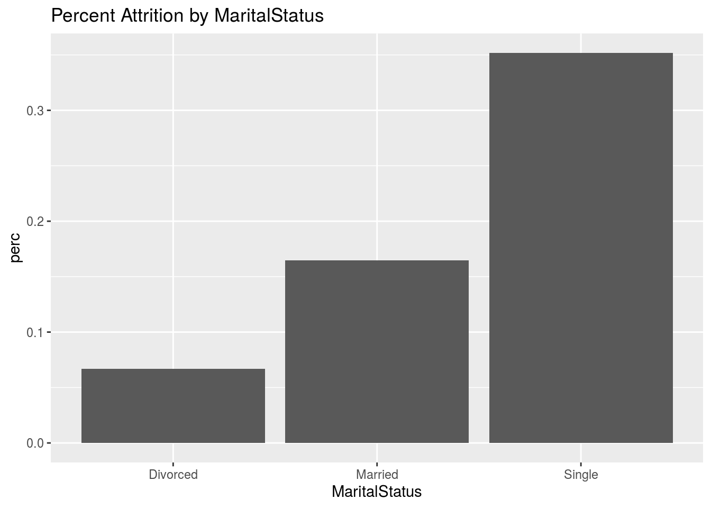
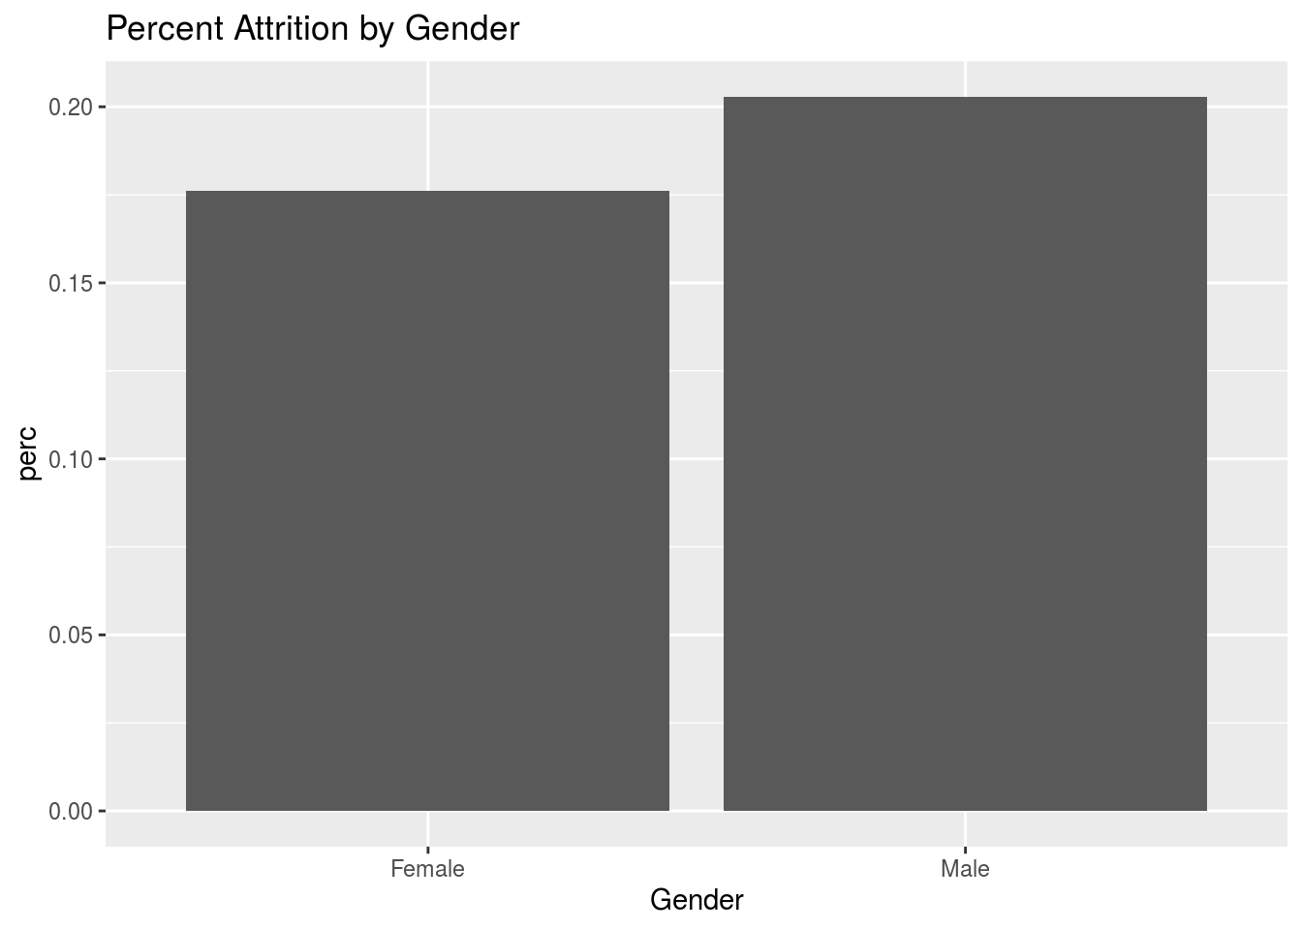
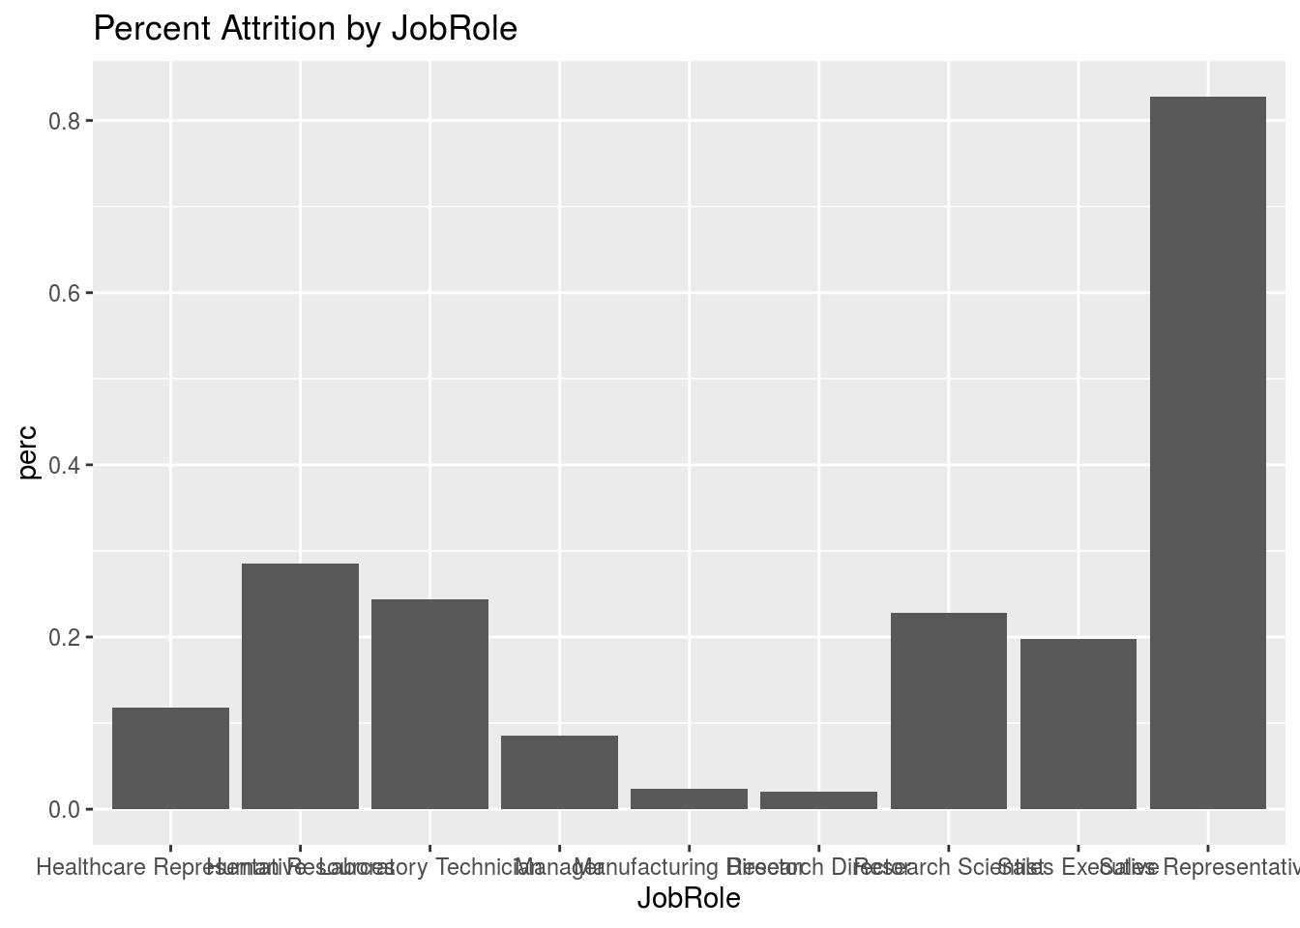
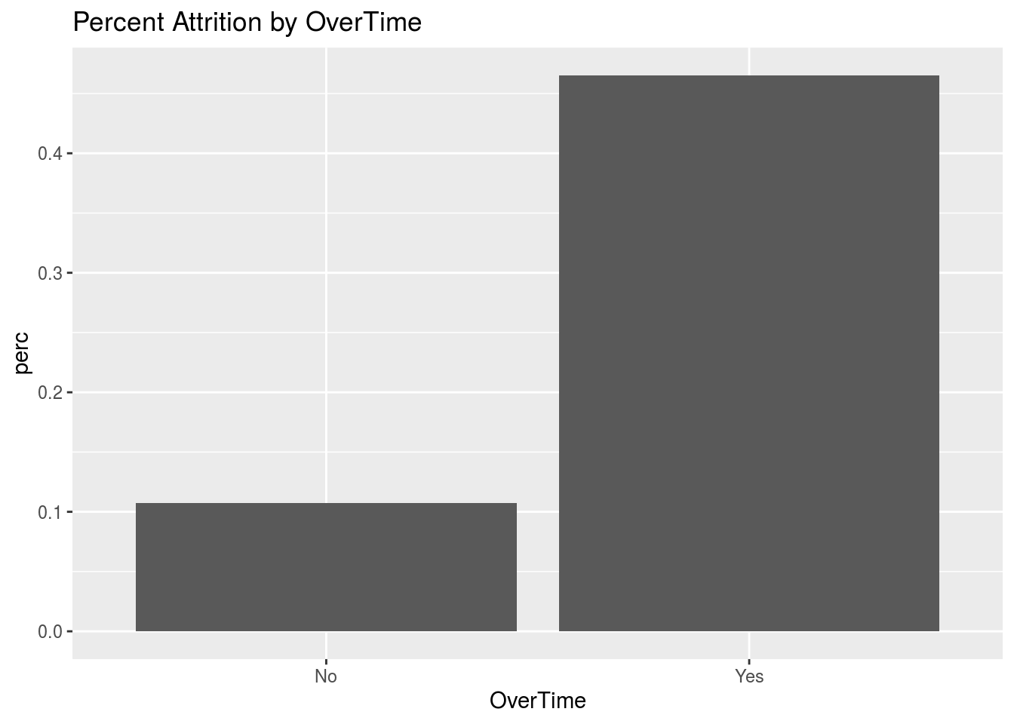
Factors related to Attrition

Slide 8
Naïve Bayes Prediction
All Factors
Predictors from Stepwise AIC Selection
accuracy of 84 %
sensitivity of 42 %
specificity of 92 %
“yes” predictions:13%
“no” predictions: 87%
accuracy of 86 %
sensitivity of 26 %
specificity of 97 %
“yes” predictions: 6%
“no” predictions: 94%
Distance From Home
EnvironmentSatisfaction
NumCompaniesWorked
OverTime
TotalWorkingYears
TrainingTimesLastYear
WorkLifeBalance
YearsSinceLastPromotion
JobInvolvement
JobSatisfaction
MaritalSTatus
Acceptable Accuracy, but Sensitivity is poor (Not catching all true 'YES')

Slide 9
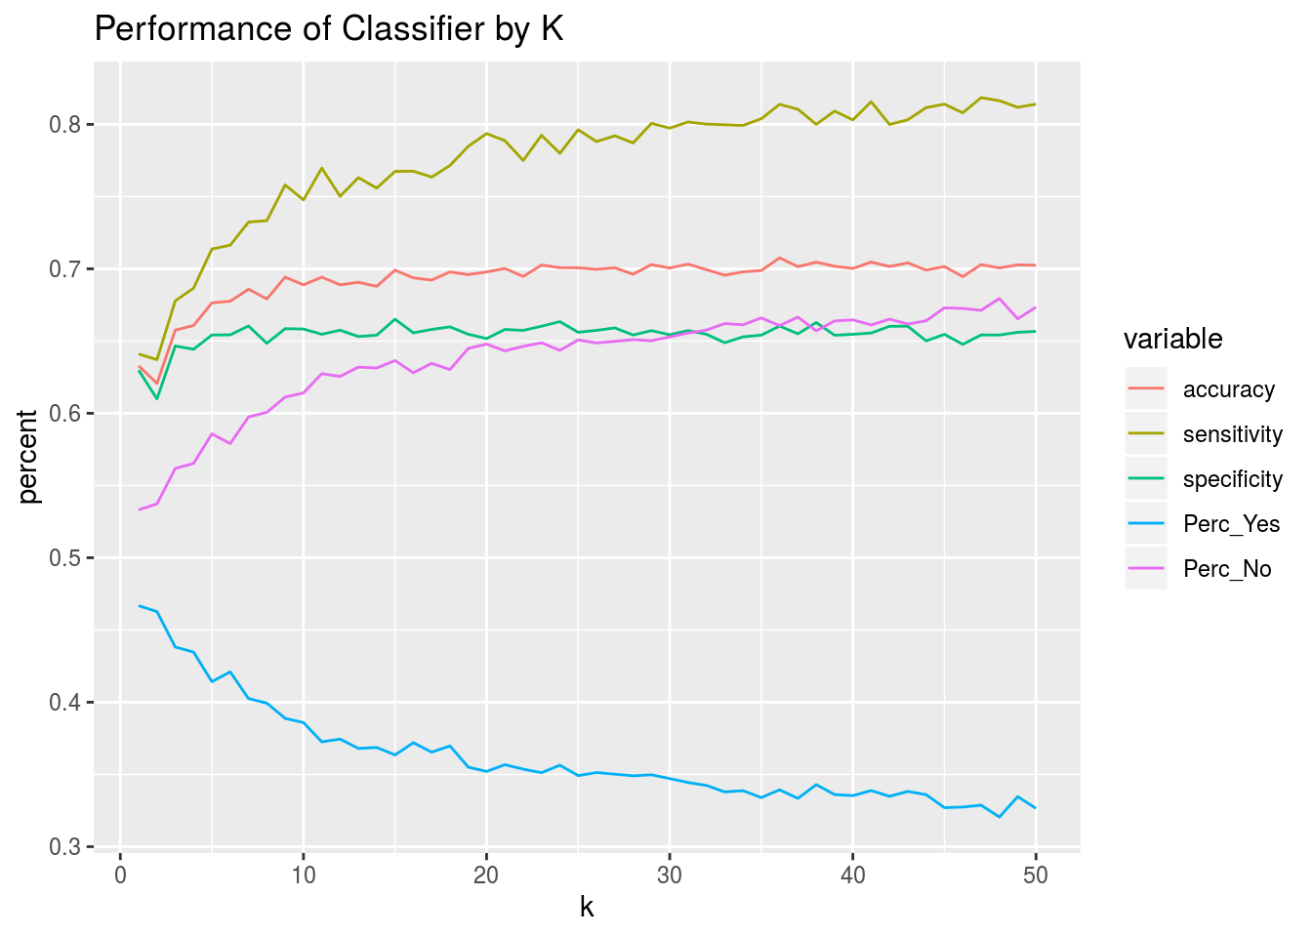
Prediction by K-Nearest-Neighbor (1)
Transform and scale numeric predictors
Use Stepwise AIC method for variable selection
Variable | F Statistic | P value
Age | 25.6 | 5e-7
Distance From Home | 7.65 | .00580
Environment Satisfaction | 6.62 | .0102
Job Involvement | 39.5 | 5e-10
Job Satisfaction | 16.6 | 5e-5
Num Companies Worked | 12.4 | .000448
Relationship Satisfaction | 2.71 | .100
Total Working Years | 36.5 | 2e-9
Training Times Last Year | 5.12 | .0239
Work Life Balance | 7.03 | .00817
Years In Current Role | 3.71 | .00545
Years Since Last Promotion | 20.7 | 6e-6
Years With Current Manager | 1.65 | .200
OverTime | 74.3 | 2e-16
Marital Status | 31.4 | 2e-8
Finding appropriate neighborhood size

Slide 10
Prediction by K-Nearest-Neighbor (2)
Problem of small attrition count relative to total number of employees
For training (finding K), select equal number of 'Yes' and 'No' Observations
For blind dataset, assume same statistics as training data
Algorithm:
Apply knn, return probabilities
Multiply probabilities by K size to get raw number of votes for Yes and No
Divide raw vote count by expected number of Yes or No votes to get score
Use score to determine new decision Yes or No
Training Data
No | Yes | Accuracy | Sensitivity | Specificity
730 | 140 | 85% | 100% | 84%
Test Data
No | Yes
229 | 71
Because knn does better, I use it for prediction instead of Naïve Bayes

Slide 11
Factors related to Salary
Subjective Variable Selection
Variable Selection by Stepwise AIC method
Categorical
Gender
JobRole
EducationField
Numeric
JobLevel
TotalWorkingYears
Education
PerformanceRating
RelationshipSatisfaction
StockOptionLevel
YearsAtCompany
Categorical
BusinessTravel
Gender
JobRole
Numeric
DistanceFromHome
JobLevel
PercentSalaryHike
PerformanceRating
TotalWorkingYears
YearsSinceLastPromotion
YearsWithCurrManager
Minimal Set
Stepwise AIC method: retain statisticallly significant
Numeric
JobLevel
TotalWorkingYears
Numeric
JobLevel
TotalWorkingYears
YearsWithCurrManager

Slide 12
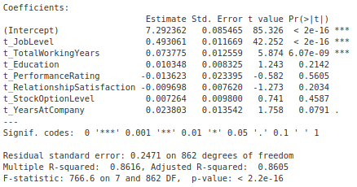
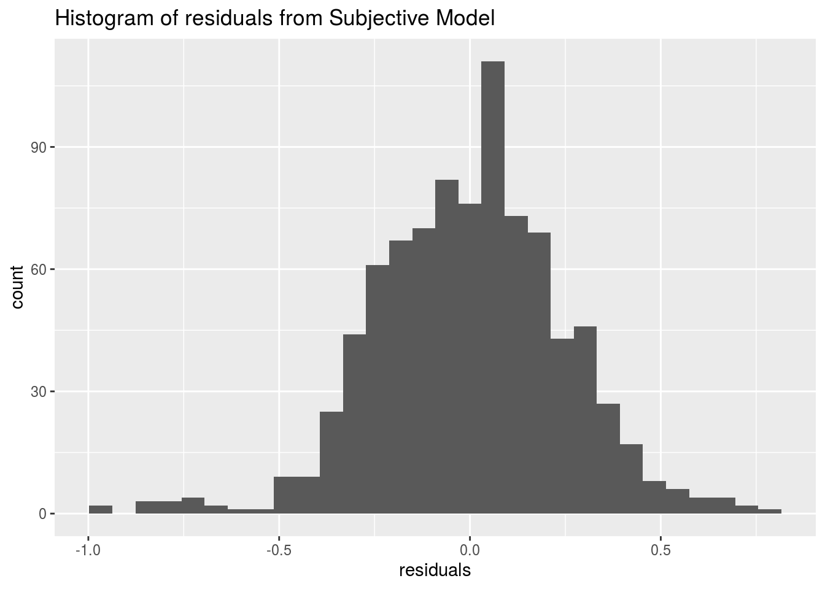
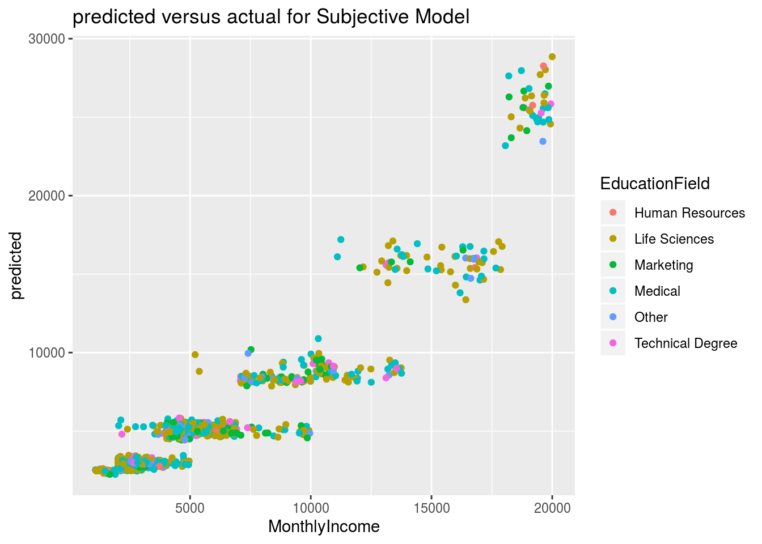
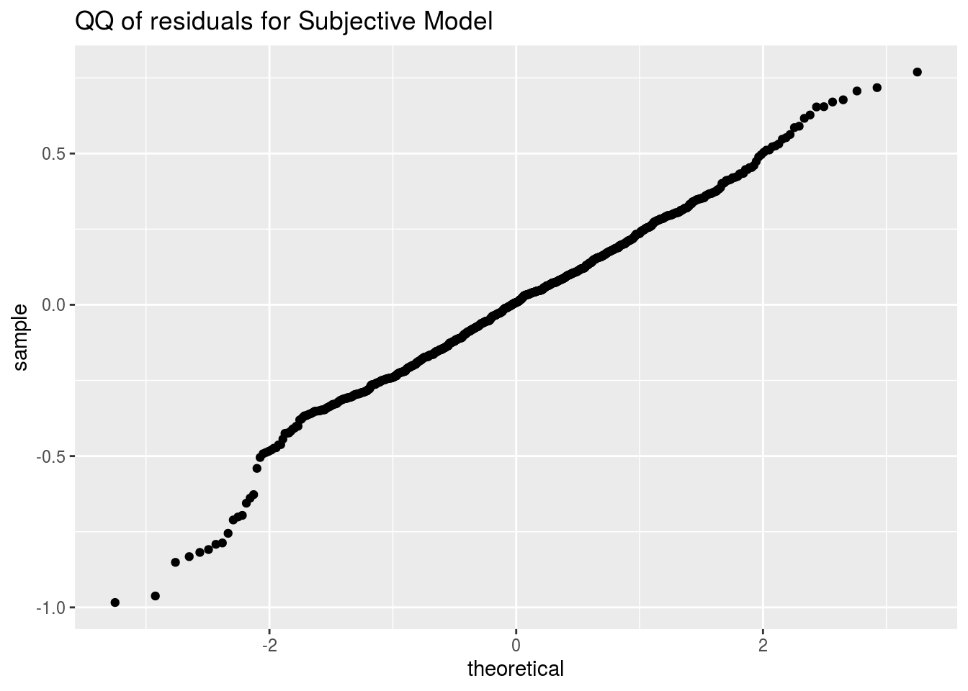
Subjective Model

Slide 13
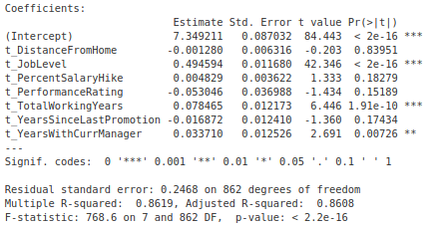
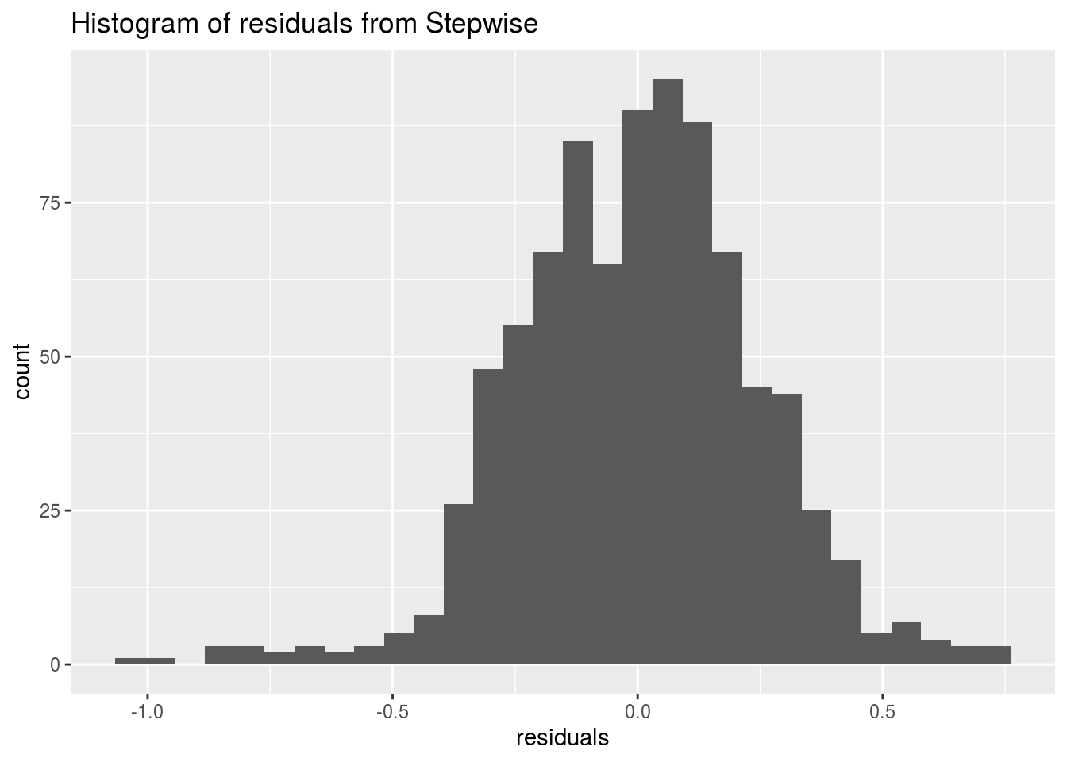
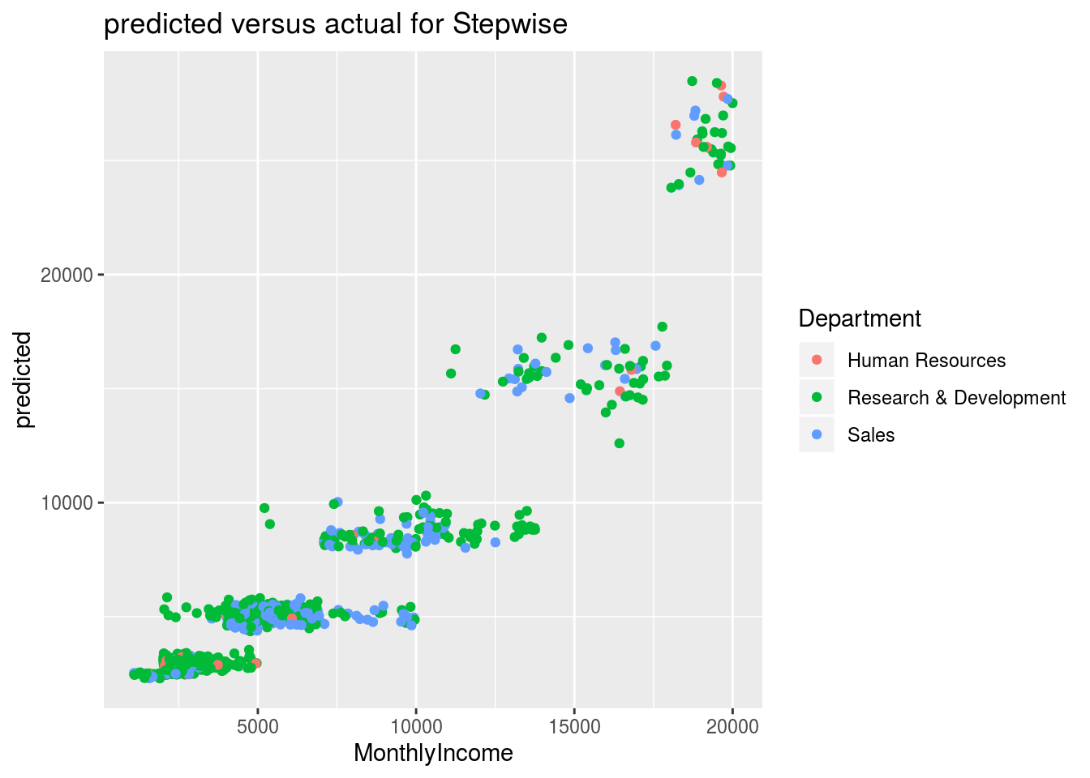
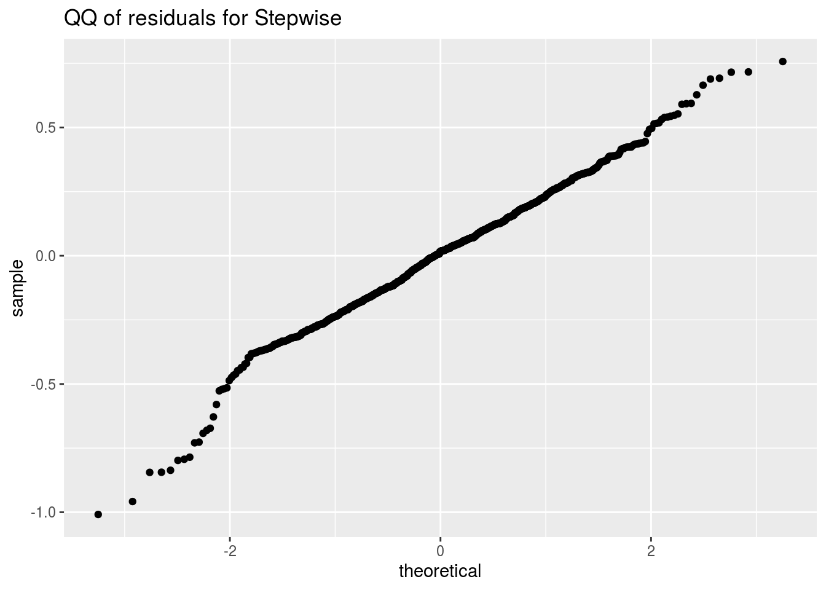
Stepwise Model

Slide 14
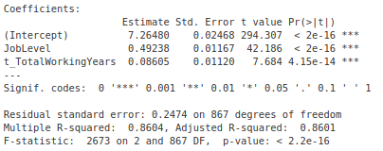
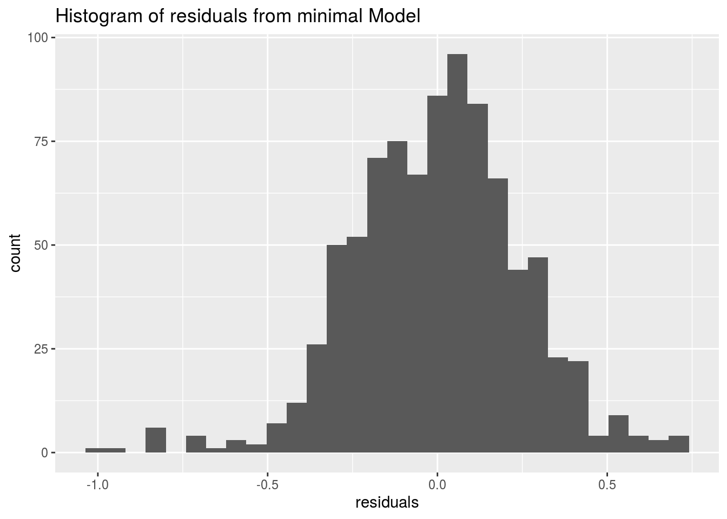

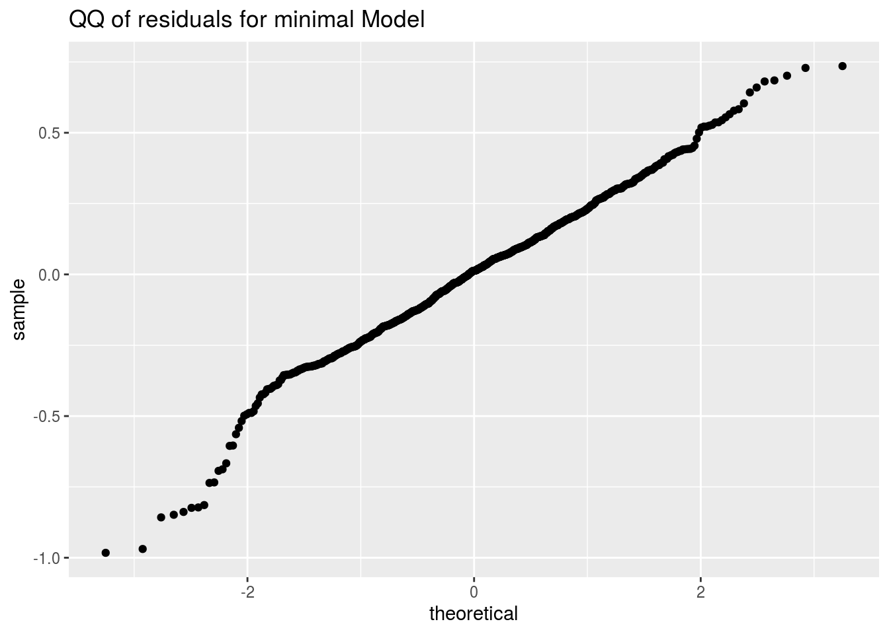
Minimal Model

Slide 15
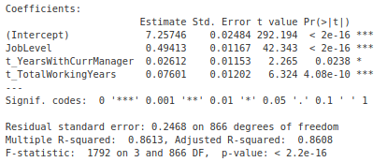
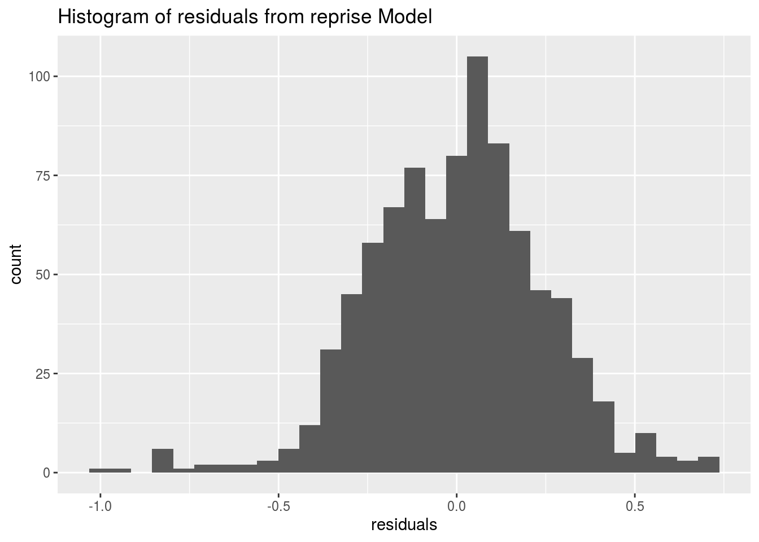
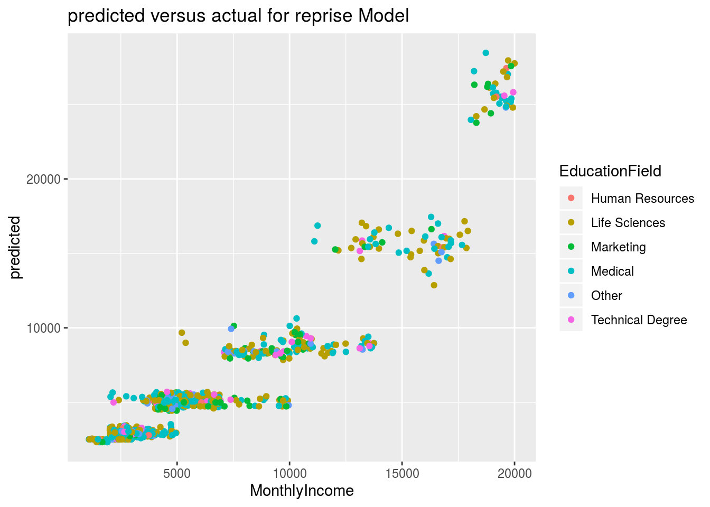
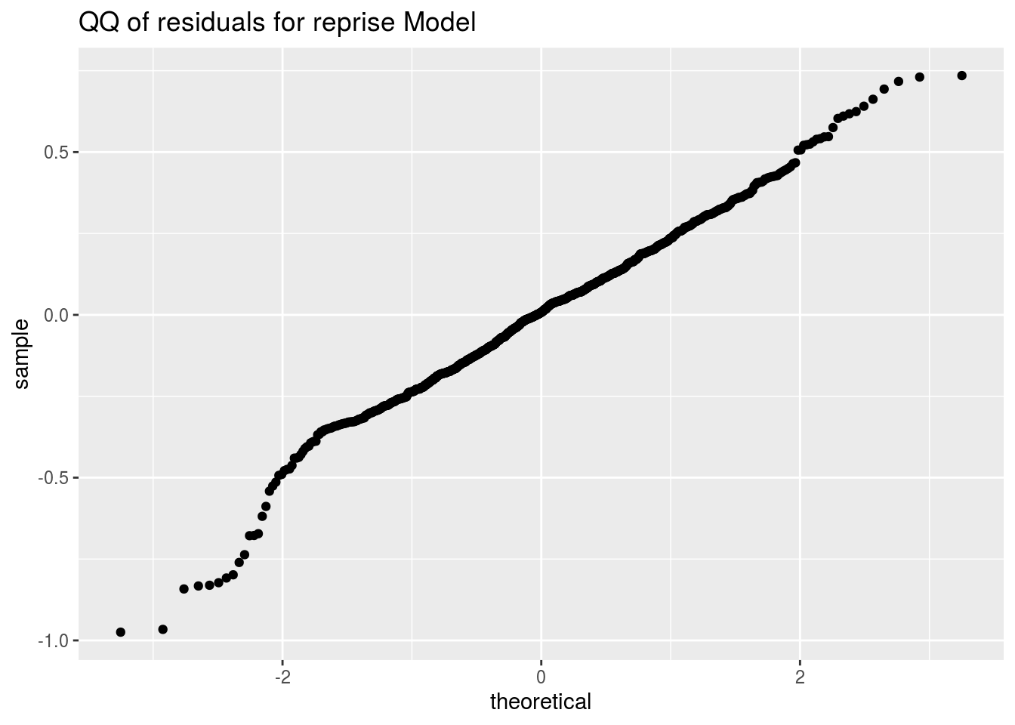
Simplified Model

Slide 16
Summary
The model produced by stepwise selection appears to have the best R squared, and residuals appear normal
This is what is used for predictions on the blind test data.
..but..
There is clustering in the residuals that indicates some other predictor may help, but I have been unable to find it.

