Slide 1
Attrition and Salary Prediction
Richard M. Palmer
Case Study 2
DS6306 – Section 408
Fall 208 – Bivin Sadler

Slide 2
Introduction
Goal is to find a way to predict Attrition of employees
Data on 870 Employees

Slide 3
Data Summary
Categorical Data
Department
EducationField
Gender
Job Role
Marital Status
Business Travel
Over18
Overtime
Numeric Data
Age
Distance From Home
EnvironmentSatisfaction
JobInvolvement
JobLevel
JobSatisfacton
NumCompaniesWorked
PercentSalaryHike
PerformanceRating
StandardHours
Numeric Data
RelationshipSatisfaction
StockOptionLevel
TotalWorkingYears
TrainingTimesLastYear
WorkLifeBalance
YearsAtCompany
YearsInCurrentRole
YearsSinceLastPromotion
YearsWithCurrManager

Slide 4
Data Transformation
Categorical Data
Department
EducationField
Gender
Job Role
BusinessTravel
Marital Status
OverTime
Over18
Numeric Data
Age
EnvironmentSatisfaction
JobInvolvement
JobLevel
JobSatisfacton
NumCompaniesWorked
PercentSalaryHike
PerformanceRating
StandardHours
Numeric Data
RelationshipSatisfaction
StockOptionLevel
TrainingTimesLastYear
WorkLifeBalance
TotalWorkingYears
Distance From Home
YearsAtCompany
YearsInCurrentRole
YearsSinceLastPromotion
YearsWithCurrManager
Made Numeric
Discarded
Square Root
Log

Slide 5
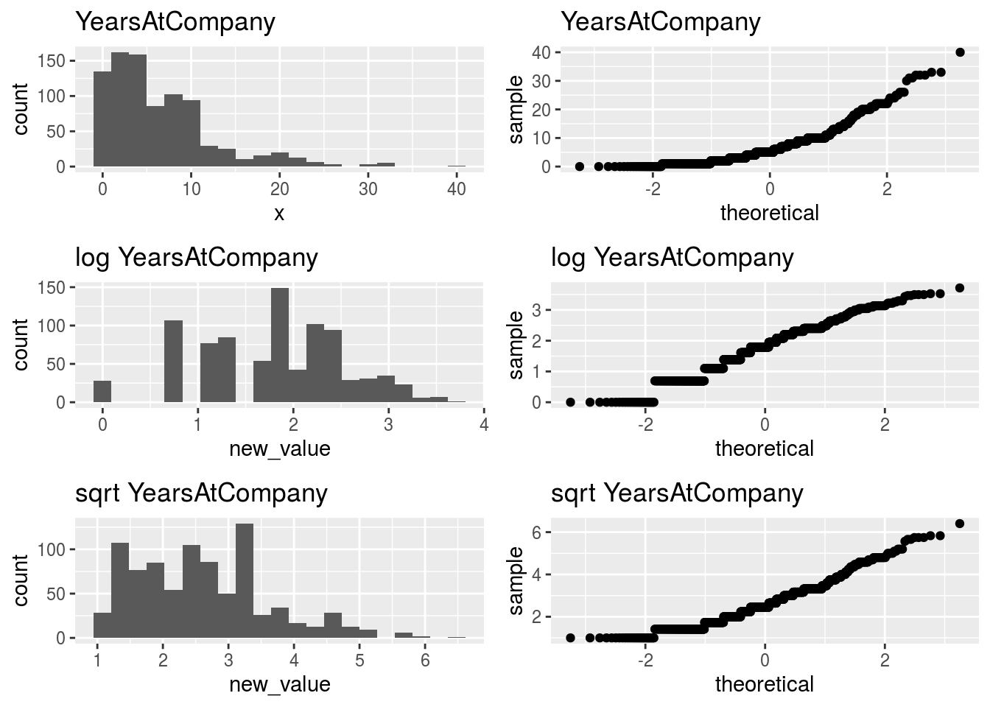
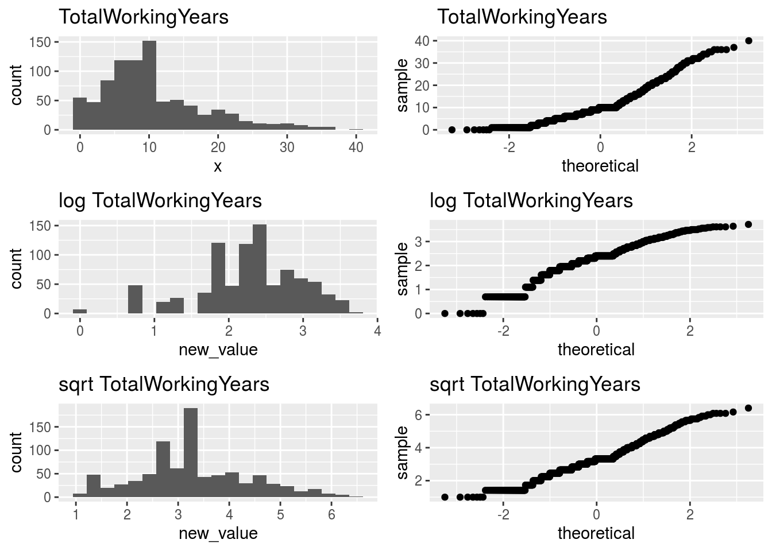
Data Transformation

Slide 6
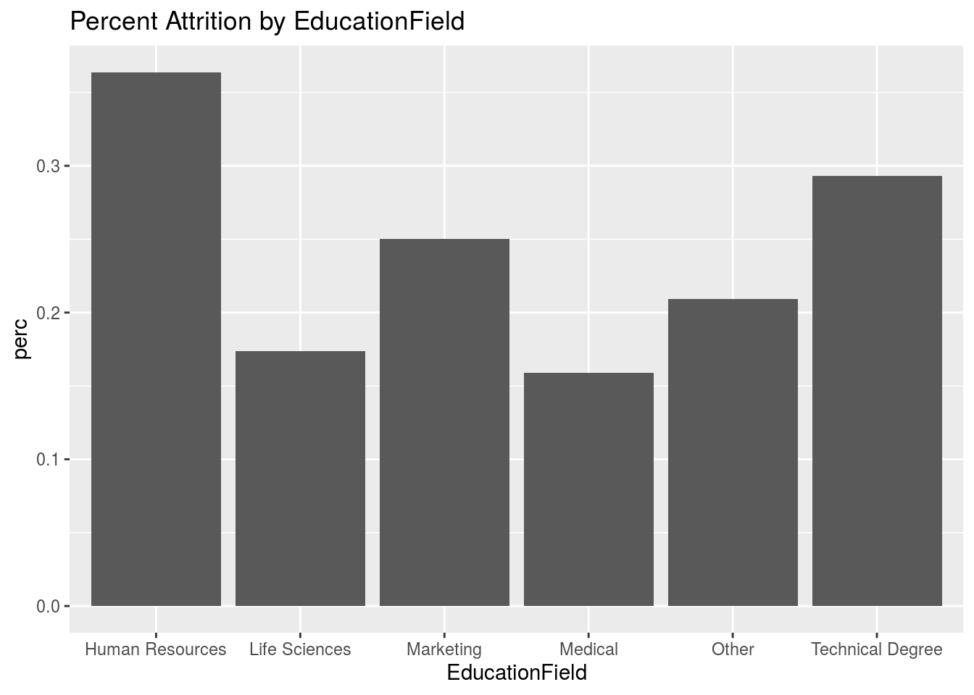
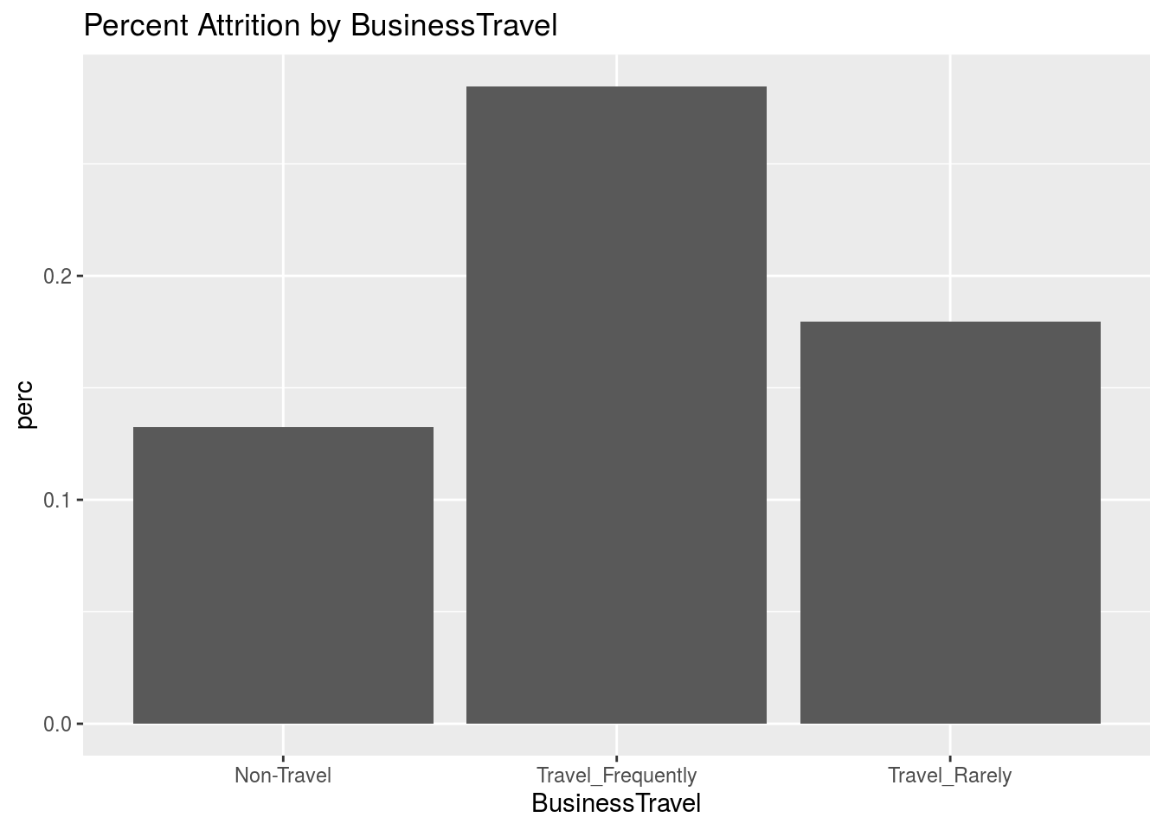
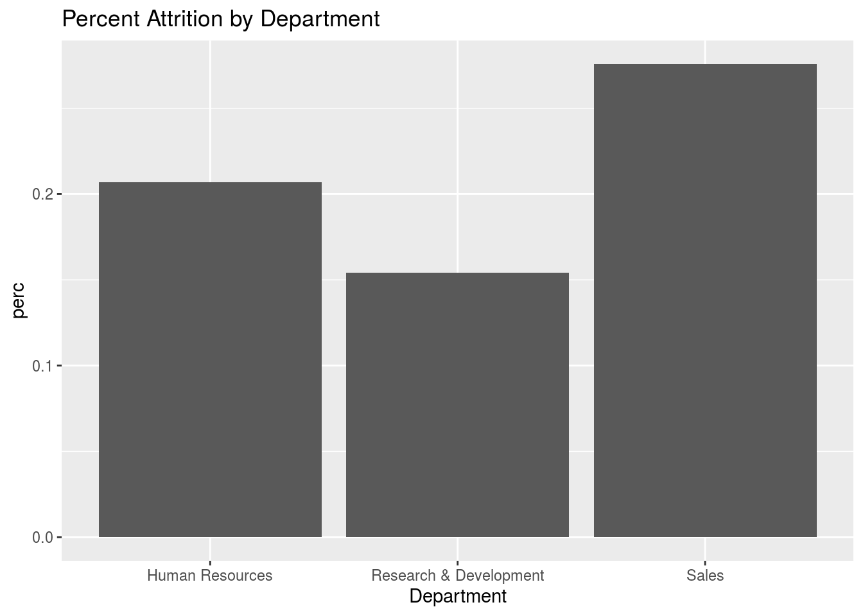
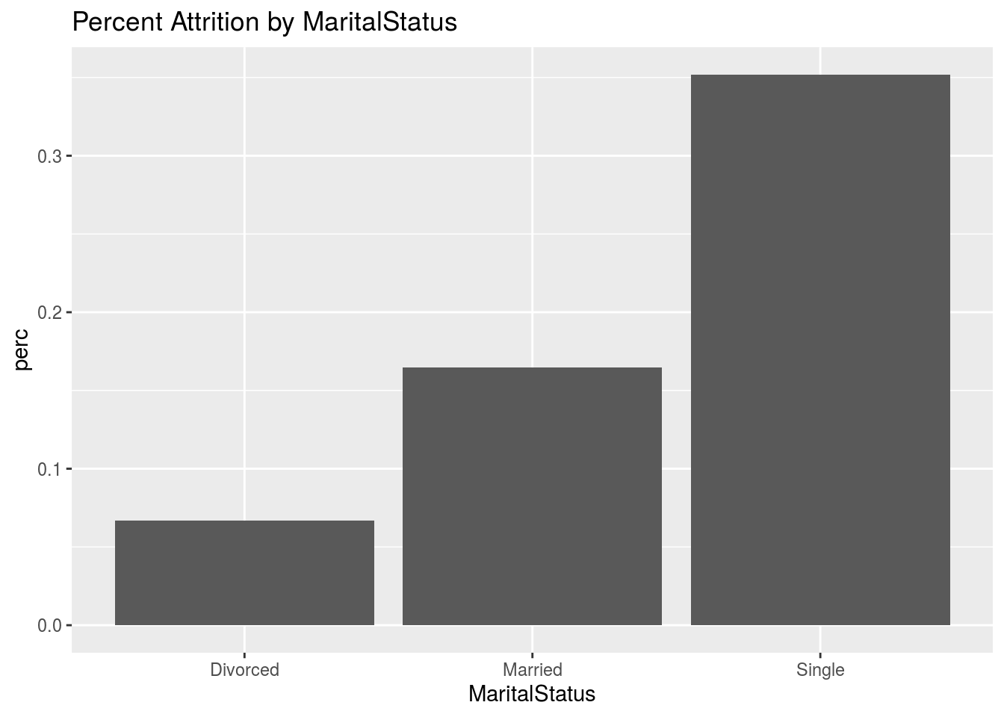
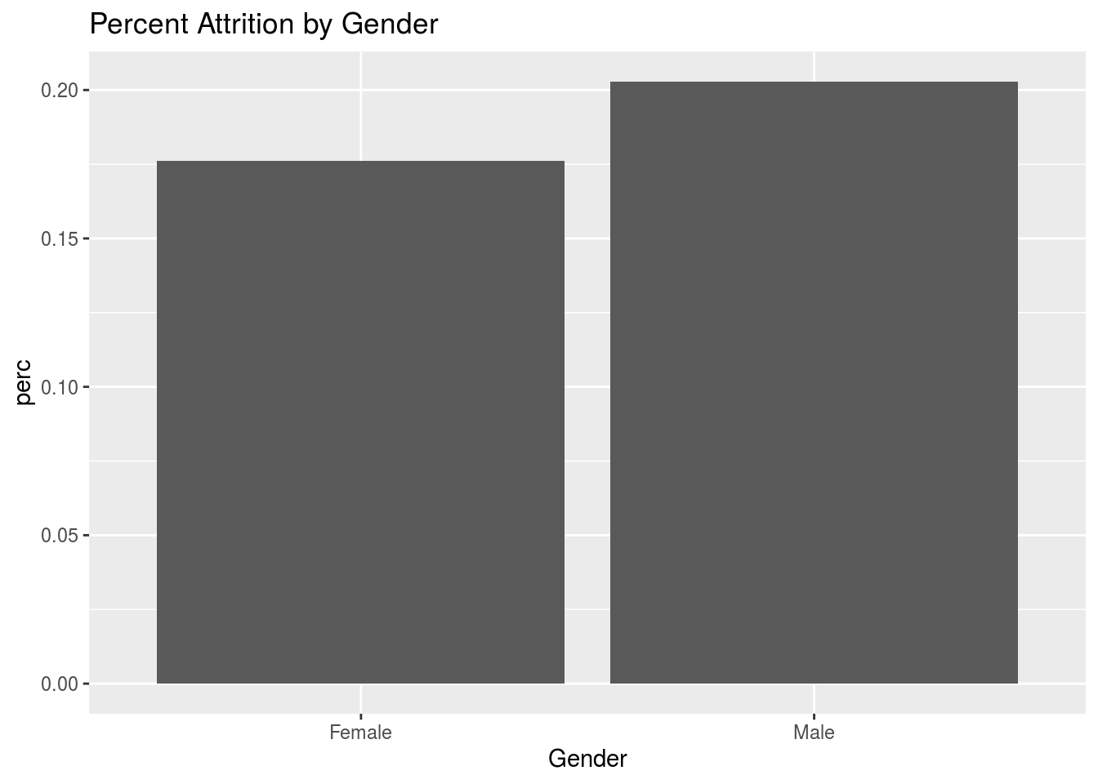
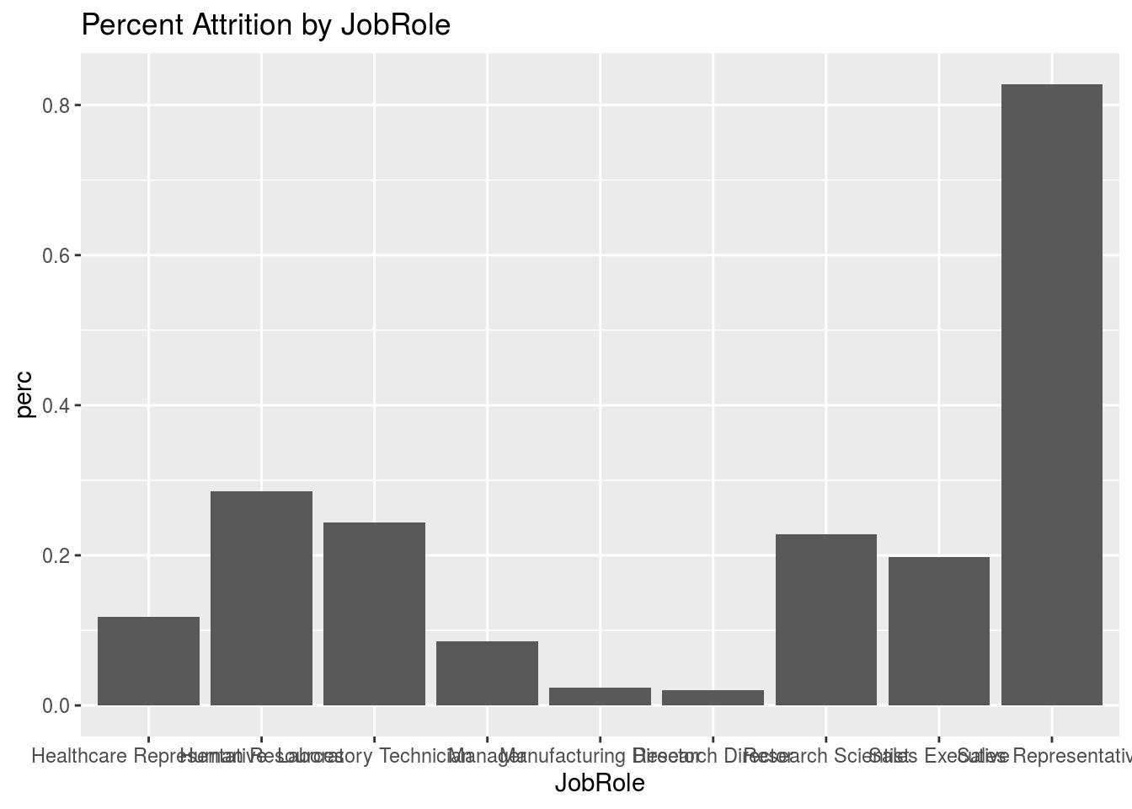
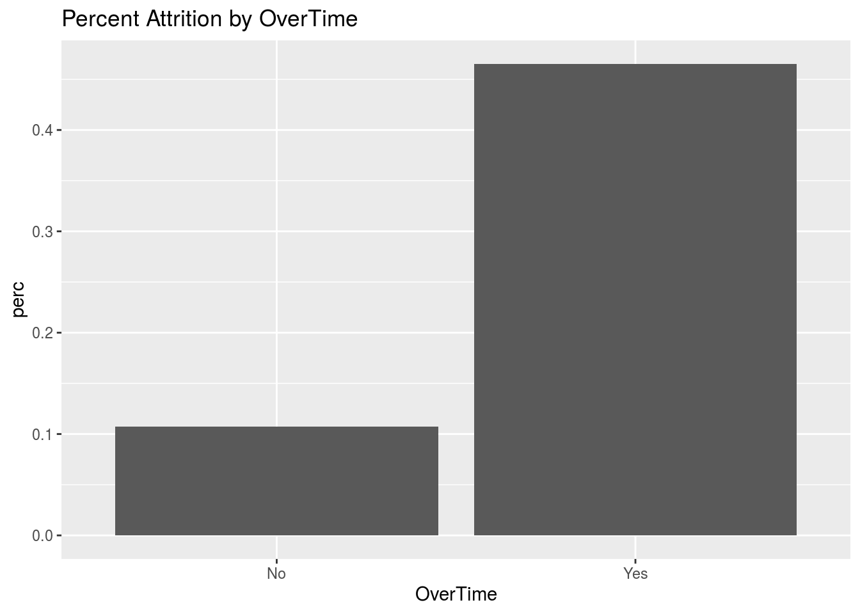
Factors related to Attrition

Slide 7
Naïve Bayes Prediction
All Factors
Predictors from Stepwise AIC Selection
accuracy of 84 %
sensitivity of 42 %
specificity of 92 %
“yes” predictions:13%
“no” predictions: 87%
accuracy of 86 %
sensitivity of 26 %
specificity of 97 %
“yes” predictions: 6%
“no” predictions: 94%
Distance From Home
EnvironmentSatisfaction
NumCompaniesWorked
OverTime
TotalWorkingYears
TrainingTimesLastYear
WorkLifeBalance
YearsSinceLastPromotion
JobInvolvement
JobSatisfaction
MaritalSTatus

Slide 8
Prediction with K-Nearest-Neighbor

Slide 9
Factors related to Salary

Slide 10
Prediction by Linear Regression

Slide 11
Summary

