Slide 1
GW-BASIC Interpreter: Lexer Module VAISHNAVI SR 293948

Slide 2

Overview of the Lexer Module
The Lexer is the first step in the GW-BASIC interpreter pipeline
Converts raw input (source code) into a sequence of tokens
Handles keywords, identifiers, numbers, strings, operators, comments, and symbols
Also validates malformed tokens and tracks token positions

Slide 3

Folder & File Structure
GWBasic64/
├── Lexer.cpp
├── Lexer.h
├── Token.h
├── main.cpp

Slide 4
Class Overview
Lexer Class
Purpose: Tokenizes a single line of GW-BASIC code into a list of token
Public Member Functions:
std::vector<Token> tokenize(const std::string& line)
Main function to tokenize a line of input

Slide 5
Public Member Functions:
void skipSpaces()
Skips whitespace characters in the input line.
Token extractNumber()
Extracts numeric literals (integers, floats, scientific notation).
Token extractString()
Extracts string literals enclosed in quotes.

Slide 6
Token extractWordorKeyword()
Identifies and extracts keywords or identifiers.
Token extractOperatorOrSymbol()
Extracts operators(like +,-,<>) and symbols(:,.,,)

Slide 7
Helper Functions
bool isKeyword
bool isOperator
bool isSymbol
Private Members
Keywords
int LineNumber
Int position

Slide 8
Token Class
Purpose: Represents a lexical token identified by the Lexer.
Member Variables:
std::string value
TokenType type
Enum type indicating token classification:
Keyword, Identifier, Number, String,
Operator, Comment, Symbol, Invalid, EndOfLine

Slide 9
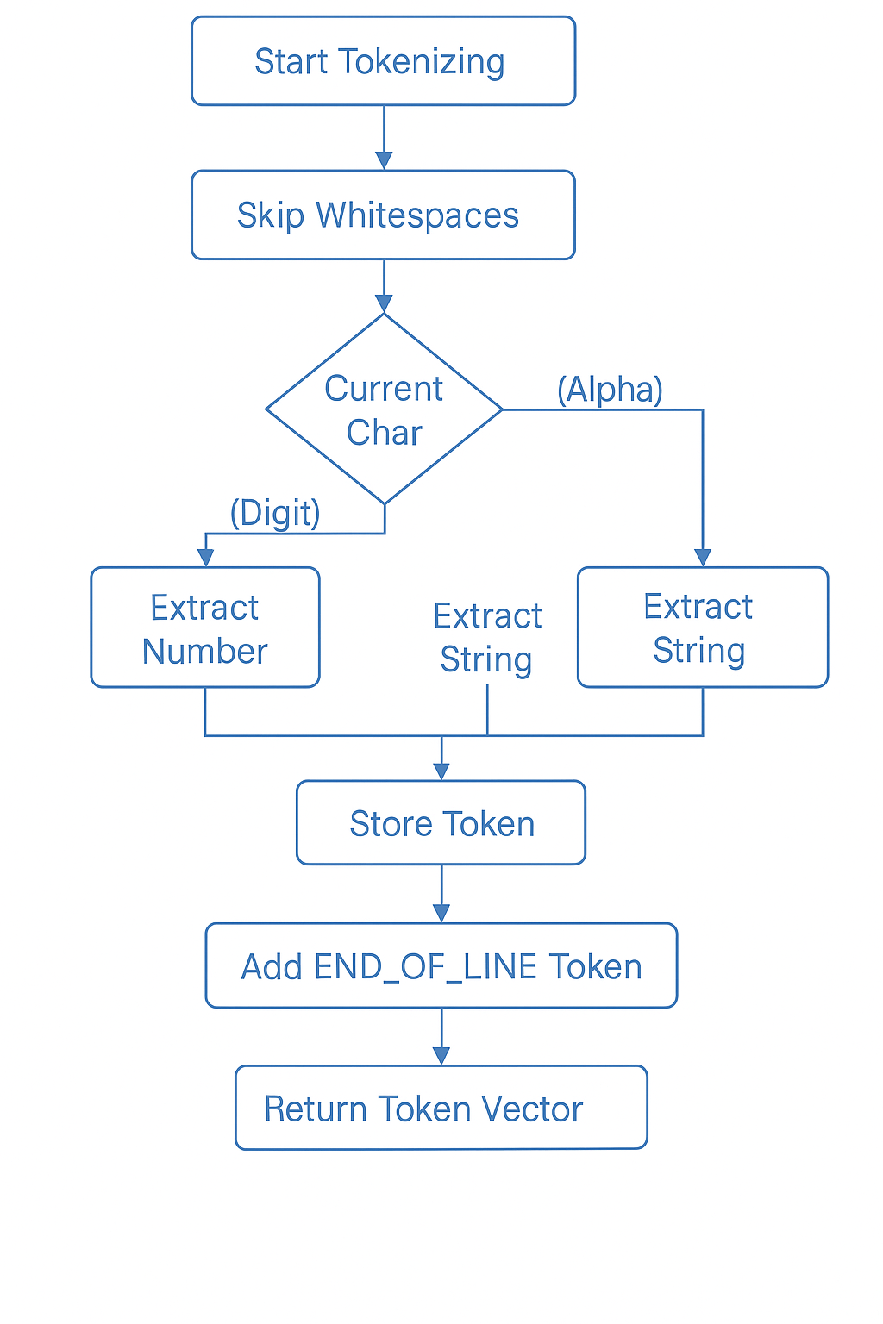

Slide 10
Tokenization Flow
Read each line from user or file
Skip whitespaces
Identify next character:
- If digit → extract number
- If letter → extract word or keyword
- If quote → extract string
- If symbol → extract operator
Store each token with line and column info
Add END_OF_LINE token at the end

Slide 11
Token Types and Examples
Keyword: PRINT, INPUT, REM
Identifier: A, TOTAL, N$
Number: 42, 3.14, 2E+5
String: "Hello", "Test\n"
Operator: +, -, *, =, <>
Comment: text after REM
Symbol: (, ), :, ,

Slide 12
Error Handling
Invalid tokens are captured as Invalid type
Missing quotes or malformed numbers are flagged
Error position tracked with line and column

Slide 13
Features Implemented
Strict identifier validation
Scientific notation number support
Escape sequence parsing in strings
REM comment support
Symbol/operator distinction
Multi-line tokenization support
Manual and file-based tokenization support

Slide 14
Lexer Design Document (Summary)
Design Pattern: Modular + Object-Oriented
Core Modules: Lexer class (token generation), Token class (token structure)
Input: Raw line from REPL or file
Output: Vector of tokens with type, value, line, column
Error Reporting: Invalid tokens flagged, tracked with position

Slide 15
Tools & Technologies Used
Language: C++
IDE: Visual Studio 2022
C++ Standard: C++17
No external dependencies
Design Pattern: Object-Oriented Programming (OOP)

Slide 16
References
Online References:
- cplusplus.com
- cppreference.com
- Wikipedia – Lexical Analysis
- GW-BASIC Command Reference (Microsoft Archives)
Tools Documentation:
- Visual Studio 2022

Slide 17
THANK YOU

