Slide 1
GW –BASIC
Magesh K

Slide 2
Module – storage
handling the storage module in a modular GW-BASIC 64 interpreter, here my goal is to implement
Program Memory—that is, how GW-BASIC source code is stored, accessed, saved, and loaded.

Slide 3
What is storage module doing ?
Purpose:
The Storage module is responsible for:
Storing BASIC code (line-numbered) in memory
Loading from and saving to .bas files
Providing access to this code for other modules (like Parser, Runtime)

Slide 4
Why Is It Important?
Module | Depends on Storage for
Parser | To store parsed source lines
Runtime (Executor) | To fetch statements by line number (for GOTO, RUN)
IO | To SAVE and LOAD programs
CommandLineEditor | To LIST code, modify/delete lines
System | To clear memory, reset system state

Slide 5
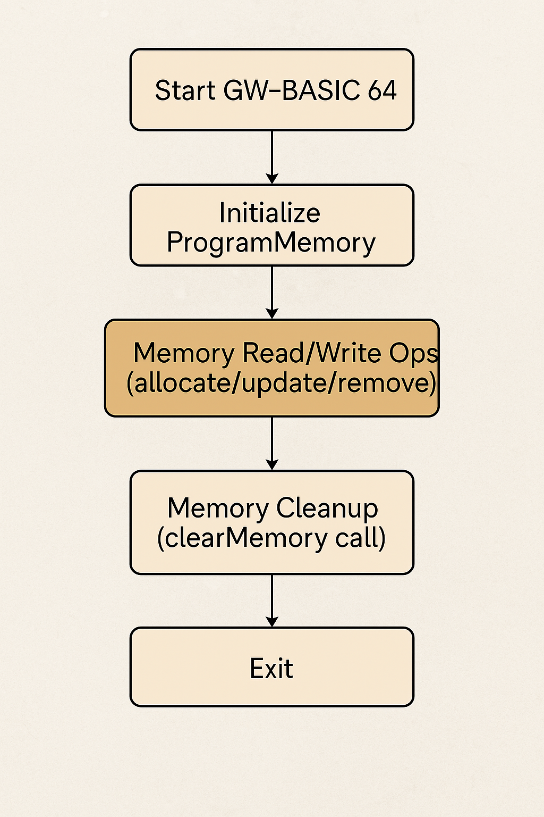
Flow diagram

Slide 6

Without the Storage module, the interpreter has no place to hold or retrieve the BASIC program the user writes.

Slide 7
Step-by-Step Development Plan:
Step | Task
1️⃣ | Create ProgramMemory.h/.cpp
2️⃣ | Use std::map<int, std::string> to store code
3️⃣ | Implement methods: insertLine(), deleteLine(), getLine(), getAllLines()
4️⃣ | Implement saveToFile() and loadFromFile()
5️⃣ | Expose ProgramMemory via header to other modules
6️⃣ | Add unit tests in tests/
7️⃣ | Link it in CMakeLists.txt

Slide 8
StoreLine
storeLine(int lineNumber, const std::string& code)
Purpose: Adds or updates a line of code at a specified line number.
Use case: Keeps the program memory up-to-date as the user adds or modifies lines.

Slide 9
getAllLines
getAllLines()
Purpose: Returns a map of all lines in memory.
Use case: Useful for iterating over the code or saving all lines at once.

Slide 10
list
list()
Purpose: Prints all lines to the screen.
Use case: Display the entire program's content for the user.

Slide 11
StoreLine
StoreLine(const std::string& line)
Purpose: Stores a single line of code (parses the line number and code).
Use case: Simplifies input parsing for storing program lines.

Slide 12
SaveFile
SaveToFile(const std::string& path)
Purpose: Saves the entire program to a file.
Use case: Persists the program code to disk for later use.

Slide 13
LoadFile
LoadFromFile(const std::string& path)
Purpose: Loads the program from a file into memory.
Use case: Allows the program to be resumed from a saved state.

Slide 14
ClearMemory
clearMemory()
Purpose: Clears all lines from memory.
Use case: Resets the program's memory

Slide 15
Storing usages
"My ProgramMemory class stores each GW-BASIC line using its line number as the key.
For example, 10 PRINT \"HELLO\" is stored as key=10, value=PRINT \"HELLO\".
I used a std::map<int, std::string> so lines stay automatically sorted.
I allow saving this map to a .bas file and loading it back.
Other modules like the parser or executor can access these lines using getLine() or getAllLines()."

Slide 16

Conclusion
• The Storage Module plays a critical role in managing memory for the GW-BASIC 64 interpreter.
• Through the ProgramMemory class, it ensures safe and efficient allocation, usage, and cleanup of memory.
• It serves as the foundation for variable handling, program line storage, and interaction with the parser, lexer, and runtime.
• Its modular design promotes clean integration with other interpreter components, enhancing maintainability and scalability.
• By providing a robust memory management system, the Storage Module ensures the reliable execution of GW-BASIC programs.

Slide 17

Thank you

