Slide 1
GWBASIC PROGRAMMING LANGUAGE (C++)
RUNTIME MODULE

Slide 2
PROJECT OVERVIEW
Building a GW-BASIC interpreter in modern C++17 as part of a larger 64-bit OS project.
Lexer module converts source code into tokens.
Parser transforms tokens into an Abstract Syntax Tree (AST) representing program structure.
Runtime module executes AST using components like SymbolTable, ExpressionEvaluator, and FlowControl.

Slide 3
INTRODUCTION
This project implements the runtime module for a 64-bit GW-BASIC interpreter in C++.
GW-BASIC is a classic programming language, and this runtime is part of a modern interpreter designed to process and execute BASIC programs parsed into an Abstract Syntax Tree (AST) by the parser module.
The runtime receives the AST from the parser and executes statements accordingly, handling program logic, control flow, variables, expressions, input/output, and data storage.

Slide 4
ROLE OF RUNTIME MODULE
Receives the parsed AST from the parser and executes each statement sequentially.
Handles variables, expressions, and program logic using SymbolTable and ExpressionEvaluator.
Manages control flow structures like IF, FOR, GOTO, and NEXT through FlowControl.
Coordinates input/output, data handling, and execution flow during program runtime.

Slide 5
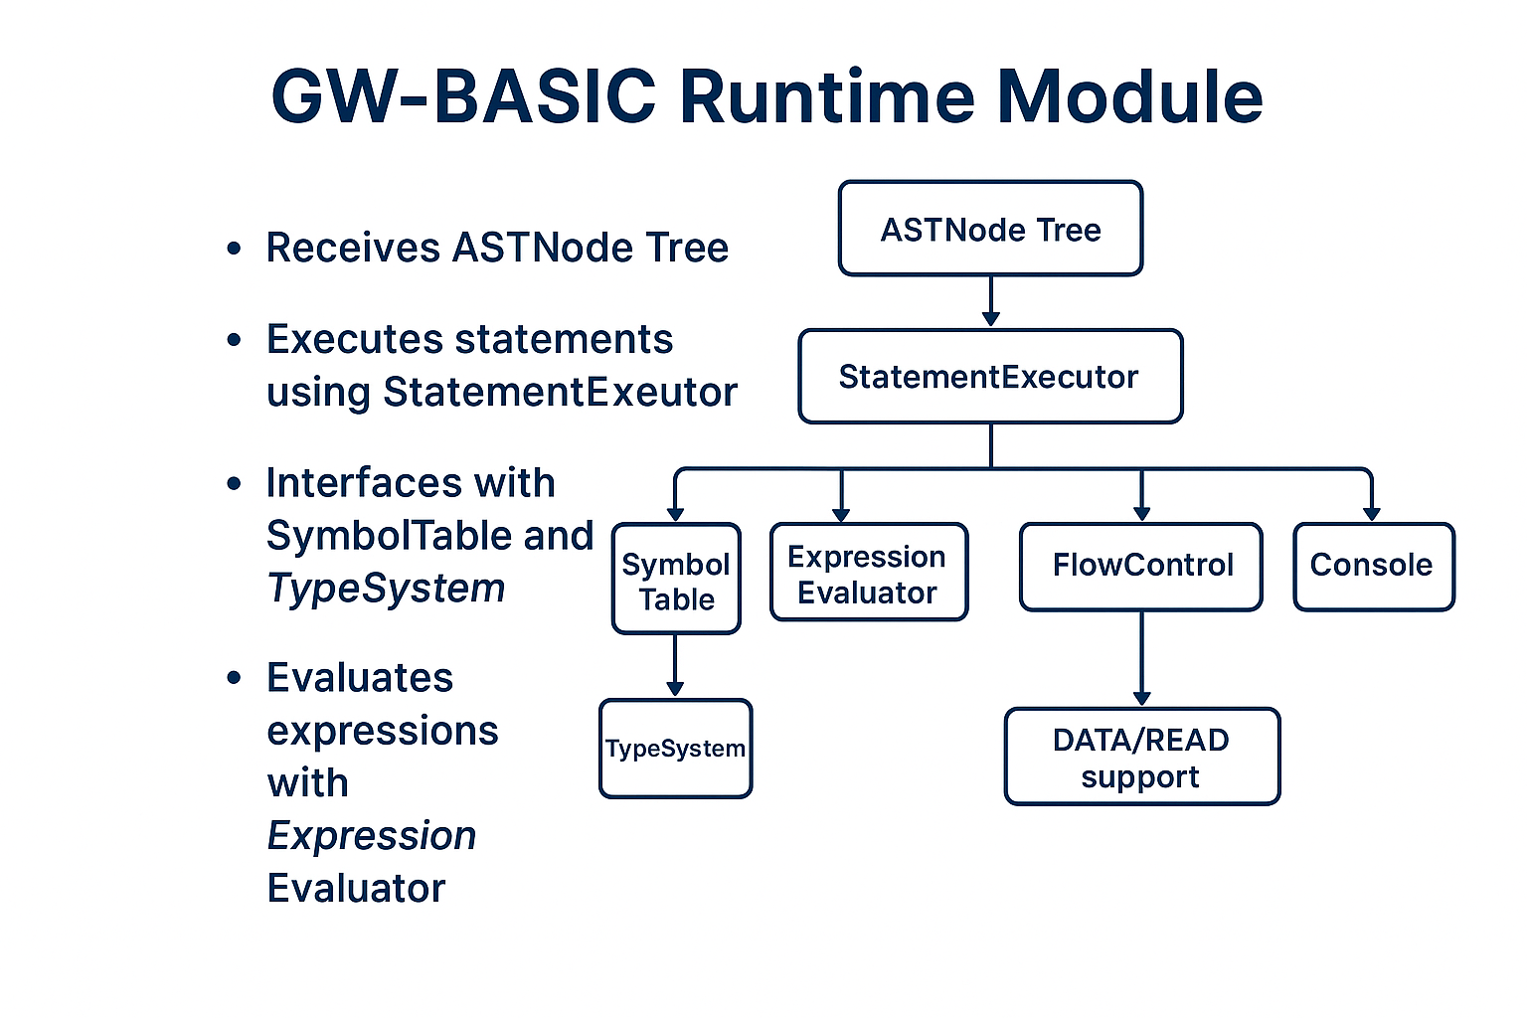
RUNTIME

Slide 6
KEY RUNTIME COMPONENTS
SymbolTable – Stores and retrieves variable values.
TypeSystem / Value – Represents values with type (int, float, string).
ExpressionEvaluator – Evaluates expressions in the AST.
FlowControl – Handles conditions, GOTO, and loop logic.
StatementExecutor – Executes BASIC statements from the AST.
IOHandler – Manages user input for INPUT statements.
DataManager – Manages DATA, READ, and RESTORE operations.

Slide 7
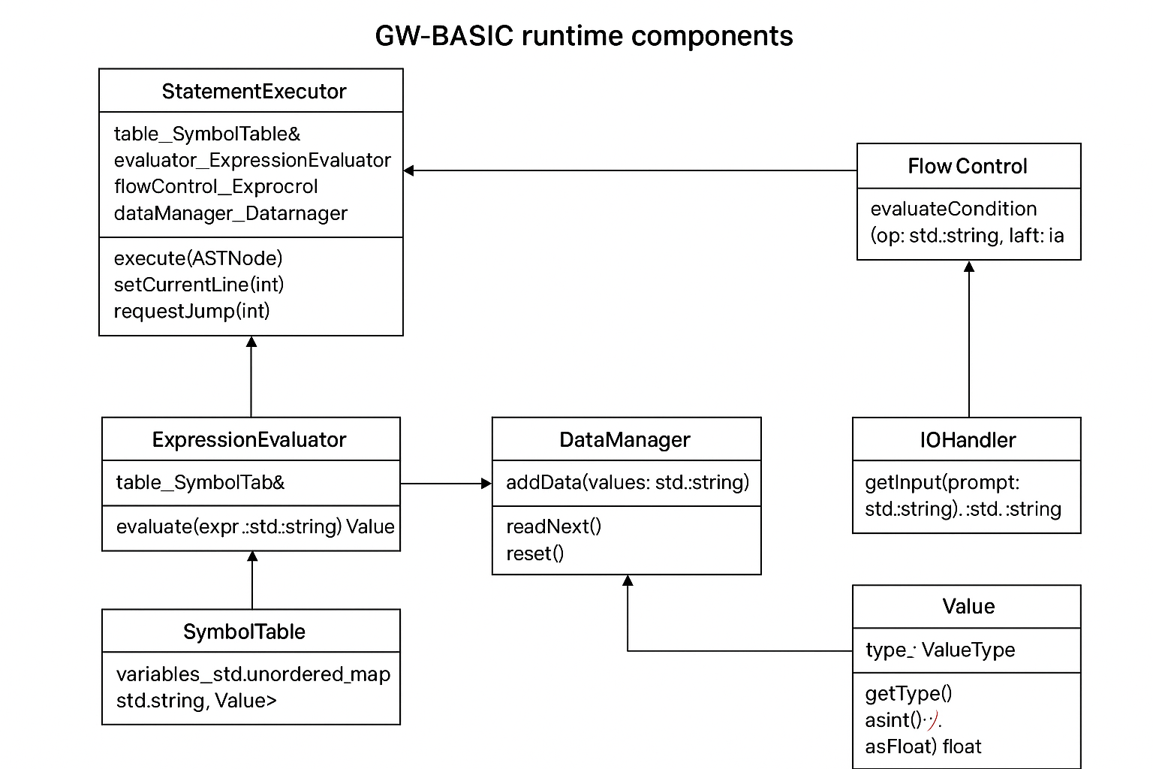
CLASS DIAGRAM

Slide 8
GW-BASIC Runtime Execution Flow
Input & Parsing
BASIC line → Tokenized → Parsed → ASTNode created.
🔹 Statement Execution
StatementExecutor runs ASTNodes by type (PRINT, LET, IF, etc.).
🔹 Expression Evaluation
ExpressionEvaluator computes math, strings, variables → returns Value.
🔹 Variable Management
SymbolTable stores variables for use in expressions and assignments.
🔹 Control Flow
FlowControl handles IF/ELSE, GOTO, FOR/NEXT jumps.
🔹 Program Lines
ProgramMemory manages numbered lines (for RUN, LIST, GOTO).
🔹 Input/Output
IOHandler reads input (INPUT), prints output (PRINT).
🔹 Data Handling
DataManager processes READ/DATA → feeds values into variables

Slide 9
TYPESYSTEM
Purpose: Encapsulates the Value class used to represent variables and literals.
🔹 Key Features:
Value class: Stores int, float, or string.
Supports methods:
asInt(), asFloat(), asString() – Convert internal value.
Used to unify operations across types in expressions and statements.

Slide 10
SYMBOLTABLE
Purpose: Stores and manages variables (identifiers and their values).
🔹 Key Functions:
setVariable(name, value) – Assign value to a variable.
getVariable(name) – Retrieve the value of a variable.
Internally uses a std::unordered_map<std::string, Value>.

Slide 11
EXPRESSION EVALUATOR
Purpose: Evaluates expressions in the AST (e.g., arithmetic, identifiers, string literals).
🔹 Key Functions:
evaluate(ASTNode*): Returns a Value based on node type:
NumberExpr, StringExpr, IdentExpr, BinOpExpr.
Uses recursive evaluation for binary expressions.

Slide 12
FLOWCONTROL
Purpose: Handles logical conditions in control structures (IF, FOR, WHILE).
🔹 Key Functions:
evaluateCondition(op, left, right) – Compares two Values.
Supports =, <, >, <=, >=, <>.
Used By: IF, IF-ELSE, FOR statements to drive logic decisions.

Slide 13
IOHANDLER
Purpose: Deals with console input/output for INPUT statements.
🔹 Key Functions:
getInput(prompt) – Prompts user and reads a line from input.
Simple wrapper around std::getline(std::cin).

Slide 14
DATAMANAGER
Purpose: Manages DATA and READ statements.
🔹 Key Functions:
addData(values) – Adds values from DATA statements.
readNext() – Returns the next value for a READ.
reset() – Resets pointer to start.

Slide 15
STATEMENTEXECUTOR
Purpose: Main controller for executing AST statements.
🔹 Key Functions:
execute(ASTNode*): Executes any supported statement.
Handles: PRINT, LET, IF, IF-ELSE, FOR, GOTO, INPUT, etc.
Works in tandem with ExpressionEvaluator, SymbolTable, FlowControl, and IOHandler.

Slide 16
THANK YOU

