Slide 1

PROTOTYPE PIRATES
DP World Hackathon | AI-Powered Trade Document Reconciliation

Slide 2
TRINITY AI
An Intelligent Document Reconciliation System for Seamless Global Trade
TEAM INTRODUCTION
​Hari Charan Vemuganti
Rajasekhar Vedula
Vojasvin Pidugu
Likhith Reddy Bedadhala
Venkata Virat Vallabhaneni

Slide 3
PROBLEM STATEMENT
Document Mismatch in Global Trade
International shipments depend on three key documents:
Commercial Invoice
Packing List
Bill of Lading
These are created by different stakeholders, leading to data inconsistencies.
Key Challenges:
Manual document verification is slow and error-prone
Even small mismatches cause shipment delays
Lack of real-time validation before customs
Impact:
Up to 60% of delays caused by document errors
Shipments stuck for days at ports
Increased costs, penalties, and operational inefficiencies

Slide 4
PROPOSED SOLUTION/SOLUTION OVERVIEW
TrinityAI: AI-Powered Cross-Validator Agent
We propose an intelligent system that:
Extracts key data from documents using AI
Compares data across all three documents
Detects mismatches instantly
Suggests corrections before shipment arrival
Result:
Faster customs clearance
Reduced manual effort
Error-free documentation

Slide 5
SOLUTION ARCHITECTURE
Step 1: Intelligent Data Extraction
Uses OCR + NLP to extract key fields
Works with PDFs, scans, and images
Step 2: Triple-Match Reconciliation
Compares:
Weight
Quantity
Container details
Shipper/Consignee info
Step 3: Compliance Validation
Predicts correct HS Code from product description
Checks latest trade regulations and requirements
Step 4: Anomaly Detection
Detects unusual pricing or quantity mismatches
Flags fraud risks and sanction-listed entities
Step 5: Action & Feedback
Sends instant alerts for detected errors
Suggests corrections for pre-arrival clearance

Slide 6
TECHNOLOGY STACK
Backend:
Python (FastAPI)
AI/ML:
OCR: Tesseract / Textract
NLP: spaCy / Transformers
Data Processing:
Fuzzy Matching Algorithms
Unit Normalization Engine
Frontend:
React Dashboard (Validation + Visualization)
Database:
MongoDB / PostgreSQL

Slide 7
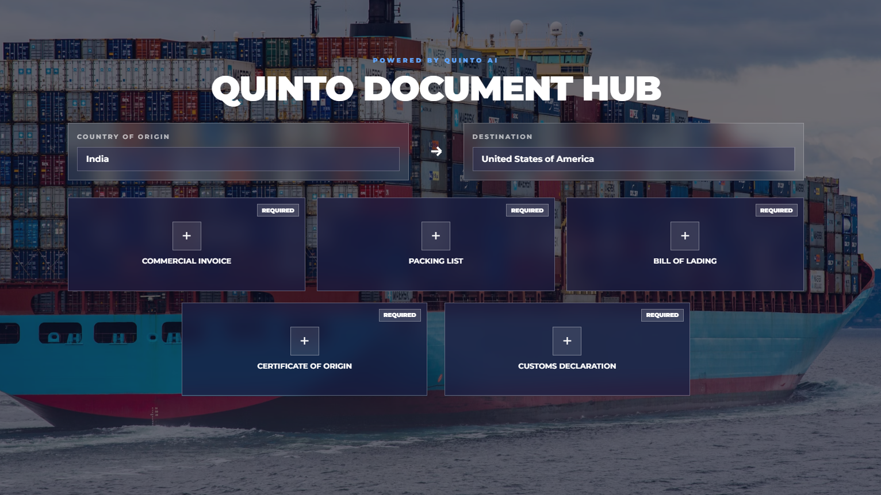
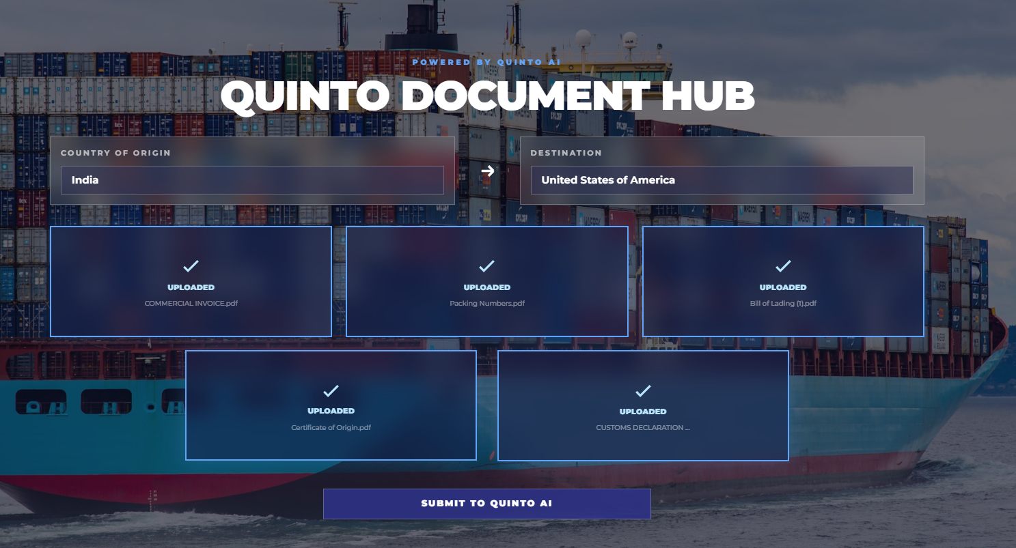
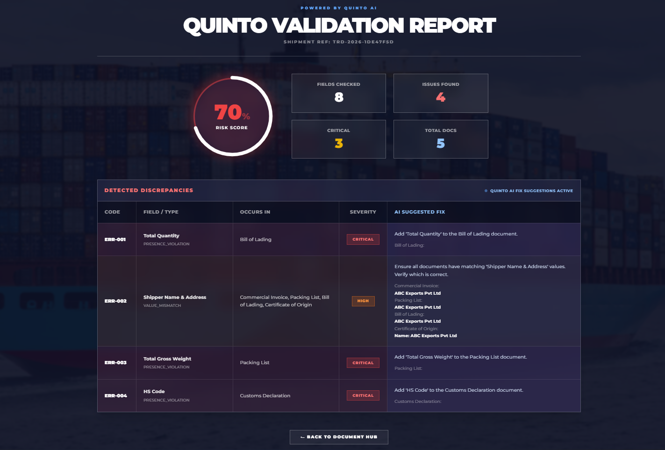
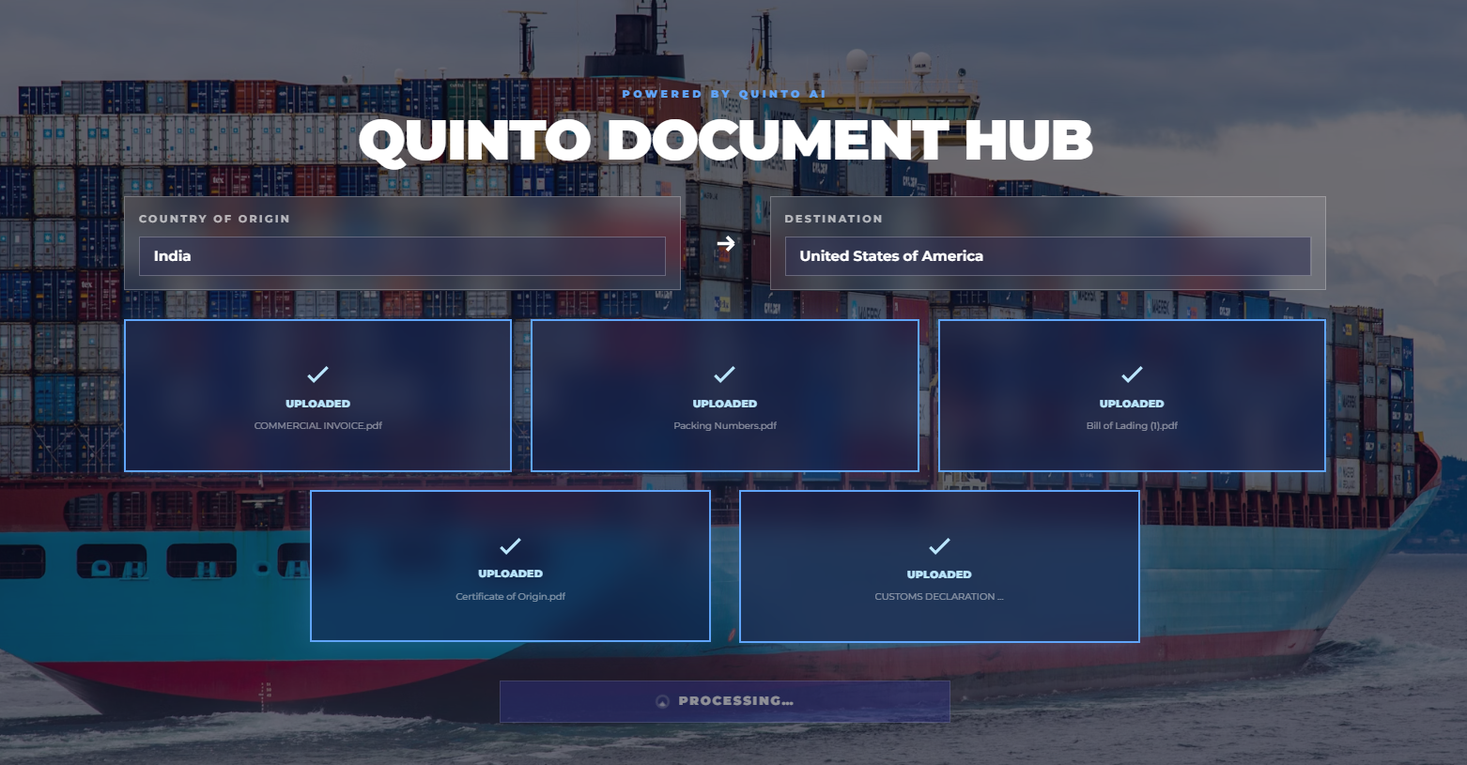
BASIC PROTOTYPE
STEP – 1
Page Load (UI Initialization)
The application interface loads and displays the document processing dashboard.
.
STEP – 2
Upload Document
Allows the user to upload a PDF document (like invoice, bill of lading, etc.) into the system.
STEP – 4
Output Screen
The system displays the extracted data in a structured format, performs validation to ensure accuracy, and provides the final output for further use.
STEP – 3
Automated Document Processing Pipeline
The backend automatically processes the document by extracting text using OCR, identifying the document type, and retrieving key information as structured data.

Slide 8
MARKET ANALYSIS
Industry Context:
Global trade heavily document-driven
High dependency on manual verification
Target Users:
Customs brokers
Freight forwarders
Warehouse operators
Export/import companies
Market Opportunity:
Large-scale adoption across global logistics ecosystem

Slide 9
BUSINESS CASE
Cost Estimate (MVP Development)
Development & AI integration: ₹3–5 Lakhs
Cloud & API costs (annual): ₹1–2 Lakhs
Savings & Benefits
50–70% reduction in document-related delays
30–40% reduction in penalties & manual processing costs
Operational Impact
Faster customs clearance (days → hours)
Increased shipment throughput for ports
Value for DP World
Reduced congestion at terminals
Improved efficiency & customer satisfaction

Slide 10
INNOVATIVE ASPECTS
What Makes Our Solution Unique:
Triple-document reconciliation (not just single document AI)
Proactive error correction before arrival
Integrated compliance + fraud detection
Real-time feedback system
Sustainability Impact:
Reduced waiting time at ports
Lower fuel consumption
Reduced carbon emissions

Slide 11
THANK YOU

