Slide 1
셰이더프로그래밍
Lecture 6
이택희

Slide 2
지난 시간
버텍스 셰이더 사용 애니메이션
프레그먼트 셰이더 사용 애니메이션

Slide 3
개요
텍스쳐 매핑
텍스쳐 생성
텍스쳐 사용
실습

Slide 4
텍스쳐 매핑

Slide 5
텍스쳐 매핑
텍스쳐란?
물체의 표면의 디테일을 표현하고자 할 때 모두 버텍스로 표현하기 위해선 매우 많은 데이터가 필요
해당 부분을 이미지로 대체 할 경우 간단하게 복잡한 표면을 표현 할 수 있음
이 이미지를 텍스쳐라 함

Slide 6
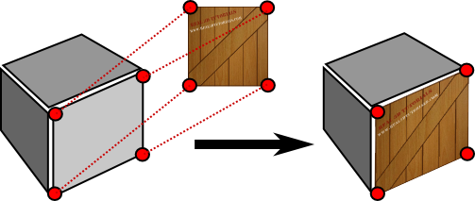
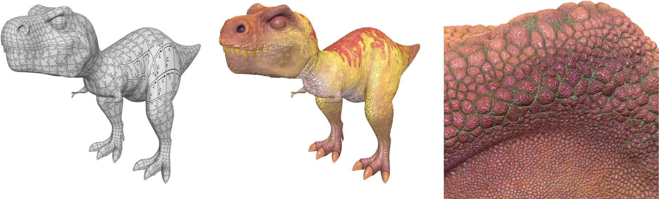
텍스쳐 매핑

Slide 7




텍스쳐 매핑
필요한 데이터
이미지 (jpg, bmp, png, tiff, …)
매핑 위치
?
$$v_{0}$$
$$v_{2}, v_{3}$$
이미지
$$v_{1},v_{4}$$
$$v_{5}$$

Slide 8
텍스쳐 매핑
텍스쳐 상에서 사용되는 좌표계는 u, v 혹은 s, t 로 표현 됨
u (s)
수업에선 u, v 의 축이 왼쪽 그림과 같다
v (t)

Slide 9
텍스쳐 매핑
u, v 혹은 s, t 의 범위는 0.0f ~ 1.0f 임
v
0.0f
1.0f
u
1.0f

Slide 10
텍스쳐 매핑
u, v 혹은 s, t 의 범위는 0.0f ~ 1.0f 임
(0.0f, 0.0f)
(1.0f, 0.0f)
(?, ?)
(0.0f, 1.0f)
(1.0f, 1.0f)

Slide 11
텍스쳐 매핑
텍스쳐 좌표는 0.0f ~ 1.0f 사이로 normalize 됨
이미지 해상도와 별개임
(1.0f, 1.0f)
(1.0f, 1.0f)

Slide 12








텍스쳐 매핑
$$t_{0}$$
$$t_{2}$$
$$v_{0}$$
$$v_{2}, v_{3}$$
$$v_{1},v_{4}$$
$$v_{5}$$
$$t_{1}$$
$$t_{3}$$

Slide 13




텍스쳐 매핑
$$v_{0}$$
$$v_{2}, v_{3}$$
$$v_{1},v_{4}$$
$$v_{5}$$

Slide 14
텍스쳐 매핑
텍스쳐 샘플링은 어느 단계에서 이루어 질까?
Vertex Shader
Primitive Assembly
Rasterization and Interpolation
Fragment Shader
Frame Buffer

Slide 15
텍스쳐 매핑
Vertex Shader
Primitive Assembly
Rasterization and Interpolation
Fragment Shader
Frame Buffer
Texture Sampling

Slide 16
텍스쳐 매핑
Vertex Shader
Primitive Assembly
Rasterization and Interpolation
Fragment Shader
Frame Buffer
Sampling 을 위해선 텍스쳐 좌표가 필요하고 좌표를 얻기 위해선 버텍스 셰이더로 부터 받아야 함
→ Attribute
Texture Sampling

Slide 17
텍스쳐 매핑
Vertex Shader
…
in vec3 Position;
Vertex Shader
…
in vec3 Position;
in vec2 TexPos;

Slide 18








텍스쳐 매핑
$$t_{0}$$
$$t_{2}$$
$$v_{0}$$
$$v_{2}, v_{3}$$
$$v_{1},v_{4}$$
$$v_{5}$$
$$t_{1}$$
$$t_{3}$$
버텍스당 텍스쳐 좌표 하나씩 필요함
→ 버텍스 정보에 텍스쳐 좌표 추가 필요

Slide 19


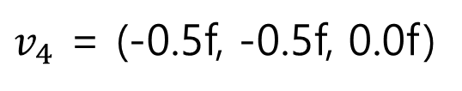



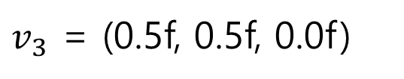

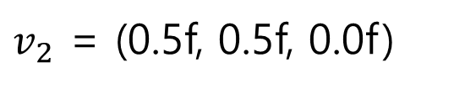



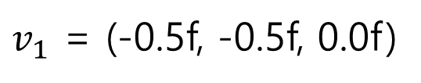

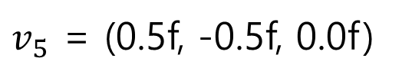


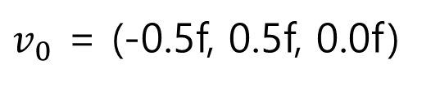
텍스쳐 매핑
$$t_{0}$$
$$t_{2}$$
$v_{0}$ = (-0.5f, 0.5f, 0.0f)
$$v_{2}, v_{3}$$
$$v_{0}$$
$v_{1}$ = (-0.5f, -0.5f, 0.0f)
$v_{2}$ = (0.5f, 0.5f, 0.0f)
$$v_{1},v_{4}$$
$v_{3}$ = (0.5f, 0.5f, 0.0f)
$$v_{5}$$
$$t_{1}$$
$$t_{3}$$
$v_{4}$ = (-0.5f, -0.5f, 0.0f)
$v_{5}$ = (0.5f, -0.5f, 0.0f)
$t_{0}$ = (0.0f, 0.0f)
$t_{2}$ = (1.0f, 0.0f)
$t_{1}$ = (0.0f, 1.0f)
$t_{3}$ = (1.0f, 1.0f)

Slide 20


















텍스쳐 매핑
$$t_{0}$$
$$v_{0}$$
$$t_{1}$$
$$v_{1}$$
$$t_{0}$$
$$t_{2}$$
$$v_{2}, v_{3}$$
$$v_{2}$$
$$v_{0}$$
$$t_{2}$$
$$t_{3}$$
$$v_{3}$$
$$v_{1},v_{4}$$
$$v_{5}$$
$$t_{1}$$
$$t_{3}$$
$$v_{4}$$
$$v_{5}$$

Slide 21
























텍스쳐 매핑
$$t_{0}$$
$$v_{0}$$
$$v_{0}$$
$$v_{2}, v_{3}$$
$$t_{1}$$
$$v_{1}$$
$t_{0}$ = (0.0f, 0.0f)
$$v_{2}$$
$$t_{2}$$
$t_{1}$ = (0.0f, 1.0f)
$t_{2}$ = (1.0f, 0.0f)
$$t_{3}$$
$t_{3}$ = (1.0f, 1.0f)
$$v_{3}$$
$$v_{1},v_{4}$$
$$v_{5}$$
$$v_{4}$$
$v_{0}$ = (-0.5f, 0.5f, 0.0f, 0.0f, 0.0f)
$$v_{5}$$
$v_{1}$ = (-0.5f, -0.5f, 0.0f , 0.0f, 1.0f)
$v_{2}$ = (0.5f, 0.5f, 0.0f , 1.0f, 0.0f)
$v_{3}$ = (0.5f, 0.5f, 0.0f , 1.0f, 0.0f)
$v_{4}$ = (-0.5f, -0.5f, 0.0f , 0.0f, 1.0f)
$v_{5}$ = (0.5f, -0.5f, 0.0f , 1.0f, 1.0f)

Slide 22


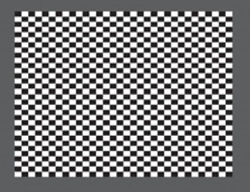
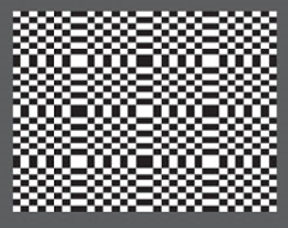
텍스쳐 매핑
u, v 좌표가 0보다 작거나 1보다 클 경우
wrap 형식에 따라 채워짐

Slide 23
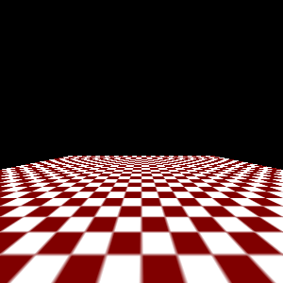
텍스쳐 매핑
텍스쳐 샘플링

Slide 24
텍스쳐 생성

Slide 25
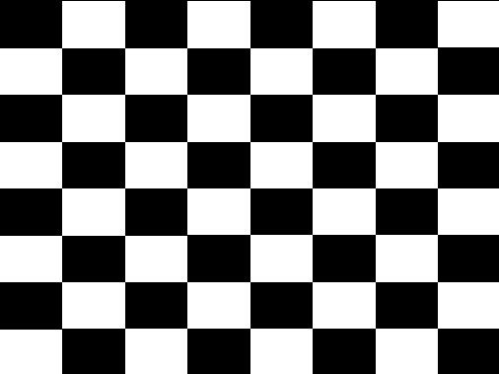
텍스쳐 생성
static const GLulong checkerboard[] =
{
0xFFFFFFFF, 0x00000000, 0xFFFFFFFF, 0x00000000, 0xFFFFFFFF, 0x00000000, 0xFFFFFFFF, 0x00000000,
0x00000000, 0xFFFFFFFF, 0x00000000, 0xFFFFFFFF, 0x00000000, 0xFFFFFFFF, 0x00000000, 0xFFFFFFFF,
0xFFFFFFFF, 0x00000000, 0xFFFFFFFF, 0x00000000, 0xFFFFFFFF, 0x00000000, 0xFFFFFFFF, 0x00000000,
0x00000000, 0xFFFFFFFF, 0x00000000, 0xFFFFFFFF, 0x00000000, 0xFFFFFFFF, 0x00000000, 0xFFFFFFFF,
0xFFFFFFFF, 0x00000000, 0xFFFFFFFF, 0x00000000, 0xFFFFFFFF, 0x00000000, 0xFFFFFFFF, 0x00000000,
0x00000000, 0xFFFFFFFF, 0x00000000, 0xFFFFFFFF, 0x00000000, 0xFFFFFFFF, 0x00000000, 0xFFFFFFFF,
0xFFFFFFFF, 0x00000000, 0xFFFFFFFF, 0x00000000, 0xFFFFFFFF, 0x00000000, 0xFFFFFFFF, 0x00000000,
0x00000000, 0xFFFFFFFF, 0x00000000, 0xFFFFFFFF, 0x00000000, 0xFFFFFFFF, 0x00000000, 0xFFFFFFFF
};

Slide 26
텍스쳐 생성
전체적인 순서는 VBO 생성하는 법과 비슷함
glGenTextures(1, &gTextureID);
glBindTexture(GL_TEXTURE_2D, gTextureID);
glTexImage2D(GL_TEXTURE_2D, 0, GL_RGBA, 8, 8, 0, GL_RGBA, GL_UNSIGNED_BYTE, checkerboard);

Slide 27
텍스쳐 생성
glTexParameteri(GL_TEXTURE_2D, GL_TEXTURE_MIN_FILTER, GL_NEAREST);
glTexParameteri(GL_TEXTURE_2D, GL_TEXTURE_MAG_FILTER, GL_NEAREST);
glTexParameteri(GL_TEXTURE_2D, GL_TEXTURE_WRAP_S, GL_CLAMP_TO_EDGE);
glTexParameteri(GL_TEXTURE_2D, GL_TEXTURE_WRAP_T, GL_CLAMP_TO_EDGE);

Slide 28
참고 코드
GLuint CreatePngTexture(char* filePath, GLuint samplingMethod);
m_RGBTexture = CreatePngTexture("./rgb.png", GL_NEAREST);
#include "LoadPng.h"
GLuint Renderer::CreatePngTexture(char* filePath, GLuint samplingMethod)
{
//Load Png
std::vector<unsigned char> image;
unsigned width, height;
unsigned error = lodepng::decode(image, width, height, filePath);
if (error != 0)
{
std::cout << "PNG image loading failed:" << filePath << std::endl;
assert(0);
}
GLuint temp;
glGenTextures(1, &temp);
glBindTexture(GL_TEXTURE_2D, temp);
glTexImage2D(GL_TEXTURE_2D, 0, GL_RGBA, width, height, 0, GL_RGBA,
GL_UNSIGNED_BYTE, &image[0]);
glTexParameterf(GL_TEXTURE_2D, GL_TEXTURE_MIN_FILTER, samplingMethod);
glTexParameterf(GL_TEXTURE_2D, GL_TEXTURE_MAG_FILTER, samplingMethod);
return temp;
}

Slide 29
텍스쳐 사용

Slide 30
텍스쳐 사용
#version 330
in vec3 Position;
in vec2 TexPos;
out vec2 vTexPos;
void main()
{
gl_Position = vec4(Position, 1.0);
vTexPos = TexPos;
}
#version 330
uniform sampler2D uTexSampler;
in vec2 vTexPos;
out vec4 FragColor;
void main()
{
FragColor = texture(uTexSampler, vTexPos);
}
int uniformTex = glGetUniformLocation(gShaderProgram, "uTexSampler");
glUniform1i(uniformTex, 0);
glActiveTexture(GL_TEXTURE0);
glBindTexture(GL_TEXTURE_2D, gTextureID);

Slide 31
실습

Slide 32
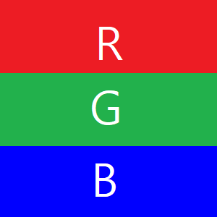
실습
새로운 Shader 및 API 생성 후 구현
문제 : 블러 효과 구현 해보기
문제 : 좌표 꼬아 보기

Slide 33



실습
문제 : 좌표 꼬아 보기

Slide 36
실습

Slide 37
실습

Slide 38
지난시간
텍스처

Slide 39
개요
다중 텍스처 사용
실습
단일 텍스처 사용 애니메이션
실습

Slide 40
다중 텍스처 사용

Slide 41
다중 텍스처 사용
지금까지는 Texture 하나만 사용
Default 값이 0 으로 지정되어 있기 때문에 따로 지정을 해 주지 않아도 동작함
Fragment Shader
#version 330
in vec2 vTexPos;
out vec4 FragColor;
uniform sampler2D uTexture;
void main()
{
FragColor = texture(uTexture, vTexPos);
}
int uniformTex = glGetUniformLocation(gShaderProgram, "uTexSampler");
glUniform1i(uniformTex, 0);
glActiveTexture(GL_TEXTURE0);
glBindTexture(GL_TEXTURE_2D, gTextureID);
ActiveTexture 가 없어도 동작함

Slide 42
다중 텍스처 사용
Texture 가 여러 장일 경우 glActiveTexture 함수를 통해 사용할 Texture 의 번호를 지정해 주어야 함
gTextureID → GL_TEXTURE0
gTextureID1 → GL_TEXTURE1
gTextureID2 → GL_TEXTURE2
gTextureID3 → GL_TEXTURE3
…
Fragment Shader

Slide 43
다중 텍스처 사용
gTextureID → GL_TEXTURE0 지정 방법
glActiveTexture(GL_TEXTURE0);
glBindTexture(GL_TEXTURE_2D, gTextureID);
gTextureID → GL_TEXTURE1 지정 방법
glActiveTexture(GL_TEXTURE1);
glBindTexture(GL_TEXTURE_2D, gTextureID1);

Slide 44
다중 텍스처 사용
즉, GL_TEXTURE_2D 는 설정 가능한 텍스처가 최소 80개가 있음
각 텍스처를 설정하기 위해 Bind 전에 Active 시키는 과정이 필요함
1. Active
glActiveTexture(GL_TEXTURE0);
glBindTexture(GL_TEXTURE_2D, gTextureID);
2. Bind

Slide 45
다중 텍스처 사용
GL_TEXTURE0
GL_TEXTURE1
GL_TEXTURE2
GL_TEXTURE3
GL_TEXTURE4
GL_TEXTURE5
GL_TEXTURE6
…
…
…
…
…
…
…
…
…
GL_TEXTURE31
glActiveTexture(GL_TEXTURE0)
glBindTexture(GL_TEXTURE_2D, gTextureID);
glActiveTexture(GL_TEXTURE1)
glBindTexture(GL_TEXTURE_2D, gTextureID1);
glActiveTexture(GL_TEXTURE2)
glBindTexture(GL_TEXTURE_2D, gTextureID2);
glActiveTexture(GL_TEXTURE3)
glBindTexture(GL_TEXTURE_2D, gTextureID3);
glActiveTexture(GL_TEXTURE4)
glBindTexture(GL_TEXTURE_2D, gTextureID4);
glActiveTexture(GL_TEXTURE4)
glBindTexture(GL_TEXTURE_2D, gTextureID5);
GL_TEXTURE_2D

Slide 46
다중 텍스처 사용
GL_TEXTURE0 : gTextureID
GL_TEXTURE1 : gTextureID1
GL_TEXTURE2 : gTextureID2
GL_TEXTURE3 : gTextureID3
GL_TEXTURE4 : gTextureID4
GL_TEXTURE5 : gTextureID5
GL_TEXTURE6 : nothing
…
…
…
…
…
…
…
…
…
GL_TEXTURE31 : nothing
GL_TEXTURE_2D

Slide 47
다중 텍스처 사용(실습 준비)
Shader code 준비
Vertex Shader
Fragment Shader
#version 330
in vec3 Position;
in vec2 TexPos;
out vec2 vTexPos;
void main()
{
gl_Position = vec4(Position, 1.0);
vTexPos = TexPos;
}
#version 330
in vec2 vTexPos;
out vec4 FragColor;
uniform sampler2D uTexSampler;
void main()
{
FragColor = texture(uTexSampler, vTexPos);
}

Slide 48
다중 텍스처 사용(실습 준비)
VBO 준비
float vertPosTex[30] =
{
-0.5f, 0.5f, 0.0f, 0.0f, 1.0f, -0.5f, -0.5f, 0.0f, 0.0f, 0.0f, 0.5f, 0.5f, 0.0f, 1.0f, 1.0f,
0.5f, 0.5f, 0.0f, 1.0f, 1.0f, -0.5f, -0.5f, 0.0f, 0.0f, 0.0f, 0.5f, -0.5f, 0.0f, 1.0f, 0.0f
};
glGenBuffers(1, &VBO_PosTex);
glBindBuffer(GL_ARRAY_BUFFER, VBO_PosTex);
glBufferData(GL_ARRAY_BUFFER, sizeof(vertPosTex), vertPosTex, GL_STATIC_DRAW);

Slide 49
다중 텍스처 사용(실습 준비)
Texture 생성
GLulong textureSmile[]
=
{
0xFFFFFFFF, 0xFFFFFFFF, 0xFFFFFFFF, 0xFFFFFFFF, 0xFFFFFFFF, 0xFFFFFFFF, 0xFFFFFFFF, 0xFFFFFFFF,
0xFFFFFFFF, 0xFF00FF00, 0xFF00FF00, 0xFF00FF00, 0xFF00FF00, 0xFF00FF00, 0xFF00FF00, 0xFFFFFFFF,
0xFF00FF00, 0xFF00FF00, 0xFF00FF00, 0xFF00FF00, 0xFF00FF00, 0xFF00FF00, 0xFF00FF00, 0xFF00FF00,
0xFF00FF00, 0xFFFFFFFF, 0xFFFFFFFF, 0xFFFFFFFF, 0xFFFFFFFF, 0xFFFFFFFF, 0xFFFFFFFF, 0xFF00FF00,
0xFFFFFFFF, 0xFFFFFFFF, 0xFFFFFFFF, 0xFFFFFFFF, 0xFFFFFFFF, 0xFFFFFFFF, 0xFFFFFFFF, 0xFFFFFFFF,
0xFF0000FF, 0xFF0000FF, 0xFFFFFFFF, 0xFFFFFFFF, 0xFFFFFFFF, 0xFFFFFFFF, 0xFFFF0000, 0xFFFF0000,
0xFF0000FF, 0xFF0000FF, 0xFFFFFFFF, 0xFFFFFFFF, 0xFFFFFFFF, 0xFFFFFFFF, 0xFFFF0000, 0xFFFF0000,
0xFFFFFFFF, 0xFFFFFFFF, 0xFFFFFFFF, 0xFFFFFFFF, 0xFFFFFFFF, 0xFFFFFFFF, 0xFFFFFFFF, 0xFFFFFFFF
};
glGenTextures(1, &gTextureID);
glBindTexture(GL_TEXTURE_2D, gTextureID);
glTexImage2D(GL_TEXTURE_2D, 0, GL_RGBA, 8, 8, 0, GL_RGBA, GL_UNSIGNED_BYTE, textureSmile);
glTexParameteri(GL_TEXTURE_2D, GL_TEXTURE_MIN_FILTER, GL_NEAREST);
glTexParameteri(GL_TEXTURE_2D, GL_TEXTURE_MAG_FILTER, GL_NEAREST);
glTexParameteri(GL_TEXTURE_2D, GL_TEXTURE_WRAP_S, GL_CLAMP_TO_EDGE);
glTexParameteri(GL_TEXTURE_2D, GL_TEXTURE_WRAP_T, GL_CLAMP_TO_EDGE);
GLulong textureSmile1[]
=
{
0xFFFFFFFF, 0xFFFFFFFF, 0xFFFFFFFF, 0xFFFFFFFF, 0xFFFFFFFF, 0xFFFFFFFF, 0xFFFFFFFF, 0xFFFFFFFF,
0xFF00FF00, 0xFF00FF00, 0xFF00FF00, 0xFF00FF00, 0xFF00FF00, 0xFF00FF00, 0xFF00FF00, 0xFF00FF00,
0xFF00FF00, 0xFF00FF00, 0xFF00FF00, 0xFF00FF00, 0xFF00FF00, 0xFF00FF00, 0xFF00FF00, 0xFF00FF00,
0xFFFFFFFF, 0xFFFFFFFF, 0xFFFFFFFF, 0xFFFFFFFF, 0xFFFFFFFF, 0xFFFFFFFF, 0xFFFFFFFF, 0xFFFFFFFF,
0xFFFFFFFF, 0xFFFFFFFF, 0xFFFFFFFF, 0xFFFFFFFF, 0xFFFFFFFF, 0xFFFFFFFF, 0xFFFFFFFF, 0xFFFFFFFF,
0xFF0000FF, 0xFF0000FF, 0xFFFFFFFF, 0xFFFFFFFF, 0xFFFFFFFF, 0xFFFFFFFF, 0xFFFF0000, 0xFFFF0000,
0xFF0000FF, 0xFF0000FF, 0xFFFFFFFF, 0xFFFFFFFF, 0xFFFFFFFF, 0xFFFFFFFF, 0xFFFF0000, 0xFFFF0000,
0xFFFFFFFF, 0xFFFFFFFF, 0xFFFFFFFF, 0xFFFFFFFF, 0xFFFFFFFF, 0xFFFFFFFF, 0xFFFFFFFF, 0xFFFFFFFF
};
glGenTextures(1, &gTextureID1);
glBindTexture(GL_TEXTURE_2D, gTextureID1);
glTexImage2D(GL_TEXTURE_2D, 0, GL_RGBA, 8, 8, 0, GL_RGBA, GL_UNSIGNED_BYTE, textureSmile1);
glTexParameteri(GL_TEXTURE_2D, GL_TEXTURE_MIN_FILTER, GL_NEAREST);
glTexParameteri(GL_TEXTURE_2D, GL_TEXTURE_MAG_FILTER, GL_NEAREST);
glTexParameteri(GL_TEXTURE_2D, GL_TEXTURE_WRAP_S, GL_CLAMP_TO_EDGE);
glTexParameteri(GL_TEXTURE_2D, GL_TEXTURE_WRAP_T, GL_CLAMP_TO_EDGE);

Slide 50
다중 텍스처 사용(실습 준비)
Texture 생성
GLulong textureSmile2[]
=
{
0xFFFFFFFF, 0xFFFFFFFF, 0xFFFFFFFF, 0xFF00FF00, 0xFF00FF00, 0xFFFFFFFF, 0xFFFFFFFF, 0xFFFFFFFF,
0xFF00FF00, 0xFF00FF00, 0xFF00FF00, 0xFF00FF00, 0xFF00FF00, 0xFF00FF00, 0xFF00FF00, 0xFF00FF00,
0xFF00FF00, 0xFF00FF00, 0xFF00FF00, 0xFFFFFFFF, 0xFFFFFFFF, 0xFF00FF00, 0xFF00FF00, 0xFF00FF00,
0xFFFFFFFF, 0xFFFFFFFF, 0xFFFFFFFF, 0xFFFFFFFF, 0xFFFFFFFF, 0xFFFFFFFF, 0xFFFFFFFF, 0xFFFFFFFF,
0xFFFFFFFF, 0xFFFFFFFF, 0xFFFFFFFF, 0xFFFFFFFF, 0xFFFFFFFF, 0xFFFFFFFF, 0xFFFFFFFF, 0xFFFFFFFF,
0xFF0000FF, 0xFF0000FF, 0xFFFFFFFF, 0xFFFFFFFF, 0xFFFFFFFF, 0xFFFFFFFF, 0xFFFF0000, 0xFFFF0000,
0xFF0000FF, 0xFF0000FF, 0xFFFFFFFF, 0xFFFFFFFF, 0xFFFFFFFF, 0xFFFFFFFF, 0xFFFF0000, 0xFFFF0000,
0xFFFFFFFF, 0xFFFFFFFF, 0xFFFFFFFF, 0xFFFFFFFF, 0xFFFFFFFF, 0xFFFFFFFF, 0xFFFFFFFF, 0xFFFFFFFF
};
glGenTextures(1, &gTextureID2);
glBindTexture(GL_TEXTURE_2D, gTextureID2);
glTexImage2D(GL_TEXTURE_2D, 0, GL_RGBA, 8, 8, 0, GL_RGBA, GL_UNSIGNED_BYTE, textureSmile2);
glTexParameteri(GL_TEXTURE_2D, GL_TEXTURE_MIN_FILTER, GL_NEAREST);
glTexParameteri(GL_TEXTURE_2D, GL_TEXTURE_MAG_FILTER, GL_NEAREST);
glTexParameteri(GL_TEXTURE_2D, GL_TEXTURE_WRAP_S, GL_CLAMP_TO_EDGE);
glTexParameteri(GL_TEXTURE_2D, GL_TEXTURE_WRAP_T, GL_CLAMP_TO_EDGE);
GLulong textureSmile3[]
=
{
0xFF00FF00, 0xFFFFFFFF, 0xFFFFFFFF, 0xFFFFFFFF, 0xFFFFFFFF, 0xFFFFFFFF, 0xFFFFFFFF, 0xFF00FF00,
0xFF00FF00, 0xFF00FF00, 0xFF00FF00, 0xFF00FF00, 0xFF00FF00, 0xFF00FF00, 0xFF00FF00, 0xFF00FF00,
0xFFFFFFFF, 0xFF00FF00, 0xFF00FF00, 0xFFFFFFFF, 0xFFFFFFFF, 0xFF00FF00, 0xFF00FF00, 0xFFFFFFFF,
0xFFFFFFFF, 0xFFFFFFFF, 0xFFFFFFFF, 0xFFFFFFFF, 0xFFFFFFFF, 0xFFFFFFFF, 0xFFFFFFFF, 0xFFFFFFFF,
0xFFFFFFFF, 0xFFFFFFFF, 0xFFFFFFFF, 0xFFFFFFFF, 0xFFFFFFFF, 0xFFFFFFFF, 0xFFFFFFFF, 0xFFFFFFFF,
0xFF0000FF, 0xFF0000FF, 0xFFFFFFFF, 0xFFFFFFFF, 0xFFFFFFFF, 0xFFFFFFFF, 0xFFFF0000, 0xFFFF0000,
0xFF0000FF, 0xFF0000FF, 0xFFFFFFFF, 0xFFFFFFFF, 0xFFFFFFFF, 0xFFFFFFFF, 0xFFFF0000, 0xFFFF0000,
0xFFFFFFFF, 0xFFFFFFFF, 0xFFFFFFFF, 0xFFFFFFFF, 0xFFFFFFFF, 0xFFFFFFFF, 0xFFFFFFFF, 0xFFFFFFFF
};
glGenTextures(1, &gTextureID3);
glBindTexture(GL_TEXTURE_2D, gTextureID3);
glTexImage2D(GL_TEXTURE_2D, 0, GL_RGBA, 8, 8, 0, GL_RGBA, GL_UNSIGNED_BYTE, textureSmile3);
glTexParameteri(GL_TEXTURE_2D, GL_TEXTURE_MIN_FILTER, GL_NEAREST);
glTexParameteri(GL_TEXTURE_2D, GL_TEXTURE_MAG_FILTER, GL_NEAREST);
glTexParameteri(GL_TEXTURE_2D, GL_TEXTURE_WRAP_S, GL_CLAMP_TO_EDGE);
glTexParameteri(GL_TEXTURE_2D, GL_TEXTURE_WRAP_T, GL_CLAMP_TO_EDGE);

Slide 51
다중 텍스처 사용(실습 준비)
Texture 생성
GLulong textureSmile4[]
=
{
0xFF00FF00, 0xFFFFFFFF, 0xFFFFFFFF, 0xFFFFFFFF, 0xFFFFFFFF, 0xFFFFFFFF, 0xFFFFFFFF, 0xFF00FF00,
0xFF00FF00, 0xFF00FF00, 0xFF00FF00, 0xFF00FF00, 0xFF00FF00, 0xFF00FF00, 0xFF00FF00, 0xFF00FF00,
0xFFFFFFFF, 0xFF00FF00, 0xFF00FF00, 0xFF00FF00, 0xFF00FF00, 0xFF00FF00, 0xFF00FF00, 0xFFFFFFFF,
0xFFFFFFFF, 0xFFFFFFFF, 0xFFFFFFFF, 0xFFFFFFFF, 0xFFFFFFFF, 0xFFFFFFFF, 0xFFFFFFFF, 0xFFFFFFFF,
0xFFFFFFFF, 0xFFFFFFFF, 0xFFFFFFFF, 0xFFFFFFFF, 0xFFFFFFFF, 0xFFFFFFFF, 0xFFFFFFFF, 0xFFFFFFFF,
0xFF0000FF, 0xFF0000FF, 0xFFFFFFFF, 0xFFFFFFFF, 0xFFFFFFFF, 0xFFFFFFFF, 0xFFFF0000, 0xFFFF0000,
0xFF0000FF, 0xFF0000FF, 0xFFFFFFFF, 0xFFFFFFFF, 0xFFFFFFFF, 0xFFFFFFFF, 0xFFFF0000, 0xFFFF0000,
0xFFFFFFFF, 0xFFFFFFFF, 0xFFFFFFFF, 0xFFFFFFFF, 0xFFFFFFFF, 0xFFFFFFFF, 0xFFFFFFFF, 0xFFFFFFFF
};
glGenTextures(1, &gTextureID4);
glBindTexture(GL_TEXTURE_2D, gTextureID4);
glTexImage2D(GL_TEXTURE_2D, 0, GL_RGBA, 8, 8, 0, GL_RGBA, GL_UNSIGNED_BYTE, textureSmile4);
glTexParameteri(GL_TEXTURE_2D, GL_TEXTURE_MIN_FILTER, GL_NEAREST);
glTexParameteri(GL_TEXTURE_2D, GL_TEXTURE_MAG_FILTER, GL_NEAREST);
glTexParameteri(GL_TEXTURE_2D, GL_TEXTURE_WRAP_S, GL_CLAMP_TO_EDGE);
glTexParameteri(GL_TEXTURE_2D, GL_TEXTURE_WRAP_T, GL_CLAMP_TO_EDGE);
GLulong textureSmile5[]
=
{
0xFF00FF00, 0xFFFFFFFF, 0xFFFFFFFF, 0xFFFFFFFF, 0xFFFFFFFF, 0xFFFFFFFF, 0xFFFFFFFF, 0xFF00FF00,
0xFF00FF00, 0xFF00FF00, 0xFFFFFFFF, 0xFFFFFFFF, 0xFFFFFFFF, 0xFFFFFFFF, 0xFF00FF00, 0xFF00FF00,
0xFFFFFFFF, 0xFF00FF00, 0xFF00FF00, 0xFF00FF00, 0xFF00FF00, 0xFF00FF00, 0xFF00FF00, 0xFFFFFFFF,
0xFFFFFFFF, 0xFFFFFFFF, 0xFFFFFFFF, 0xFFFFFFFF, 0xFFFFFFFF, 0xFFFFFFFF, 0xFFFFFFFF, 0xFFFFFFFF,
0xFFFFFFFF, 0xFFFFFFFF, 0xFFFFFFFF, 0xFFFFFFFF, 0xFFFFFFFF, 0xFFFFFFFF, 0xFFFFFFFF, 0xFFFFFFFF,
0xFF0000FF, 0xFF0000FF, 0xFFFFFFFF, 0xFFFFFFFF, 0xFFFFFFFF, 0xFFFFFFFF, 0xFFFF0000, 0xFFFF0000,
0xFF0000FF, 0xFF0000FF, 0xFFFFFFFF, 0xFFFFFFFF, 0xFFFFFFFF, 0xFFFFFFFF, 0xFFFF0000, 0xFFFF0000,
0xFFFFFFFF, 0xFFFFFFFF, 0xFFFFFFFF, 0xFFFFFFFF, 0xFFFFFFFF, 0xFFFFFFFF, 0xFFFFFFFF, 0xFFFFFFFF
};
glGenTextures(1, &gTextureID5);
glBindTexture(GL_TEXTURE_2D, gTextureID5);
glTexImage2D(GL_TEXTURE_2D, 0, GL_RGBA, 8, 8, 0, GL_RGBA, GL_UNSIGNED_BYTE, textureSmile5);
glTexParameteri(GL_TEXTURE_2D, GL_TEXTURE_MIN_FILTER, GL_NEAREST);
glTexParameteri(GL_TEXTURE_2D, GL_TEXTURE_MAG_FILTER, GL_NEAREST);
glTexParameteri(GL_TEXTURE_2D, GL_TEXTURE_WRAP_S, GL_CLAMP_TO_EDGE);
glTexParameteri(GL_TEXTURE_2D, GL_TEXTURE_WRAP_T, GL_CLAMP_TO_EDGE);

Slide 52
다중 텍스처 사용(실습 준비)
렌더링 준비
glUseProgram(gShaderProgram);
glActiveTexture(GL_TEXTURE0);
glBindTexture(GL_TEXTURE_2D, gTextureID);
glActiveTexture(GL_TEXTURE1);
glBindTexture(GL_TEXTURE_2D, gTextureID1);
glActiveTexture(GL_TEXTURE2);
glBindTexture(GL_TEXTURE_2D, gTextureID2);
glActiveTexture(GL_TEXTURE3);
glBindTexture(GL_TEXTURE_2D, gTextureID3);
glActiveTexture(GL_TEXTURE4);
glBindTexture(GL_TEXTURE_2D, gTextureID4);
glActiveTexture(GL_TEXTURE5);
glBindTexture(GL_TEXTURE_2D, gTextureID5);

Slide 53
다중 텍스처 사용(실습 준비)
렌더링 준비
int uniformTex = glGetUniformLocation(gShaderProgram, "uTexSampler");
glUniform1i(uniformTex, 0);

Slide 54
다중 텍스처 사용(실습 준비)
렌더링 준비
int attrribPosition = glGetAttribLocation(gShaderProgram, "Position");
int attrribTexPos = glGetAttribLocation(gShaderProgram, "TexPos");
glEnableVertexAttribArray(attrribPosition);
glEnableVertexAttribArray(attrribTexPos);
glBindBuffer(GL_ARRAY_BUFFER, VBO_PosTex);
glVertexAttribPointer(attrribPosition, 3, GL_FLOAT, GL_FALSE, 5 * sizeof(float), 0);
glVertexAttribPointer(attrribTexPos, 2, GL_FLOAT, GL_FALSE, 5 * sizeof(float), (GLvoid*)(3 * sizeof(float)));

Slide 55
다중 텍스처 사용(실습 준비)
glDrawArrays(GL_TRIANGLES, 0, 6);

Slide 56
실습
내용 구현
uniform 값(sampler2D) 을 지속적으로 변경하여 gTextureID0 ~ gTextureID5 까지 애니메이션 되도록 구현
너무 빠르게 바뀐다면 Sleep(1000); 을 넣어서 천천히 확인할 수 있음

Slide 57
단일 텍스처 사용 애니메이션

Slide 58
단일 텍스처 사용 애니메이션
다중 텍스처를 사용하여 애니메이션 구현
텍스처 Switch 가 발생하여 효율성이 떨어짐
캐시 효율성이 떨어짐
하나의 텍스처에 여러장의 텍스처를 합쳐서 그리는 방식
텍스처 Switch 발생이 없음
캐시 효율성 높음

Slide 59
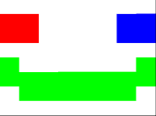
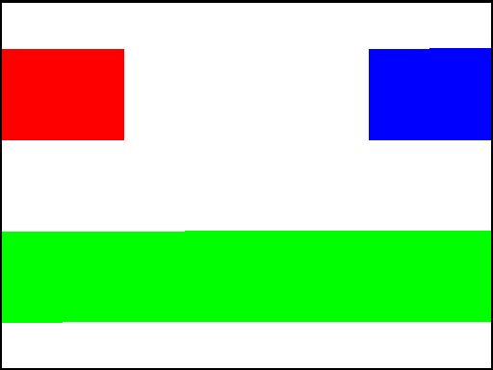
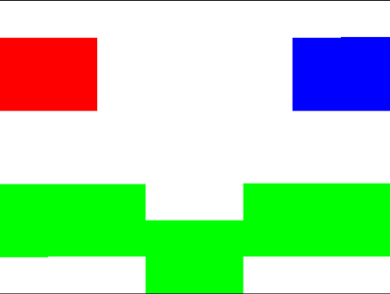
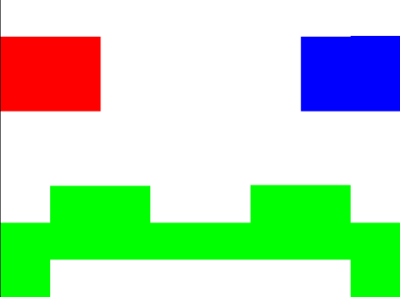
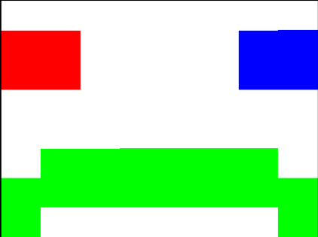
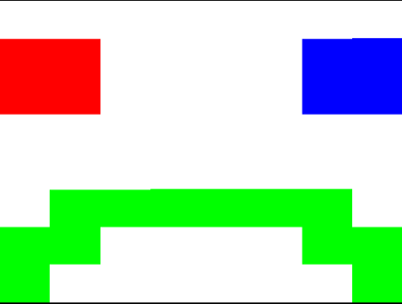
단일 텍스처 사용 애니메이션
0
1
2
3
4
5

Slide 60


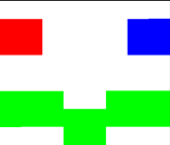

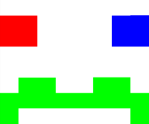





단일 텍스처 사용 애니메이션
0
1
2
3
4
5
8X8 6개
8X48 1개

Slide 61





단일 텍스처 사용 애니메이션
(1.0, 1.0)
(1.0, 1.0)
(1.0, 5.0/6.0)
(1.0, 5.0/6.0)
(1.0, 4.0/6.0)
(1.0, 4.0/6.0)
(1.0, 3.0/6.0)
(1.0, 3.0/6.0)
(1.0, 2.0/6.0)
(1.0, 2.0/6.0)
(1.0, 1.0/6.0)
(1.0, 1.0/6.0)
(1.0, 0.0)
(1.0, 0.0)

Slide 62
단일 텍스처 사용 애니메이션
Fragment Shader
#version 330
in vec2 vTexPos;
out vec4 FragColor;
uniform float uTime;
uniform sampler2D uTexSampler;
void main()
{
vec2 newTexPos = vec2(vTexPos.x, uTime/6.0 + vTexPos.y/6.0);
FragColor = texture(uTexSampler, newTexPos);
}
uTime 을 0~5.f 사이로 넘김

Slide 63
단일 텍스처 사용(실습 준비)
Shader code 준비
Vertex Shader
Fragment Shader
#version 330
in vec3 Position;
in vec2 TexPos;
out vec2 vTexPos;
void main()
{
gl_Position = vec4(Position, 1.0);
vTexPos = TexPos;
}
#version 330
in vec2 vTexPos;
out vec4 FragColor;
uniform float uTime;
uniform sampler2D uTexSampler;
void main()
{
vec2 newTexPos = vec2(vTexPos.x, uTime/6.0 + vTexPos.y/6.0);
FragColor = texture(uTexSampler, newTexPos);
}

Slide 64
단일 텍스처 사용(실습 준비)
VBO 준비
float vertPosTex[30] =
{
-0.5f, 0.5f, 0.0f, 0.0f, 1.0f, -0.5f, -0.5f, 0.0f, 0.0f, 0.0f, 0.5f, 0.5f, 0.0f, 1.0f, 1.0f,
0.5f, 0.5f, 0.0f, 1.0f, 1.0f, -0.5f, -0.5f, 0.0f, 0.0f, 0.0f, 0.5f, -0.5f, 0.0f, 1.0f, 0.0f
};
glGenBuffers(1, &VBO_PosTex);
glBindBuffer(GL_ARRAY_BUFFER, VBO_PosTex);
glBufferData(GL_ARRAY_BUFFER, sizeof(vertPosTex), vertPosTex, GL_STATIC_DRAW);

Slide 65
단일 텍스처 사용(실습 준비)
Texture 생성
GLulong textureSmileTotal[]
=
{
0xFFFFFFFF, 0xFFFFFFFF, 0xFFFFFFFF, 0xFFFFFFFF, 0xFFFFFFFF, 0xFFFFFFFF, 0xFFFFFFFF, 0xFFFFFFFF,
0xFFFFFFFF, 0xFF00FF00, 0xFF00FF00, 0xFF00FF00, 0xFF00FF00, 0xFF00FF00, 0xFF00FF00, 0xFFFFFFFF,
0xFF00FF00, 0xFF00FF00, 0xFF00FF00, 0xFF00FF00, 0xFF00FF00, 0xFF00FF00, 0xFF00FF00, 0xFF00FF00,
0xFF00FF00, 0xFFFFFFFF, 0xFFFFFFFF, 0xFFFFFFFF, 0xFFFFFFFF, 0xFFFFFFFF, 0xFFFFFFFF, 0xFF00FF00,
0xFFFFFFFF, 0xFFFFFFFF, 0xFFFFFFFF, 0xFFFFFFFF, 0xFFFFFFFF, 0xFFFFFFFF, 0xFFFFFFFF, 0xFFFFFFFF,
0xFF0000FF, 0xFF0000FF, 0xFFFFFFFF, 0xFFFFFFFF, 0xFFFFFFFF, 0xFFFFFFFF, 0xFFFF0000, 0xFFFF0000,
0xFF0000FF, 0xFF0000FF, 0xFFFFFFFF, 0xFFFFFFFF, 0xFFFFFFFF, 0xFFFFFFFF, 0xFFFF0000, 0xFFFF0000,
0xFFFFFFFF, 0xFFFFFFFF, 0xFFFFFFFF, 0xFFFFFFFF, 0xFFFFFFFF, 0xFFFFFFFF, 0xFFFFFFFF, 0xFFFFFFFF,
0xFFFFFFFF, 0xFFFFFFFF, 0xFFFFFFFF, 0xFFFFFFFF, 0xFFFFFFFF, 0xFFFFFFFF, 0xFFFFFFFF, 0xFFFFFFFF,
0xFF00FF00, 0xFF00FF00, 0xFF00FF00, 0xFF00FF00, 0xFF00FF00, 0xFF00FF00, 0xFF00FF00, 0xFF00FF00,
0xFF00FF00, 0xFF00FF00, 0xFF00FF00, 0xFF00FF00, 0xFF00FF00, 0xFF00FF00, 0xFF00FF00, 0xFF00FF00,
0xFFFFFFFF, 0xFFFFFFFF, 0xFFFFFFFF, 0xFFFFFFFF, 0xFFFFFFFF, 0xFFFFFFFF, 0xFFFFFFFF, 0xFFFFFFFF,
0xFFFFFFFF, 0xFFFFFFFF, 0xFFFFFFFF, 0xFFFFFFFF, 0xFFFFFFFF, 0xFFFFFFFF, 0xFFFFFFFF, 0xFFFFFFFF,
0xFF0000FF, 0xFF0000FF, 0xFFFFFFFF, 0xFFFFFFFF, 0xFFFFFFFF, 0xFFFFFFFF, 0xFFFF0000, 0xFFFF0000,
0xFF0000FF, 0xFF0000FF, 0xFFFFFFFF, 0xFFFFFFFF, 0xFFFFFFFF, 0xFFFFFFFF, 0xFFFF0000, 0xFFFF0000,
0xFFFFFFFF, 0xFFFFFFFF, 0xFFFFFFFF, 0xFFFFFFFF, 0xFFFFFFFF, 0xFFFFFFFF, 0xFFFFFFFF, 0xFFFFFFFF,
0xFFFFFFFF, 0xFFFFFFFF, 0xFFFFFFFF, 0xFF00FF00, 0xFF00FF00, 0xFFFFFFFF, 0xFFFFFFFF, 0xFFFFFFFF,
0xFF00FF00, 0xFF00FF00, 0xFF00FF00, 0xFF00FF00, 0xFF00FF00, 0xFF00FF00, 0xFF00FF00, 0xFF00FF00,
0xFF00FF00, 0xFF00FF00, 0xFF00FF00, 0xFFFFFFFF, 0xFFFFFFFF, 0xFF00FF00, 0xFF00FF00, 0xFF00FF00,
0xFFFFFFFF, 0xFFFFFFFF, 0xFFFFFFFF, 0xFFFFFFFF, 0xFFFFFFFF, 0xFFFFFFFF, 0xFFFFFFFF, 0xFFFFFFFF,
0xFFFFFFFF, 0xFFFFFFFF, 0xFFFFFFFF, 0xFFFFFFFF, 0xFFFFFFFF, 0xFFFFFFFF, 0xFFFFFFFF, 0xFFFFFFFF,
0xFF0000FF, 0xFF0000FF, 0xFFFFFFFF, 0xFFFFFFFF, 0xFFFFFFFF, 0xFFFFFFFF, 0xFFFF0000, 0xFFFF0000,
0xFF0000FF, 0xFF0000FF, 0xFFFFFFFF, 0xFFFFFFFF, 0xFFFFFFFF, 0xFFFFFFFF, 0xFFFF0000, 0xFFFF0000,
0xFFFFFFFF, 0xFFFFFFFF, 0xFFFFFFFF, 0xFFFFFFFF, 0xFFFFFFFF, 0xFFFFFFFF, 0xFFFFFFFF, 0xFFFFFFFF,
0xFF00FF00, 0xFFFFFFFF, 0xFFFFFFFF, 0xFFFFFFFF, 0xFFFFFFFF, 0xFFFFFFFF, 0xFFFFFFFF, 0xFF00FF00,
0xFF00FF00, 0xFF00FF00, 0xFF00FF00, 0xFF00FF00, 0xFF00FF00, 0xFF00FF00, 0xFF00FF00, 0xFF00FF00,
0xFFFFFFFF, 0xFF00FF00, 0xFF00FF00, 0xFFFFFFFF, 0xFFFFFFFF, 0xFF00FF00, 0xFF00FF00, 0xFFFFFFFF,
0xFFFFFFFF, 0xFFFFFFFF, 0xFFFFFFFF, 0xFFFFFFFF, 0xFFFFFFFF, 0xFFFFFFFF, 0xFFFFFFFF, 0xFFFFFFFF,
0xFFFFFFFF, 0xFFFFFFFF, 0xFFFFFFFF, 0xFFFFFFFF, 0xFFFFFFFF, 0xFFFFFFFF, 0xFFFFFFFF, 0xFFFFFFFF,
0xFF0000FF, 0xFF0000FF, 0xFFFFFFFF, 0xFFFFFFFF, 0xFFFFFFFF, 0xFFFFFFFF, 0xFFFF0000, 0xFFFF0000,
0xFF0000FF, 0xFF0000FF, 0xFFFFFFFF, 0xFFFFFFFF, 0xFFFFFFFF, 0xFFFFFFFF, 0xFFFF0000, 0xFFFF0000,
0xFFFFFFFF, 0xFFFFFFFF, 0xFFFFFFFF, 0xFFFFFFFF, 0xFFFFFFFF, 0xFFFFFFFF, 0xFFFFFFFF, 0xFFFFFFFF,
0xFF00FF00, 0xFFFFFFFF, 0xFFFFFFFF, 0xFFFFFFFF, 0xFFFFFFFF, 0xFFFFFFFF, 0xFFFFFFFF, 0xFF00FF00,
0xFF00FF00, 0xFF00FF00, 0xFF00FF00, 0xFF00FF00, 0xFF00FF00, 0xFF00FF00, 0xFF00FF00, 0xFF00FF00,
0xFFFFFFFF, 0xFF00FF00, 0xFF00FF00, 0xFF00FF00, 0xFF00FF00, 0xFF00FF00, 0xFF00FF00, 0xFFFFFFFF,
0xFFFFFFFF, 0xFFFFFFFF, 0xFFFFFFFF, 0xFFFFFFFF, 0xFFFFFFFF, 0xFFFFFFFF, 0xFFFFFFFF, 0xFFFFFFFF,
0xFFFFFFFF, 0xFFFFFFFF, 0xFFFFFFFF, 0xFFFFFFFF, 0xFFFFFFFF, 0xFFFFFFFF, 0xFFFFFFFF, 0xFFFFFFFF,
0xFF0000FF, 0xFF0000FF, 0xFFFFFFFF, 0xFFFFFFFF, 0xFFFFFFFF, 0xFFFFFFFF, 0xFFFF0000, 0xFFFF0000,
0xFF0000FF, 0xFF0000FF, 0xFFFFFFFF, 0xFFFFFFFF, 0xFFFFFFFF, 0xFFFFFFFF, 0xFFFF0000, 0xFFFF0000,
0xFFFFFFFF, 0xFFFFFFFF, 0xFFFFFFFF, 0xFFFFFFFF, 0xFFFFFFFF, 0xFFFFFFFF, 0xFFFFFFFF, 0xFFFFFFFF,
0xFF00FF00, 0xFFFFFFFF, 0xFFFFFFFF, 0xFFFFFFFF, 0xFFFFFFFF, 0xFFFFFFFF, 0xFFFFFFFF, 0xFF00FF00,
0xFF00FF00, 0xFF00FF00, 0xFFFFFFFF, 0xFFFFFFFF, 0xFFFFFFFF, 0xFFFFFFFF, 0xFF00FF00, 0xFF00FF00,
0xFFFFFFFF, 0xFF00FF00, 0xFF00FF00, 0xFF00FF00, 0xFF00FF00, 0xFF00FF00, 0xFF00FF00, 0xFFFFFFFF,
0xFFFFFFFF, 0xFFFFFFFF, 0xFFFFFFFF, 0xFFFFFFFF, 0xFFFFFFFF, 0xFFFFFFFF, 0xFFFFFFFF, 0xFFFFFFFF,
0xFFFFFFFF, 0xFFFFFFFF, 0xFFFFFFFF, 0xFFFFFFFF, 0xFFFFFFFF, 0xFFFFFFFF, 0xFFFFFFFF, 0xFFFFFFFF,
0xFF0000FF, 0xFF0000FF, 0xFFFFFFFF, 0xFFFFFFFF, 0xFFFFFFFF, 0xFFFFFFFF, 0xFFFF0000, 0xFFFF0000,
0xFF0000FF, 0xFF0000FF, 0xFFFFFFFF, 0xFFFFFFFF, 0xFFFFFFFF, 0xFFFFFFFF, 0xFFFF0000, 0xFFFF0000,
0xFFFFFFFF, 0xFFFFFFFF, 0xFFFFFFFF, 0xFFFFFFFF, 0xFFFFFFFF, 0xFFFFFFFF, 0xFFFFFFFF, 0xFFFFFFFF
};
glGenTextures(1, &gTextureIDTotal);
glBindTexture(GL_TEXTURE_2D, gTextureIDTotal);
glTexImage2D(GL_TEXTURE_2D, 0, GL_RGBA, 8, 48, 0, GL_RGBA, GL_UNSIGNED_BYTE, textureSmileTotal);
glTexParameteri(GL_TEXTURE_2D, GL_TEXTURE_MIN_FILTER, GL_NEAREST);
glTexParameteri(GL_TEXTURE_2D, GL_TEXTURE_MAG_FILTER, GL_NEAREST);
glTexParameteri(GL_TEXTURE_2D, GL_TEXTURE_WRAP_S, GL_CLAMP_TO_EDGE);
glTexParameteri(GL_TEXTURE_2D, GL_TEXTURE_WRAP_T, GL_CLAMP_TO_EDGE);

Slide 66
단일 텍스처 사용(실습 준비)
렌더링 준비
glUseProgram(gShaderProgram);
glActiveTexture(GL_TEXTURE0);
glBindTexture(GL_TEXTURE_2D, gTextureIDTotal);
int uniformTex = glGetUniformLocation(gShaderProgram, "uTexSampler");
glUniform1i(uniformTex, 0);
int uniformTime = glGetUniformLocation(gShaderProgram, "uTime");
glUniform1f(uniformTime, gTimeStamp);
gTimeStamp += 1.f;
if (gTimeStamp > 5.f)
gTimeStamp = 0.f;

Slide 67
단일 텍스처 사용(실습 준비)
렌더링 준비
int attrribPosition = glGetAttribLocation(gShaderProgram, "Position");
int attrribTexPos = glGetAttribLocation(gShaderProgram, "TexPos");
glEnableVertexAttribArray(attrribPosition);
glEnableVertexAttribArray(attrribTexPos);
glBindBuffer(GL_ARRAY_BUFFER, VBO_PosTex);
glVertexAttribPointer(attrribPosition, 3, GL_FLOAT, GL_FALSE, 5 * sizeof(float), 0);
glVertexAttribPointer(attrribTexPos, 2, GL_FLOAT, GL_FALSE, 5 * sizeof(float), (GLvoid*)(3 * sizeof(float)));

Slide 68
단일 텍스처 사용(실습 준비)
glDrawArrays(GL_TRIANGLES, 0, 6);

Slide 69
실습
내용 구현

