Slide 1
“The Project”
Remote Impact Sensor
By
Robert Roy
Spring Semester, 2016

Slide 2
Remote Impact Sensor
Application:
Sensor to be used to monitor the impact that athletes are experiencing while playing contact sports
The sensor will be placed inside of the helmets worn by the athletes
The device will monitor the maximum impact, as well as, the cumulative effect of lessor impacts

Slide 3
Remote Impact Sensor
Platform:
The sensor is designed around the Particle Photon development kit. It supports an Arduino like development environment
An external accelerometer (ADXL345)
An external temperature sensor (DS18B20)
Battery Pack (4.5 volt – 3 AAA)

Slide 4
Remote Impact Sensor
Theory of Operation:
The device will operate in both “connected” and “non-connected” modes.
While connected the device will use the cloud to control the behavior of the device
While in a non-connected mode, the preset defaults will be used to control the device
A single RGB LED will indicate the status
Impact Severity, Impact Count and Temperature are preset, but can be controlled by the cloud
A player can be “cleared to play” or “removed from play” by the medical staff, with the command coming from a remote device

Slide 5
Remote Impact Sensor
Particle IO and Analytics:
The cloud support for the project is provided by the Particle IO web site.
Events are published from the remote sensor
Functions are invoked on the remote sensor
Web hooks are provided to forward events to other sites
Librato is used to provide some real time graphical analytics
Twilio is used to provide text messages on events

Slide 6
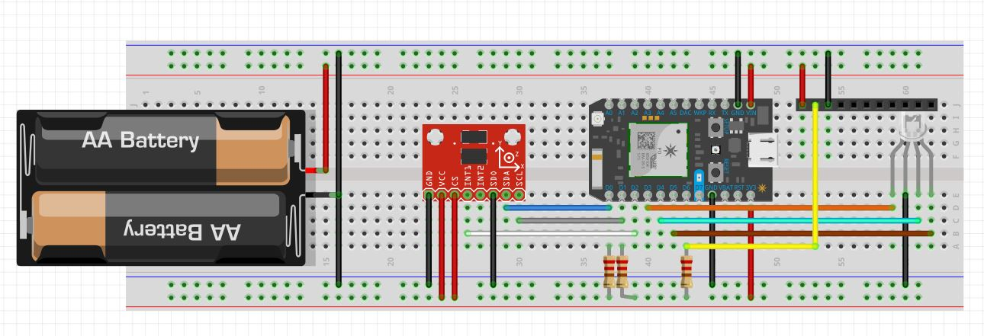
The Board

Slide 7
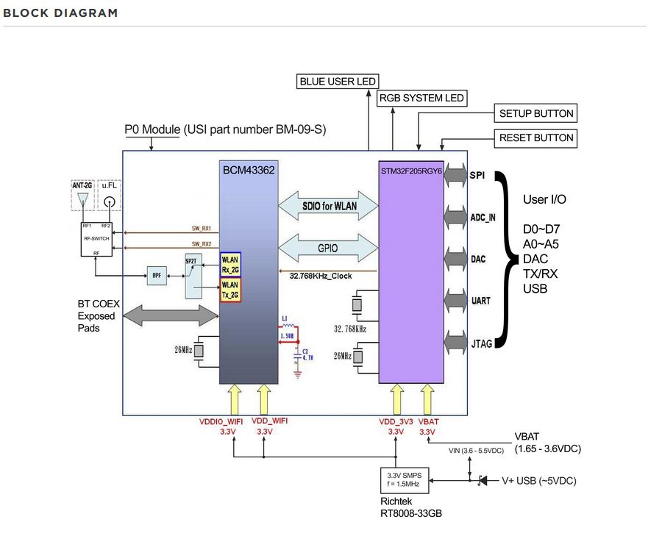
The Photon

Slide 8
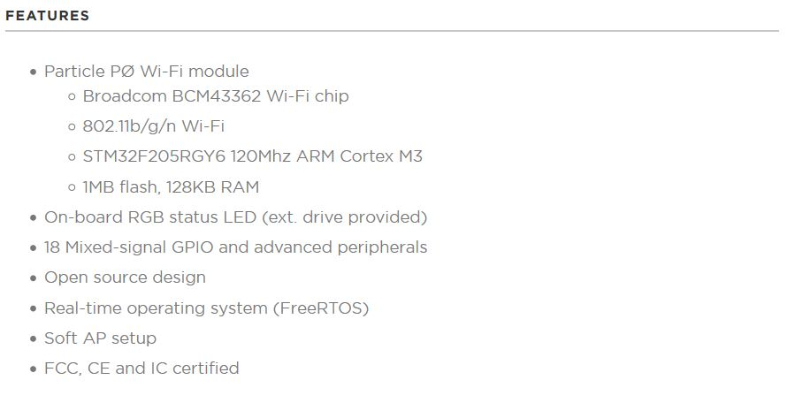
The Photon

Slide 9
The “Code”
Tasks:
LED Task
Temp Sensor Task
Impact Sensor Task
Control State Machine (Main Task)
Called from Arduino Loop
Cloud Function:
Clear Player
Remove Player
Respond to Impact

Slide 10
THE DEMO (It’s worth like 10,000 words)

Slide 11
Questions???

