Slide 1

Ah Beng & the Operating System
https://rms46.vlsm.org/2/172.pdf
Revision 20181104-538
(c) 2007-2018 VauLSMorg

Slide 2






20th Century Ah Beng
Ah Zeck 1999
Ah Beng’s Sign
Cellphone with a tentacle
MP3 Player
Pager
Sunglasses

Slide 3
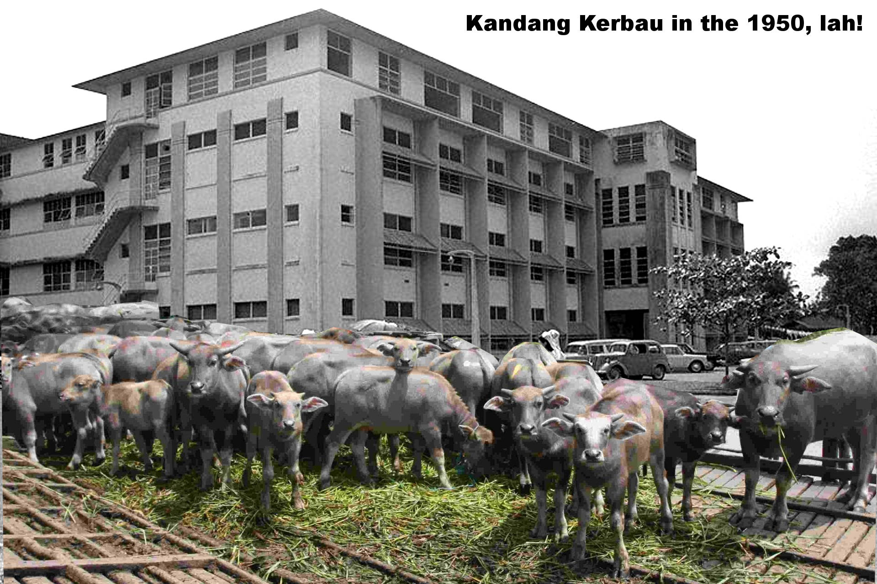
Ah Beng was born in Kandang Kerbau

Slide 4
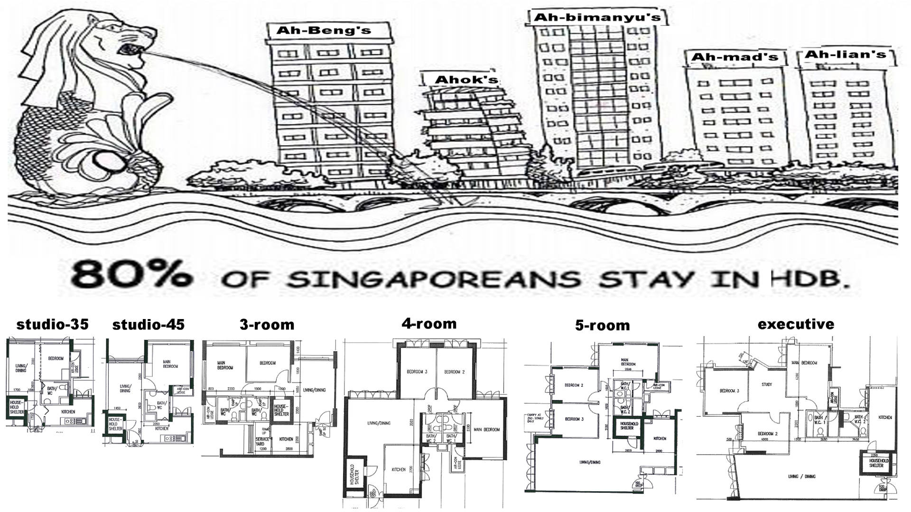
Ah Beng lives in a HDB studio

Slide 5
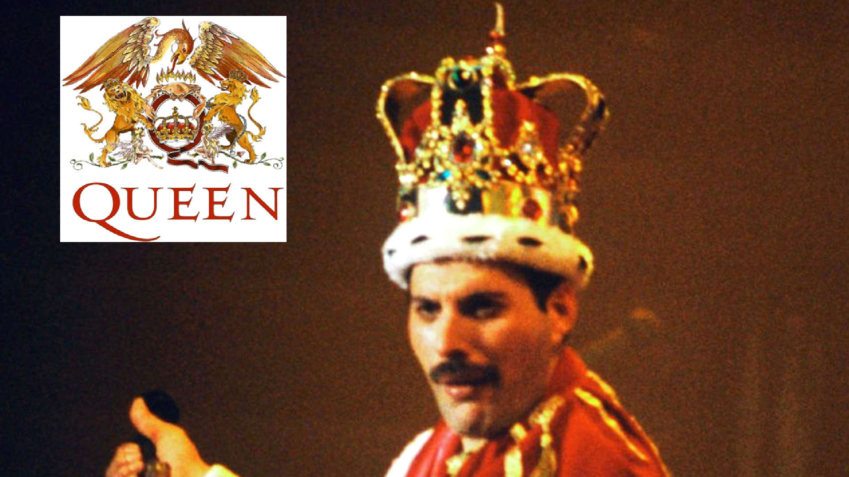
Ah Beng will study in Queen Universe
After National Service...

Slide 6

The Story of Ah Beng
To make the story short:
  Ah Beng went abroad
  Fall in love
  married Ang Mo Eva Braun (红毛丹)
  Ah Lian, Ah Beng's former lover was very unhappy!

Slide 7

Eva Braun
Alas! Unlike Ah Lian, Eva can not cook Sichuan Chicken Rice, Ah Beng favorites!
Eva argued that she is no local, and therefore can not cook chicken rice, lah!
Everybody agrees.

Slide 8
20 Years After
Eva still can not cook chicken rice,
Eva still argued that she ain't local!
Ah Beng is very up set:
  “Neither Ah Lian was able to cook chicken rice when she was born. But she learned how to cook it!”

Slide 9
The Moral of The Story
It was OK not fluently understand:
  GNU/Linux
  the vi editor
  C programing
  network programing
  shell scripting
  regex
  fork()

Slide 10
BUT
Operating Systems is a 4 SKS (unit) COURSE
  For every 4 hour class meeting, you are supposed to learn 8 more hours!
  Therefore, STUDY HARDER!
  Do not wait until the end of the semester!
Tararenk You, euy!
rms46

