Slide 1
Indonesia in the 1990s
Rahmat M. Samik-Ibrahim
VauLSMorg
(c) 2010 rev 02

Slide 2
Some Internet Related Issues
reflection of country’s Internet development
  Indonesia in the 1980s and 1990s
vision of country’s Internet evolution
outlook of Asian Internet
perspective of Research Network

Slide 3
INHERENT Today (1)
Indonesia Higher Education and Research Network
  82 Public Higher Education nodes
  224 Private Higher Education nodes
  Bandwidth 2 - 155 MBps
  Programs:
    research grants
    tele-teachings and teleconferences
    resource sharing
    local content developtment

Slide 4
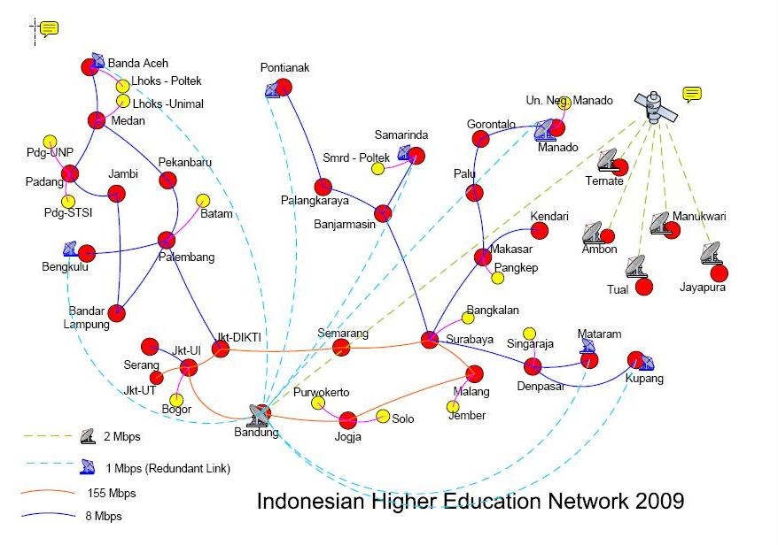
INHERENT Today (2)

Slide 5
Indonesia Today
PSTN

Slide 6
How were the 1980s and 1990s?
1980s: Pre Internet
Early 1990s: Pioneers
1994-2000 : Commercial Internet
2000- : Mobile and Wireless Internet

Slide 7
1980s: Pre Internet
The days of the Mainframes and Minis
Less powerfull PC
Low Speed/ Quality Dial Up Connections
Expensive X.25 service
UUCP (batch): UNInet, AUSEAnet
UUCP MAP: ”Understands .id domain”
First UI IP address block: 192.41.206/24

Slide 8
Early 1990s: Pioneer
Packet Radio Links (1992s)
  Jakarta - Depok - Bogor- Bandung
IPTEKNET (trial: 1993)
  X.25 link to RWTH Aachen (Germany)
”.ID” Domain (1993)
  forwarding UUCP mail to UUNET, USA.
Campus Networks (1993)
  Depok (UI) 152.118/16
  Bandung (ITB) 167.205/16

Slide 9
1994- : Commercial Internet
Major Commercial ISP
  INDOnet, RADnet, CBN --> APJII
SubDomains
  ”ac.id”. ”co.id”, ”go.id”
  early registration guidelines
WebHosting
  BisnisWeb, IndoGlobal, WebIndonesia
IIX: Peering

Slide 10
Conclusion
Early Internet Stage in Indonesia
  commercial ISPs: the pipes
  young entrepreuners: the ecommerce
  universities: the resources

Slide 11
Reference
''INHERENT and Higher Education Development in Indonesia'', Secretary of the Board of Higher Education, 2009.

