Slide 1
Introducing:
Free/Open Source Software
Distributed Systems
Real Time Systems and Multimedia Systems
Rahmat M. Samik-Ibrahim
VauLSMorg
Ver. 2013-05-14 rev 02

Slide 2
References 1 (Cut&Pasted)
Beberg, Distributed Systems: Computation With a Million Friends (and a few Foes), EE380, Stanford University, 2008.
FSF, What is Free Software, www.gnu.org, accessed on 12-May-2013.
Haridi, Introduction to Distributed Systems
Jayaswal, Administerting Data Centers, Wiley, 2001.

Slide 3
References 2 (Cut&Pasted)
Microchip, Concepts of Real Time Systems, WebSeminar, accessed on 10-May-2013.
OSI, The Open Source Definition, www.opensource.org, accessed on 12-May-2013.
Silberschatz, et.al., Operating Systems Concepts, 9th Ed, 2012.
–, Wikipedia: The Free Encyclopedia, Wikipedia Foundation, accessed on 12-13 May-2013.

Slide 4
Topics
Free/Open Source Software
Distributed Systems
Real Time Systems
Multimedia Systems

Slide 5
Topic #1
Free/Open Source Software
Topic #1: Free/Open Source Software
Topic #2: Distributed Systems
Topic #3: Real Time Systems
Topic #4: Multimedia Systems

Slide 6
Sub-Agenda
Introduction
License
Free Software
Open Source Software
Free Software vs. Open Source Software
Popular F/OSS Licenses
Success Stories

Slide 7
Guess: are these following free?
Microsoft Windows
Microsoft Internet Explorer
Mozilla Firefox
GNU/Linux
LibreOffice
Public Domain
Shareware
Freeware

Slide 8
Is it Free Software IF you can:
use for non-commercial usage only.
download it from the internet for free.
have the source code of the software
charge a fee to development
charge a fee to distribute
use it for illegal activities

Slide 9
License
A license agreement is needed for using a software (do-s and don't-s):
  Can you use it?
  Can you copy and redistribute it?
  Can you modify it?
  Can you transfer the license?
  Is it viral? - allows derivative works only when licensed identically to the original

Slide 10
Free Software
about liberty
FREE like in ”free speech”
not like FREE in ”free gift”
A matter of the users' freedom to run, copy, distribute, study, change and improve the software.

Slide 11
Four Essential Freedoms
To run the program, for any purpose.
To study how the program works, and adapt it to your needs (needs source code).
To redistribute copies/ help neighbor.
To improve the program, and release the improvements to the public, so that the whole community benefits (needs source code).

Slide 12
The Open Source Definition (1)
Free Redistribution
Source Code
Derived Works
Integrity of The Author's Source Code
No Discrimination Against Persons or Groups

Slide 13
The Open Source Definition (2)
No Discrimination Against Fields of Endeavor
Distribution of License
License Must Not Be Specific to a Product
License Must Not Restrict Other Software
License Must Be Technology-Neutral

Slide 14
Free = Open Source ?
”All religions are one!?”
Free Software (FSF, 1985)
  four-point definition
Open Source Software (OSI, 1998)
  ten-point definition
guarantee a certain set of freedoms.
but, different words convey different ideas

Slide 15
Free Software vs. Open Source
Open Source Software
  a development methodology
  non-free software is a sub-optimal solution.
Free Software: a social movement
  non-free software is a social problem
  Free software is the solution!

Slide 16
Popular F/OSS Licenses
Apache License 2.0
BSD 3-Clause "New" or "Revised" license
Common Development and Distribution License
GNU General Public License (GPL)
MIT license
GNU Library or "Lesser" General Public License (LGPL)
Microsoft Public License
Mozilla Public License 2.0
Nokia Open Source License
PHP License 3.0

Slide 17
Success Stories (1)
Red Hat
  Founded in 1993
  Product: Red Hat Enterprise Linux
  F/OSS for the enterprise community
  The Fedora Project sponsor
  the first one-billion dollar FOSS company (2012)
  Minority owners: Intel, Netscape (Mozilla), HP, IBM, Dell, Novell.

Slide 18
Success Stories (2)
Ubuntu Linux/Canonical Ltd.
  Founded in 2004
  A fork of Debian with a “6 months release cycle”
  Most popular Linux Distribution for desktop/laptop
  A distribution for laymen
  A US$ 30 million company (2009)

Slide 19
End of Topic #1
Free/Open Source Software

Slide 20
Topic #2
Distributed Systems
Topic #1: Free/Open Source Software
Topic #2: Distributed Systems
Topic #3: Real Time Systems
Topic #4: Multimedia Systems

Slide 21
Sub-Agenda
Introduction
Definition
Issues
Distributed Operating Systems
Network Model
Robustness
Design Issues
Consolidation

Slide 22


A Distributed System is
collection of loosely coupled processors interconnected by a communications network
– Silberschatz et. al.
one in which the failure of a computer you didn't even know existed can render your own computer unusable.
– Leslie Lamport.

Slide 23
A Distributed System is
a set of nodes, connected by a network, which appear to its users as a single coherent system. – Haridi
Clients & Servers

Slide 24
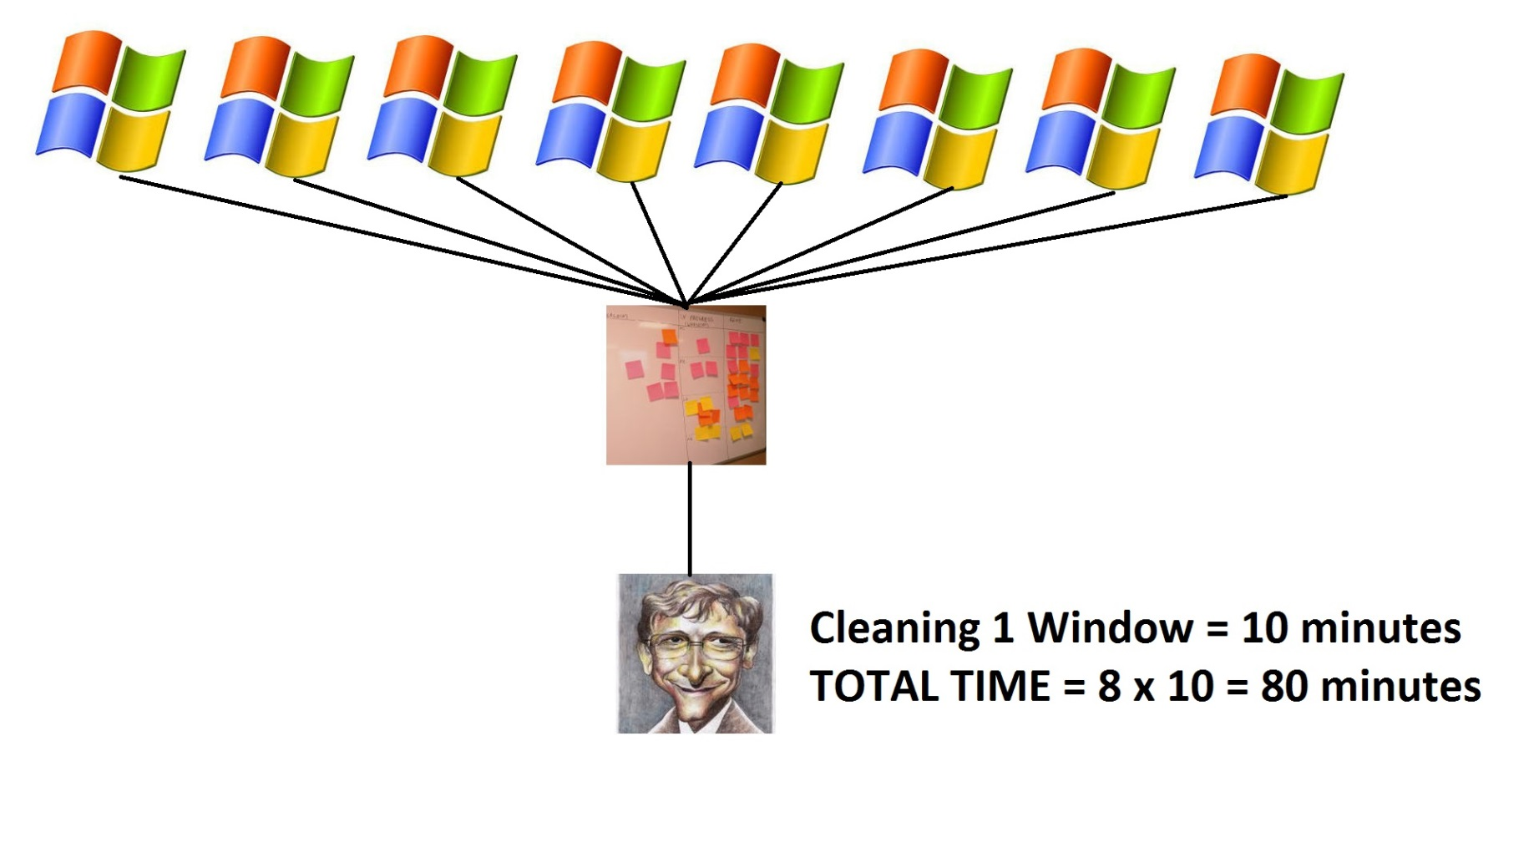
Cleaning 8 Windows

Slide 25
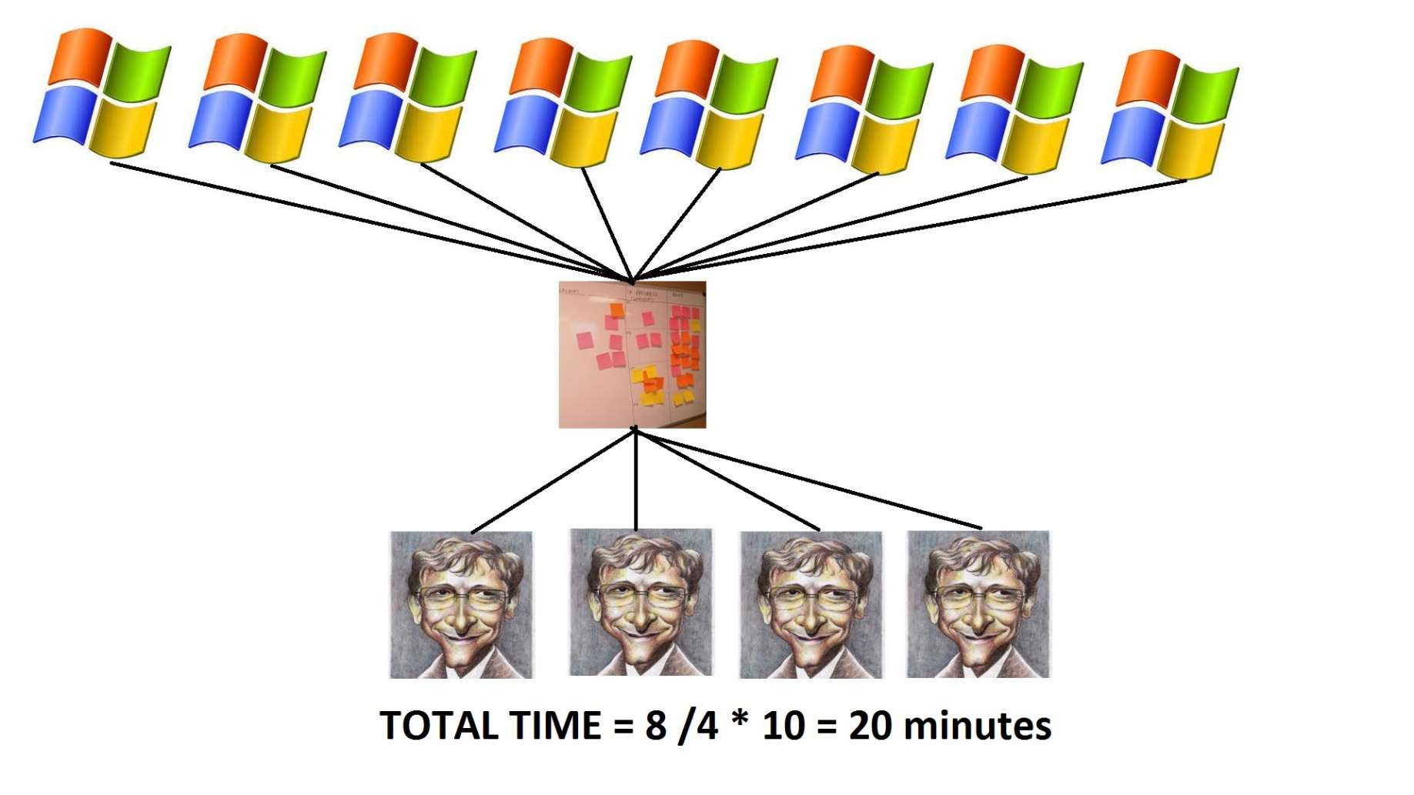
Cleaning By 4

Slide 26
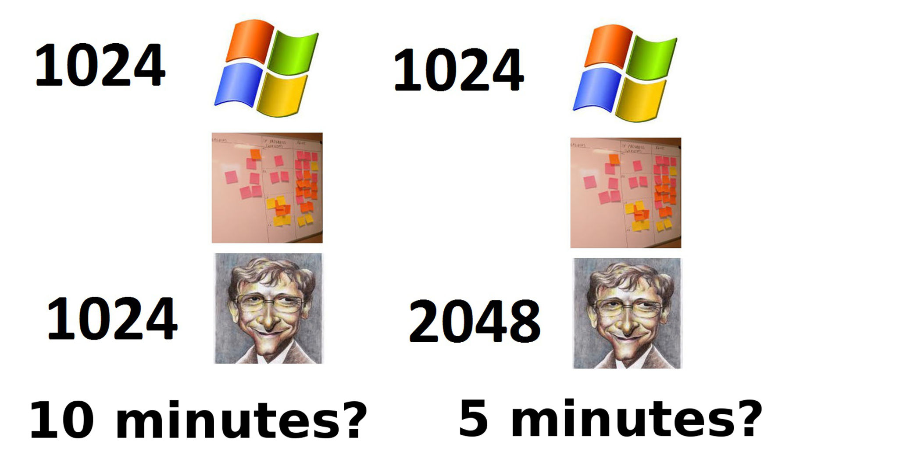
How about this?

Slide 27
Why Distributed Systems?
Resource Sharing
  Most everything is now connected
Computation Speedup
  Spreading the load
Reliability
  One is down, others can take over
Communication

Slide 28
Central vs. Distributed
SLA
“Reliable”
Homogeneous
Trusted
Cost=Money
Untrusted systems
Unstable
Heterogeneous
Distrusted
Cost=Time

Slide 29
Issues
Improve Scalability
  Concurency: web/mail server
Reliability
  Tandem System
Inherent Distribution

Slide 30
Types of Distributed OS
Network Operating Systems
  Users are aware of multiplicity of machines (more difficult)
Distributed Operating Systems
  Users are not aware of multiplicity of machines

Slide 31
Distributed Operating Systems
Data Migration
Computation Migration
Process Migration
  Load balancing
  Computation speedup
  HW/SW preferences
  Remote Data Access

Slide 32
Wide Area Network

Slide 33
ISO Network Model

Slide 34
TCP/IP vs OSI ISO model

Slide 35
Robustness
Failure Detection
  Heatbeat protocol: I am UP/Are you UP?
  Failure Types: host, link, loss
Reconfiguration
  Notify host/link/loss failure
  Reconfigure to avoid host/link/loss

Slide 36
The Two Generals' Problem
How can G1 synchronize with G2?
How can G1 be sure that G2 has received the message?
How can G2 be sure that G1 knows that G2 has received the message?
GENERAL #1
ENEMY
GENERAL #2

Slide 37
Design Issue
Transparency – the distributed system should appear as a conventional, centralized system to the user
Fault tolerance – the distributed system should continue to function in the face of failure
Scalability – as demands increase, the system should easily accept the addition of new resources to accommodate the increased demand
  Consider Hadoop open source programming framework for processing large datasets in distributed environments (based on Google search indexing)
Clusters – a collection of semi-autonomous machines that acts as a single system

Slide 38
Consistency
Is locally cached copy of the data consistent with the master copy?
Client-initiated approach
  Client initiates a validity check
  Server checks whether the local data are consistent with the master copy
Server-initiated approach
  Server records, for each client, the (parts of) files it caches
  When server detects a potential inconsistency, it must react

Slide 39
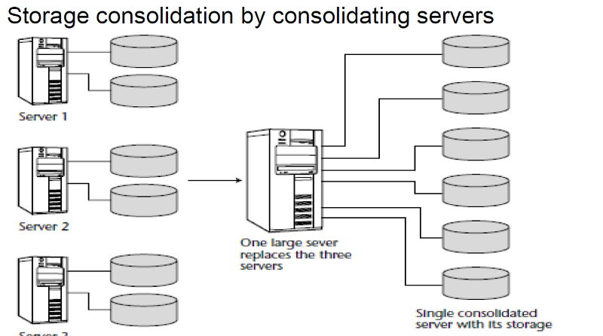
Data Center Consolidation (1)

Slide 40
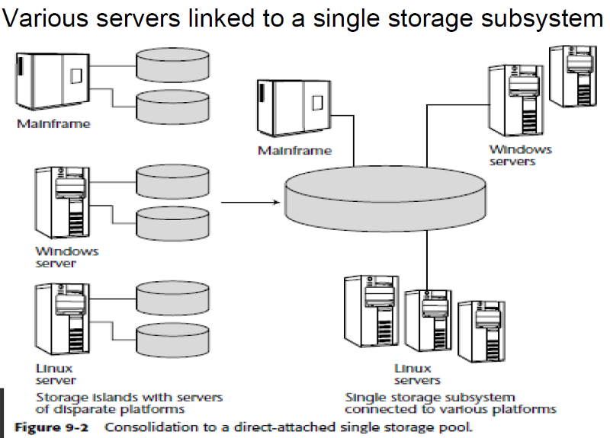
Data Center Consolidation (2)

Slide 41
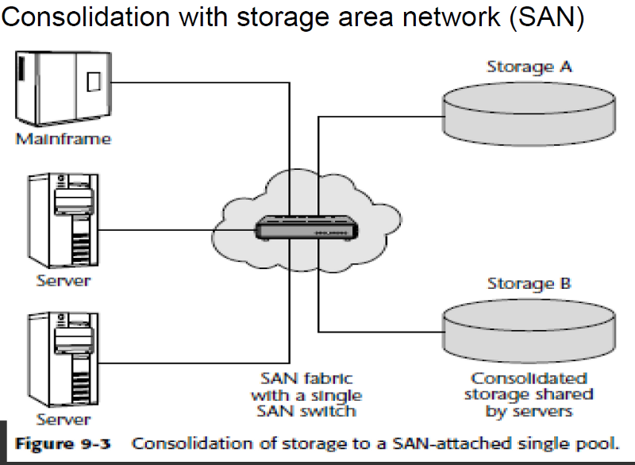
Data Center Consolidation (3)

Slide 42
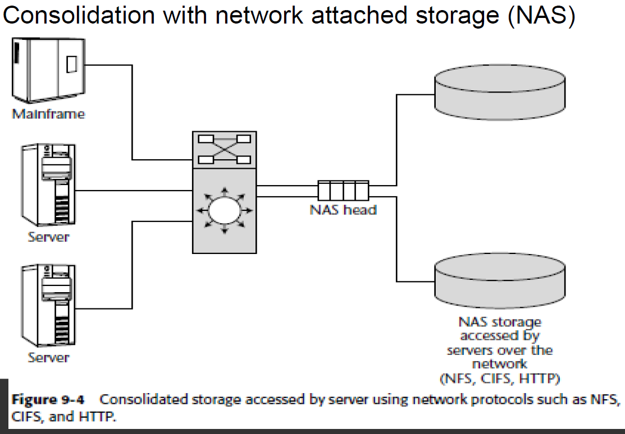
Data Center Consolidation (4)

Slide 43
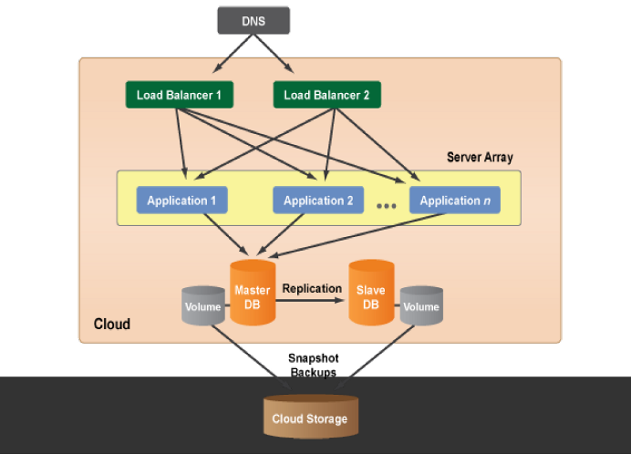
Data Center Consolidation (5)

Slide 44
End of Topic #2
Distributed Systems

Slide 45
Topic #3
Real Time Systems
Topic #1: Free/Open Source Software
Topic #2: Distributed Systems
Topic #3: Real Time Systems
Topic #4: Multimedia Systems

Slide 46
Sub-Agenda
Introduction
Characteristics
Implementation
Schedulling

Slide 47
Real Time Systems (RTS)
A real-time system requires that results be produced within a specified deadline period.
An embedded system is a computing device that is part of a larger system (i.e., automobile, airliner).
A safety-critical system is a real-time system with catastrophic results in case of failure.
A hard real-time system guarantees that real-time tasks be completed within their required deadlines.
A soft real-time system provides priority of real-time tasks over non real-time tasks.

Slide 48
RTS Characteristics
Single purpose & Small size
Inexpensively mass-produced
Specific timing requirements
Designed using system-on-a-chip (SOC) strategy
SOC allows the CPU, memory, memory-management unit, and attached peripheral ports (i.e., USB) to be contained in a single integrated circuit
Not all features found in a standard system

Slide 49
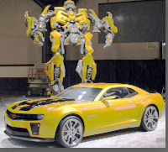
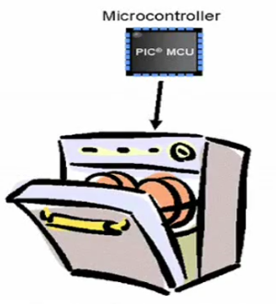
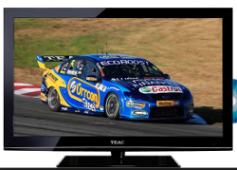

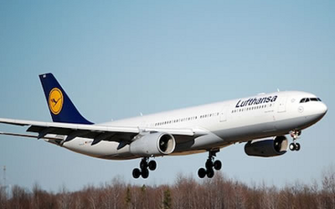

RTS Examples

Slide 50
RTS Processes
Tasks/Processes
  Have priority
  Have deadlines
  Higher priority tasks PREEMPT lower ones (Priority Based Preemption)

Slide 51
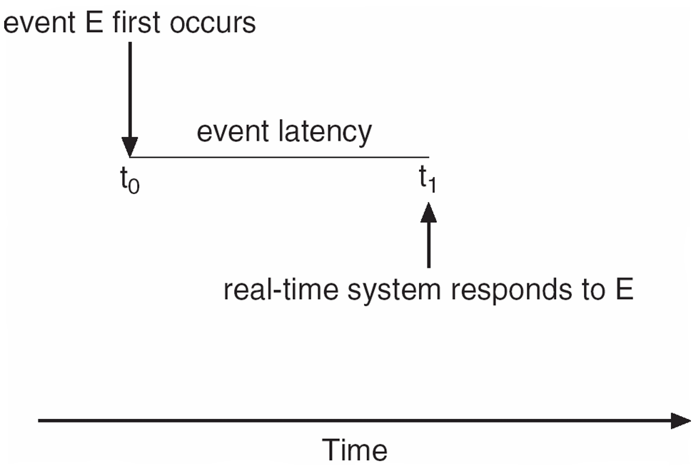
Implementing RTS
RTS must provide:
  Preemptive, priority-based scheduling
  Preemptive kernels
  Latency must be minimized

Slide 52
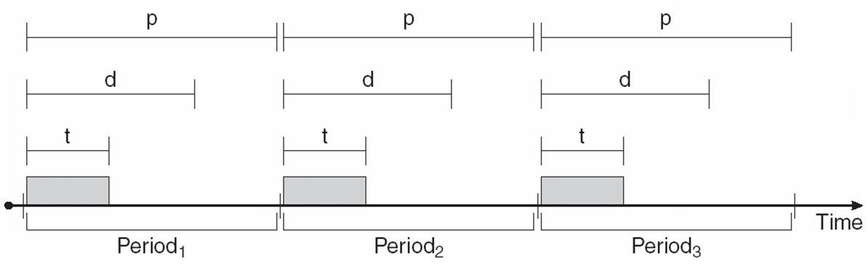
RTS CPU Schedulling
Periodic processes require the CPU at specified intervals (periods)
p is the duration of the period
d is the deadline by when the process must be serviced
t is the processing time

Slide 53
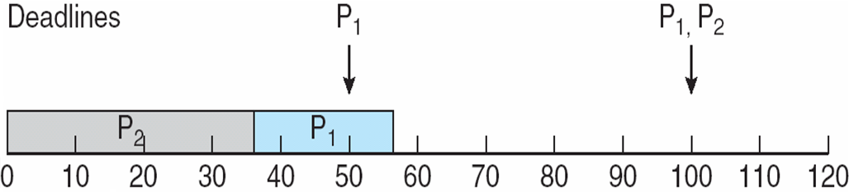
Priority Schedulling
P2 has a higher priority than P1

Slide 54
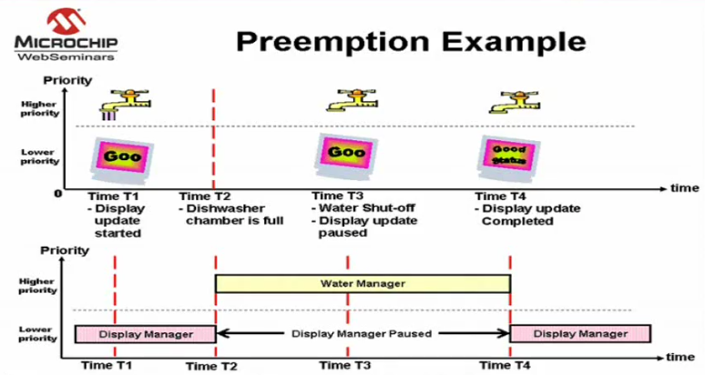
Preemption Example

Slide 55
End of Topic #3
Real Time Systems

Slide 56
Topic #4
Multi Media Systems
Topic #1: Free/Open Source Software
Topic #2: Distributed Systems
Topic #3: Real Time Systems
Topic #4: Multimedia Systems

Slide 57
Sub-Agenda
Introduction
Delivery
Characteristics
Streaming
Compression
QoS
Delivery Methods

Slide 58
Introduction
Multimedia data includes
  audio and video clips (i.e., MP3 and MPEG files)
  live webcasts
Multimedia data may be delivered to
  desktop PC’s
  handheld devices

Slide 59
Media Delivery
Data must be accessed with specific timing requirements. Eg.
  video must be displayed at 24-30 frames per second. Multimedia video data must be delivered at a rate which guarantees 24-30 frames/second
  Continuous-media data is data with specific rate requirements

Slide 60
Characteristics
Multimedia files can be quite large
Continuous media data may require very high data rates
Multimedia applications may be sensitive to timing delays during playback of the media

Slide 61
Streaming
Streaming is delivering a multimedia file from a server to a client - typically the deliver occurs over a network connection.
There are two different types of streaming:
  Progressive download - the client begins playback of the multimedia file as it is delivered. The file is ultimately stored on the client computer.
  Real-time streaming - the multimedia file is delivered to - but not stored on - the client’s computer.

Slide 62
Real Time Streaming
There are two types of real-time streaming:
  Live streaming - used to deliver a live event while it is occurring
  On-demand streaming - used to deliver media streams such as movies, archived lectures, etc. The events are not delivered in real-time.

Slide 63
Compression
Because of the size and rate requirements of multimedia systems, multimedia files are often compressed into a smaller form
MPEG Compression:
  MPEG-1 - 352 X 240 @ 30 frames/second
  MPEG-2 - Used for compressing DVD and high-definition television (HDTV)
  MPEG-4 - Used to transmit audio, video, and graphics. Can be delivered over slow connections (from 56 Kbps)

Slide 64
QoS
Guaranteeing QoS has the following effects in a computer system:
  CPU processing
  Scheduling
  File systems
  Network protocols
Levels:
  Best-effort service
  Soft QoS
  Hard QoS

Slide 65
Delivery Methods
Three general methods for delivering content from a server to a client across a network:
  Unicasting - the server delivers the content to a single client.
  Broadcasting - the server delivers the content to all clients, regardless whether they want the content or not.
  Multicasting - the server delivers the content to a group of receivers who indicate they wish to receive the content

Slide 66
End of Topic #4
Multimedia Systems

Slide 67
EOF
Thank You!

