Slide 1


Slide 2

Online Sales Information Web Portal

Slide 3
Group Members Introduction
Group ID : F160206913
Salman Saeed: BC120401366

Slide 4

INTRODUCTION OF PROJECT
Online Sales Information Web Portal
1:- In this web portal we provide information of brands online.
2:- It shows online product offers.
3:- They offer scope for instant query subscribing / unsubscribing to notification and getting the latest notifications of all the events and happenings on this portal.
4:- It shows offer product description, comparisons, price, and much more.
5:- It’s also provides security with the use of login-id and password so that any unauthorized users can not use your account.
6:- If a user is registered to the site he can edit subscription, ratings and posted comments.

Slide 5
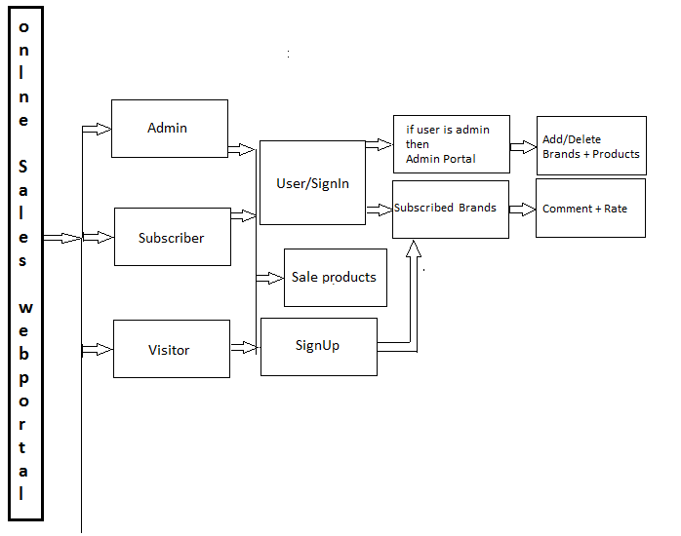
Diagram Of Process Model

Slide 6
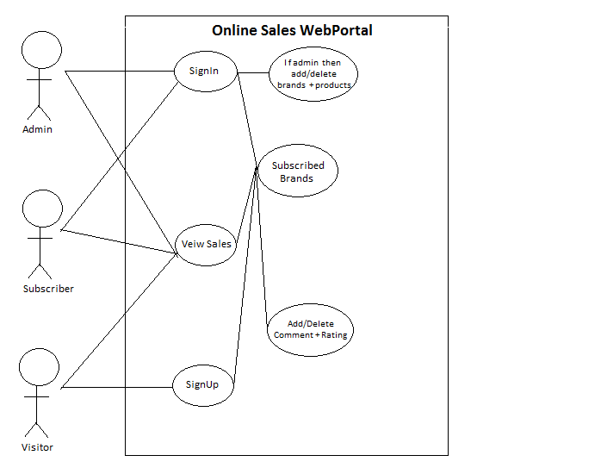
Use Case Diagram

Slide 7
Business Rules Catalog
Admin, a brand representative and a subscriber shall be able to manage account.
Admin shall be able to manage users
Admin shall be able to manage all brands info.
Visitor shall be able to browse website to get info about latest sales.
Visitor shall open account on website to get latest update through subscribed brand on their subscribed page.
Visitor able to edit subscription and ratings

Slide 8
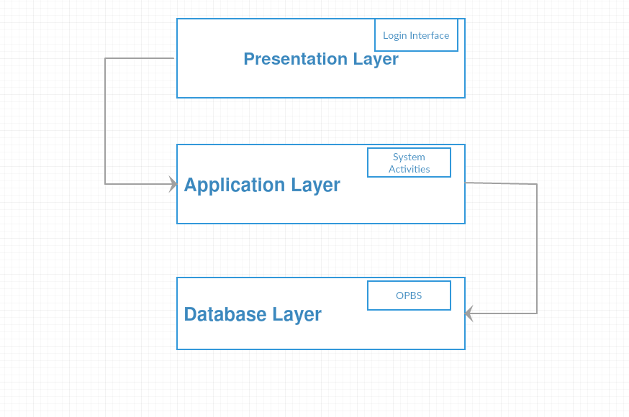
Architectural Design

Slide 9
Team Structure
Honestly say this(me) is a single Man army.
So I don’t have any member to work with me as a team.
Thanks

Slide 10
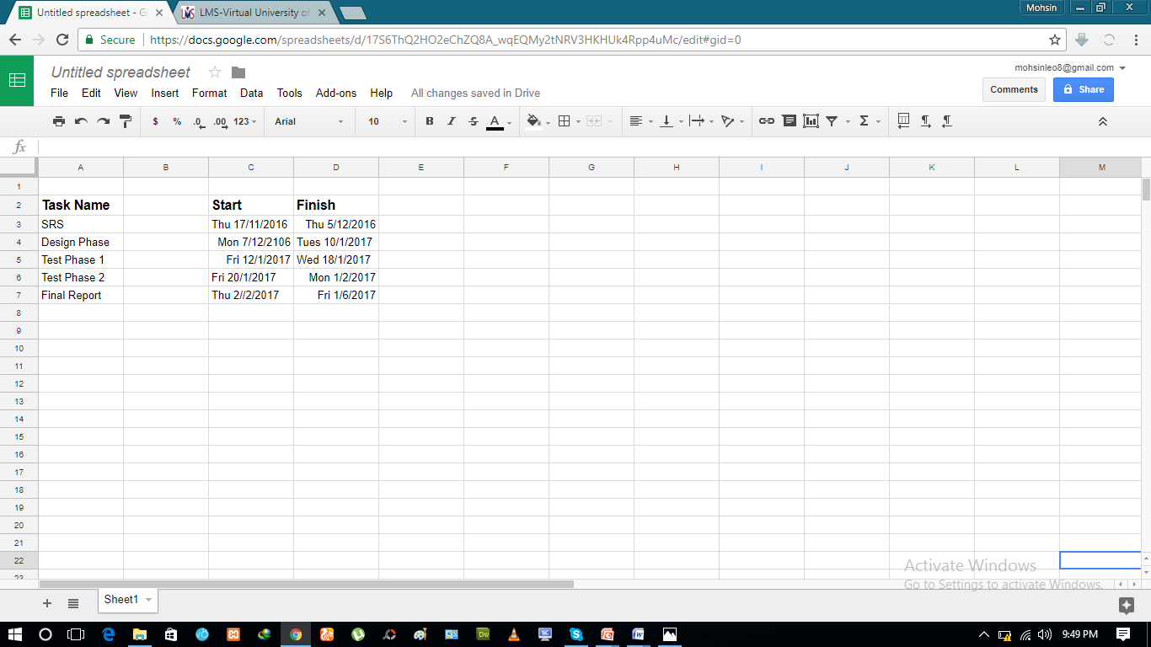
Project Schedule
Provide the Schedule (Gantt Chart) of your
project here.

Slide 11
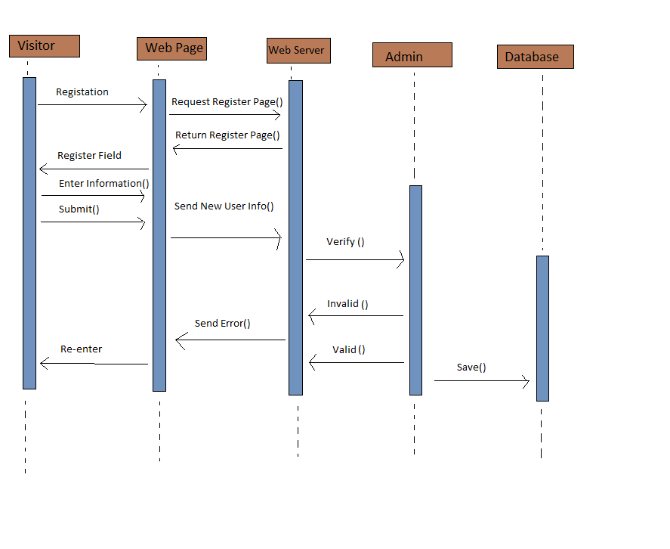
Sequence Diagrams

Slide 12
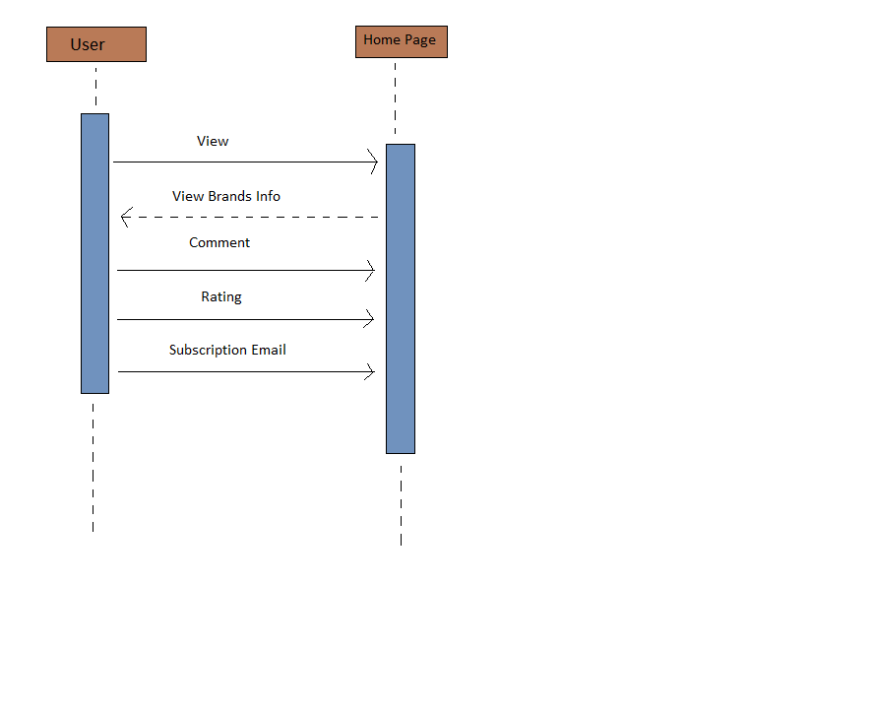

Slide 13
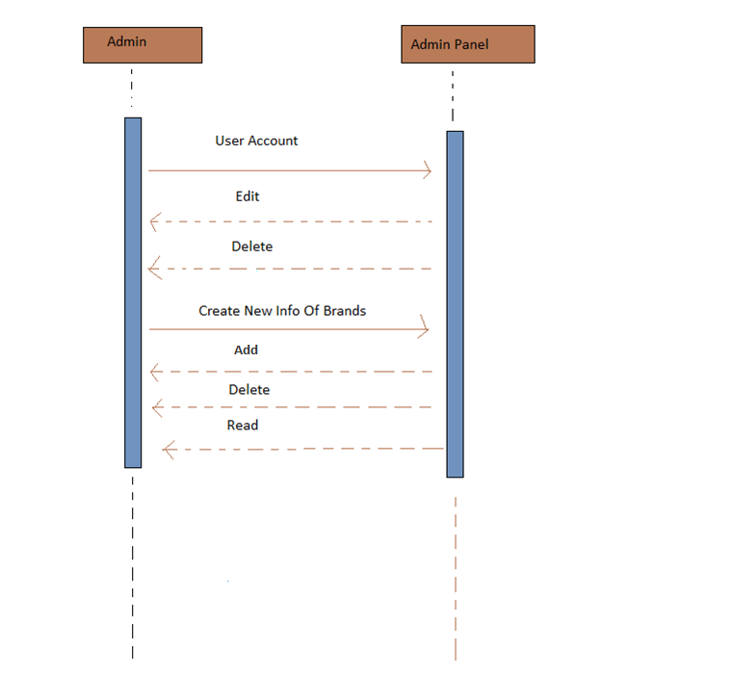

Slide 14
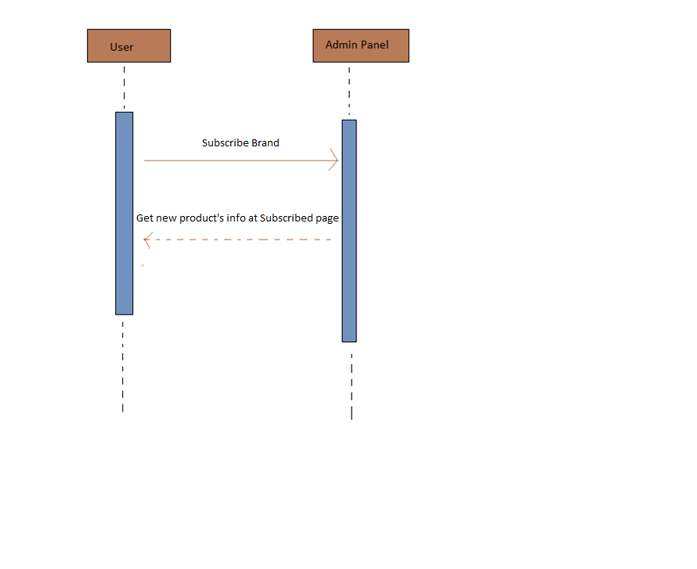

Slide 15
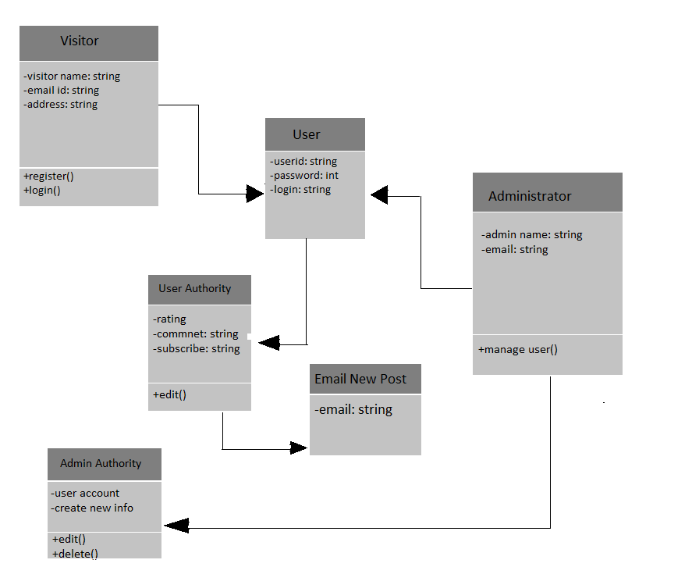
Logical Model/Class Diagram

Slide 16
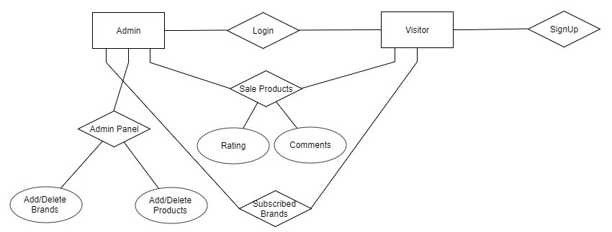
Entity-Relationship Diagram

Slide 17
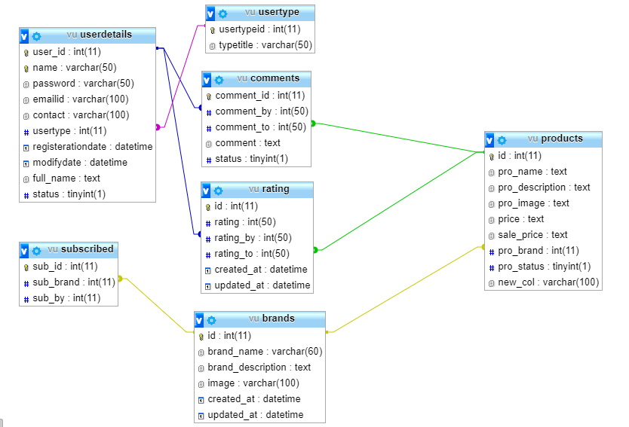
Database Diagram

Slide 18
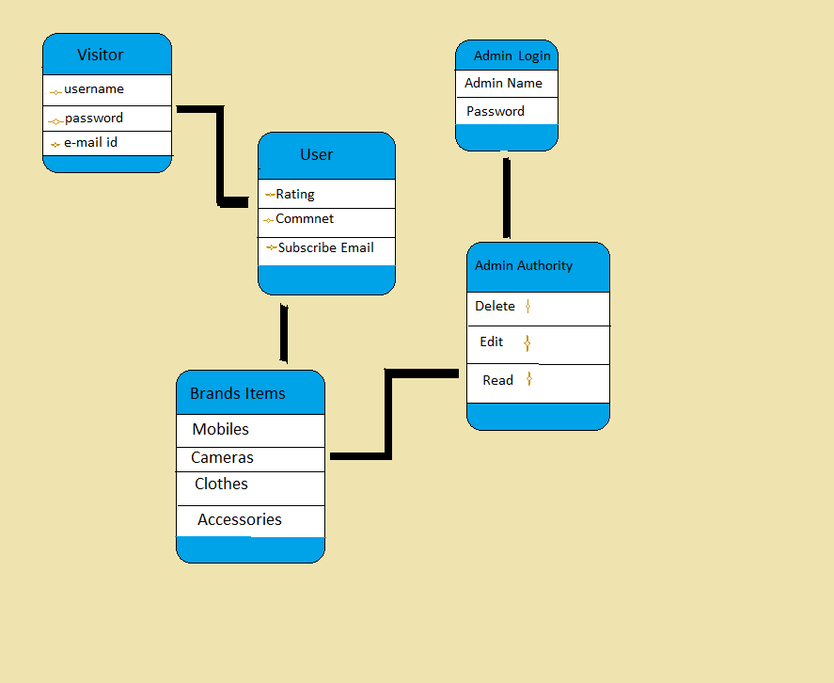
Database Diagram

Slide 19
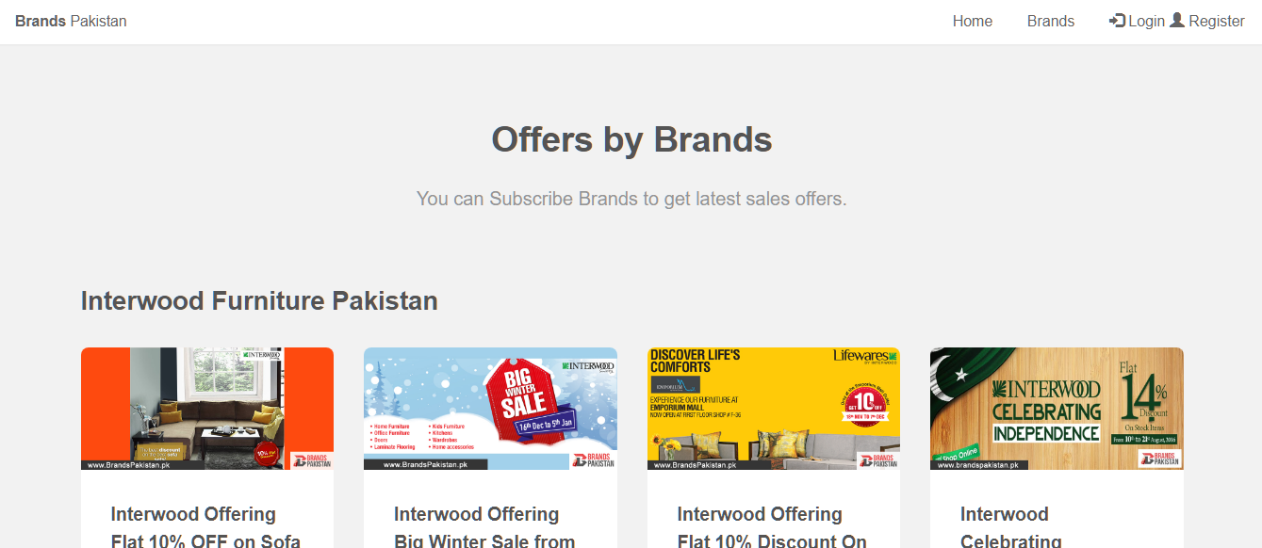
User Interfaces

Slide 20
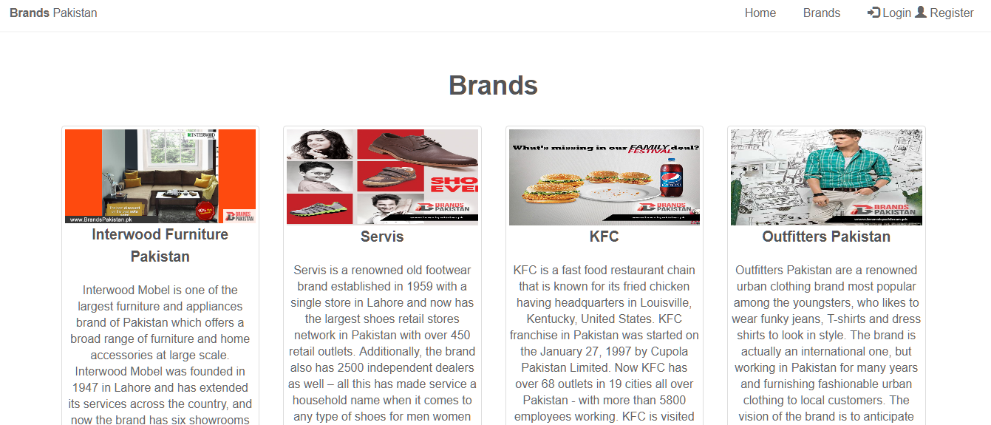

Slide 21
Tools
Php language
Xampp Server
Html/CSS language
Bootstrap css framework
Mysqli database
Notepad++ code editer

