Slide 1
Introduction to Self-Supervised Learning
Peyman Tahghighi
Winter 2024

Slide 2
Learning objectives
What is self-supervised learning?
How we can use it in NLP and Vision?
How it can benefit us?

Slide 3
Self-supervised learning: The dark matter of intelligence
Supervised learning is a bottleneck for building more intelligent generalist models that can do multiple tasks and acquire new skills without massive amounts of labelled data.
As babies, we learn how the world works largely by observation.
We learn new skills by short training, e.g. driving.
A working hypothesis is that generalized knowledge about the world, or common sense, forms the bulk of biological intelligence in both humans and animals.
Common sense helps people learn new skills without requiring massive amounts of teaching for every single task.
Notes:
Even if we can label all the data in the world, for low resource languages we don’t have huge data to label
How is it that humans can learn to drive a car in about 20 hours of practice with very little supervision, while fully autonomous driving still eludes our best AI systems trained with thousands of hours of data from human drivers? The short answer is that humans rely on their previously acquired background knowledge of how the world works.

Slide 4
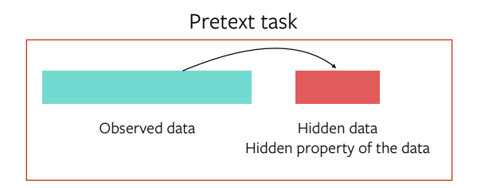
What is self-supervision?
Obtain “labels” from the data itself and leverage the underlying structure in data.
Predict unobserved or hidden parts.

Slide 5
Examples of data generation in NLP
A
?
A
quick
?
A
quick
brown
?
GPT
A
quick
brown
fox
?
A
quick
brown
fox
jumped
?
A
quick
brown
fox
jumped
over
?
A
quick
brown
fox
jumped
over
the
?
A
quick
brown
fox
jumped
over
the
lazy
?
A
quick
brown
fox
jumped
over
the
lazy
dog
A
?
brown
fox
?
over
the
?
dog
BERT
A
quick
?
fox
jumped
over
?
lazy
?
A
quick
brown
?
jumped
over
the
?
dog
A
?
brown
fox
?
?
the
lazy
dog

Slide 6
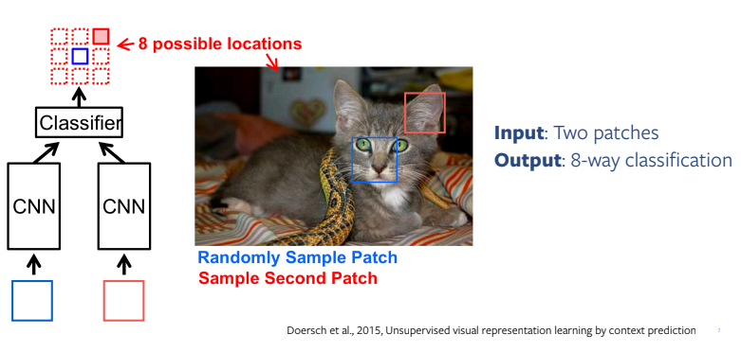
Examples of data generation in vision
Relative position of patches

Slide 7
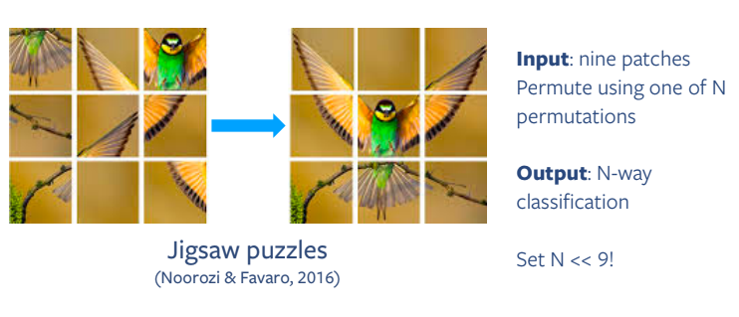
Examples of data generation in vision
Jigsaw puzzle

Slide 8
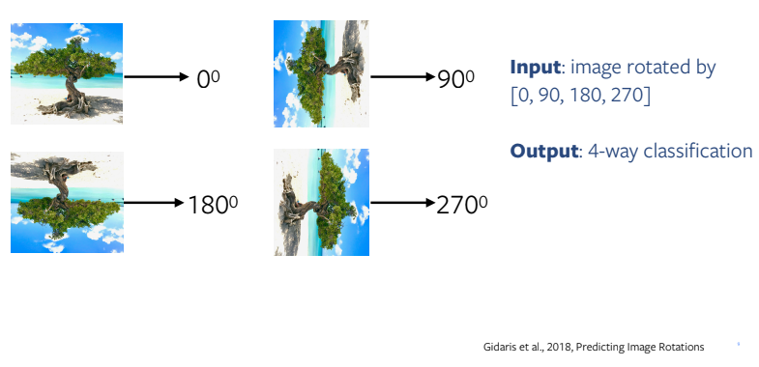
Examples of data generation in vision
Rotation prediction

Slide 9
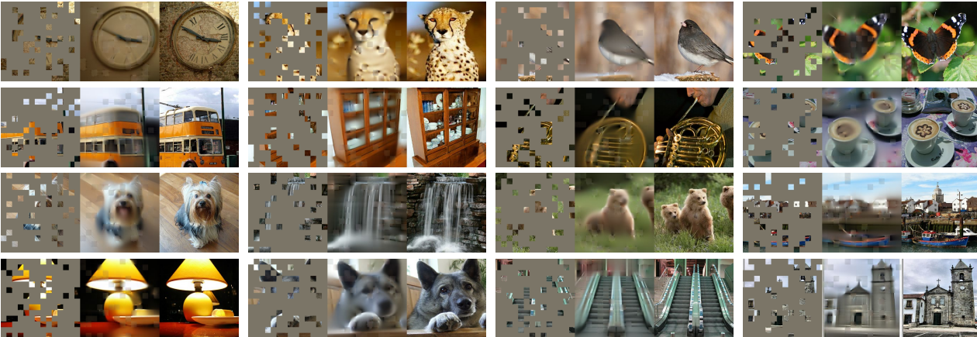
Examples of data generation in vision
Masking input

Slide 10
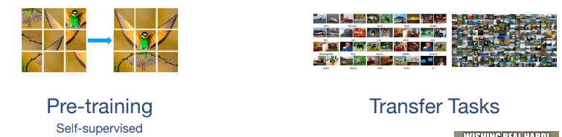
The hope of generalization
We hope that the pre-text task and downstream task are aligned.

Slide 11
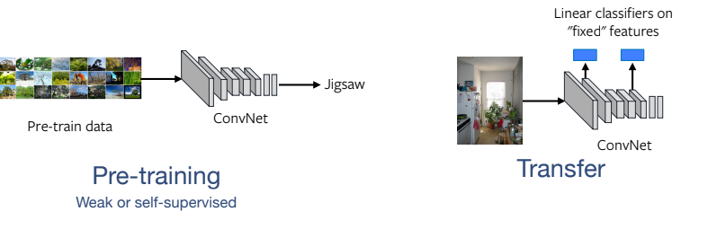
The hope of generalization

Slide 12
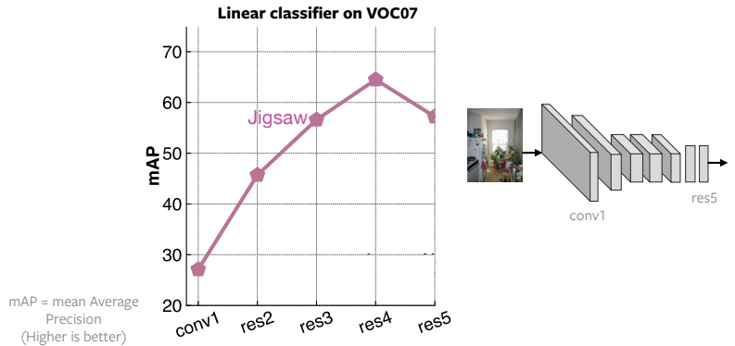
The hope of generalization
Higher layers do not generalize

Slide 13
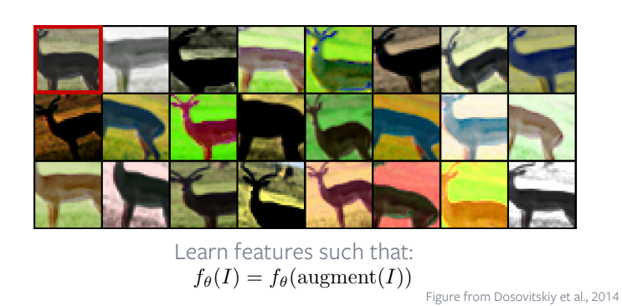
Pretrained features should
Represent how images relate to each other.
Be robust to “nuisance factors”
E.g., exact location, lighting, texture, color,…

Slide 14


Self-supervision NLP vs Vision
NLP
Vision
Type
Discrete
Continuous
Uncertainty
Number of possible outcomes can’t be enumerated in vision.
Notes:
These techniques, however, can’t be easily extended to new domains, such as CV. Despite promising early results, SSL has not yet brought about the same improvements in computer vision that we have seen in NLP (though this will change).
The main reason is that it is considerably more difficult to represent uncertainty in the prediction for images There are an infinite number of possible video frames that can plausibly follow a given video clip. It is not possible to explicitly represent all the possible video frames and associate a prediction score to them

Slide 15
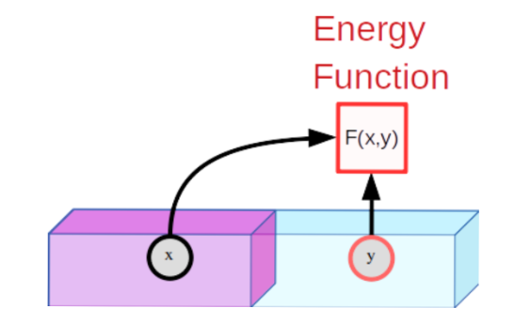
Energy-based model (EBM)
An EBM is a trainable system that, given two inputs, x and y, tells us how incompatible they are with each other.
Two steps of training:
Showing compatible x and y, produces low energy
For incompatible examples of y,
give high energy

Slide 16
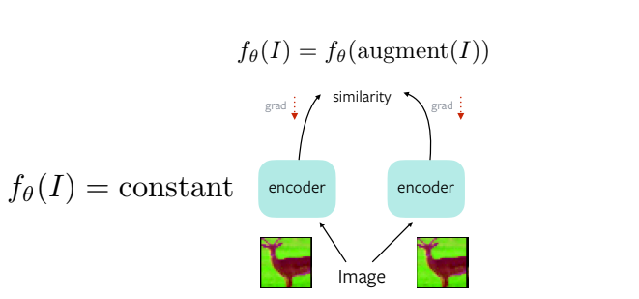

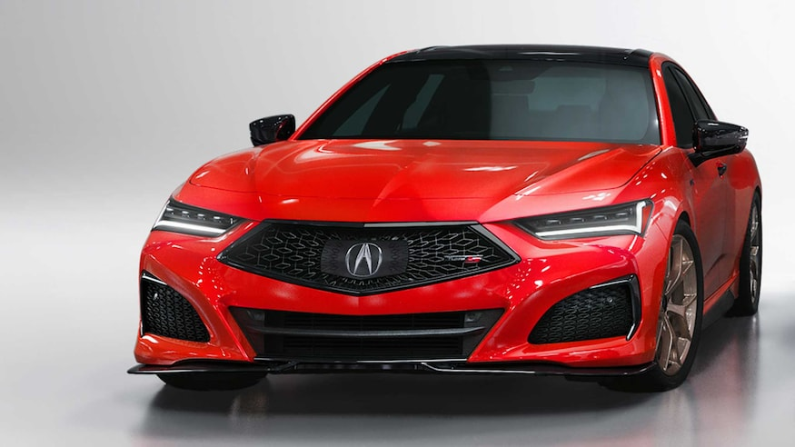
Join Embedding, Siamese networks
What could go wrong here?
Network ignoring input and generating same output regardless.
Called Collapse

Slide 17
Contrastive energy-based SSL

Slide 18
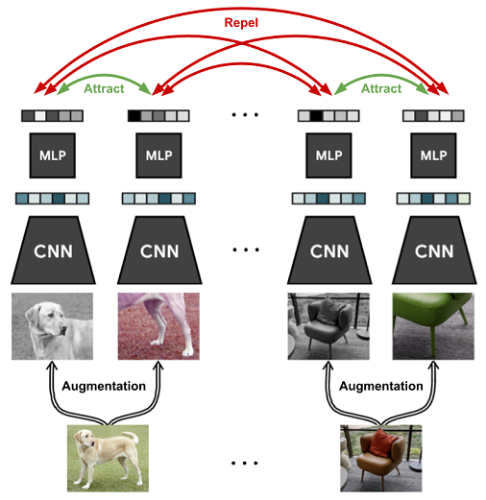
SimCLR: A Simple Framework for Contrastive Learning
Projection
Encoder

Slide 19
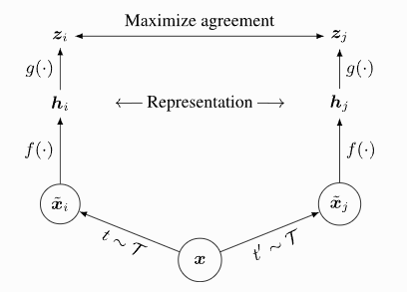
SimCLR: A Simple Framework for Contrastive Learning
Used a pre-trained weights

Slide 20
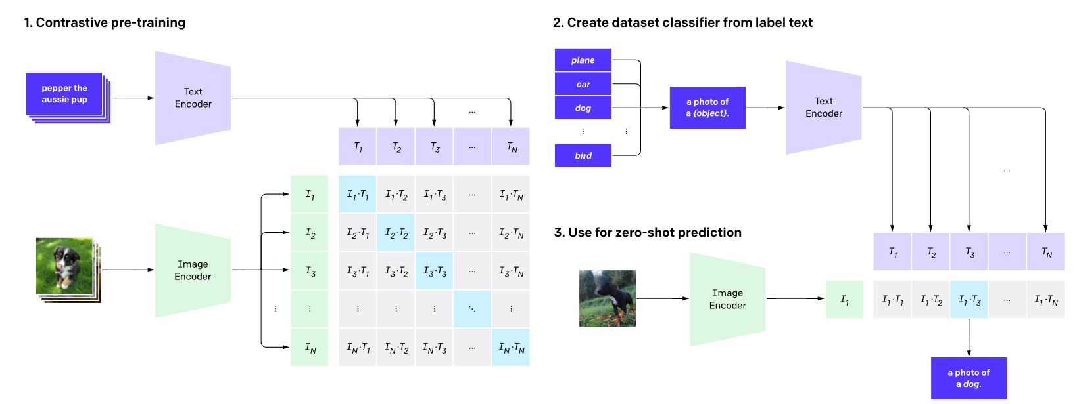
CLIP: Contrastive Language-Image Pretraining
Clip solves:
Costly dataset: Can be trained using image-text pair found on internet.
Adaptation: Easily adopted to other unseen datasets

Slide 21
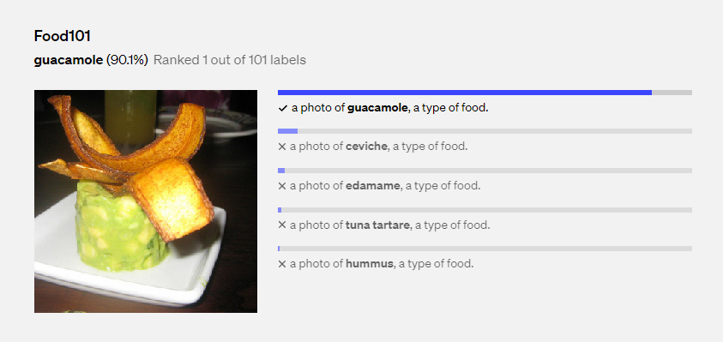
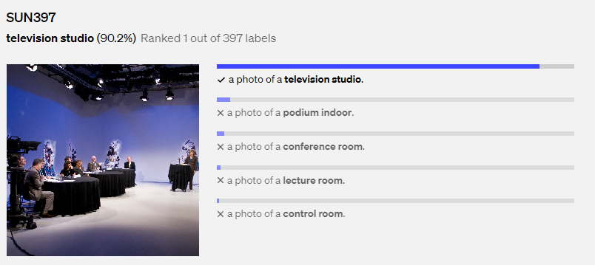
CLIP: Contrastive Language-Image Pretraining

Slide 22
Summary
Self-supervised learning means using the underlying structure of data to obtain data.
Self-supervised learning is effective in both NLP and Vision
Self-supervised learning is mostly used as pretraining phase

Slide 23
Useful resources
https://www.youtube.com/watch?v=8L10w1KoOU8&t=486s&ab_channel=AlfredoCanziani
https://ai.meta.com/blog/self-supervised-learning-the-dark-matter-of-intelligence/

