Slide 1
Tweet Geolocation Identifier
Patrick, Jonathan and Roberto

Slide 2
Motivation
Demographic lexica have potential for widespread use in social science, economic, and business applications.
Accurate estimation of user location is an important factor for many online services, such as recommendation systems (Quercia et al., 2010), event detection (Sakaki et al., 2010), and disaster management (Carley et al., 2016).
However, the vast majority of text classification articles and tutorials on the internet are binary text classification such as email spam filtering, sentiment analysis (positive vs. negative).
In most cases, our REAL WORLD problem are MUCH more complicated than that.
Quercia, Daniele, et al. "Recommending social events from mobile phone location data." 2010 IEEE international conference on data mining. IEEE, 2010.
Takeshi Sakaki, Makoto Okazaki, and Yutaka Matsuo. 2010. Earthquake shakes Twitter users: real-time event detection by social sensors. In Proceedings of the 19th International conference on World Wide Web (WWW '10). ACM, 851-860.
Carley, Kathleen M., et al. "Crowd sourcing disaster management: The complex nature of Twitter usage in Padang Indonesia." Safety science 90 (2016): 48-61.

Slide 3
Project Goals
Locate the county from a tweet without a geolocation tag using multi-class text classification

Slide 4
Challenges
Single tweets rarely contain enough information by themselves to reliably infer a location;
Large number of labels combinations that grows exponentially, high dimensionality, unbalanced data;
Some proposed solutions:
Exploiting correlations among labels to facilitate multi label learning
Proposing new features selection methods that are suitable for the nature of multi label datasets
Construct a hierarchy of ML classifiers where each classifier considers small subset of labels
Alazaidah, Raed, and Farzana Kabir Ahmad. "Trending challenges in multi label classification." International Journal of Advanced Computer Science and Applications 7.10 (2016): 127-131.
Grigorios Tsoumakas, Ioannis Katakis, and Ioannis Vlahavas. 2008. Effective and efficient multilabel classification in domains with large number of labels. In Proceedings of the ECML/PKDD 2008 Workshop on Mining Multidimensional Data (MMD’08)

Slide 5
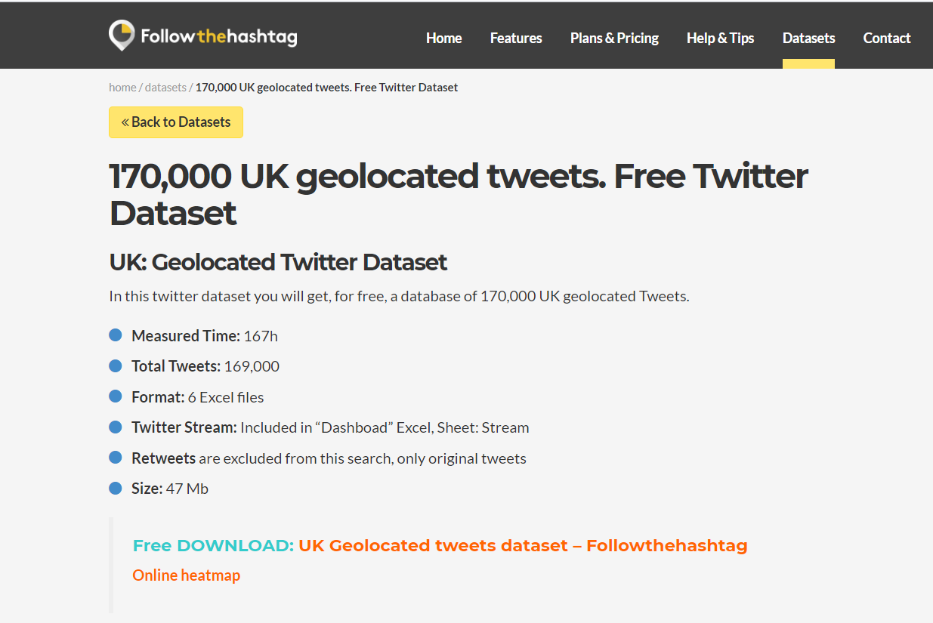
Dataset
http://followthehashtag.com/datasets/170000-uk-geolocated-tweets-free-twitter-dataset/

Slide 6
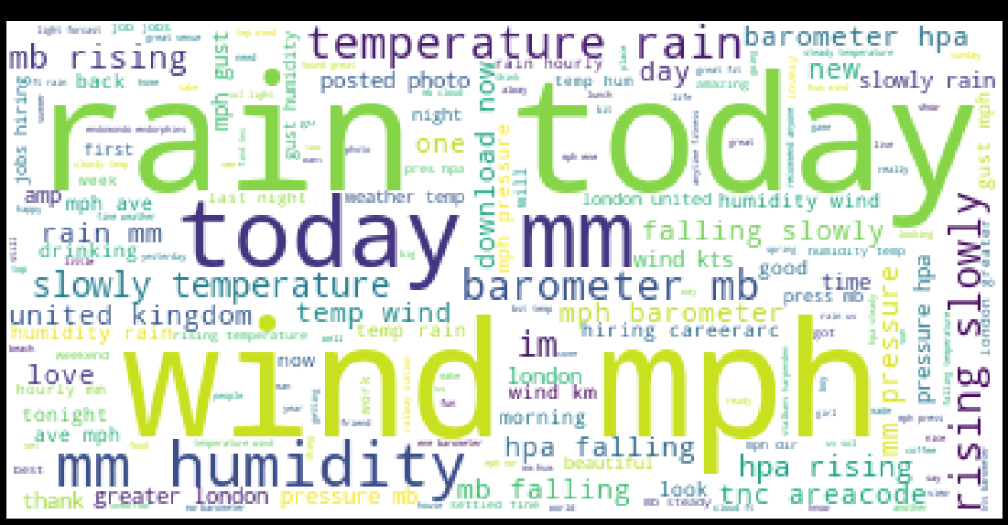
Wordcloud of the most used words

Slide 7
Data ETL

Slide 8
Training Models

Slide 9
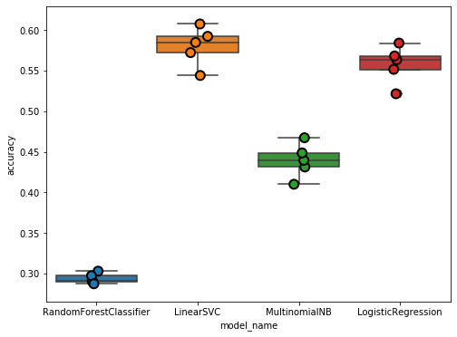
Accuracy Comparison

Slide 10
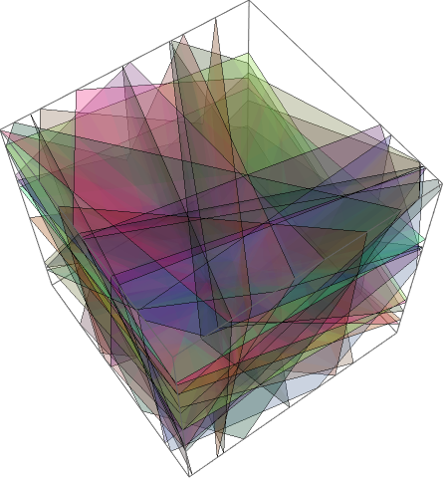
Linear SVC model (SVC: Support Vector Classifier)
High dimensional input space
Document vectors are sparse
Most text categorization problems are linearly separable
made with Mathematica®
Bennett, Kristin P.; Campbell, Colin (2000). "Support Vector Machines: Hype or Hallelujah?" . SIGKDD Explorations. 2 (2): 1–13.
https://medium.com/analytics-vidhya/support-vector-machine-86bbcb650e81

Slide 11
Transport Data and Front End

Slide 12
Front End Concept

Slide 13
Demonstration

