Slide 1
Big Data & Analytic
Strategi Pilihan Raya dan Taktikal
InsightPulse Analytics Platform

Slide 2
Agenda
Pengenalan Big Data dalam Politik
Kepentingan Analytics dalam Pilihan Raya
Platform InsightPulse - Tools Monitoring
Strategi Taktikal Menggunakan Data
Case Study & Contoh Aplikasi
Kesimpulan & Q&A

Slide 3
Big Data dalam Politik: Era Baru Kempen
✅ Volume Data Besar-besaran
Jutaan posting media sosial setiap hari
10 platform: Facebook, Instagram, X, TikTok, YouTube, LinkedIn, News, Lowyat, Shopee, Lazada – Threads New
✅ Kelajuan & Masa Nyata (Real-time)
Sentiment berubah dalam masa nyata
Crisis detection dalam minit
✅ Kepelbagaian Data
Text, images, videos, engagement metrics
Multilingual: Malay, English, Chinese

Slide 4
Kepentingan Analytics dalam Pilihan Raya
🎯 Fahami Sentiment Pengundi
Positive, Neutral, Negative - masa nyata
Emosi: Joy, Anger, Fear, Sadness, Love, Surprise
📊 Monitor Isu Trending
Topik panas dalam kalangan pengundi
Viral detection & response strategy
⚠️ Crisis Detection
Detect negative sentiment spikes
Response dalam 15-30 minit
📍 Geographic & Demographic Insights
Sentiment by location & demographics
Targeted campaign strategies

Slide 5
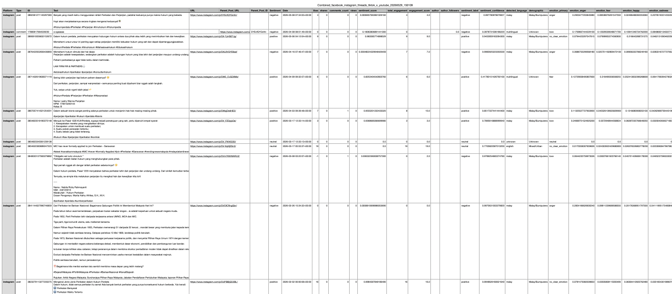
.CSV Data

Slide 6
InsightPulse - Platform Analytics Pilihan Raya
🚀 Features Utama
11 Platform Monitoring (Social Media + E-commerce)
Multilingual AI: Malay, English, Chinese
Real-time Sentiment & Emotion Analysis
Crisis Detection & Alerts
Trend Analysis & Forecasting
📈 Metrics Penting
Engagement Score (likes + shares + comments + views)
Sentiment Score (-1 to +1)
Viral Coefficient & Reach
💾 Data Storage
Raw Data: 30-day retention
Analyzed Data: 7-day retention
Combined Cross-platform Data

Slide 7
Strategi Taktikal Menggunakan Big Data
🎯 Strategi 1: Monitoring Lawan
Track sentiment terhadap lawan
Identify weaknesses & attack points
🎯 Strategi 2: Micro-targeting
Segment pengundi by demographics
Personalized messaging per segment
🎯 Strategi 3: Rapid Response
Monitor negative sentiment spikes
Response strategy dalam 15-30 minit
🎯 Strategi 4: Content Optimization
Test A/B messaging
Optimize posting time & format

Slide 8
Sample Keywords - InsightPulse Monitoring
🔍 Election General Keywords
PRU16, PRN Selangor, Pilihan Raya Negeri
Pengundi, Mengundi, Daftar Undi
🔍 Party & Candidate Keywords
Pakatan Harapan, Perikatan Nasional, Barisan Nasional
[Nama Calon], [Nama Ketua Parti]
🔍 Issue-Based Keywords
Kos Sara Hidup, Inflasi, Gaji Minimum
Corruption, Rasuah, Integriti
Pendidikan, Kesihatan, Perumahan
🔍 Sentiment Keywords
Kecewa, Harapan, Marah, Gembira
Sokong, Tolak, Tukar, Ubah

Slide 9
InsightPulse: Data Flow Pipeline
1️⃣ Data Collection
Crawl 10 platforms simultaneously
Store raw data: data/smart_crawlers/PLATFORM/
2️⃣ AI Analysis
Sentiment Analysis (Multilingual)
Emotion Detection (8 emotions)
Engagement Scoring
3️⃣ Data Storage
Analyzed data: data/analyzed/
Combined cross-platform: data/combined/
4️⃣ Visualization & Insights
Real-time dashboard
Trend graphs & sentiment timeline
Export to Excel/CSV for reporting

Slide 10
Case Study: PAS ..BERSATU …PN
📊 Data Collection
Keywords:
PAS OR Bersatu OR "Perikatan Nasional" OR PN OR hajihadi OR "haji hadi"
"PAS bergerak solo" OR "PAS solo" OR "PAS gerak solo"
("PAS Bersatu" OR "PAS-Bersatu" OR "PAS dan Bersatu" OR "hubungan PAS Bersatu" OR "kerjasama PAS Bersatu") AND ("perpecahan" OR "berpecah" OR "retak" OR "retak menanti belah")
PAS OR Bersatu OR PAS Bersatu OR "Perikatan Nasional" OR PN OR "hubungan PAS Bersatu"
(PAS AND Bersatu) AND (perpecahan OR retak OR "retak menanti belah" OR gaduh OR tegang OR krisis)
("Hadi Awang" OR "Abdul Hadi") AND (Bersatu OR Muhyiddin OR "kesabaran ada batas")
Platforms: Facebook, X, Instagram, TikTok, Youtube, threads
Dataset: 39K+ posts & comments – raw data from crawling

Slide 11
Cadangan Belanjawan - Big Data Analytics
Platform & Tools (Monthly)
InsightPulse Platform + ML/DL Analytics + LLM + RAG : FREE
API Crawling Engine: RM 3,000 – RM 5,000 (data crawling numbers)
API(News monitoring + Etc.): RM 1,500
Cloud Storage : ??
Human Resources Team
Data Analyst (1-2 pax): JITP
Social Media Strategist (1 pax): Penerangan
Content Writer/Responder (2 pax): Penerangan

Slide 12
InsightPulse SaaS - Pricing Tiers (Subscription Model)
TIER 1: BASIC - RM 8,000/month
5000 – 10,000 posts/month, 5 keywords, 5 platforms
weekly reports, 30-day retention
TIER 2: PROFESSIONAL - RM 15,000/month
50,000 posts/month, 20 keywords, 8 platforms
Real-time crisis detection, API access, 90-day retention
TIER 3: ENTERPRISE - RM 25,000/month
200,000 posts/month, 100 keywords, ALL 10 platforms
24/7 monitoring, Predictive analytics, Unlimited API
Hybrid modelling – Unstructured + Structured : Tambahan
✅ No upfront costs, No hiring, Start in 3 weeks!

Slide 13
Kesimpulan
✅ Big Data = Competitive Advantage
Real-time insights untuk decision making
Data-driven campaign strategies
✅ InsightPulse = Complete Solution
10 platforms monitoring
Multilingual AI analysis
Crisis detection & rapid response
✅ Next Steps
Define keywords for monitoring
Setup automated daily reports
Train team on data interpretation
🙏 Terima Kasih! Q&A

