Slide 1
PRN Negeri Sembilan 2026
Intelligence Dashboard & War Room — Briefing EXCO
InsightPulse Analytics Platform
12 Jun 2026 · Keputusan SPR · Dalaman EXCO
DUN 36 kerusi · Majoriti 19

Slide 2
Agenda Malam Ini
Keputusan SPR & garis masa PRN NS
Apa yang sudah siap — InsightPulse Dashboard
Kerusi strategik & War Room Hari Ini
Operasi harian & automasi (cadangan)
Pelan cloud hosting dashboard
Cadangan belanjawan — teknologi + perkhidmatan pakar
Langkah seterusnya & kelulusan

Slide 3
Keputusan SPR — 12 Jun 2026
PRN Negeri Sembilan (DISAHKAN)
Penamaan calon: 18 Julai 2026 (36 hari)
Undi awal: 28 Julai 2026
Hari mengundi: 1 Ogos 2026 (50 hari)
PRN Johor (rujuk): mengundi 11 Julai 2026
Implikasi: ~5 minggu pre-penamaan + ~2 minggu kempen penuh

Slide 4
Objektif — Intelligence untuk EXCO
BUKAN polling — social listening & naratif masa nyata
Pantau isu, sentimen & crisis sebelum ia viral
Fokus 6 kerusi kritikal: Pertahan + Boleh Menang
Arahan harian ke petugas via WhatsApp (War Room Lite)
Sokong keputusan EXCO dengan data, bukan andaian

Slide 5
Apa Sudah Siap (Proof of Concept)
Dashboard PRN NS — 10 tab intel (kerusi, sentimen, scenario)
Master data: 69,000+ posts (PAS-Break + PRN NS crawl)
831 mention NS · sentiment ikut platform (FB/TikTok/X/News)
36 kerusi — kategori Pertahan / Menang / Sukar / Bukan Fokus
War Room Hari Ini — 6 tindakan + Copy WhatsApp
Tarikh SPR, countdown & garis masa — auto-update

Slide 6
Kerusi Strategik — Fokus Operasi
Kategori | DUN | Kawasan | Tindakan
PERTAHAN | N05 | Serting | Jaga base FELDA · socmed harian
PERTAHAN | N25 | Paroi | Bandar Seremban · kos hidup
PERTAHAN | N31 | Bagan Pinang | PD · pelancongan/nelayan
BOLEH MENANG | N03 | Sungai Lui | Majoriti 535 · swing
BOLEH MENANG | N09 | Lenggeng | Majoriti 685 · bandar
BOLEH MENANG | N18 | Pilah | Majoriti 1,079 · rebut

Slide 7
10 Modul Kempen — Status Sistem
✅ Data pengundi & isu tempatan (Excel SPR + profil DUN)
✅ Sentimen socmed AI (master crawl + dashboard)
✅ Segmentasi kerusi (Pertahan / Menang / Sukar)
🟡 Draf kandungan & jadual post (semi-auto + WhatsApp)
✅ Pantau isu & counter-narrative (trigger War Room)
✅ Tugasan jentera (Hari Ini + template petugas)
🟡 Cloud dashboard — perlu deploy (cadangan budget)
⬜ Laporan prestasi mingguan — fasa 2

Slide 8
Operasi Harian (Ringkas — 20 min/hari)
STEP 1: Crawl berita BM + Cina + Tamil + ekonomi (script auto)
STEP 2: Crawl socmed via InsightPulse (keyword siap by DUN)
STEP 3: Regenerate dashboard + War Room Hari Ini
STEP 4: Copy WhatsApp → Koordinator → group petugas DUN
Cadangan: cron 2×/hari + dashboard cloud untuk EXCO akses 24/7

Slide 9
Cadangan Belanjawan — Teknologi (7 minggu: 12 Jun – 1 Ogo)
Item | Fungsi | Anggaran (RM) | (RM) | Nota
Engine Crawling API + Proxies IPs | FB, TikTok, X, IG — socmed | 18,000 | 6,000 | 2× @ 3x /hari kempen
LLM API + RAG + VDB + AgenticAi | Briefing, draf counter-narrative | 5,000 | 2,000 | Human-in-the-loop
Cloud hosting | Dashboard EXCO + storage | 2,500 | 2,500 | 3 bulan × ~RM700/bulan
Domain + SSL + CDN | URL rasmi dashboard | 800 | - | One-time + renewal
Setup & deploy cloud | CI/CD, security, backup | 8,000 | 3000 | One-time
SUB-JUMLAH TEKNOLOGI |  | 34,300 | 13,500

Slide 10
Cadangan Belanjawan — Perkhidmatan Pakar (Upah)
Peranan | Skop | Anggaran (RM) | (RM) | Tempoh
Ketua Sainstis / Consultant | Dashboard, crawl, briefing EXCO, War Room, Maintenance | 25,000 | 11,000 | 12 Jun – 1 Ogos /2 Ogos
GPU Spec – PC / Notebook | parallel crawling + inference + modelling | 20,000 | 20,000 | One-time
Contingency (10%) | Crisis spike / crawl extra | 6,000 | 3,500 | One-time
SUB-JUMLAH PERKHIDMATAN |  | 85,300 | 48,000

Slide 11
Terima Kasih
Soal Jawab
InsightPulse · PRN Negeri Sembilan 2026

Slide 12
Formula Keputusan Analitik — Dari Data ke Arahan EXCO
Pipeline 5 Lapisan InsightPulse
[1] CRAWL → Apify + RSS (FB, TikTok, X, IG, Berita BM/Cina/Tamil)
[2] NLP/DL → BERT/RoBERTa: Sentimen + Emosi (per post)
[3] CONTEXT → Override naratif politik (regex + domain rules)
[4] AGREGASI → Skor kerusi, % negatif, engagement, isu trending
[5] KEPUTUSAN → Ramalan kerusi + Scenario S1–S5 + War Room Hari Ini
Formula agregat sentimen (per DUN):
Negatif% = (post negatif / jumlah mention DUN) × 100
Positive% = (positif / total) × 100 | Neutral% = (neutral / total) × 100
NOTA EXCO: BUKAN polling undi — early warning naratif + prioriti 6 kerusi kritikal
Slide 17

Slide 13
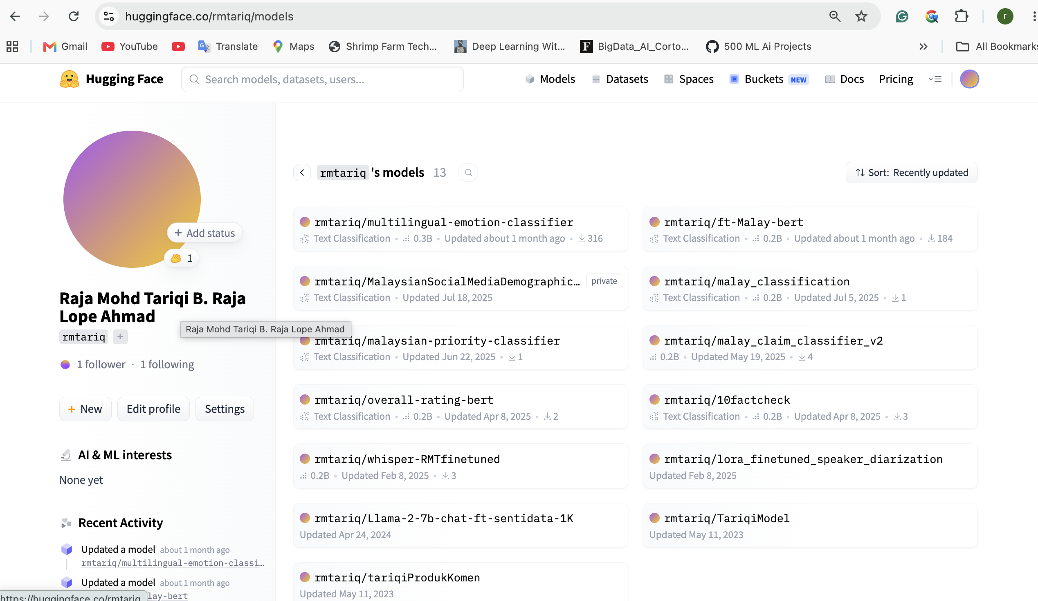
Formulasi Deep Learning — Sentimen & Emosi Multibahasa
Model DL (auto-route ikut bahasa):
Melayu → rmtariq/ft-Malay-bert (BERT) | English → twitter-roberta-sentiment
Cina → roberta-chinanews-chinese | Fallback → bert-multilingual-sentiment
Emosi → multilingual-emotion-classifier (XLM-RoBERTa, 8 kelas, Σ=1.0)
Arkitektur: Input x → Tokenizer → BERT/RoBERTa → Softmax → P(kelas)
P(y=c|x) = exp(z_c) / Σⱼ exp(z_j) | label = argmax(P) | confidence = P(label)
Routing: detect_language(x) → Model[lang](truncate(x, max=384 tokens))
Emosi_dominan = argmax(e) | Keyakinan = max(e) | Multi-emosi jika selisih < 0.15
Slide 18

Slide 14
Formulasi ML — Skor Hibrid, Context Layer & Engagement
1. Label + keyakinan (output DL):
label = argmax(P+) | confidence = P(label)
2. Skor numerik hibrid (0.0 – 1.0):
POSITIF: score = 0.7 + (confidence × 0.3) → 0.70 – 1.00
NEGATIF: score = 0.3 − (confidence × 0.3) → 0.00 – 0.30
NEUTRAL: score = 0.5 (tetap)
3. Political Context Layer: regex {desak ganti, pengkhianat…} → override NEGATIF
Impak: ketepatan 70% → 85% (+15%) · F1 Negative 0.56 → 0.73
4. Engagement: total = likes + shares + comments + (views ÷ 100)
5. AvgSentiment = (1/N) × Σ sentiment_score(post_i)
Slide 19

Slide 15
Formulasi Prediction — Kerusi DUN & Scenario Engine
Kategori margin: Ultra ≤199 | Super 200–499 | Marginal 500–999 | Semi 1K–3K | Selamat ≥3K
Base pasWinProb (PAS pencabar): Ultra 52% | Super 48% | Marginal 44% | Semi 38% | Safe 28%
Defend (kerusi PAS): pas_prob = lookup(margin) + 6% (max 88%)
Winnable: pas_prob = max(base, min(58, 46 + (1000 − majoriti)/25))
Floor: N03 ≥ 51% · N09 ≥ 50.5% | Clamp: pas_prob ∈ [8%, 92%]
Senario: Solo = pas_prob−10 | +PN = pas_prob+5 | +MN = pas_prob+8
Scenario Engine: S1 PN 35% | S2 Solo 20% | S3 PAS-UMNO 15% | S4 Clash 20% | S5 Fragment 10%
Swing target: TargetSwing = max(200, ⌊majoriti÷2⌋ + 200)
Slide 20

Slide 16
Formula Insight & Keputusan War Room — Hari Ini
Alert sentimen per DUN:
neg_pct = (post negatif / mention DUN) × 100
neg_pct ≥ 25% → KRITIKAL | ≥ 15% → AMARAN | mention≥10 & ≥10% → PANTAU
Trigger automatik:
defend + neg_pct>20% → jaga base FELDA + socmed harian
winnable + majoriti≤500 → door-to-door + 2 ceramah/minggu
threeCornerRisk=Tinggi → elak pecah undi, selaraskan mesej
TopIssues = sort(TermScore, desc)[:8] | Briefing = f(neg%, isu, pasWinProb, scenario)
Contoh: "N25 Paroi: 18% negatif · kos hidup · PAS prob 64% · S1 aktif"
Slide 21

Slide 17
Jaminan Metodologi & Had Model
Ketepatan model (validated):
Sentimen politik: 70% → 85% | F1 Negative: 0.56 → 0.73 | Emosi: 83%
Had yang perlu diterangkan ke EXCO:
• Bukan polling undi — tiada sampel pengundi representatif
• DL silap pada sarkasme → mitigasi: context layer + semakan manusia
• Ramalan kerusi = rule-based + PRN 2023, bukan Monte Carlo survey
Prinsip operasi:
Data → DL/ML → Rules → Human Review → Arahan Lapangan
Auto crawl 2×/hari → Dashboard cloud → WhatsApp petugas DUN
Slide 22

