Slide 1
4th Year Project : Phase 1 Homogeneous Image to Text Conversion with Noise Reduction Technology
Presented by:
Sharmin Mahzabin Roll : SN-03
Rezwan Mahmud
Roll : SH -12
Supervisor:
Md. Shiplu Hawlader Lecturer,Department of CSE,
University of Dhaka

Slide 2
Introduction
Problem definition and reasons for choosing it

Slide 3
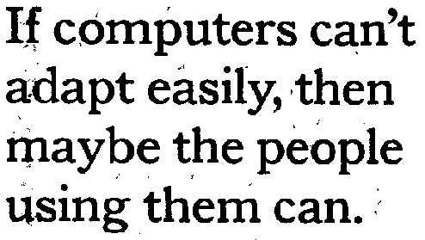
What Is Noise?
random variation of brightness or color information or inverted pixels.

Slide 4
Different types of Noise
Gaussian noise
Salt-and-pepper noise
Shot noise
Periodic noise
Quantization noise
Film grain
Anisotropic noise
Anisotropic noise
- Different types of noises have to be handled in different ways.

Slide 5
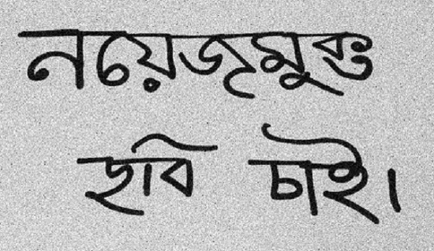
Reducing Noise
We ought to reduce as much of noise as possible.

Slide 6
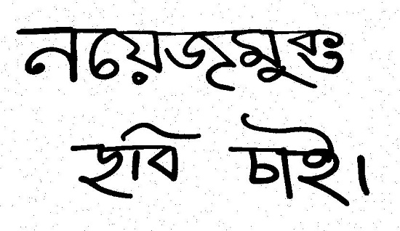
Dealing with Brightness
An idea can be to turn the input image into a black & white image.

Slide 7
Dealing with salt and pepper noise
Can be done using one of the followings:
Arithmetic Mean Filter
Geometric Mean Filter
Harmonic Mean Filter
Median Filter
Adaptive Median Filter

Slide 8
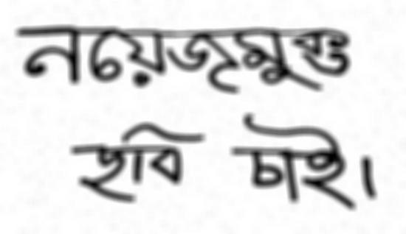
Applying Mean Filter
Noise is a bit reduced
The image gets a bit blurry.

Slide 9

Applying Median Filter
Worked like magic.

Slide 10
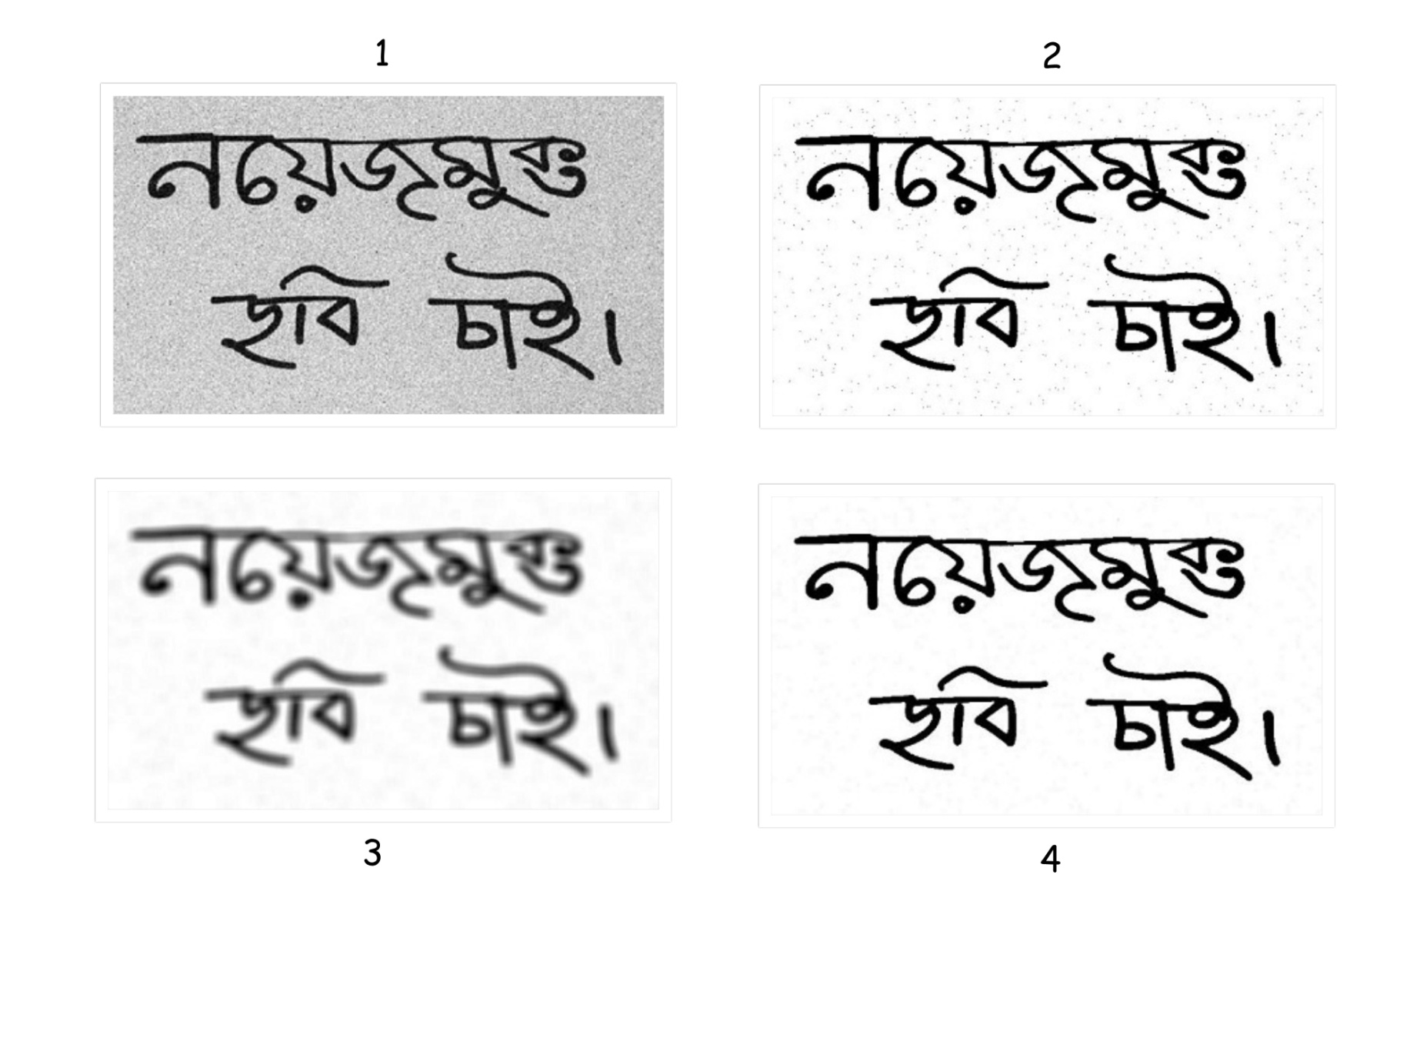
Comparing The Images

Slide 11
Rakhi, Insert Slides on Adaptive Median Filter

Slide 12
Other Filters
Bandreject Filter
Bandpass Filter
Notch Filte
Minimum mean square error filtering

Slide 13
Digit recognition using artificial neural network.

Slide 14
References
[1] Esakkirajan, S., Veerakumar, T., Subramanyam, A.N. and PremChand, C.H., 2011. Removal of high density salt and pepper noise through modified decision based unsymmetric trimmed median filter. IEEE Signal processing letters, 18(5), pp.287-290.
[2] Toh, K.K.V. and Isa, N.A.M., 2010. Noise adaptive fuzzy switching median filter for salt-and-pepper noise reduction. IEEE signal processing letters, 17(3), pp.281-284.
[3] Jayaraj, V., Ebenezer, D. and Aiswarya, K., 2009. High density salt and pepper noise removal in images using improved adaptive statistics estimation filter. International Journal of Computer Science and Network Security, 9(11), pp.170-176.
[4] Chan, R.H., Ho, C.W. and Nikolova, M., 2005. Salt-and-pepper noise removal by median-type noise detectors and detail-preserving regularization. IEEE Transactions on image processing, 14(10), pp.1479-1485.

Slide 15
Thank you all!

Slide 16
Any Questions?

