Slide 1
4th Year Project : Phase 1 Homogeneous Image to Text Conversion with Noise Reduction Technology
Presented by:
Sharmin Mahzabin Roll : SN-03
Rezwan Mahmud
Roll : SH -12
Supervisor:
Md. Shiplu Hawlader Lecturer,Department of CSE,
University of Dhaka

Slide 2
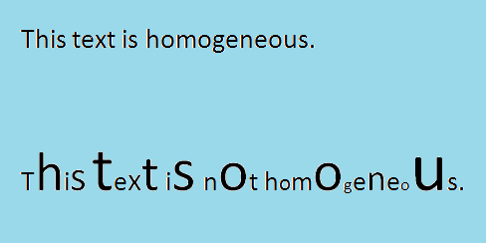
Introduction
Homogeneous Texts: Texts having same fonts and orientation and unique representation of the characters.

Slide 3
Image to text conversion: It is the mechanical or electronic conversion of images of typed, handwritten or printed text. Also known as the optical character recognition.
Tesseract: An OCR engine which works on the provided training datas. Tesseract supports various output formats: plain-text, html, pdf.

Slide 4
Objective
Develop a software that can convert a homogeneous image file containing texts into a text file.
Reduce noise from the input file so that the conversion from image to increase accuracy.

Slide 5
Related work
“A survey on Script Segmentation for Bangla OCR” by Arif Billah Al-Mahmud Abdullah and Mumit Khan
“An open source Tesseract based Optical Character Recognizer for Bangla script” by Md. Abul Hasnat Muttakinur, Rahman Chowdhury and Mumit Khan.

Slide 6
Thank you all!

Slide 7
Any Questions?

