Slide 1

Richmond Emergency Call Data
Randy Treat

Slide 2
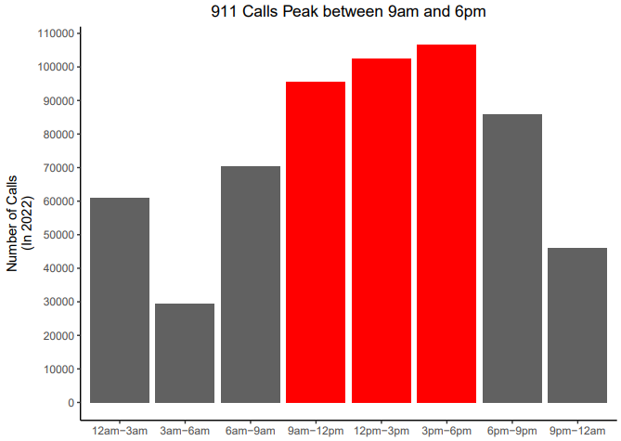
Peak Hours for Emergency Calls Mean of Calls (74,743)
Between 3pm-6pm has the highest number of calls: 106,672 or 30% more than the mean
Between 3am-6am has the lowest number of calls: 29,548 less than 40% of the mean

Slide 3
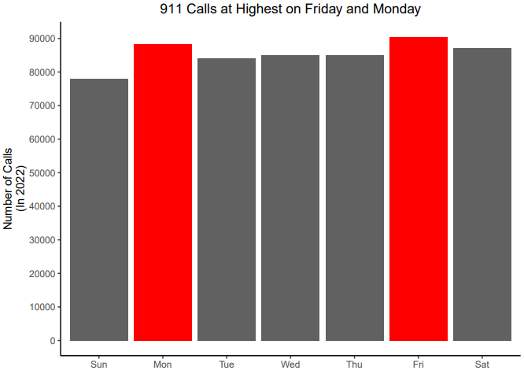
Peak Day for Emergency Calls Mean of Calls (85,421)
Sunday has the lowest number of calls: 78,084 or 9.3% lower than the average call count
Friday has the highest number of calls: 90,439 or 5.5% higher than the average call count

Slide 4
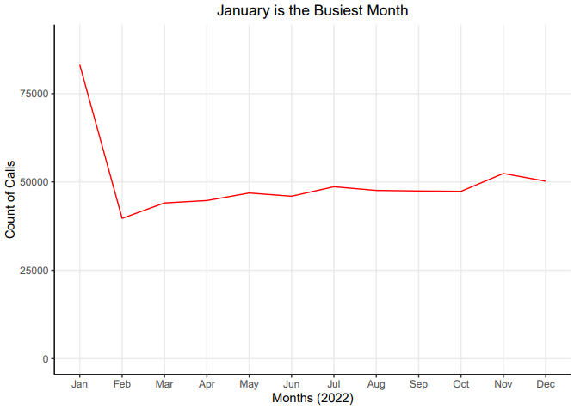
Peak Month for Emergency Calls Mean of Calls (49,829)
January has the highest number of calls: 83,144 or 30% more than the mean
February has the lowest number of calls: 39,693 or 20.3% below the mean

Slide 5
Thoughts:
Knowing the peak hours, days and months, the Emergency Department can staff their call centers appropriately.
More years would be needed in future study to off set for one offs like COVID, poor weather for a year, etc.
Need to further investigate time for each part of call to set of adhere to standards.
Interesting observation:
8,162 of 606,113 or 1.6% of rows contained 0 duration time
Could be misdial or pranks
Worth investigation to improve cost and efficiency

