Slide 1

Benchmarking of Elastic Cellular Core
CS 678
Presenters: Mubeen Zulfiqar, Syed Arham Mukhtar

Slide 2
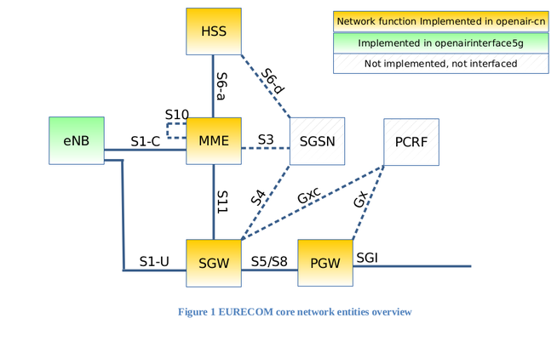
Background & Challenges
Constraints of physical middleboxes
Shift to an elastic core
Studied in class - > “KLIEN”
Installation
Challenges
Poor Documentation of OAI
Extensive Configuration required
Unstable Emulation (frequent crashes)
Notes:
Backhaul network of telecom service providers:
RAN -> eNodeB (base station to which the User Equipment i.e mobile device connects)
Packet Core network: MME, HSS,S and P Gateways. Network functions like NATs, firewalls
Lack flexibility, scalability
NFVs deal with this problem

Slide 3
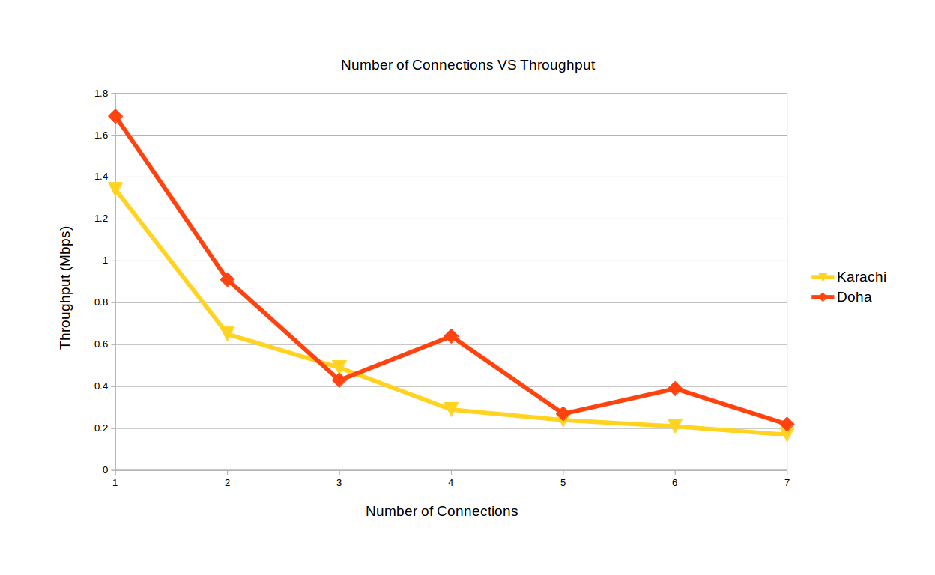
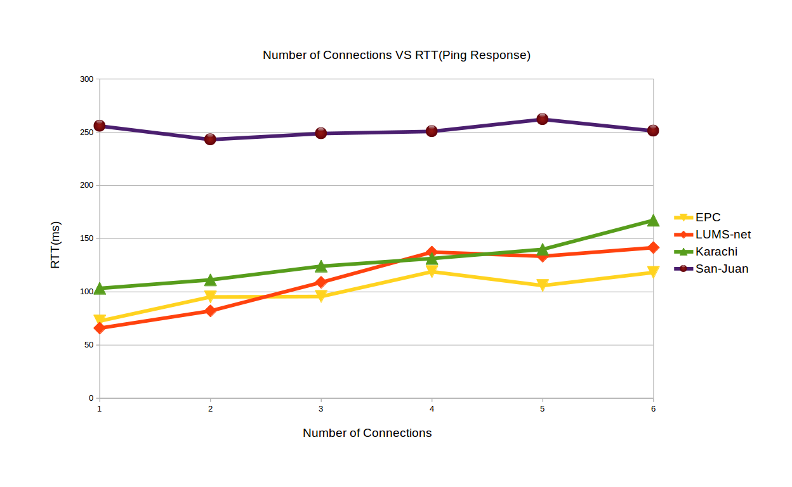
Results
Notes:
Latency-friendly but throughput-sensitive
Tools -> ping, speedtest-cl

Slide 4
Conclusion
Need for more rigorous examination.
Results show that increasing processes degrades performance.
EPC is Latency-friendly but throughput decreases exponentially in multiple bandwidth-hungry connections, unfairly.
Constraints of OAI (emulation tool), significant configuration needed.

