Slide 1
Diabetes prediction
OptML Project 1
Aim – Diabetes prediction using “Gradient Descent ” and “Gradient Descent With Nesterov Momentum ”.
Problem Statement – Implement the “Gradient Descent ” and “Gradient Descent With
“Nesterov Momentum” from scratch for classifying the diabetes data.
Motivation – Predict the possibility of having diabetes, based on certain diagnostic
measurements like Glucose, blood pressure, skin thickness, etc..
Novelity – Observed behaviors of GD and Nesterov momentum with “Hinge loss”.
Mukesh Kumar Ram
20654

Slide 2
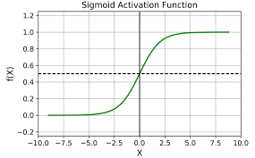
Dataset- “Diabetes Dataset” having diagnostic measurements.
Source - https://www.kaggle.com/datasets/akshaydattatraykhare/diabetes-dataset
Dimension – 768 x 9
Model- Logistic Regression
Loss – Binary cross Enrtopy - L(y, ŷ) = - [y * log(ŷ) + (1-y) * log(1-ŷ)]
Activation function – Sigmoid

Slide 3
Gradient Descent- Gradient descent is an optimization algorithm that iteratively minimizes a cost function by updating model parameters in the opposite direction of the gradient of the cost function.
Waight update
w = w - learning_rate * gradient_w
Gradient Descent With Nesterov Momentum - Nesterov Momentum is an enhanced version of gradient descent that uses a "momentum" term to speed up the optimization process.
Update
v = gamma * v + learning_rate * gradient_w
w = w - gamma * v + learning_rate * gradient_w
v' is the previous update vector
'gamma' is the momentum term, typically set between 0.9 and 0.99
'learning_rate' is the step size or learning rate
'gradient_w' is the gradient of the cost function with respect to 'w'

Slide 4
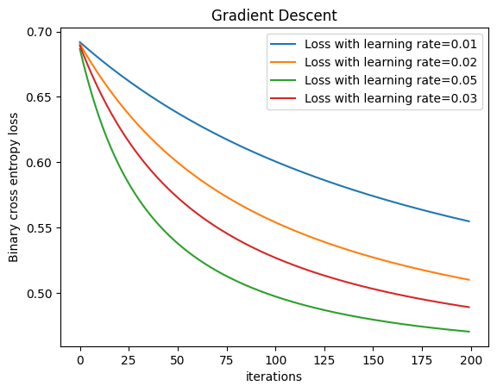
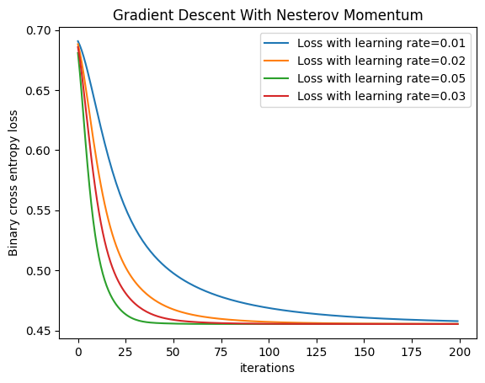
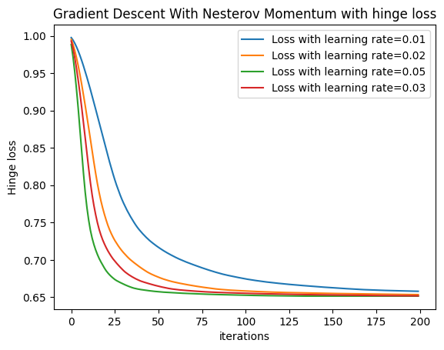
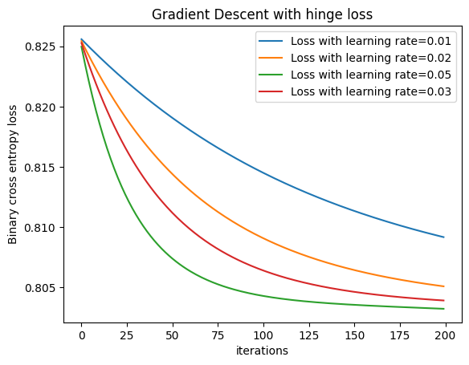

Slide 5
Obserevation
The data set is linearly separable, because Gradient descent is working similarly for cross-entropy and hinge loss in logistic regression.
The loss function is convex.
Thank You

