Slide 1

Monocular Visual Inertial Simultaneous Localization and
Mapping for Detecting Obstacles through Point Clouds
Special Study by Raunak Mukhia
Examination Committee:
Dr. Matthew N. Dailey (Chairperson)
Dr. Mongkol Ekpanyapong
Dr. Attaphongse Taparugssanagorn
May 2019

Slide 2
Introduction

Slide 3
Introduction
An autonomous vehicle should be aware of its environment to take the next decision.
SLAM (Simultaneous Localization and Mapping) systems can localize and map the environment at the same time.

Slide 4
Introduction
The objective of this special study is to generate real time point clouds and robot poses by executing a monocular visual inertial SLAM algorithm.
The scope of the study is to build a visual inertial SLAM system that can provide point clouds and robot pose to other components in the perception/action pipeline of an autonomous robot.

Slide 5
Literature Review

Slide 6
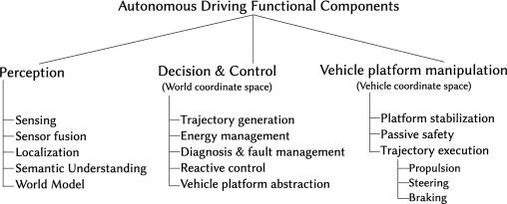
Software Architecture of Autonomous Driving Vehicles
Perception of the environment in which the vehicle operates.
Decision making and control of vehicle motion with respect to the external environment that is perceived.
Vehicle platform manipulation, which deals with achieving the desired motion.

Slide 7
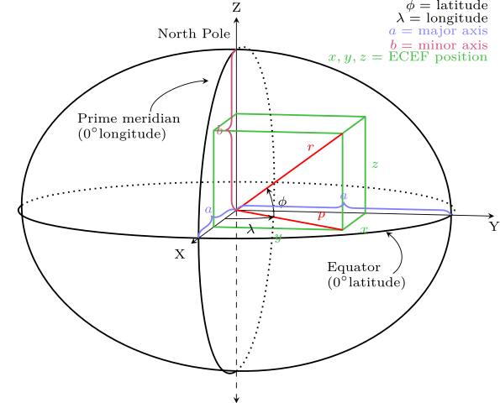
Coordinate Systems(Earth Centric, Earth Fixed)

Slide 8
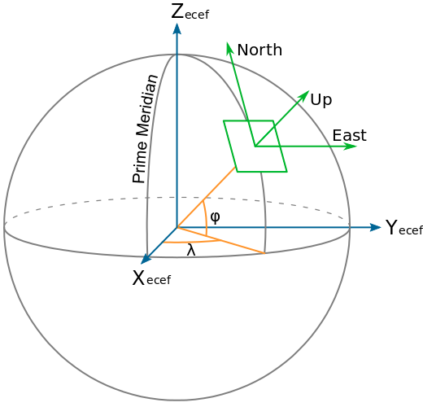
Coordinate Systems(Local Tangent Plane)
X=East, Y=North, Z=Up (ENU).
X=North, Y=East, Z=Down (NED)

Slide 9

Coordinate Systems(PixHawk and ROS)
PixHawk follows the NED convention.
ROS follows the ENU convention.
ROS has other reference frames
  base_link is rigidly attached to the mobile robot base.
  odom is a world fixed frame.
  map is a world fixed frame. with Z axis pointing upwards.
  earth is the origin on the ECEF frame.

Slide 10
Simultaneous Localization and Mapping
A method by which a mobile robot can build a map of an environment and at the same time use this map to infer its location.
The trajectory of the platform and the location of all landmarks are estimated online without the need for any previous information of the location.

Slide 11
Visual SLAM
Images from one or more cameras are used for observation of the landmarks.
Visual SLAM can be classified into feature based and direct methods.
Feature based methods extract features from the input image and use those features as observations.
Direct methods for vSLAM takes the whole image for tracking and mapping and produce dense point clouds.

Slide 12
Visual SLAM
Some of the important vSLAM algorithms are
  Parallel Tracking and Mapping (PTAM)
  ORB SLAM
  ORB SLAM2
Some of the direct vSLAM algorithms are
  Dense Tracking and Mapping (DTAM)
  Large-Scale Direct SLAM (LSD SLAM)

Slide 13
Visual SLAM Modules
Initialization
Tracking
Mapping
Re-localization
Global map optimization

Slide 14
ORB SLAM
Feature based vSLAM algorithm.
Uses ORB feature detectors and the same features are used in mapping as well as tracking.
It has three threads running in parallel for tracking, local mapping and loop closing.

Slide 15
Visual Inertial ORB SLAM
Extends upon ORB SLAM by integrating stream of IMU measurements which solves the scale ambiguity problem of monocular SLAM.
In tracking, the IMU pose is estimated and the camera pose is predicted.
In local mapping, the local window is retrieved by the transitory sequence of keyframes, while in ORB SLAM covisibility graph is used.
In loop closing, the pose graph optimization is performed on 6 degrees of freedom instead of 7 degrees of freedom as scale is observed.
IMU initialization is done using only vision.

Slide 16
Methodology

Slide 17
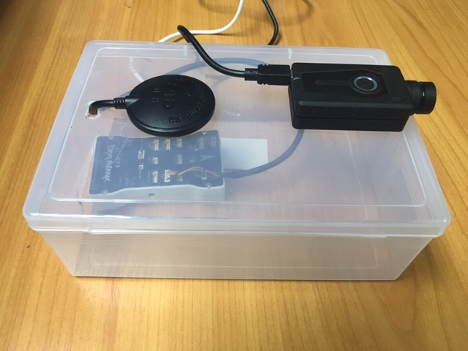
Hardware
The Mobius Maxi action cam mounted on a rigid base.
The PixHawk 2.4.8 flight controller with internal IMU and external GPS module is attached to the same rigid base.
Both devices are connected through USB to a laptop with
  i7 CPU
  16 GB of RAM
  Ubuntu 16.04

Slide 18
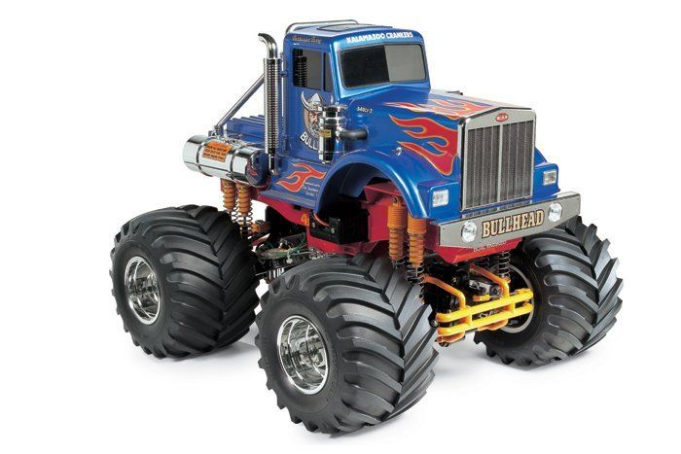
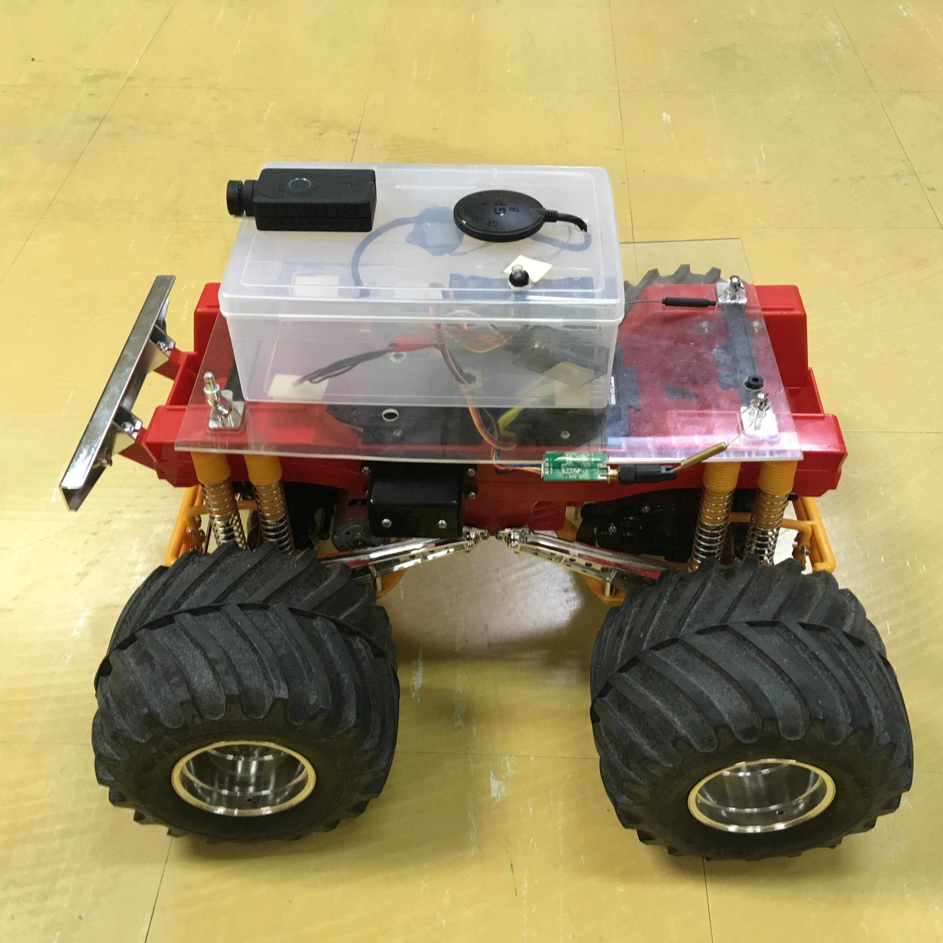
Hardware
PixHawk has PX4 as its firmware.
The test rig is mounted on top of RC vehicle, the Tamiya Bullhead.

Slide 19
Software
Robot Operating System (ROS) version Kinetic.
Four ROS packages running on the test laptop.
  usb_cam: Modified to support H264 streams.
  mavros: Communicates with PixHawk using MAVLINK protocol.
  clips: A new middleware layer to ensure at least one IMU measurement is present between each pair of image frames.
  LearnVIORB: Modified to publish pose, point clouds, and tf information.

Slide 20
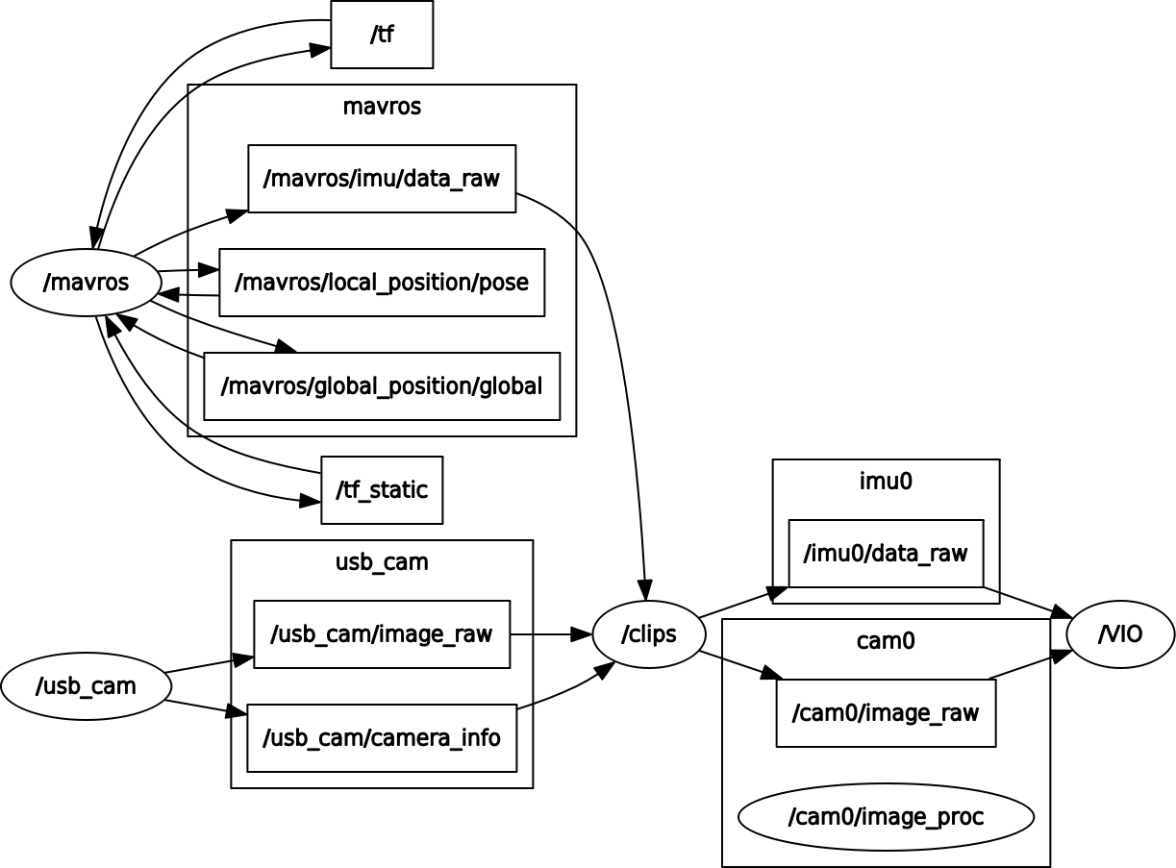
Software

Slide 21
Software (usb_cam)
Mobius Maxi supports H264 hardware encoding.
Video stream captured through H264 stream is smoother and supports higher framerates than raw stream.
The library libavutils used by usb_cam has support for H264 streams.
Added support for h264 pixel format.

Slide 22
Software (mavros)
The PixHawk connection is shown as serial port /dev/ttyACM0 on the test laptop.
The baud rate is 921600.
PX4 publishes coordinates using the NED convention.
mavros handles the conversion of NED coordinates to ENU coordinates to use with ROS.
sys_time mavros plugin handles time synchronization between the host and the remote flight controller.

Slide 23

Software(sys_time)
A timesync message M is sent at a consistent frequency from the host system to FCU with with timestamp t_{s}.
The remote FCU adds its timestamp t_{c} and replies.
It is assumed that the round trip time for the message is equal in both ways,

Slide 24

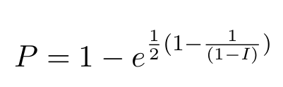


Software(sys_time)
t_{offset} is used for interpolating the time offset and time skew with a window of size n. k = {0 … n-1} is the index of the timesync message used for interpolation before convergence.

Slide 25
Software(sys_time)
Online exponential smoothing filter is used to calculate interpolated time offset t and time skew t_{skew}.
If a maximum number of consecutive observations are received that is higher than a threshold deviation from the present estimate, the interpolation is reset.
If the interpolation has not converged, the intermediate t and t_{skew}are used.

Slide 26
Software (clips)
The IMU and camera are not tightly bound.
At least one IMU measurement between any two consecutive image frames is necessary for VIORB to predict the next keyframe location.
This custom package which I created ensures that there is IMU measurement between two image frame.
Drops the image frame if IMU measurement is not received.

Slide 27
Software (LearnVIORB)
LearnVIORB is a community-developed implementation of Visual Inertial ORB SLAM.
I added support for publishing pose, point cloud, and tf information as ROS topics.
I referred to the open source project ORB_SLAM2_CUDA (Nguyen)

Slide 28
Software(PX4 firmware)
PX4 by default does not support more than 50 Hz IMU rate.
In the source code ROMFS/px4fmu_common/init.d/rcS had to be edited and re-compiled to increase IMU measurement rate to 200 Hz.

Slide 29
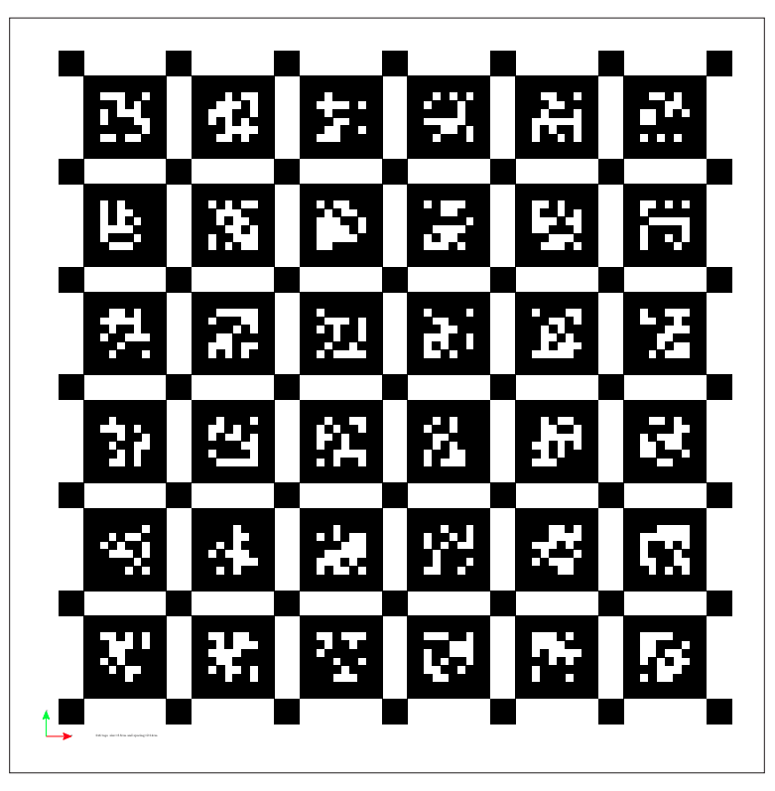
Calibration
Camera intrinsic parameters were calibrated with the ROS camera_calibration package, using a checkerboard pattern.
Noise density, and random walk for the accelerometer and gyroscope was calculated using kalibr_allan through Allan variance method.
Camera-to-IMU translation matrix was calculated using kalibr tool, using apriltags and the IMU noise analysis results.

Slide 30
Integration
A configuration yaml file configured with the results of calibration.
IMU noise density and random walk constants in LearnVIORB src/IMU/imudata.cpp was updated.
A launch file in clips starts usb_cam, mavros, and clips and publishes /imu0/data_raw and /cam0/image_raw.
The topics can be stored in a bag file or directly subscribed by LearnVIORB.

Slide 31
Experimental Results

Slide 32
Experiment Environment
The test rover was manually controlled in indoor and outdoor environment.
The test laptop was connected to the camera and the flight controller.
The data collected was stored in a ROS bag file.
The bag file was replayed and the collected data was used to run VIORB and ORB SLAM.

Slide 33
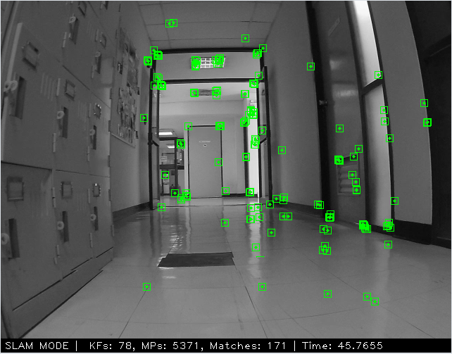
Indoor Experiment
The test rover was run in indoor environment for 170 seconds.
The number of ORB features to extract was kept at 2000.
The approximate length of the path was 17 meters.

Slide 34
Indoor Experiment
VIORB SLAM relocalized a couple of times.
VIORB SLAM lost tracking and could not be relocalized after 117.5 seconds.
ORB SLAM was more robust and did not lost track.
ORB SLAM reported path length of 3.92 meters. VIORB SLAM reported path length of 13.875 meters.

Slide 35
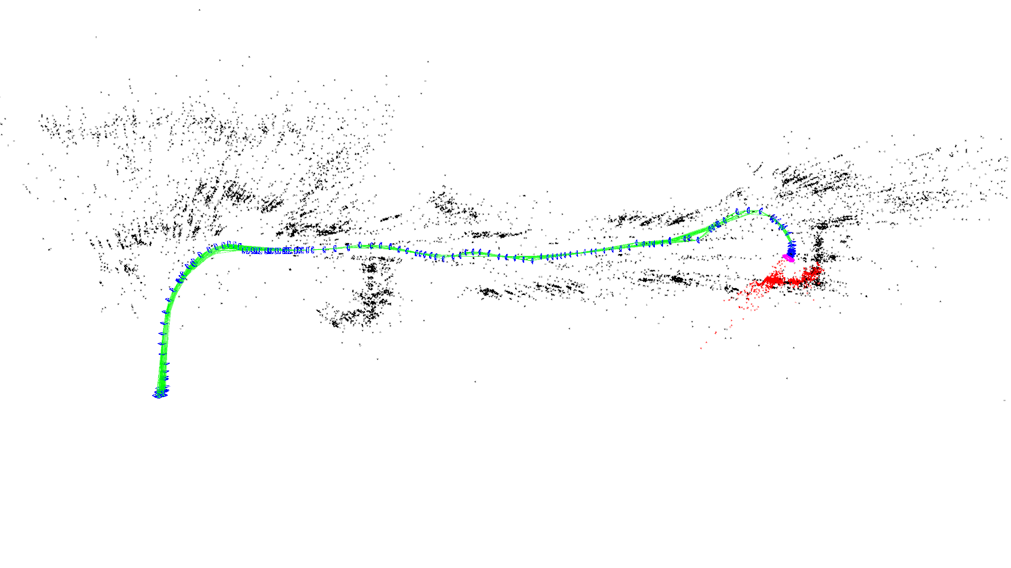
Indoor Experiment (VIORB SLAM)

Slide 36
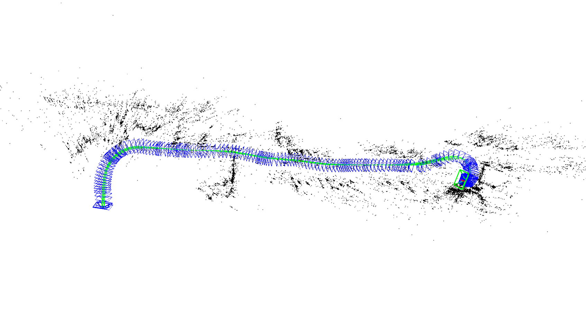
Indoor Experiment (ORB SLAM)

Slide 37
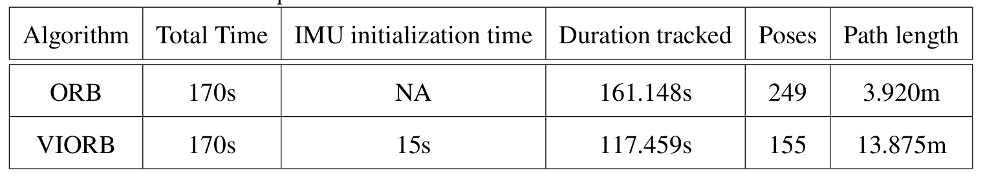
Indoor Experiment

Slide 38
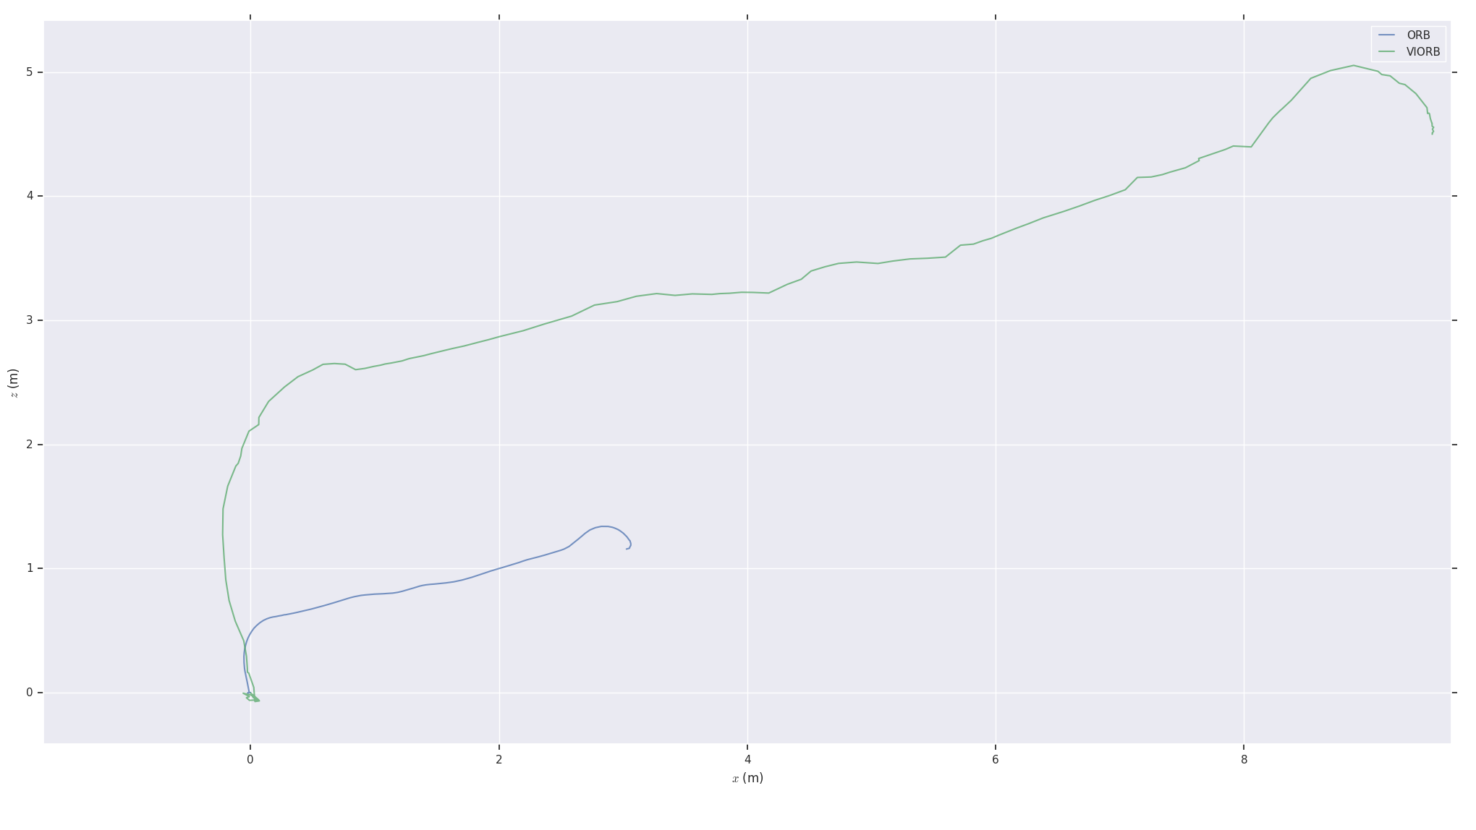
Indoor Experiment

Slide 39
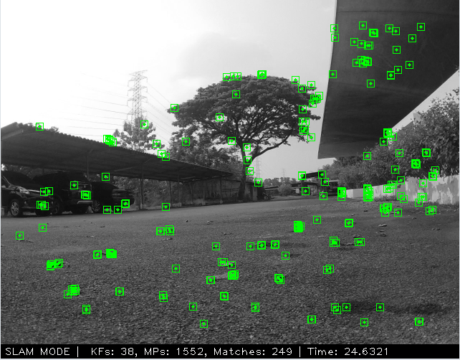
Outdoor Experiment
The test rover was run in outdoor environment for 174 seconds.
The number of ORB features to extract was kept at 2000.
The rover faced more jerky movements than the indoor experiment.

Slide 40
Outdoor Experiment
VIORB SLAM relocalized a couple of times.
VIORB SLAM lost tracking and could not be relocalized after 96.871 seconds.
ORB SLAM was more robust and did not lost track.
ORB SLAM reported path length of 3.15 meters. VIORB SLAM reported path length of 14.427 meters.

Slide 41
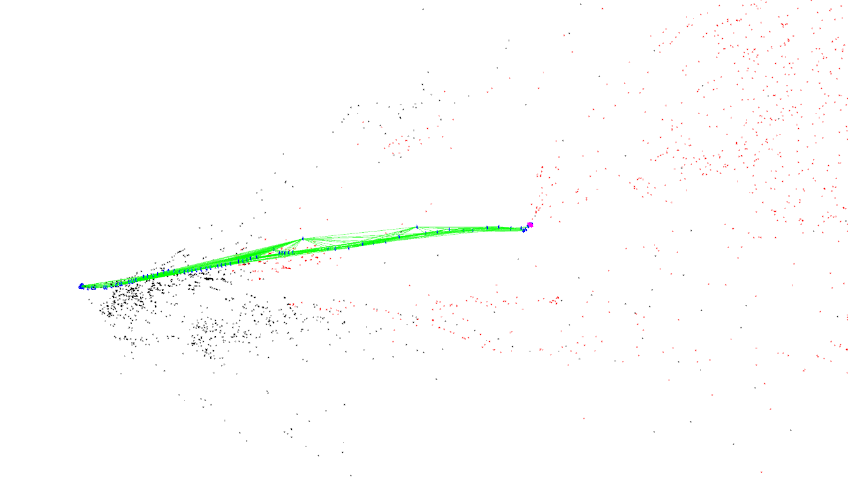
Outdoor Experiment (VIORB SLAM)

Slide 42
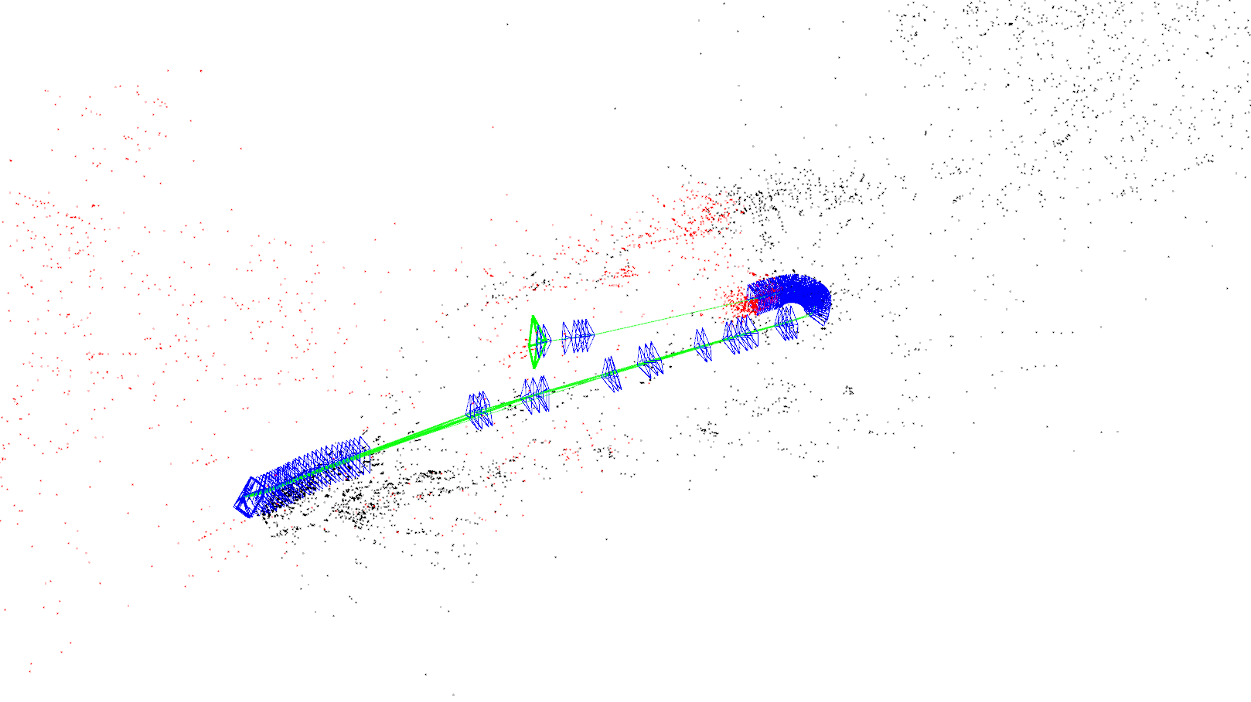
Outdoor Experiment (ORB SLAM)

Slide 43
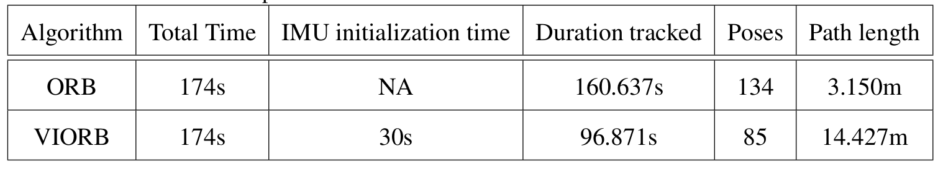
Outdoor Experiment

Slide 44
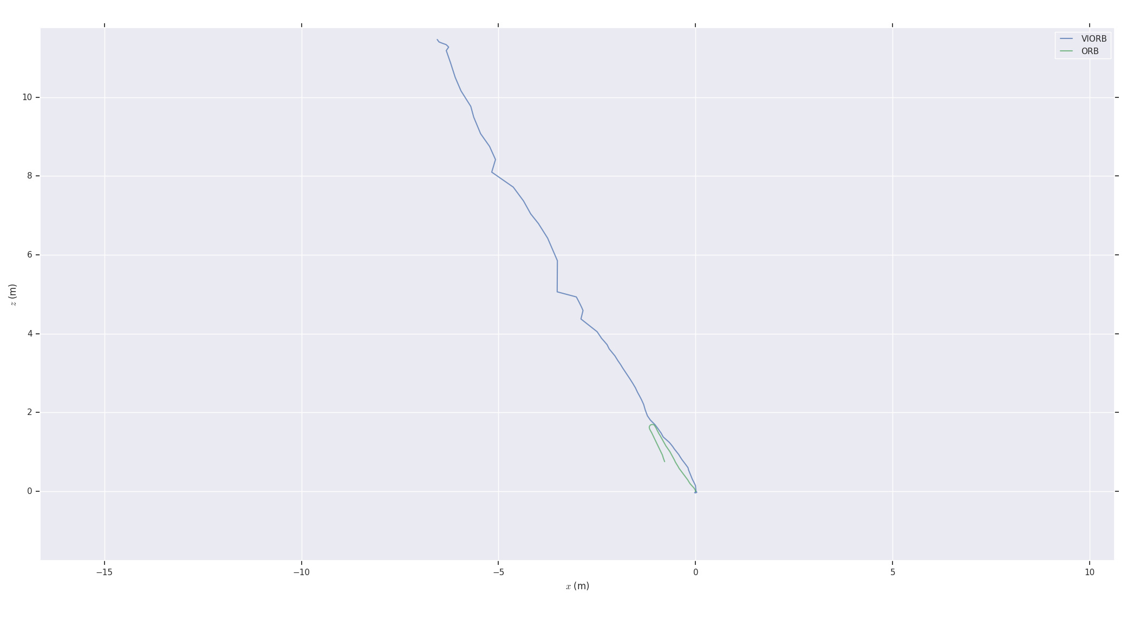
Outdoor Experiment

Slide 45
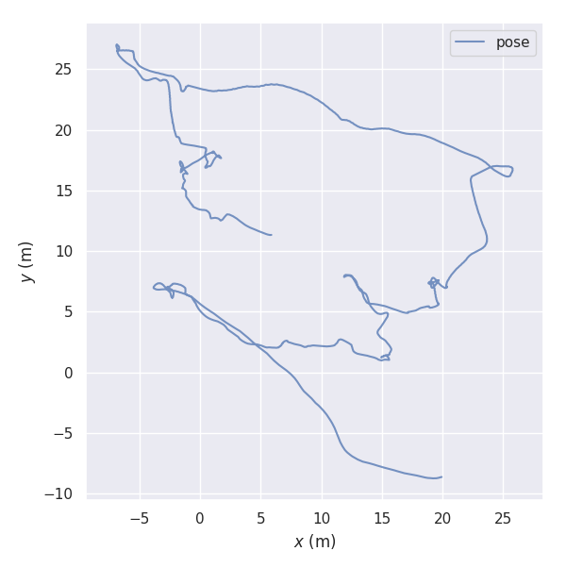
Outdoor Experiment

Slide 46
Conclusion and Recommendations

Slide 47
Conclusion
VIORB SLAM is closer to the ground truth in approximating the scale of the constructed map than ORB SLAM.
ORB SLAM is more robust than VIORB SLAM and does not lose track as easily.
Setting up VIORB SLAM is more complex than ORB SLAM. This increased complexity may be one reason VIORB SLAM is less robust than ORB SLAM.

Slide 48
Conclusion
The interpolated time offset interpolated by sys_time plugin may not represent the actual time offset. This may affect VIORB SLAM.
The GPS module attached to the PixHawk drifts and is not precise over short distances.
VIORB and ORB SLAM publish pose in a zyx coordinate system, where the z axis protrudes out in the front direction of the camera or the IMU.

Slide 49
Recommendations
Proper calibration may make VIORB more robust.
Replacing the internal IMU in PixHawk with an external IMU having low noise, may make the calibration more accurate.
A tightly coupled camera-IMU system, where the camera is triggered through the host computer or the flight controller may help in time synchronization.
Reducing jerky movements through mechanical means while the rover is moving on the ground may make it more robust.

Slide 50
Thank You

