Slide 1
SAT Trends
What do we see in the 2017 and 2018 SAT Scores
Notes:
There are a lot of ways to understand and learn about a Scholastic Aptitude Test for college entrance and one good way is through comparison among the states.

Slide 2
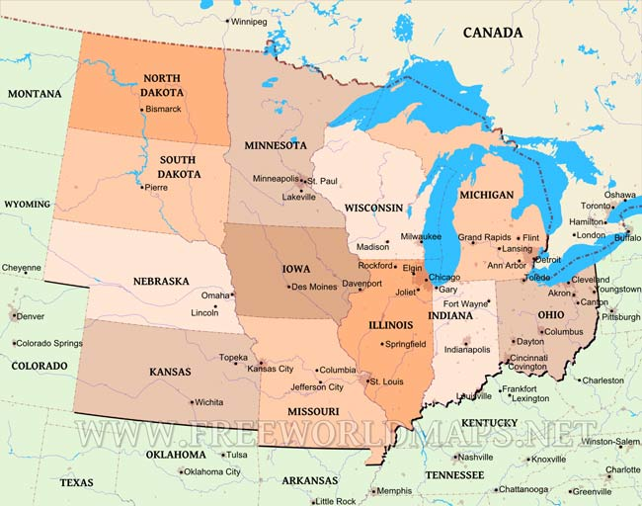
Midwest:
Notes:
Even a small comparison might give us some insight, given the right data. If we are looking at ways to spot and understand ways that influence SAT participation we might want to look at areas that are successful with high SAT scores.

Slide 3

The SAT:
Offers more time per question on all sections of the exam.
Does not contain a section entirely devoted to science (does test for concepts).
Math is more reason-based than heavy arithmetic-based.
Provides math formulas.
https://blog.prepscholar.com/act-vs-sat
Notes:
Just some things to remember about the SAT. READ THEM. These are selling points for the SAT.

Slide 4
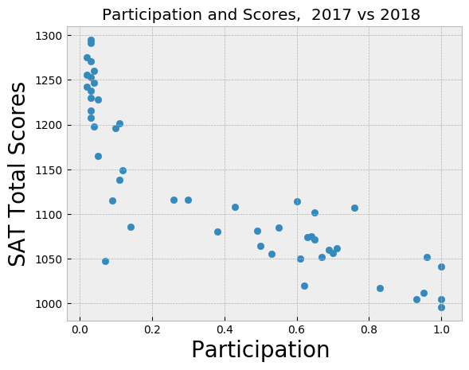
Driven:
Overall: Participation negatively correlates with SAT scores.
Notes:
One finding among the states is that those states with the highest SAT scores have the lowest participation rate. And conversely, those states with the low scores have the highest participation rate - more students taking the exam.

Slide 5
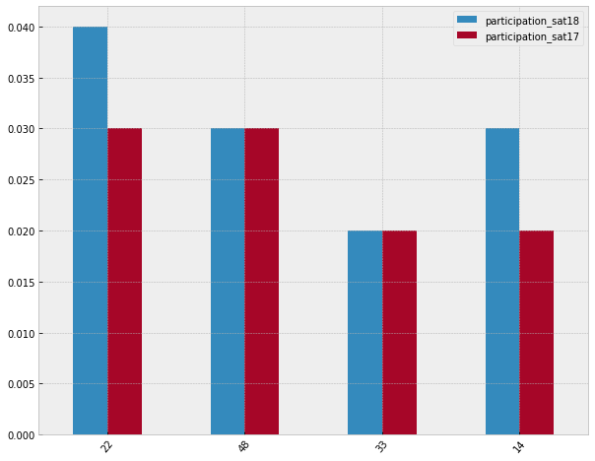
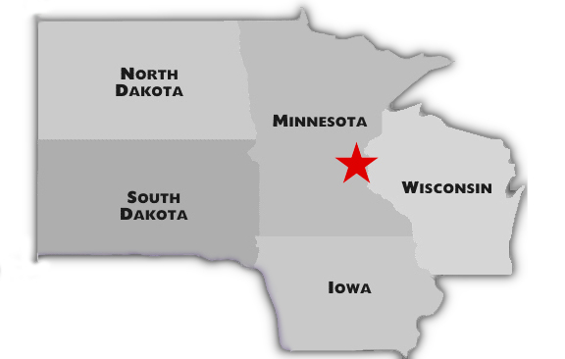
Skills & expertise
Top SAT Scores - 2017/18
Minnesota
Wisconsin
North Dakota
Iowa

Slide 6
Highest Scores in:
Minnesota, Wisconsin, North Dakota, Iowa
Math
Minnesota, Wisconsin, South Dakota, Iowa
Highest Composite Scores
Minnesota, Wisconsin, North Dakota, Iowa
Evidence Based Reading
And Writing
No SAT Requirements
Minnesota - In the top 14% of all students taking the SAT

Slide 7
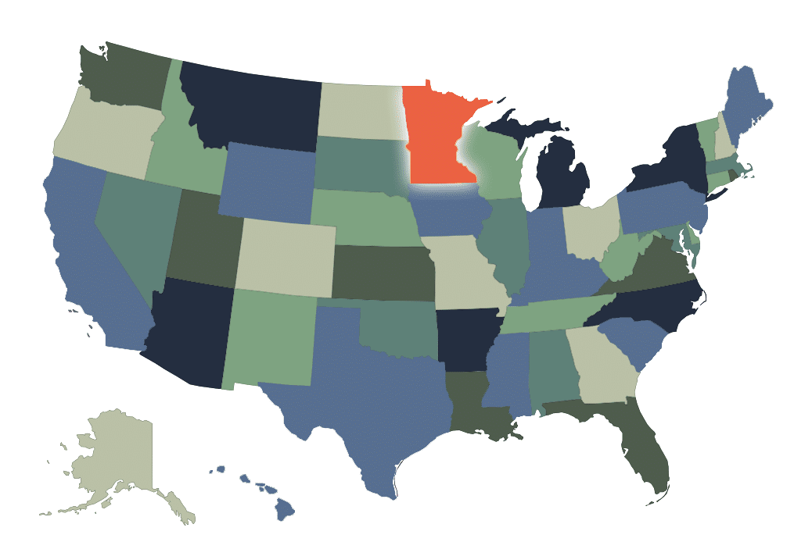
Minnesota
Top 15th Percentile for SAT exams in the country -1295
Highest Math SAT Score for 2017 - 651
2018 - 655
Highest EBWR SAT Score for 2017 - 644
2018 - 643
Very low participation rate
3 - 4%

Slide 8
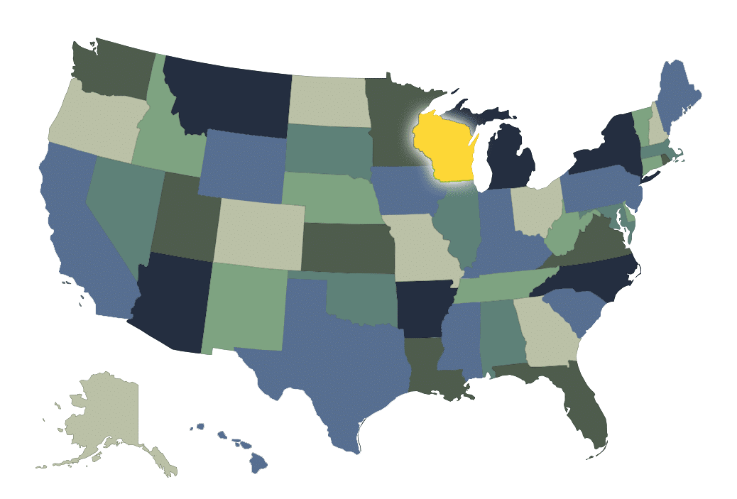
Wisconsin
Second to Minnesota in SAT Composite scores - 1291
Second to Minnesota in SAT Math scores
2017 - 649
2018 - 653
Second overall in Evidence-Based Reading and Writing
2017 - 642
2018 - 641

Slide 9
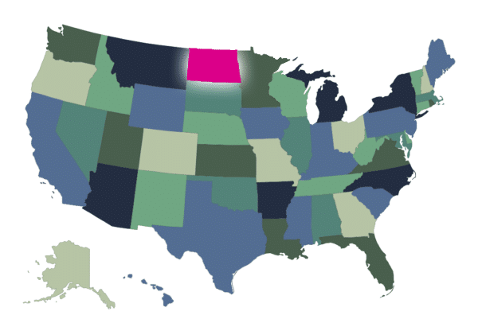
North Dakota
Third highest in SAT Evidence-Based Reading and Writing
2017 - 635 (5th)
2018 - 640

Slide 10
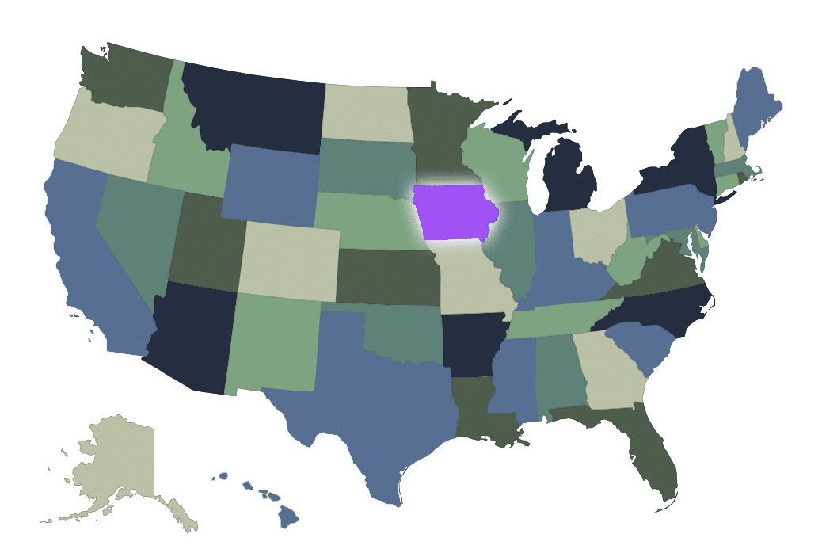
Iowa
Third in Composite SAT scores
2017 -1275
2018 -1265 (4th)
Third highest Math SAT scores
2017 - 635
2018 -631 (4th)

Slide 11
Conclusions:
As participation
Scores
Social climate
May dictate academic performance
Recommend a more granular
study to investigate causal
relationships for geographical
socioeconomic factors and SAT
scores to help understand how we
can influence participation.

Slide 12
https://magoosh.com/hs/sat/sat-scores/2018/average-sat-scores-by-state-how-does-your-state-stack-up/

